Slide 1
What is History?
1-1

Slide 2
Why Study History?
Study of people and events of the past
How things change…
How things stay the same…

Slide 3
Historians
Examine the cause, or reasons, that something happened in the past.
What happened?
Why did it happen?

Slide 4
Periods of History
Measuring time by groups of years:
Decade – 10
Century – 100
Millennium – 1,000

Slide 5
Eras
History divided into large block of time

Slide 6
Eras
Prehistory - Time before people developed writing

Slide 7
Ancient History – 5,500 B.C. – 500 A.D.

Slide 8
Middle Ages – 500 A.D. – 1400 A.D.
Medieval

Slide 9
Modern History – 1400 A.D. - present

Slide 10
Calendars
System for arranging days in order
Worldwide there are about 40 different calendars
Cultures
Nature – moon cycles

Slide 12
Julian Calendar
Developed by Julius Caesar – Roman leader
Started by counting years at the founding of Rome
365 ¼ days long
Extra day every 4 years – leap year
1 lost day every 128 years

Slide 13
Gregorian Calendar
By A.D. 1582 Julian Calendar lost about 10 days
Pope Gregory XIII
Start – birth of Jesus
Corrected for days lost over years
3 centuries before most of the world adopted it

Slide 14
Dating Events
B.C. – before Christ
A.D. – anno domini
Latin – “Year of the Lord”
AD and BC Explained (as well as CE and BCE)
Youtube

Slide 15
B.C.E. – before the common era
C.E. – common era

Slide 16
Time Lines

Slide 17
History and Science
Archaeology – study of objects to learn about the past
Artifacts – objects made by people

Slide 18
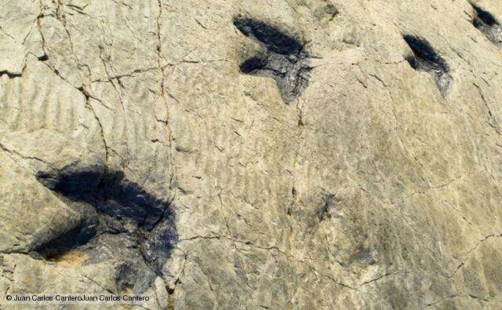
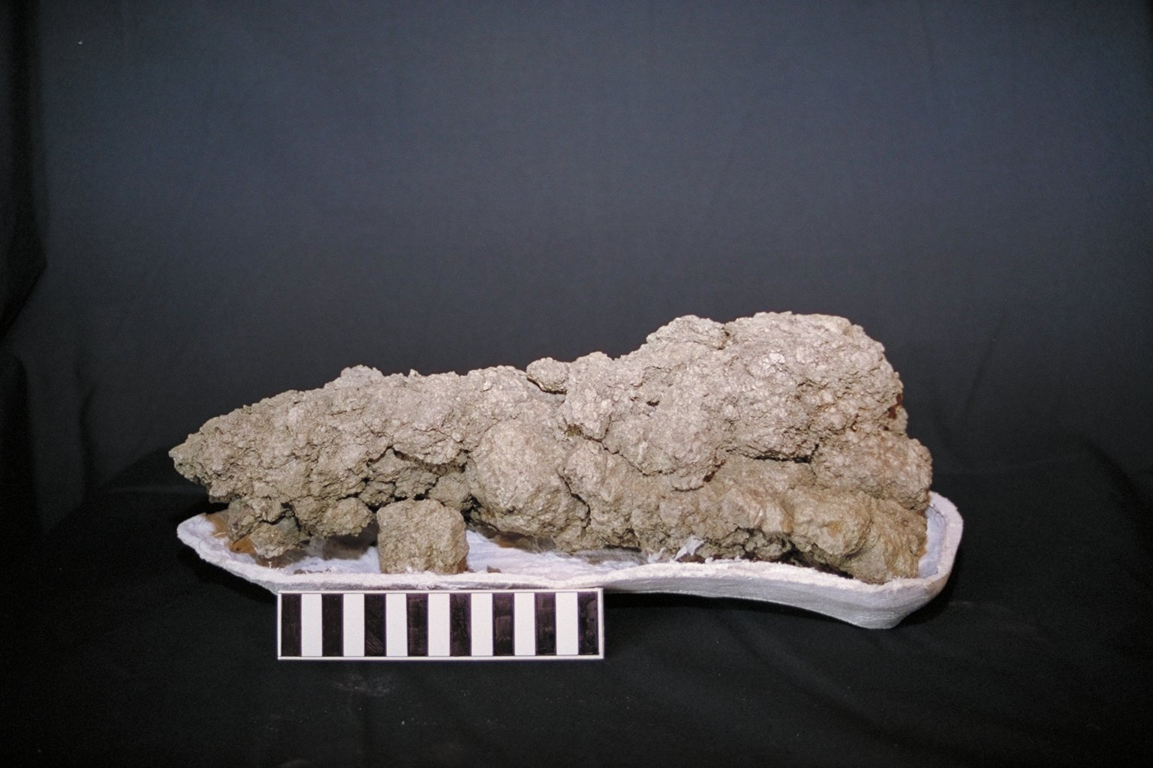
Paleontology – the study of fossils
Fossil – remains of plant and animal life

Slide 19
Anthropology – study of human culture

Slide 20
Human Discoveries
1974 – Ethiopia, Africa
Human Ancestor – “Lucy”
3.2 million years old
Species – class of individuals with similar characteristics

