Slide 1
7-4
Resources and Conservation

Slide 2
Mining Impacts
Air and noise pollution
Water may carry toxic substances
Surface mining damages ecosystems

Slide 4
Subsurface mining – sinkholes
Coal mines – fires left to burn out
10’s to 100’s of years

Slide 8
Centralia Mine Fire burning beneath the borough since 1962 - Pennsylvania

Slide 9
Mining Regulations
Federal and state law regulates the operation of mines
Clean Water Act
Safe Drinking Water Act
Endangered Species Act

Slide 10
Mine Reclamation
Reclamation - Mining companies are required to return the area to original condition

Slide 12
Fossil Fuels
Burning coal releases SO2
SO2 combines with water to form acid precipitation
Burning gas from cars
Catalytic Converter

Slide 13
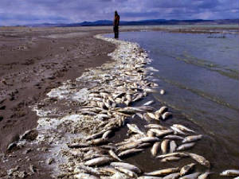

Slide 15
Conservation
The preservation and wise use of natural resources

Slide 16
Mineral Conservation
More and more people
More and more resources
Developing countries are using more
Recycle – using materials more than once

Slide 17
Fossil Fuel Conservation
Use less energy
Insulation
Energy efficient appliances
Drive less
1 gal of gas = 8kg of CO2

Slide 18
Conserving Other Resources
2050 – freshwater shortage?
Larger population
How can you save water?

