Slide 1
7-2
Nonrenewable Energy

Slide 2
Nonrenewable Resources
Energy resources that exist in limited amounts
Hydrocarbons – compounds of hydrogen and carbon

Slide 3
Formation of Coal
Carbonization – decomposed plants material is buried in swamp
Peat

Slide 4
Types of Coal
Peat covered by sediment
1st - Lignite forms
2nd – Bituminous
Most common
3rd - Anthracite

Slide 6
Petroleum and Natural Gas
Microorganisms and plants died in prehistoric seas
Pressure and chemical changes turn to fuel

Slide 8
Hydrocarbons
Oil or petroleum – liquid
Natural gas - gas

Slide 9
Deposits
Found in permeable sedimentary rocks
Trapped under cap rock

Slide 11
Oil Traps

Slide 12
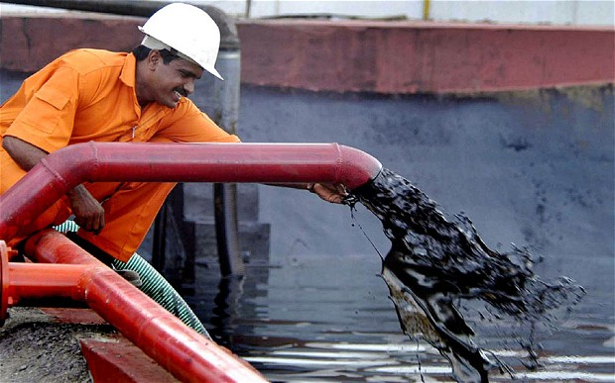
Crude Oil
Unrefined petroleum
Plastics
Fabrics
Medicines
Waxes
Shampoos

Slide 14
Coal
Most abundant fossil fuel
US
Russia
China

Slide 15
Nuclear Power
1950’s and 1960’s
Energy of the future
Clean energy
1970’s and 1980’s
120 plants shut down
Other abandoned
What happened?

Slide 17
Fission: Splitting Atoms
Nuclear energy – energy within the nucleus of an atom
Uranium used as fuel

Slide 18
Nuclear Energy
Forces that hold a nucleus together 1 million times stronger than a chemical bond

Slide 19
Nuclear Fission
Nuclear fission – nuclei of uranium atoms bombarded
Neutrons
Causes nuclei to split

Slide 21
Fission
Releases energy and neutron
More neutrons = more collisions
Uncontrolled reaction – bomb
Controlled reaction – power plant

Slide 23
Nuclear Energy
Outside – thick concrete walls and cooling fluids
Inside reactor – control rods with uranium pellets
Absorb neutrons for control

Slide 24
Nuclear Energy
Energy released heats water
Water turns to steam
Steam turns turbine
Water dumped

Slide 25
Advantages
Concentrated energy source
No greenhouse gases
Low radioactivity
Provide areas with limited resources with energy

Slide 27
Nuclear Energy
Very expensive to build
Where to store nuclear waste?
Wastes remain radioactive for thousands of years

Slide 28
Nuclear Energy
Storage areas need to be geologically stable for thousands of years
Yucca Mountain in Nevada
Studying for 20 years now
Transmutation - recycling

Slide 31
Safety
Chernobyl
Ukraine in 1986
Safety devised were turned off for testing
Bad design
Explosion released radiation
Areas still contaminated

Slide 32
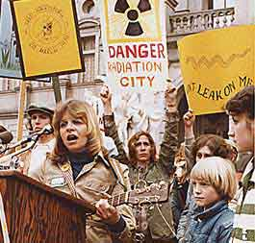
Safety
Three Mile Island
United States 1979
Pennsylvania
Human error and blocked valves
Escaped radioactivity

Slide 33
Into the Future
Nuclear fusion – light nuclei combine with heavy nuclei
Releases lots of energy
Powers stars
Safer byproducts
Why not do it?

Slide 34
Into the Future
Nuclei heated to 180,000,000 F
Nuclei remain at high concentrations
Properly confined

