Slide 1
7-1
Mineral Resources

Slide 2
Mineral Resources
More than 3,000 different resources in Earth’s Crust
Metals – Gold, Silver
Nonmetals – Sulfur, Quartz

Slide 3
Elements
Native elements – metallic minerals
Compounds – most of the minerals
2 or more elements

Slide 4
Ores
Minerals that are mined for profit
Fe – iron
Magnetite
Hematite
Al – Aluminum
Bauxite

Slide 5
Cooling Magma
Magma cools
Dense minerals sink
Form ore deposits

Slide 7
Contact Metamorphism
Heat and chemical reactions with hot fluids create ores

Slide 8
Hydrothermal Solutions
Fluids that move through small cracks in rock
Minerals from surrounding rocks dissolve in solution
Form in veins

Slide 10
Moving Water
Placer deposits - Fragments of minerals become concentrated on bottom of stream

Slide 11
Mineral Resources
Gemstones – rare nonmetal minerals

Slide 12
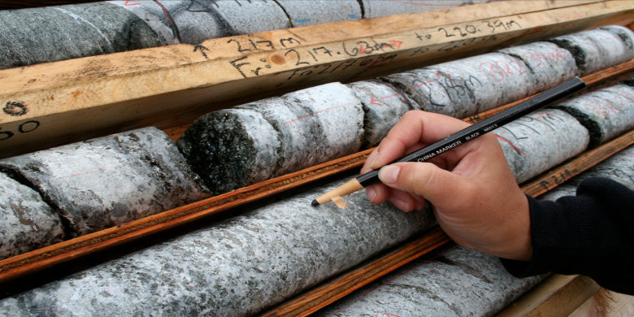
Mineral Exploration
Area that has at least 100 to 1,000 times the concentration found in other places
Looking for:
Density differences
Magnetism
Radioactivity
Rock color

Slide 13
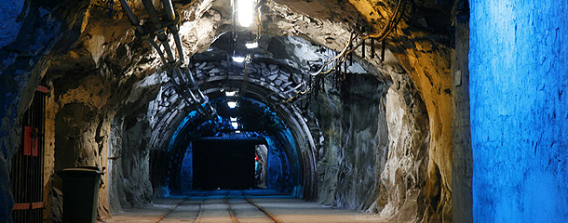
Subsurface Mining
Minerals mined underground

Slide 14
Surface Mining
Open pit mines
Minerals near surface

Slide 15
Placer Mining
Dredging
Buckets scope sediment from barges

Slide 16
Undersea Mining
Nodules – lumps of minerals on ocean floor
Difficult to mine

