Slide 1
Chapter 6 - 3
Sedimentary rocks

Slide 2
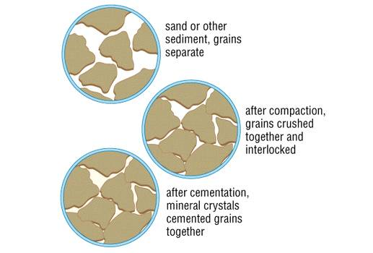
Formation of Sedimentary
Sediment is formed through erosion
Loose sediment is deposited
Compaction – sediment is squeezed together

Slide 3
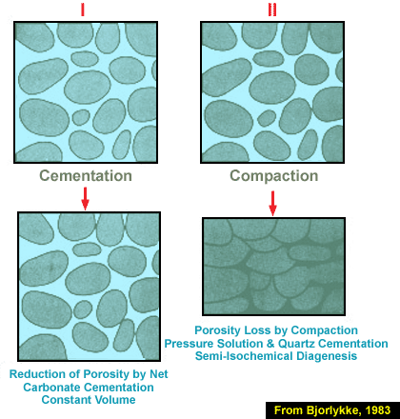
Cementation – sediments are glued together by minerals that are deposited by water
Minerals precipitate from water
Surround sediment grains

Slide 4
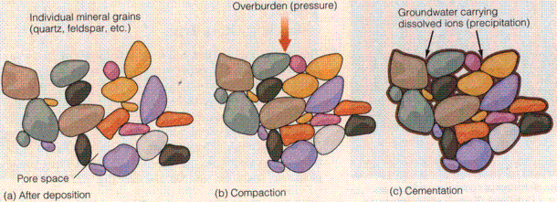

Slide 5
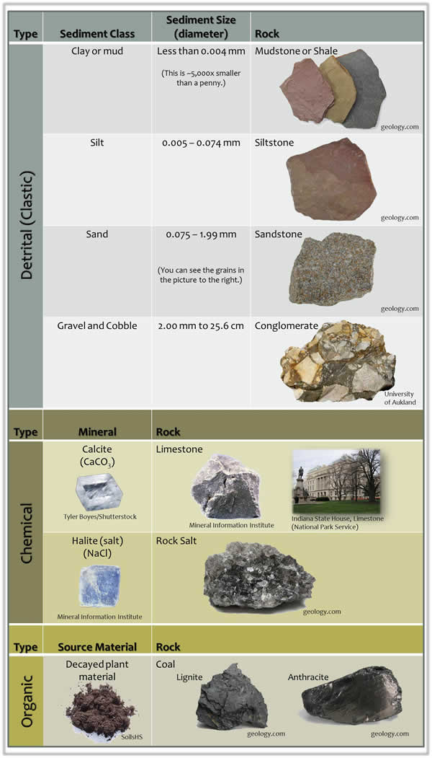
3 Types of Rocks
1. Chemical
2. Organic
3. Clastic

Slide 6
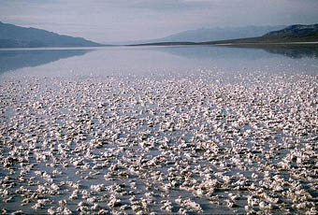
Chemical
Form from minerals that were once dissolved in water
Dissolved minerals form out of a precipitate
Evaporates – minerals left behind to form rock
Gypsum, halite, rock salt

Slide 7
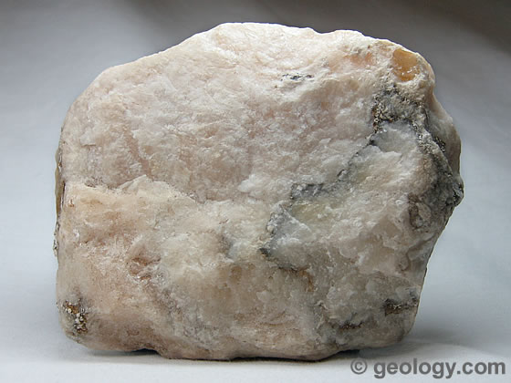
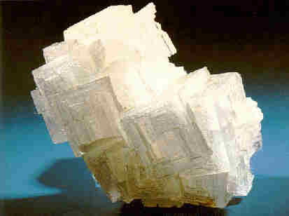

Slide 8
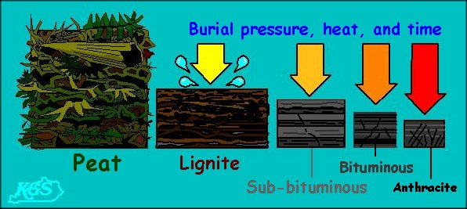
Organic
Formed from the remains of once living things
Coal and chalk

Slide 9
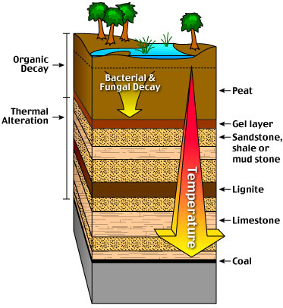

Slide 10
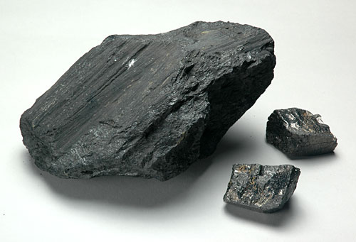
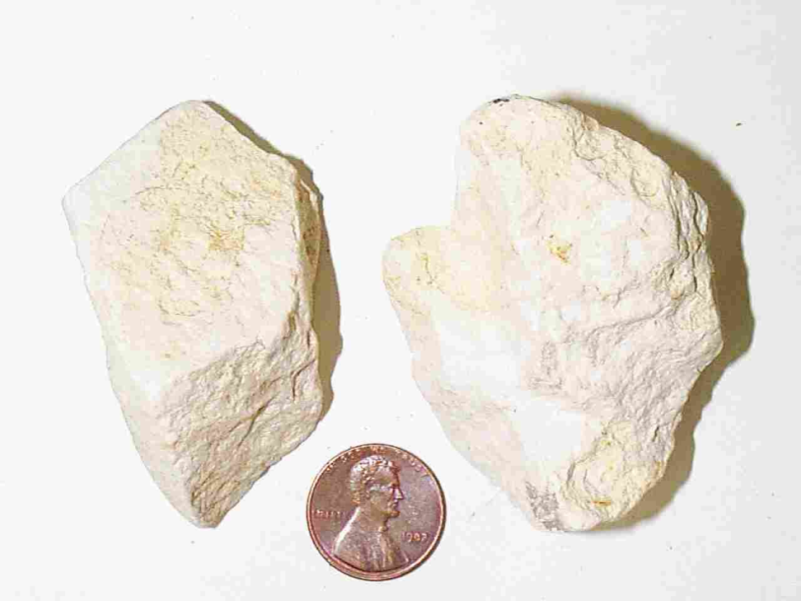

Slide 11
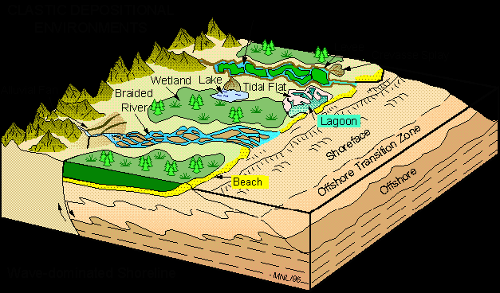
Clastic
Made from rock fragments that were carried away by water, wind, or ice

Slide 12
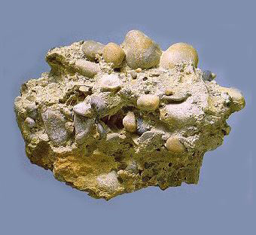
Clastic Rocks
Conglomerate – rounded sediments
All sizes
Breccia – fragments with sharp edges

Slide 13
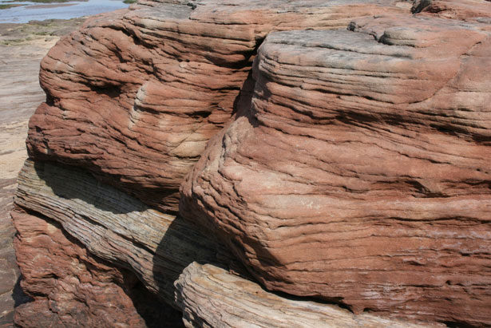
Clastic Rocks
Sandstone – sand sized sediments

Slide 14
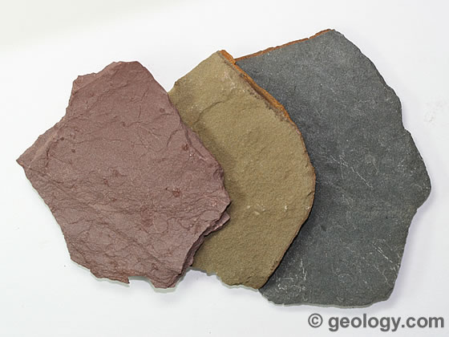
Clastic Rocks
Shale – Clay size particles
Slit easily

Slide 15
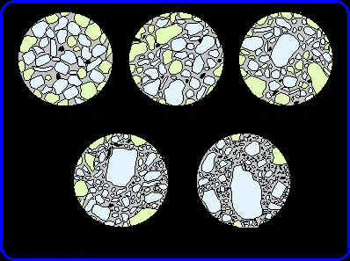
Sorting
Sorting – tendency for currents of water or air to sort according to size
Large – heavy – bottom
Small – light - top

Slide 16
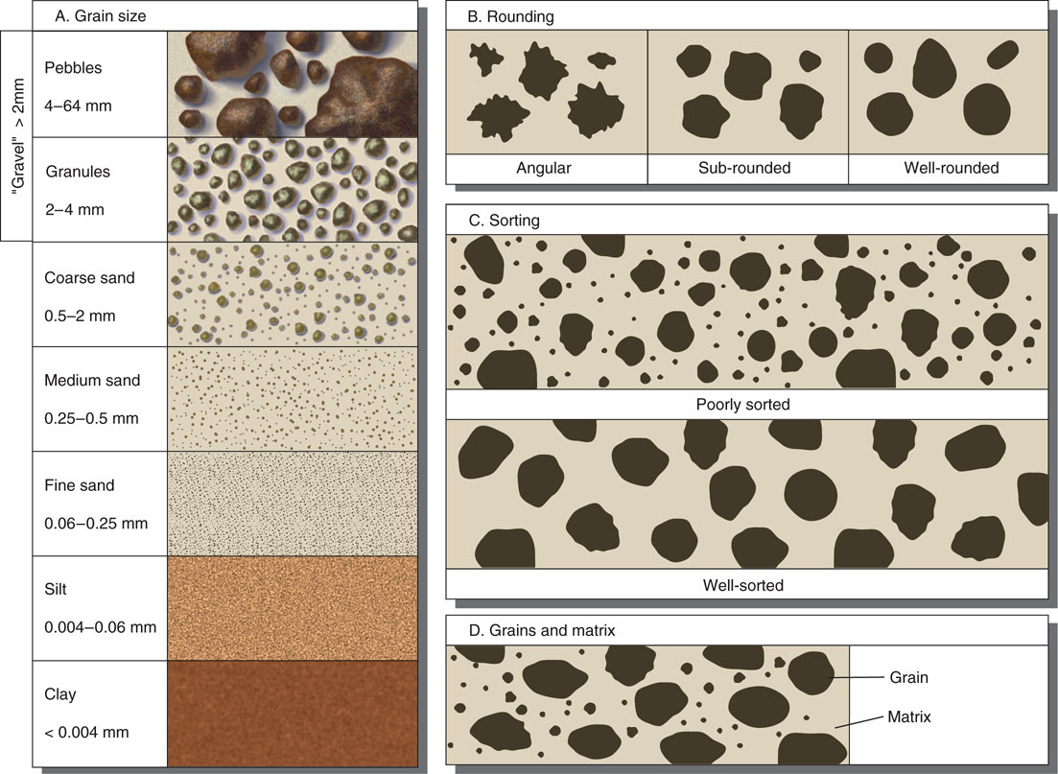

Slide 17
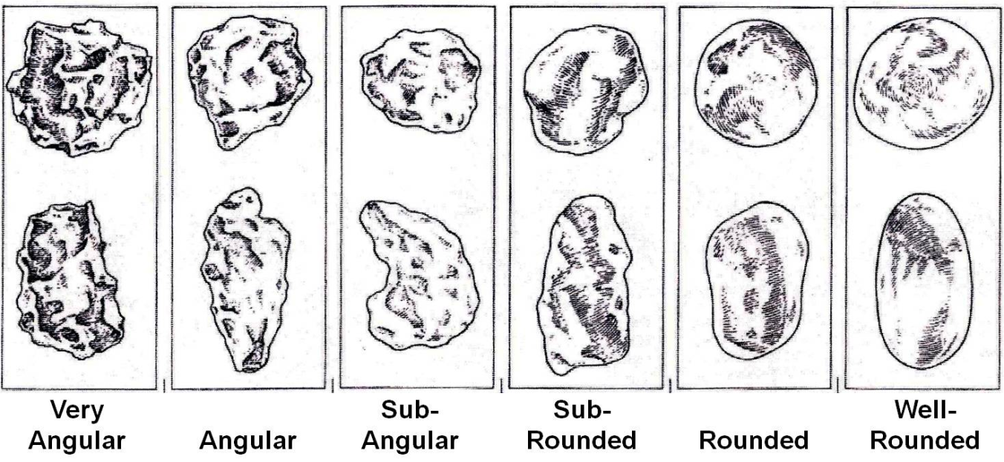
Angularity
Sharper – newly broken off from source
Rounded – have been traveling longer

Slide 18
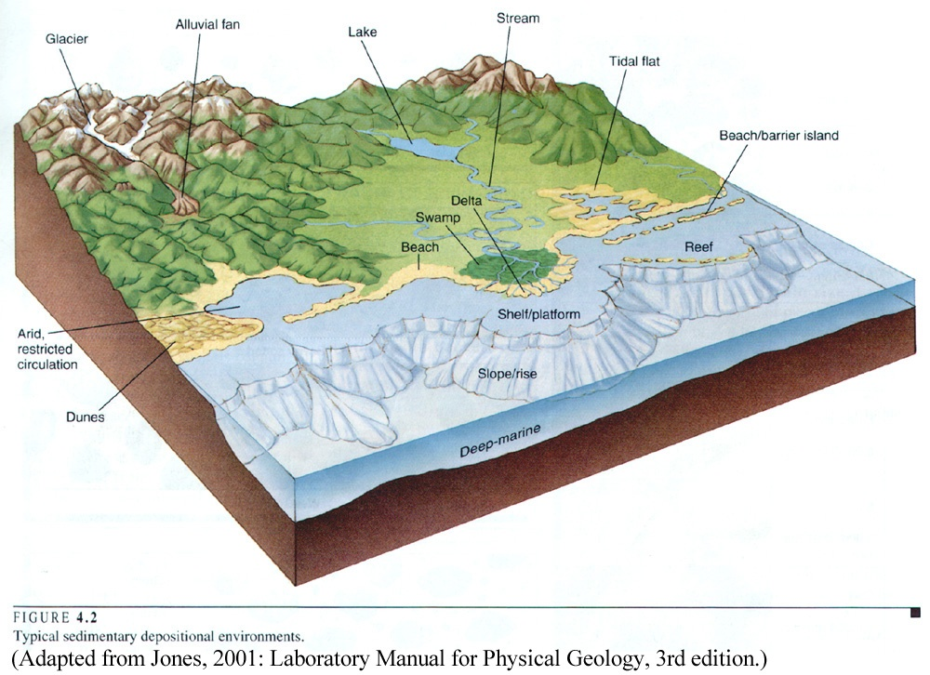
Depositional Environments
Rivers
Deltas
Beaches
Oceans

Slide 19
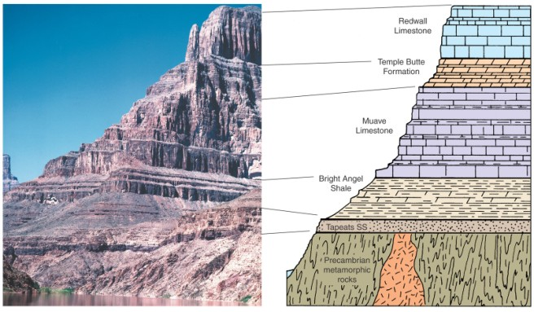
Stratification
Layering of sedimentary rock
Beds – stratification layers
Vary in thickness
Depends on how long and how much sediment was deposited

Slide 20
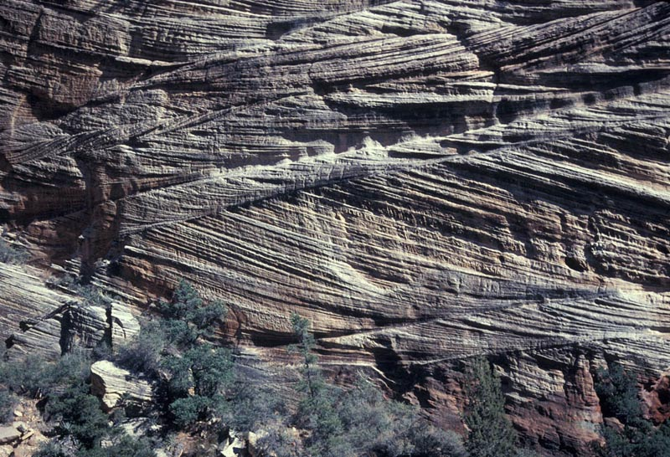
Cross Bedding
Slanted uneven layers
Sand dunes or river beds

Slide 21
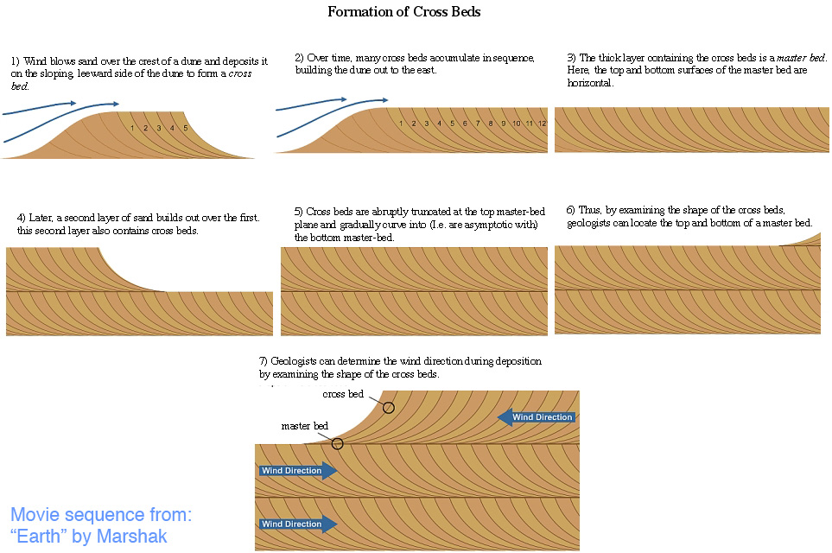

Slide 22
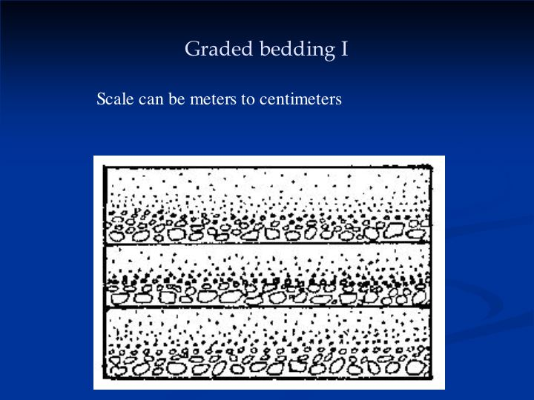
Graded Bedding
Different sizes and shape settle at different levels
Reverse graded - opposite

Slide 23
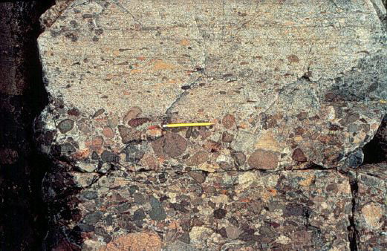

Slide 24
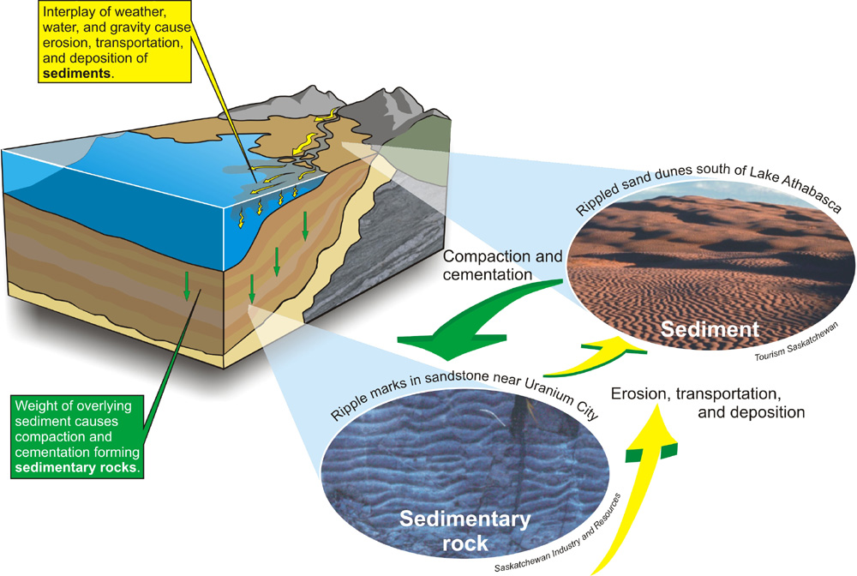
Ripple Marks
Caused by wind or water on sand

Slide 25
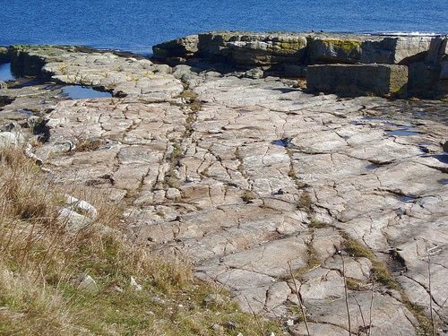
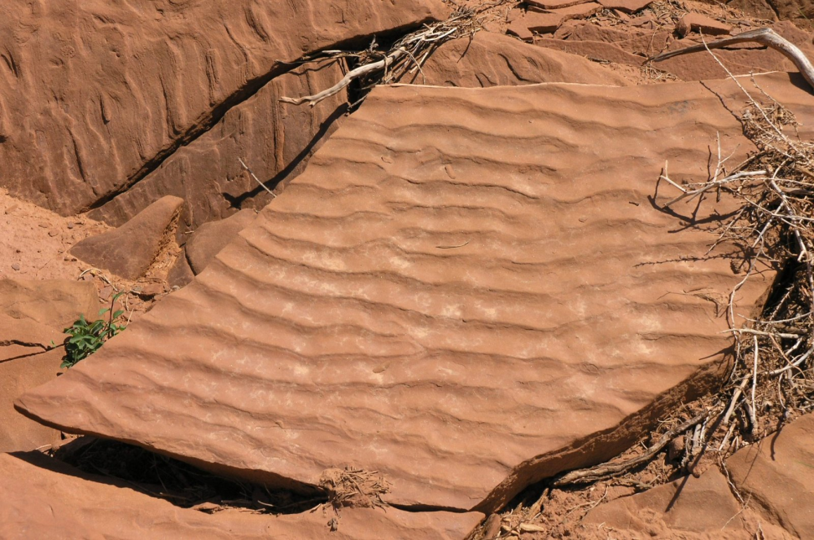

Slide 26
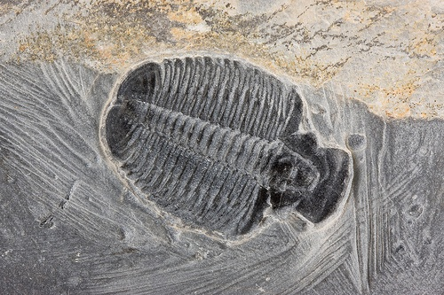
Fossils
Fossils – remains or traces of ancient plants or animals
Why sedimentary rocks?

Slide 27
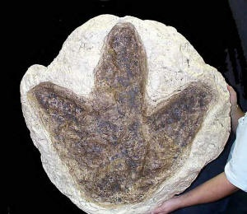

Slide 28
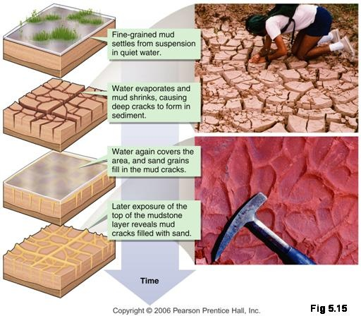
Mud Cracks
Muddy deposits dry and shrink
New depositions preserve

Slide 29
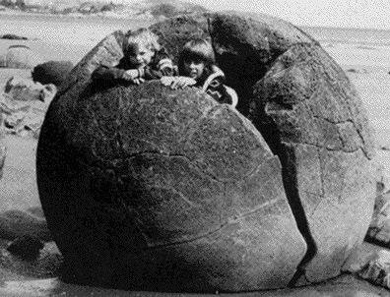
Concretions
Minerals precipitate from fluids and build up
Geodes

