Slide 1
4-3
Government and Economy

Slide 2
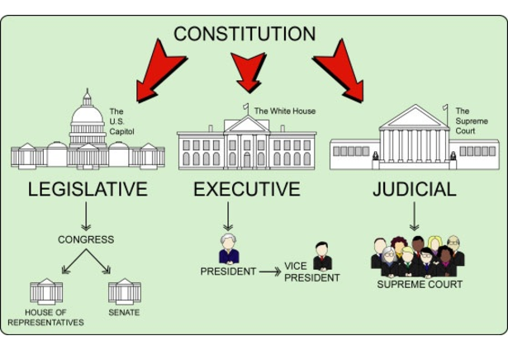
Why have a government?
Make and enforce rules
Regulate business and trade
Provide aide to people

Slide 3

Democratic government
Form of government in which the people elect leaders and rule by majority
US
Canada
Mexico

Slide 4
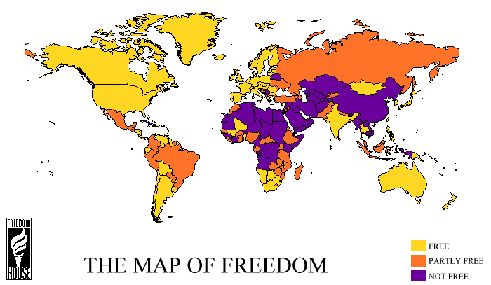
Choose representative to make and enforce laws
Not all democratic governments are completely free

Slide 5
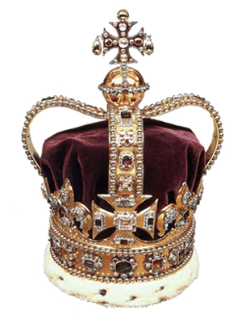
Monarchy
Ruled by a king or queen
Saudi Arabia
  All the power in one person
Norway and Spain
  Use democratic practices

Slide 6
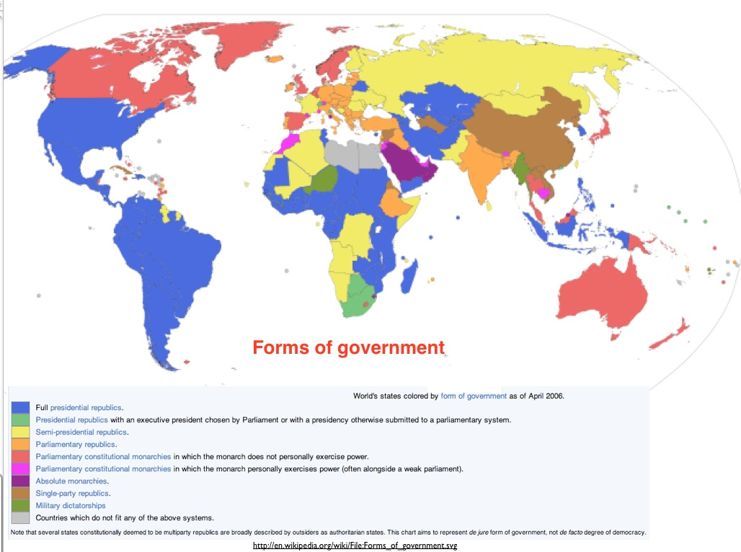

Slide 7
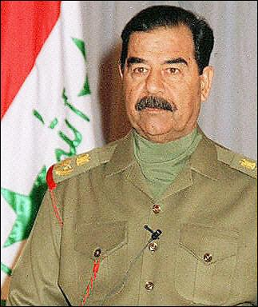
Dictatorship
Single, powerful ruler has total control
Iraq – Saddam Hussein
People are not free and have little rights

Slide 8
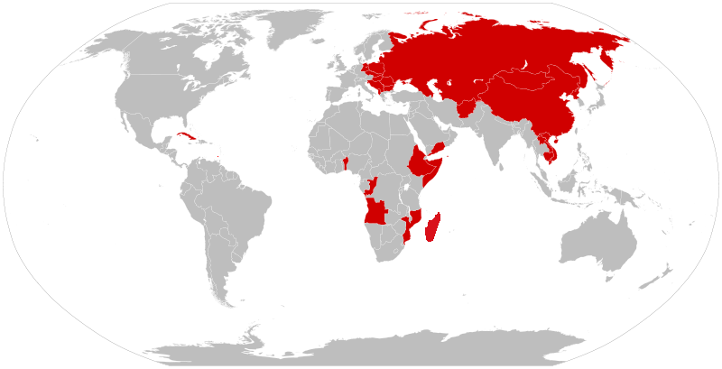
Communism
Government owns all property and dominates all aspects of life in a country
Leaders not elected by citizens
Little freedoms
Cuba
North Korea

Slide 9
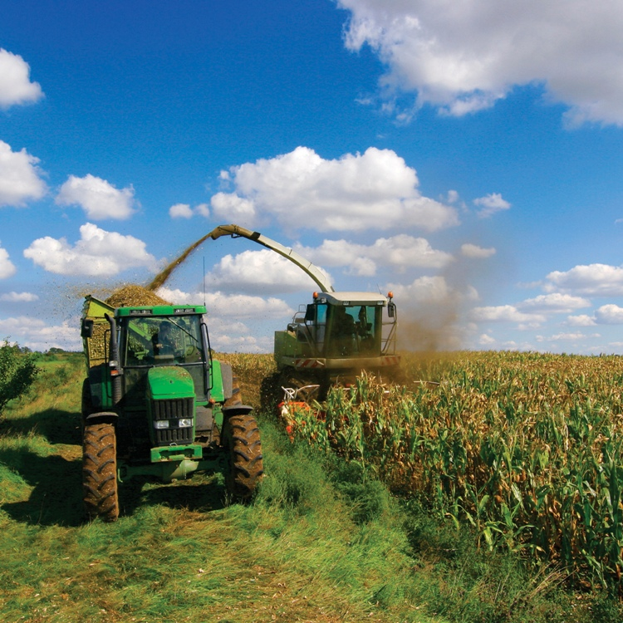
Economy
1st level – Primary Industry
Natural Resources or Raw Material
Farming
Fishing

Slide 10
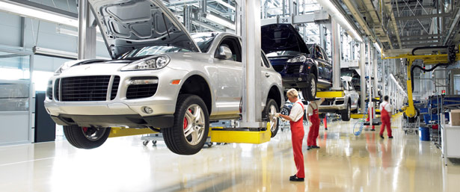
2nd level – Secondary Industry
Uses raw material to produce other products
Furniture builders
Automotive manufacturers

Slide 11
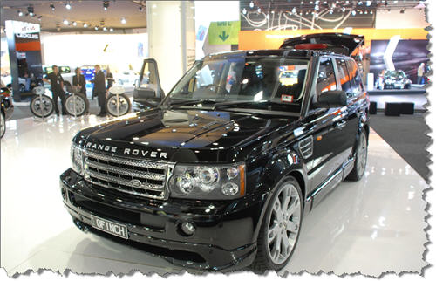
3rd level –Tertiary Industry
Goods and services exchanged
Sells the furniture
Sells the cars
Teachers, doctors, store clerks

Slide 12

4th level – Quaternary Industry
Research and distribution of information
Architects, lawyers, scientists

Slide 13
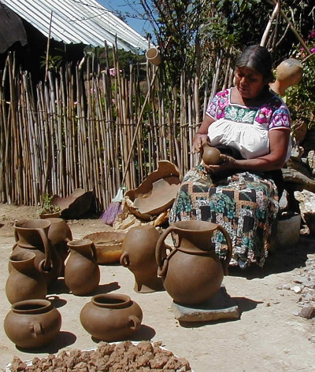
Traditional Economy
People grow their own food and make their own goods.
No real money
Rural or remote areas

Slide 14
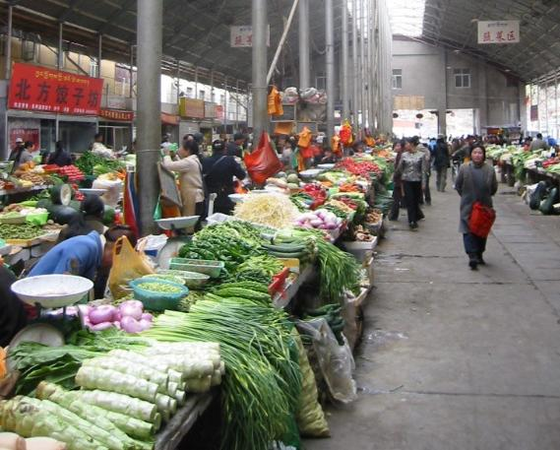
Market economy
Based on private ownership, free trade, and competition
Most common
U.S.

Slide 15
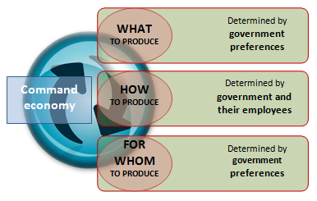
Command economy
Central government makes all economic decisions
Cuba and North Korea are close to this
Communist governments

Slide 16
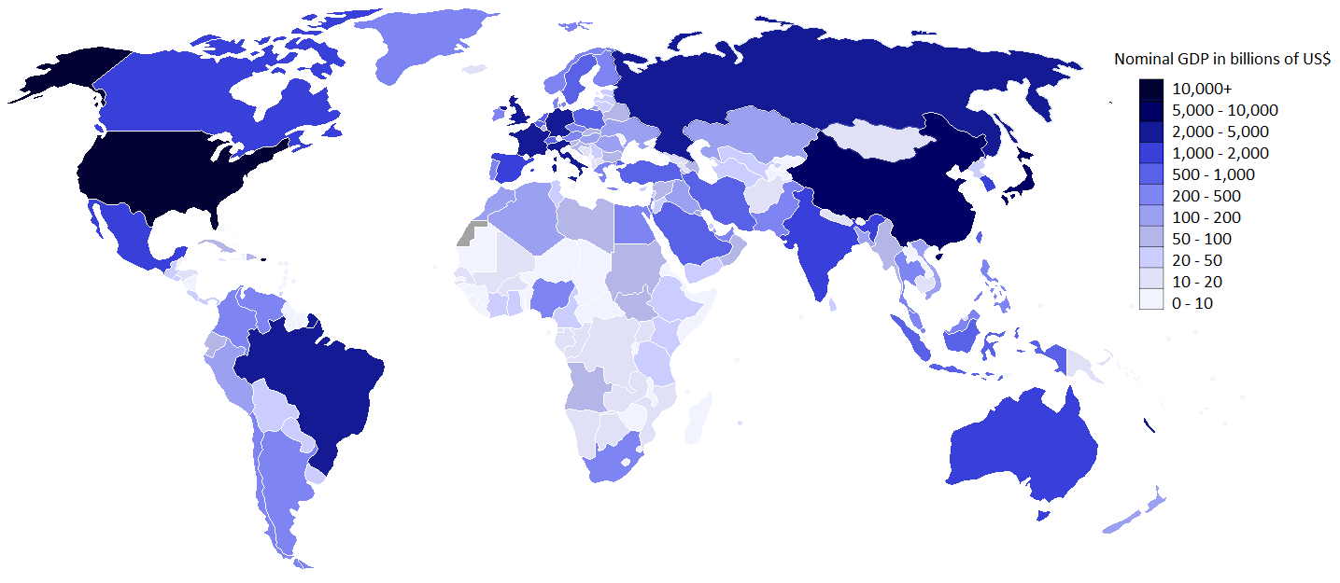
Gross domestic Product (gdp)
Value of all goods and services produced within a country in a single year

Slide 17
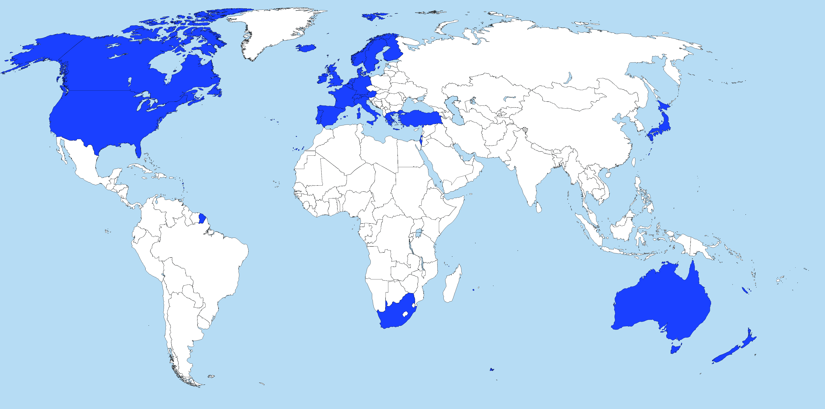
Developed countries
Strong economies and a high quality of life
U.S.
Germany

Slide 18
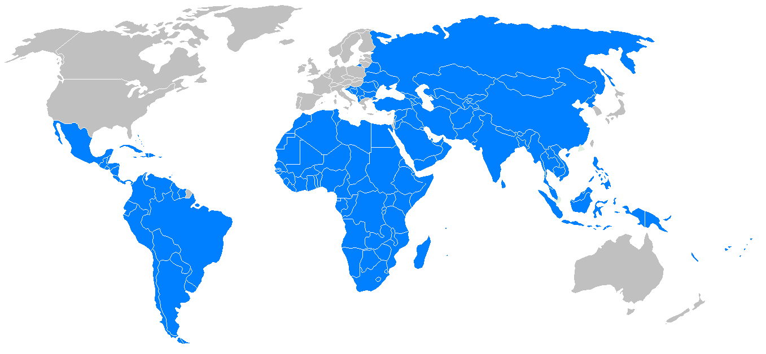
Developing countries
Less productive economies and a lower quality of life
2/3 of the people in the world
Guatemala
Nigeria
Afghanistan

