Slide 1
22-1
East Africa
Physical Geography

Slide 2
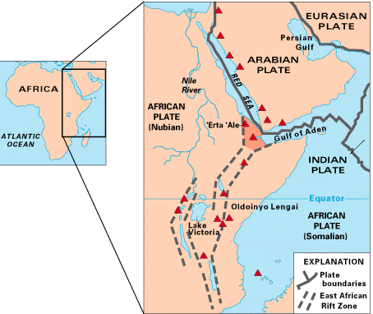
The Rift Valleys
Area where crust stretches and breaks
Plate tectonics

Slide 3
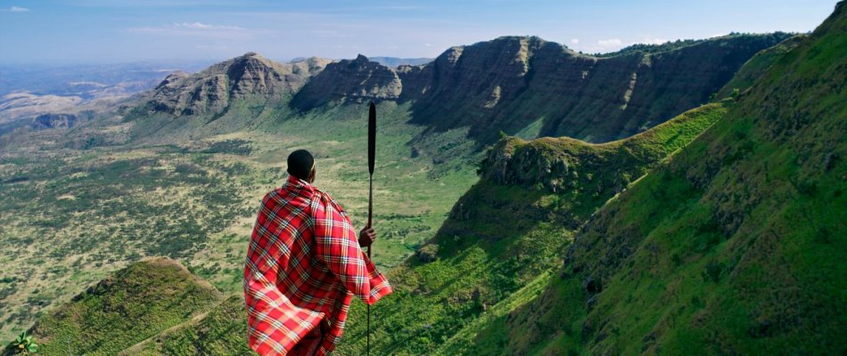
Great Rift Valley - largest rift on Earth

Slide 4
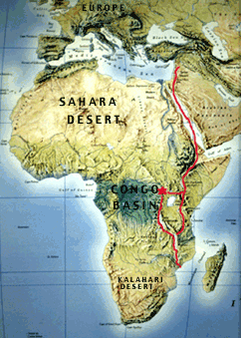

Slide 5
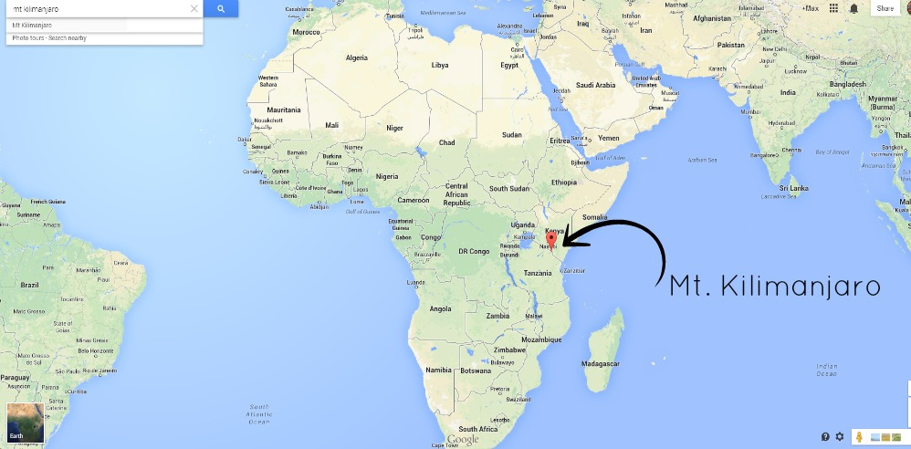
Mountains
Mount Kilimanjaro – highest in Africa
Volcanic

Slide 6
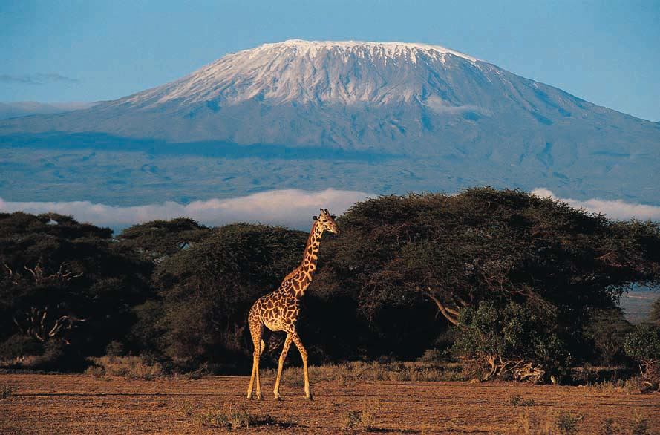

Slide 7
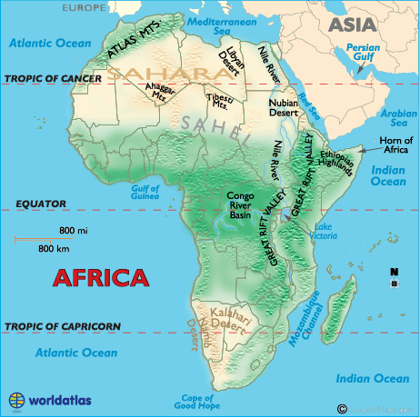
Ethiopian Highlands
Rugged, river valleys

Slide 8
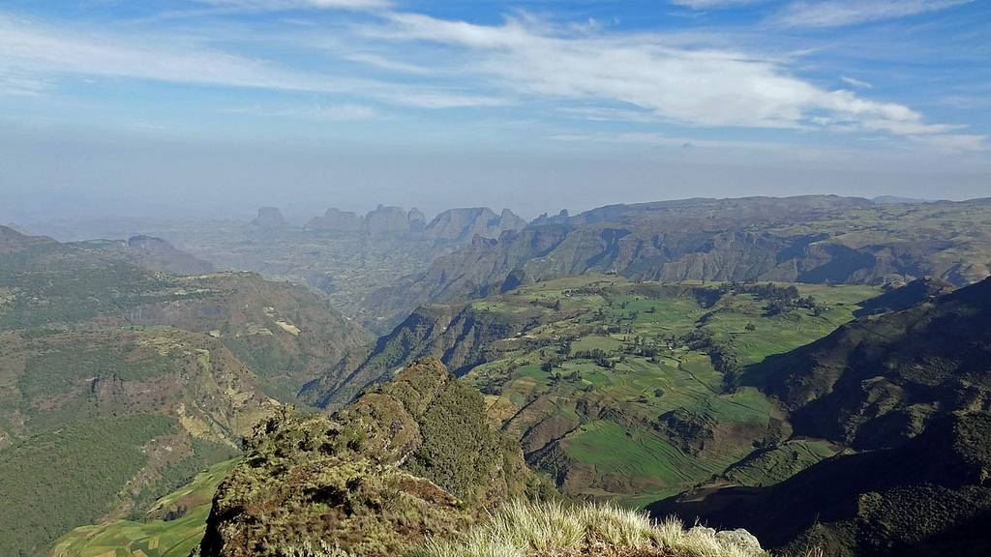

Slide 9
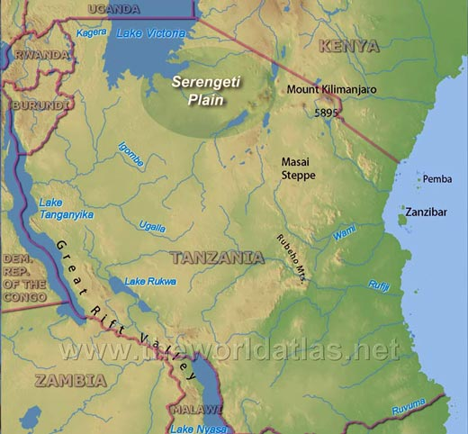
Plains
Most of areas are high elevations
Serengeti Plain – one of the largest
  Tanzania
  Lots of animals
  National Park

Slide 10
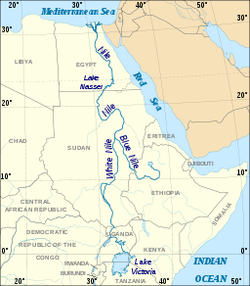
Rivers and Lakes
Nile is formed from:
  Blue and White Nile
Lake Victoria
  White Nile starting place
  Africa’s biggest Lake
Ethiopian Highlands
  Blue Nile start

Slide 11
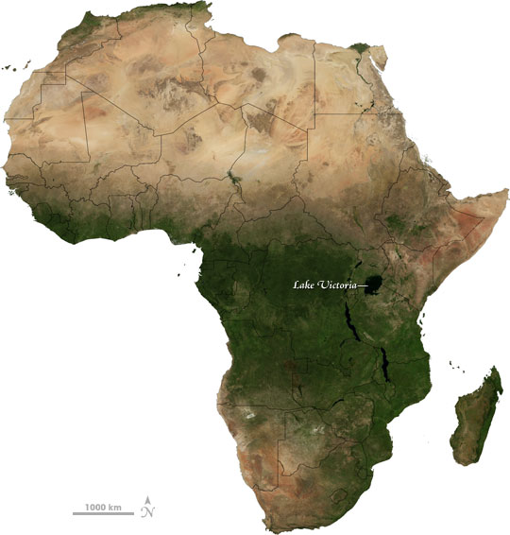
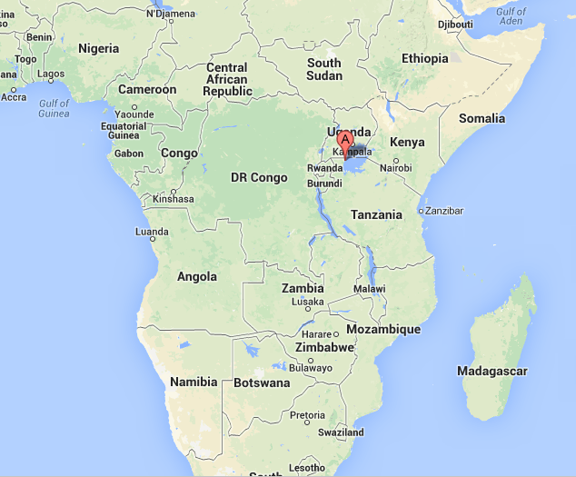

Slide 12
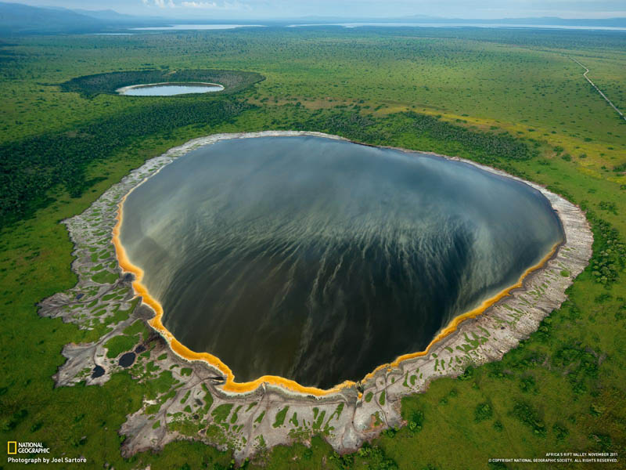
Hot Lakes
Volcanic activity cause hot and salty water

Slide 13
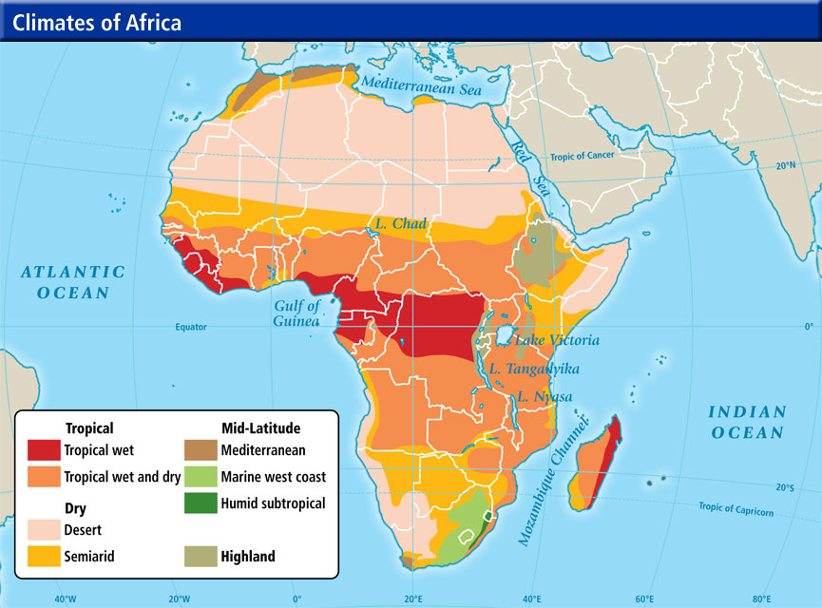
Climate
Elevation affects climate
Equator – rain
Farther from equator – drought
South – tropical savanna

Slide 14
Highlands – cool
  Populated
  Mild
  Farms

