Slide 1
21-1
Ocean Currents

Slide 2
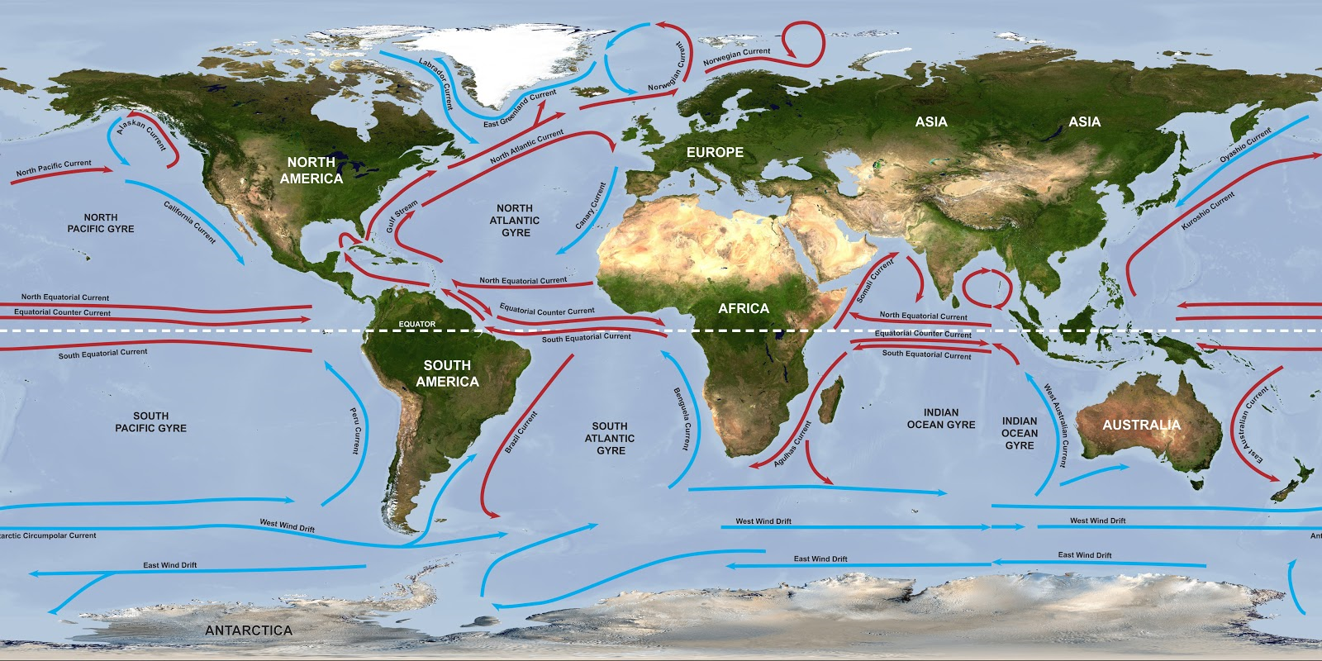
Ocean Currents
Currents - giant streams in the ocean
Studied by –
Chemical properties
Physical properties
Categories
1. Surface
2. Deep

Slide 3
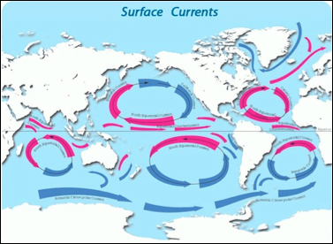
Surface Currents
Currents on or near the surface of the ocean
Controlled by three factors
Air currents
Earth’s rotation
Location of continents

Slide 4
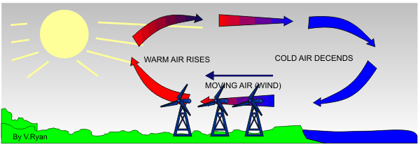
Winds
Cause uneven heating of earth’s surface.
SURFACE currents are affected by winds.
Cold –dense air sinks and forms high pressure- air moves away from high pressure to low pressure

Slide 5
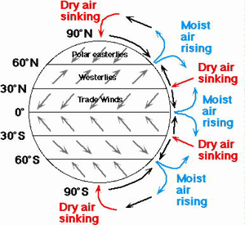
Global wind belts
Trade winds- 0-30 degrees N and S of equator
Westerlies- 30-60 degrees N and S of equator
Polar Easterlies- 60-90 degrees N and S of equator

Slide 6
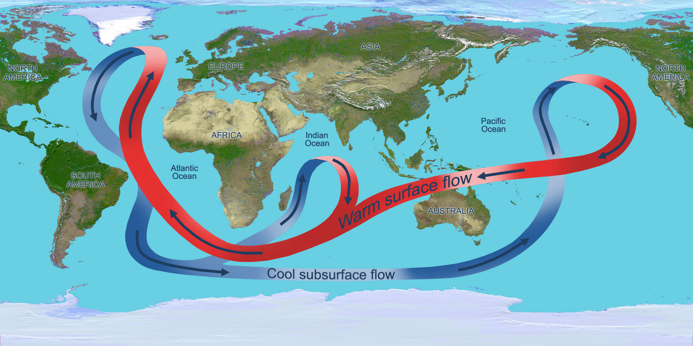
Continental barriers
Currents hit continents and deflect and divide

Slide 7
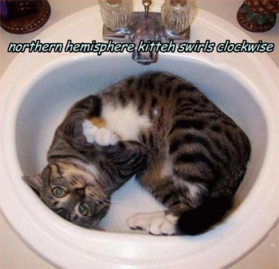
The Coriolis Effect
Curving path of oceans and winds due to earth’s rotation
Northern Hemisphere – right (clockwise)
Southern Hemisphere- left (counterclockwise)

Slide 8
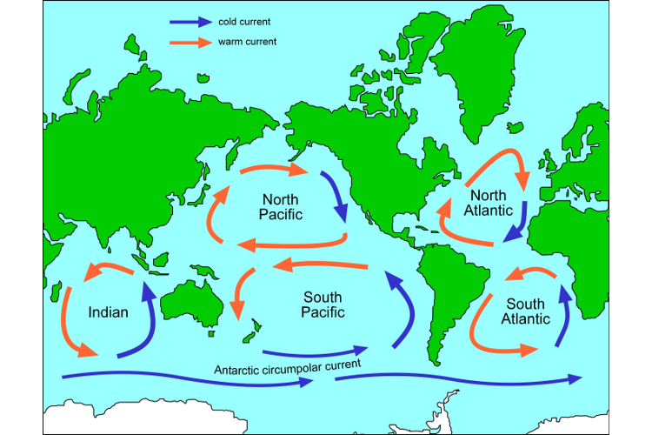
Gyres
Wind belts from the Coriolis effect cause circles of water called GYRES

Slide 9
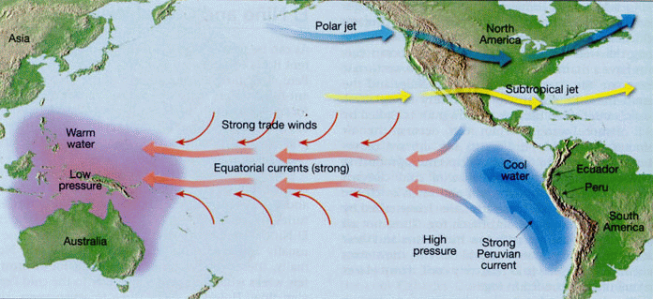
Surface Currents
Equatorial currents-
Location
Atlantic
Pacific
Indian
MOVE IN A WESTWARD DIRECTION

Slide 10
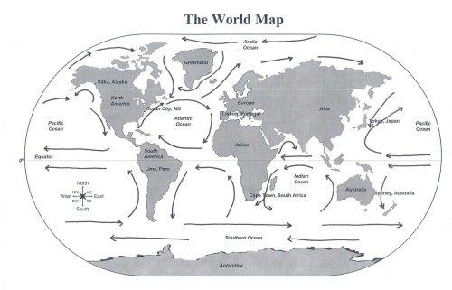
Southern Hemisphere Currents
Move counterclockwise
Southerly ocean have constant westward winds that produce large currents.
Antarctic Circumpolar Current- OR West Wind Drift

Slide 11
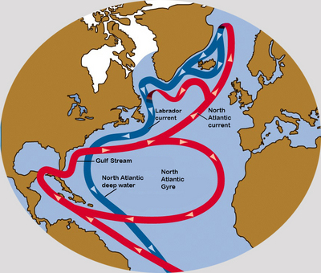
North Atlantic Currents
Gulf stream- fast moving warm water current moving along the continents
North Atlantic current – gulf stream widens and slows
Labrador current- cold water in the north combines with the gulf stream

Slide 12
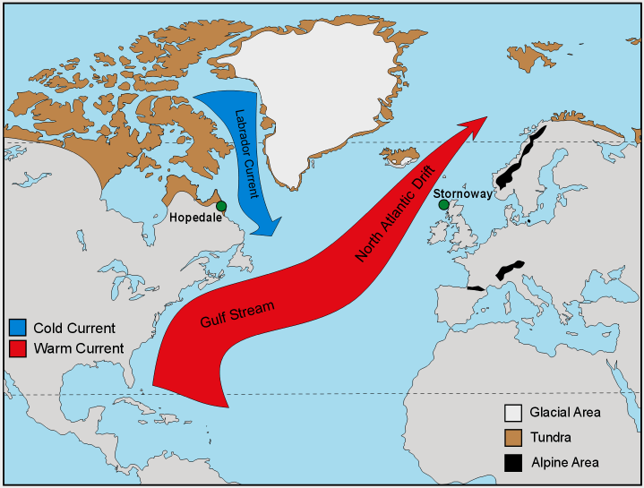

Slide 13
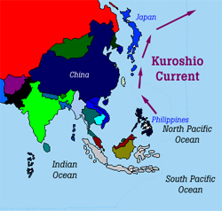
North Pacific Currents
Kuroshio Current-warm current that flows north along the east coast of Asia

Slide 14
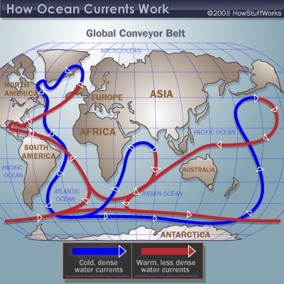
Deep Currents
Cold- Dense Water
Density of water is determined by
Salinity
Temperature

Slide 15
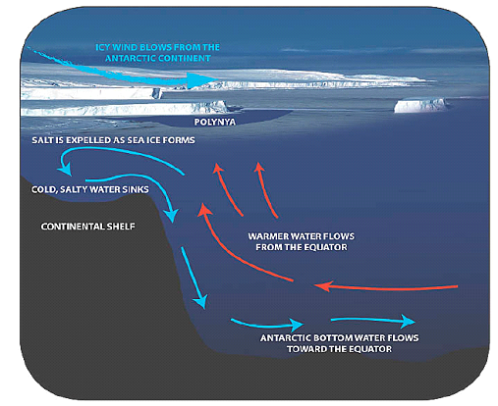
Antarctic Bottom Water
Densest and coldest water in the world
High salinity
-2 degrees Celsius

Slide 16
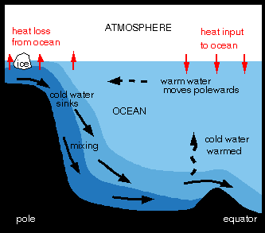
North Atlantic Deep Water
VERY cold with high salinity –forms a deep current that moves southward under the gulf stream.

Slide 17
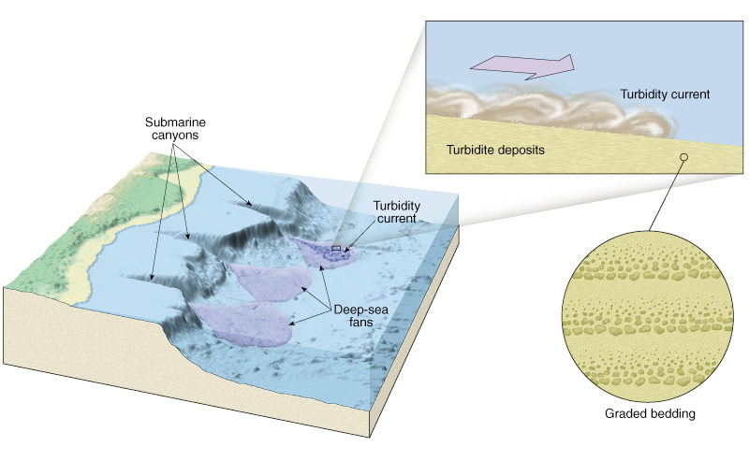
Turbidity Current
Strong current caused by an underwater landslide.
Starts when large masses of sediment accumulate along continental shelves and suddenly break loose and slide downhill.

