Slide 1
Chapter 2 -1 Earth: A unique planet

Slide 2
Section 1: Earth—A Unique Planet
Earth Basics
Third Planet from Sun
About 4.6 billion years old
Global Ocean-71% covered by water

Slide 3
Not a perfect sphere, but an oblate spheroid
smooth surface

Slide 4
Earth’s Interior
Viewed indirectly—seismic waves
Two types of zones:
Compositional Zones
Structural Zones

Slide 5
Compositional Zones
Crust—Thin, solid outermost layer
1% of Earth’s Mass
15-80 km thick
Oceanic and Continental crusts
Thickest beneath high mountain ranges

Slide 6
Mohorovicic Discontinuity (Moho)
Lower boundary of crust

Slide 7
Compositional Zones
Mantle
Layer that is under crust
Denser, rock
Approximately 2900 km thick
2/3 of Earth’s mass

Slide 8
Compositional Zones
Core
Center of the Earth
3500 km radius
Outer Core: Made up of liquid
Inner core: Solid (Iron and Nickel)

Slide 9
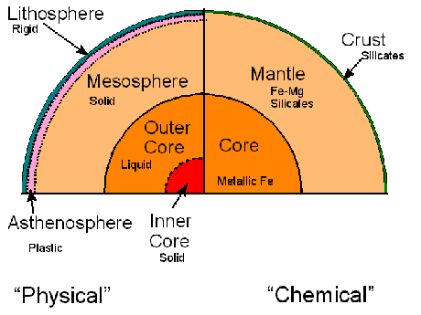
Compositional Zones
Crust
Mantel
Core

Slide 10
Structural Zones
Lithosphere
15-300 km thick
Made up of:
Cool, brittle uppermost mantle
Crust

Slide 11
Structural Zones
Asthenosphere
200-250 km thick
Heat and Pressure
Solid rock can flow (Plasticity)

Slide 12
Mesosphere
Layer of solid mantle rock

Slide 13
Structural Zones
Core: 1/3 Earth’s Mass
Outer Core
Depth: 2900 km
Dense Liquid
Inner Core
Depth: 5150 km
Dense, rigid solid

Slide 15
Srtuctural Zones
Lithosphere
Asthenosphere
Mesosphere
Inner Core
Outer core

Slide 16
Earth as a Magnet
Magnetosphere
Two Magnetic Poles—North and South

Slide 17
Sources of Magnetic Field?
Liquid Core?
Core motions?
Sun and Moon also have magnetic field
Sun-Little iron
Moon-No liquid core

Slide 18
Gravity
Force of attraction that exists between all matter in universe
Issac Newton
Law of Gravitation

Slide 20
Weight vs. Mass
Weight and Location

