Slide 1
17-2
Magnetism from Electric Current

Slide 2
Long, long ago…
People noticed that a lightning bolt can change a compass needle direction.
Iron pans magnetized during a lightning storm
Not until 1820 when they figured it out.

Slide 3
Magnetism from Electric Currents
Hans Christian Oersted
1st to experiment with electricity and compasses
Magnetism produced by electric charges

Slide 4
Electricity and Magnetic fields
If you bring a compass close to a current carrying wire it will react
Iron filings will form concentric circles

Slide 5
Right-hand Rule
Direction of wires magnetic field
Clockwise or counter-clockwise?

Slide 6
Current is in the same direction as positive charges.
So in metals where the charge carriers (electrons) are negative, conventional current is in the opposite direction as the electrons.

Slide 7
Solenoids
A coil of wire with an electric current in it
Magnetic field of each loop of wire adds strength of magnetic field to it.
Resembles a bar magnet
North and south pole

Slide 8
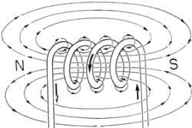

Slide 9
Electromagnet
Increased the strength of solenoid:
Insert iron rod into center
Rod becomes magnetized

Slide 11
Moving Charges
Moving charges causes all magnetism.
Negatively charged electrons moving around the nuclei of all atoms make magnetic fields

Slide 12
Electron Spin
Property of electrons that produces tiny magnetic fields

Slide 13
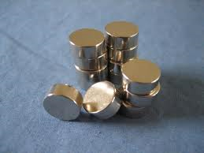
In most cases..
Various sources of magnetic fields in an element cancel out
Iron, nickel, and cobalt
Not all of fields cancel

Slide 14
Magnetism
Magnetic atoms rotate to align with the magnetic fields of nearby atoms
Domains – regions in atoms
Domains line up with magnetic field

Slide 17
Galvanometers
Measures:
Current in ammeters
Voltage in voltmeters

Slide 18
Electric Motors
Converts electric energy into mechanical energy

Slide 19
Stereo speakers and magnetic force

Slide 20
Youtube
Deconstructed
Speakers
Electric motor

