Slide 1
17-3 Israel

Slide 2
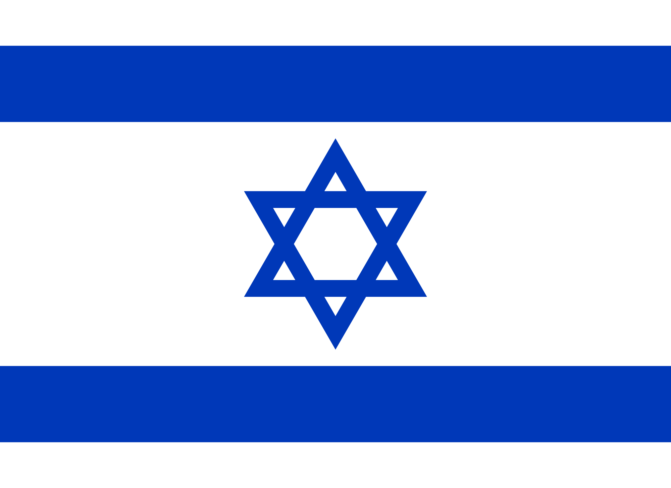

Slide 3
The Holy Land
Jerusalem - home to sacred sites of:
Judaism
Christianity
Islam

Slide 4
The Holy Land
Israelites established Israel in 1000 BC

Slide 5
Roman Empire conquered region
Called Judea

Slide 7
Diaspora
Several Jewish revolts
Romans forces Jews to leave
Renamed Palestine

Slide 8
Muslims
Conquered Palestine in 600’s

Slide 9
Crusades (1000s to 1200s)
Christian invasions from Europe
Captured city of Jerusalem

Slide 11
Ottoman Empire
Crusaders pushed from area
Control of Ottoman Empire
Video Clip – Rise of the Ottoman Empire

Slide 12
British Control
After WWI under British control

Slide 13
Palestine and Israel
Zionism – movement for Jews to establish a Jewish state in homeland
Thousands moved to area
Divided under British control
Jews – Created Israel
Arabs

Slide 14
Arabs invaded Israel
Jews won the conflict
Constant conflict between Israel and Arab countries

Slide 15
So what is the difference between Israel and Palestine?
Until 1948, Palestine typically referred to the geographic region located between the Mediterranean Sea and the Jordan River.
Today, Palestine theoretically includes the West Bank (a territory that divides modern-day Israel and Jordan) and the Gaza Strip (land bordering modern-day Israel and Egypt). However, control over this region is a complex and evolving situation.
The borders aren’t formally set, and many areas claimed by Palestinians have been occupied by Israelis for years.
More than 135 United Nations member countries recognize Palestine as an independent state, but Israel and some other countries, including the United States, don’t make this distinction.

Slide 17
Israel Today
Prime minister and parliament – Knesset
Strong military
Men and women must serve for 1 year at the age of 18

Slide 18
Jerusalem – capital
75% Jewish
Hebrew and Arabic – official languages

Slide 19
Culture – Holy Days
Sabbath – sunset Friday until sundown Saturday
Yom Kippur – fall
A day set aside each year to atone for sins
Passover – spring
Celebrates escape from ancient Egypt

Slide 20
Kosher – “fit”
Food allowed under Jewish diet
No pork or shellfish
Can’t mix milk and meat

Slide 21
Kibbutz – large farm where people share everything
Rural areas

Slide 22
United Nations
1947 – Voted to divide Palestine
Jewish state – OK!
Arab state- NO!
1948 – State of Israel created
Fighting ever since!

Slide 23
Palestinian Territories
1967 – Israel captured areas from Jordan and Egypt
Palestine Arabs lived in these regions

Slide 24
Gaza
Palestinian control
Citrus fruits

Slide 25
West Bank
Agriculture
Peace agreements have tried to divide region
Rural
Terrorist attacks against Israelis

Slide 26
East Jerusalem
Holy site for 3 major religions
Christians
Jews
Muslims

Slide 27
Palestine Territories
Areas that Jews and Arabs have fought over the right to live in.
Gaza
West Bank
East Jerusalem

