Slide 1
Chapter 17-1
Eastern Mediterranean

Slide 2
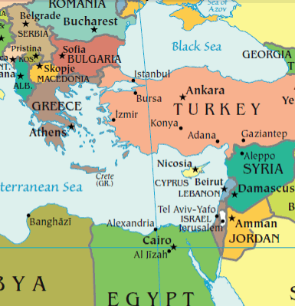

Slide 3
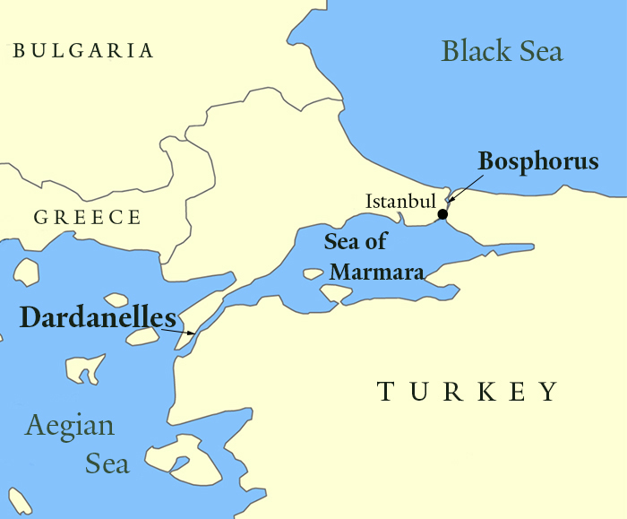
Waterway
A narrow waterway separates Europe from Asia
Dardanelles
Bosporus
Sea of Marmara
Connects Black Sea to Mediterranean Sea

Slide 4
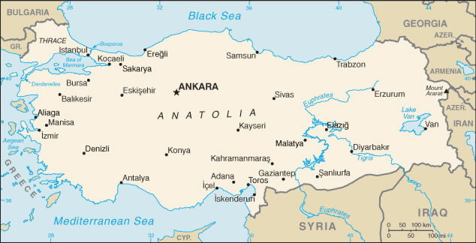
Anatolia – Asian part of Turkey
Peninsula

Slide 5
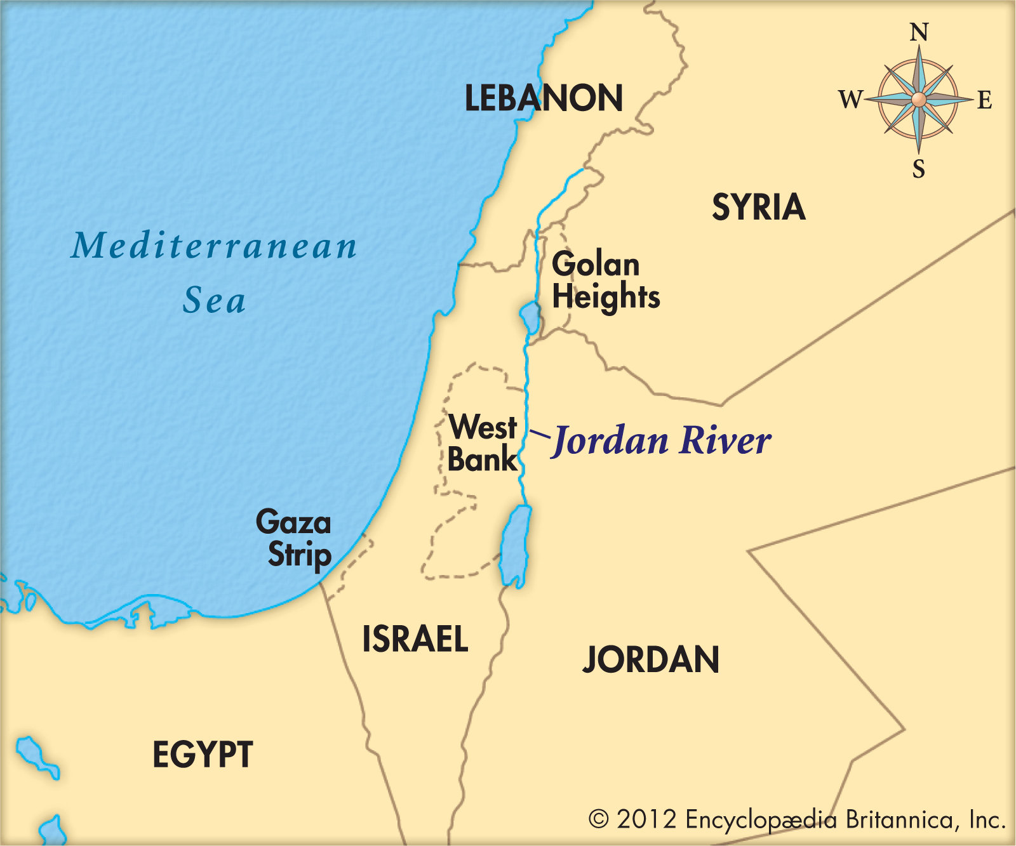
Rivers and Lakes
Jordan River – Syria to Israel and Jordan
Dead Sea – little life
  Very salty
  Lowest point on any continent
  1,312 ft below sea level

Slide 6
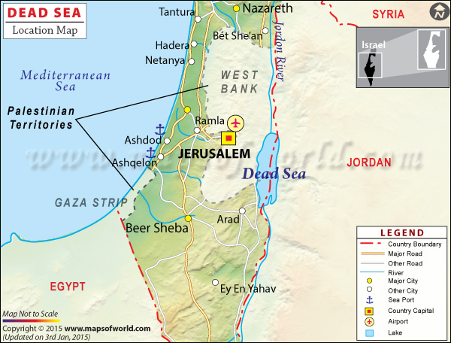

Slide 7
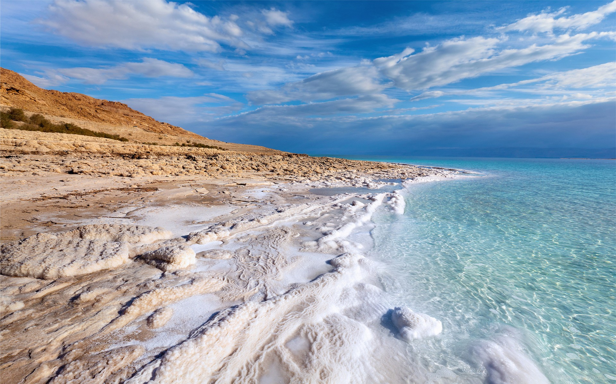
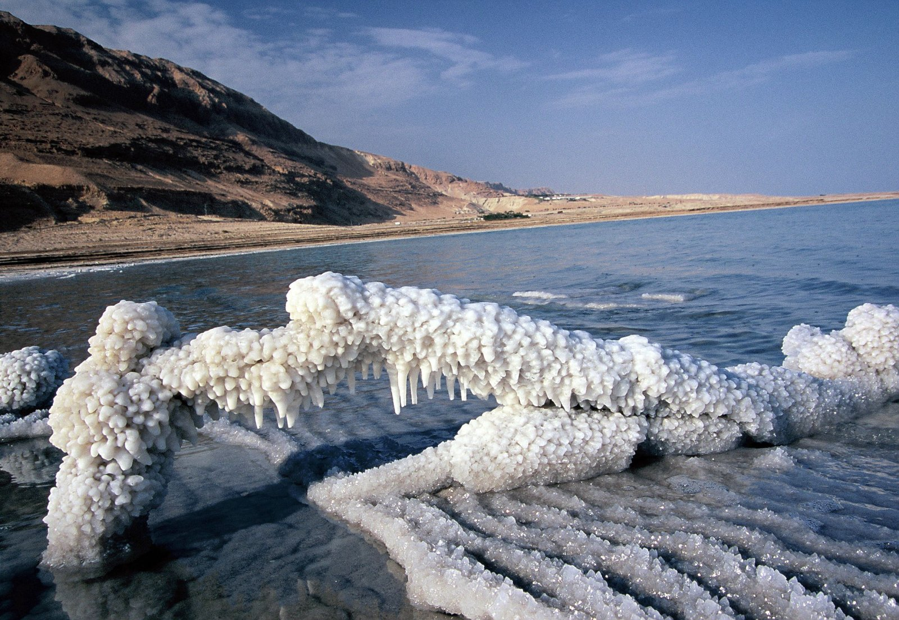

Slide 8
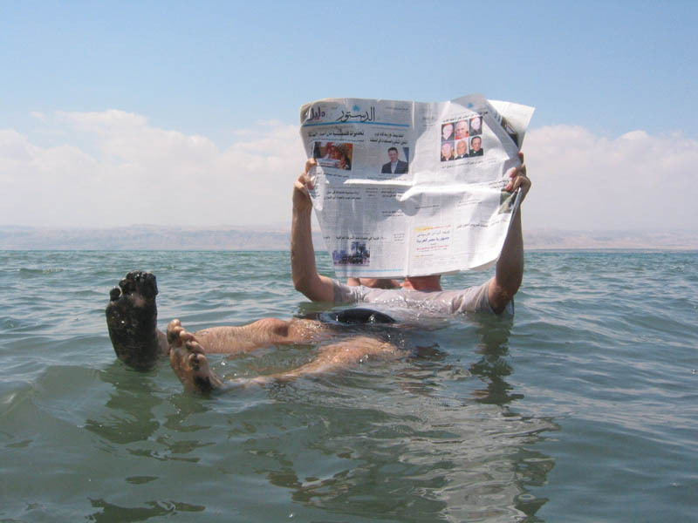
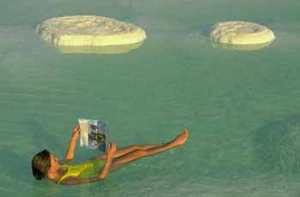

Slide 9
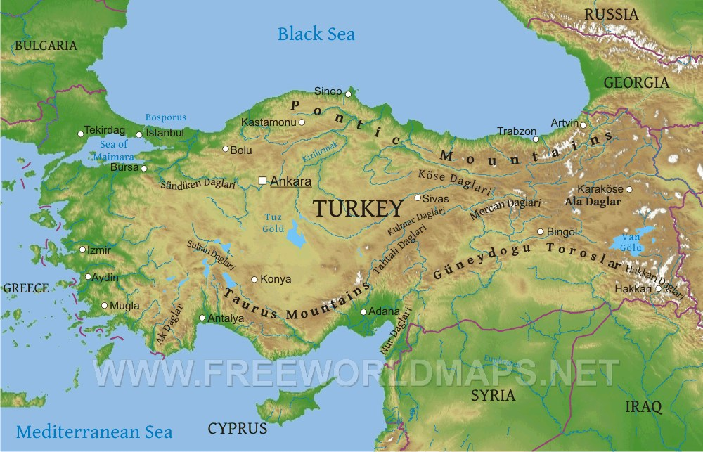
Mountains
Pontic Mountains
  North edge of Turkey
Taurus Mountains
  South edge of Turkey

Slide 10
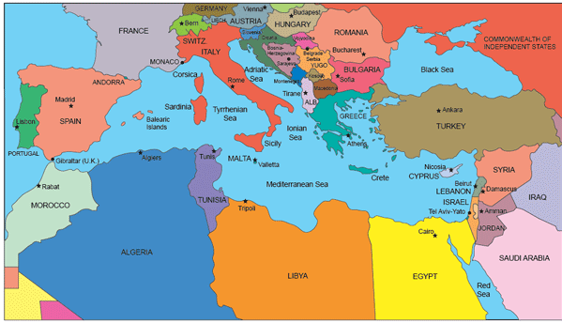
Climate
Dry
Coast – Mediterranean
Interior – steppe
Syria – desert
North Turkey – humid subtropical

Slide 11
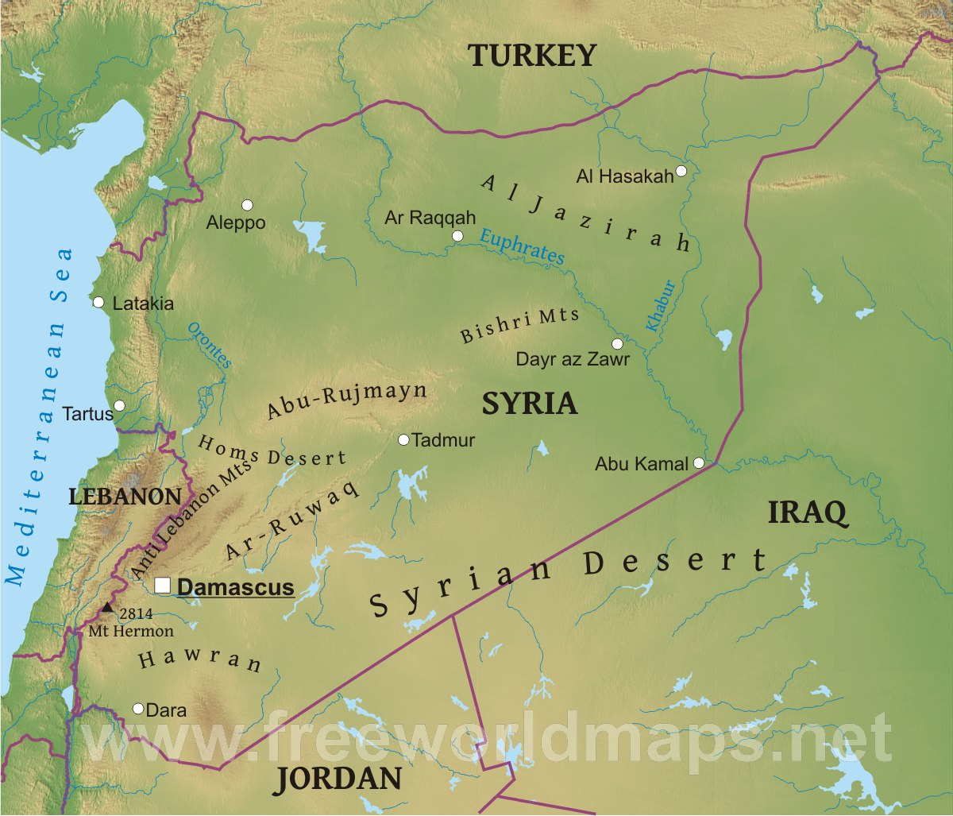
Syrian Desert
Syria and Jordan

Slide 12
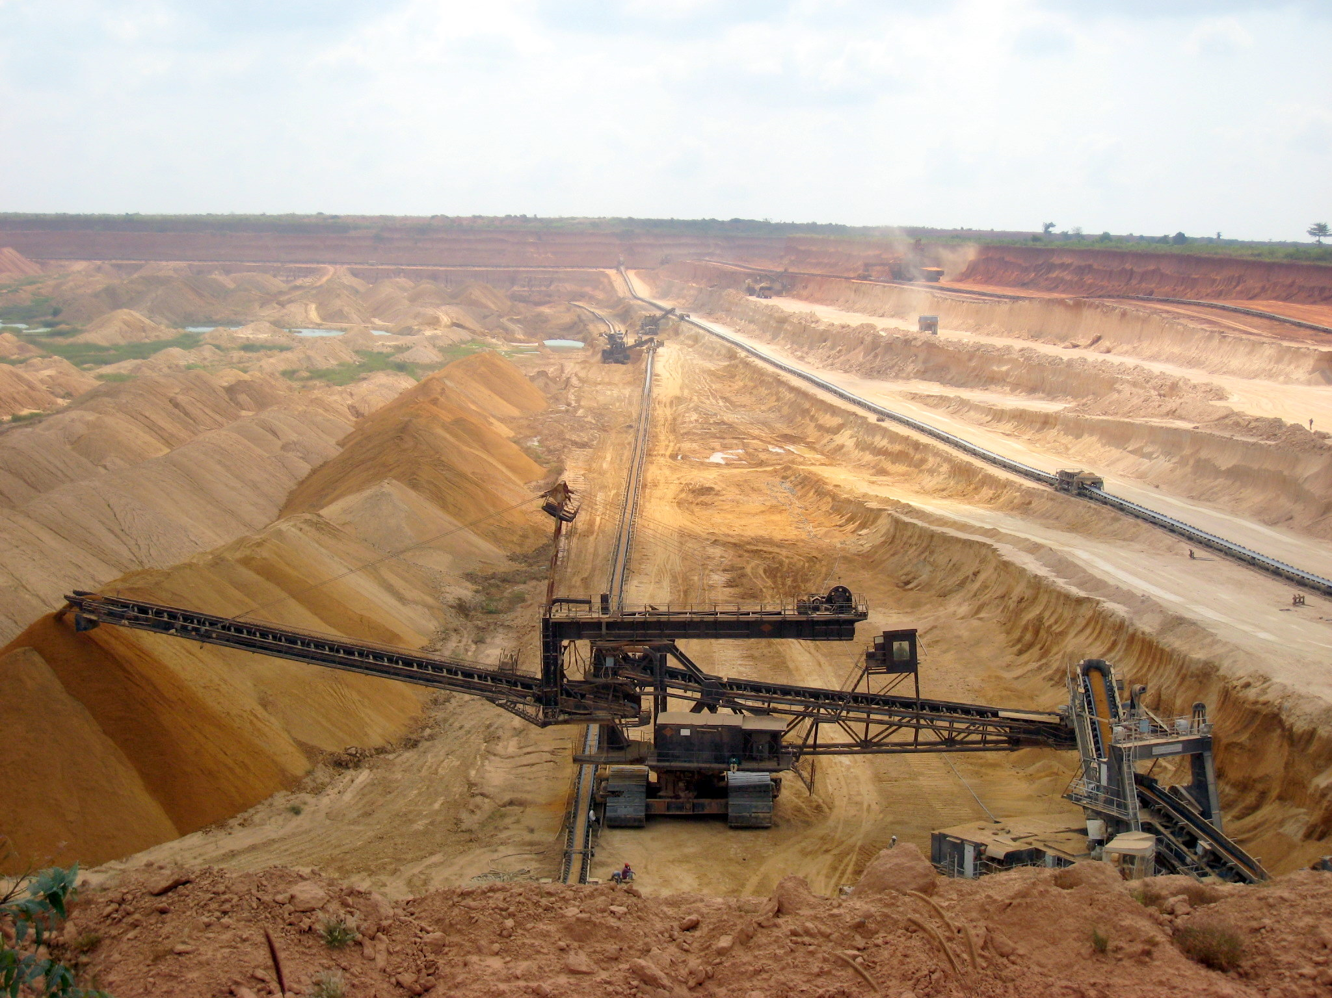
Land and Water
Water is limited
Phosphates – used to make fertilizers

Slide 13
