Slide 1
Chapter 16 - 3
Determining Absolute Age

Slide 2
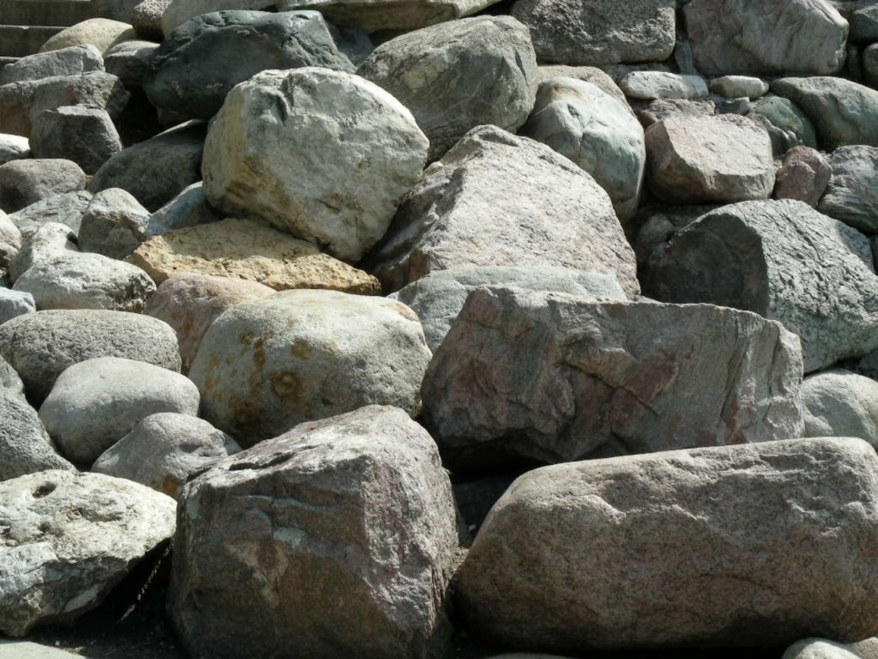
Absolute Age
Numeric age, in years, of a rock or object

Slide 3

Rate of Erosion
Measure rate at which streams erode a bed
Can estimate the age of the rock

Slide 4
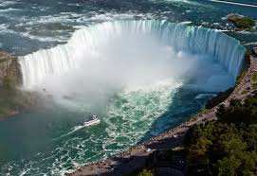
Niagara Falls
Erodes at 1.3 m per year.
9,900 years

Slide 5
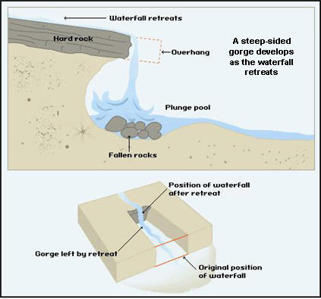

Slide 6
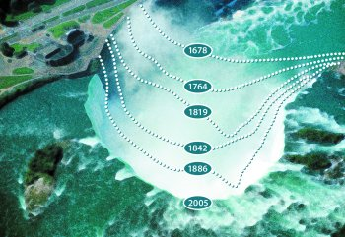

Slide 7
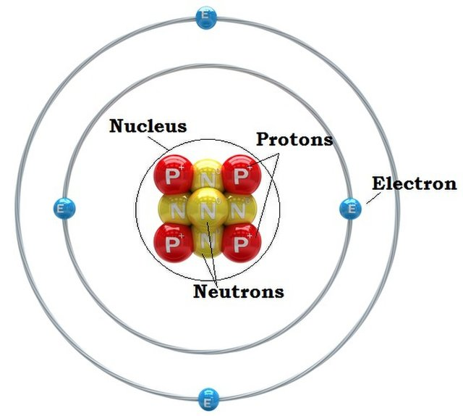
The Atom

Slide 8
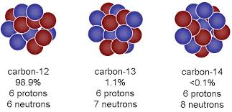
Isotopes
Atoms of the same element that have different numbers of neutrons

Slide 9
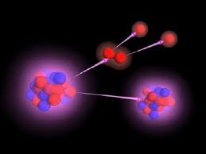
Radioactive Decay
Most isotopes are stable
Radioactive isotope – unstable and decay
Unstable element changes into a stable element

Slide 10
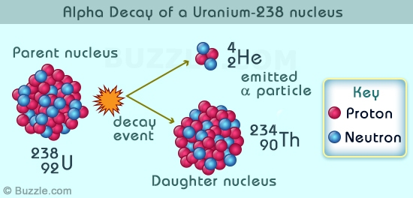

Slide 11
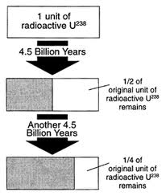
Half-Life
Time it takes for ½ of the parent isotope to decay into the daughter isotope
Parent to daughter

Slide 12
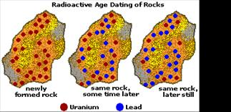

Slide 13
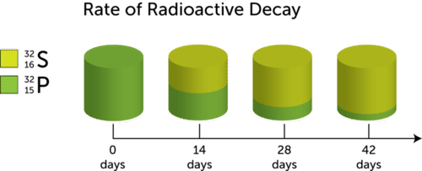

Slide 14
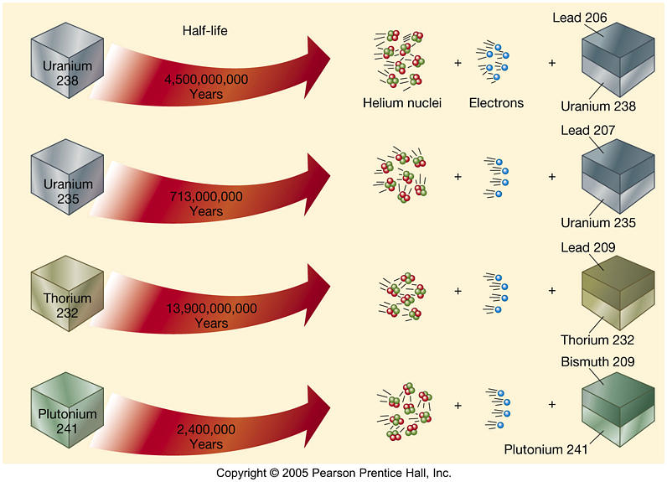
Radioactive Isotope

Slide 15
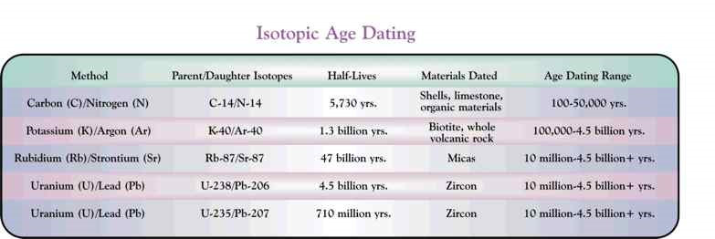

Slide 16
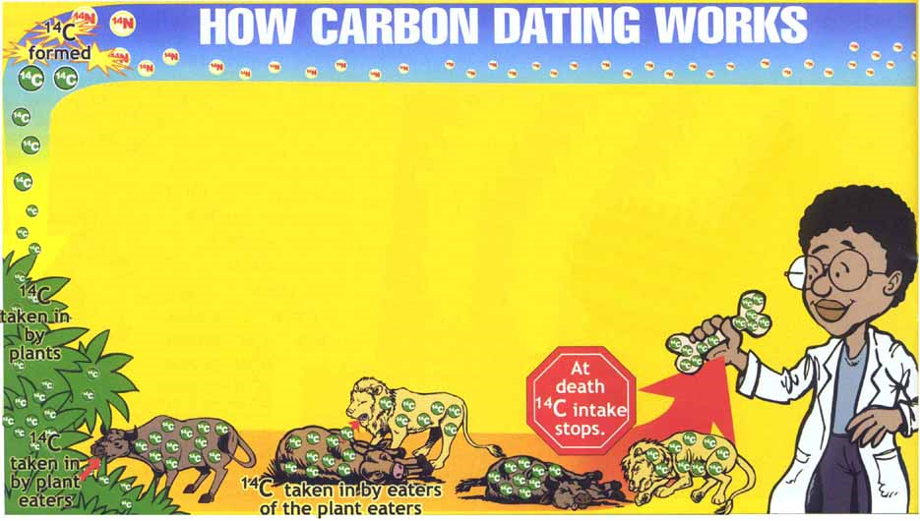
Radiocarbon Dating
Younger rocks
How much organic material is in the rock

Slide 17
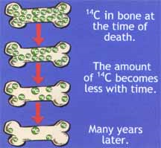
Organic material in rock – compare C-14 to C-12
Constant while alive
Ration changes when dead

Slide 18
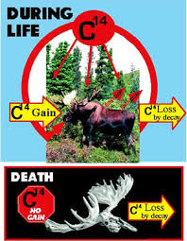

Slide 19
