Slide 1
15 - 2
Stream Erosion

Slide 2
Parts of a River
Tributaries – feeder streams that flow into the main stream

Slide 3
Watershed – land from which water runs off into these streams
Divides – ridges or elevated regions that separate watersheds

Slide 4
Channel – narrow depression that a stream flows downhill
Stream bed – below water level
Banks – edge of stream

Slide 5
Channel Erosion
Headwater erosion – channel lengthens and branch out at upper end
Stream piracy – stream from one water shed is captured by another

Slide 6
Stream Load
Streams transport:
Soil
Rock
Dissolved minerals
Stream load – material carried by streams

Slide 7
Suspended Load
Particles don’t sink to stream bed

Slide 8
Bed Load
Larger coarse materials
Gravel

Slide 9
Dissolved Load
Transported in liquid solution

Slide 10
Stream Discharge
Volume of water moved by a stream in a given time period
Fast – higher
Slow - lower

Slide 11
Stream Gradient
Change in elevation of stream over a given horizontal distance
Steepness
Headwaters – steep
Mouth - flatter

Slide 12
Evolution of River Channels
Over time:
River channels erode
Wider and flatter

Slide 13
Meandering Channels
Low gradient
Bends and curves
Low velocity

Slide 14
Bar – deposited sediment on inside of bend

Slide 15
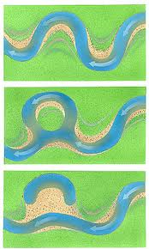
Oxbow Lake
Meander becomes isolated from the river

Slide 16
Braided Streams
Multiple channel
Divide and rejoin
Sediment bars

