Slide 1
14-3
The Theory of Plate Tectonics

Slide 2
Plate Tectonics
What couldn’t Wegener figure out?
His evidence along with sea-floor spreading lead to the Theory of Plate Tectonics.

Slide 3
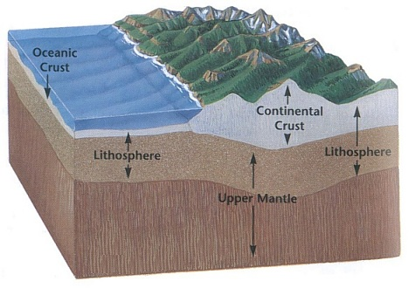
Lithosphere
Lithosphere – crust and ridged upper mantel

Slide 5
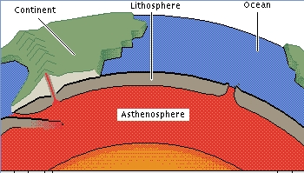
Asthenosphere
Asthenoshpere – layer of “plastic” like rock below lithosphere

Slide 7
Crust
Oceanic crust – dense
Continental crust – low density

Slide 8
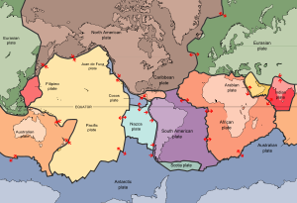
Plates
Plate - rigid sections of the lithosphere

Slide 9
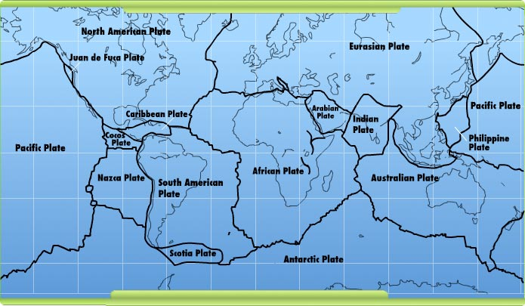

Slide 12
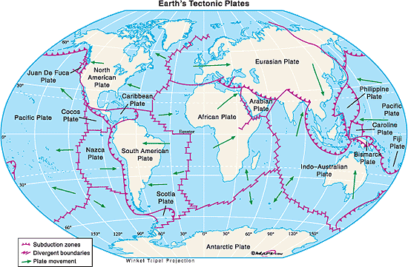

Slide 14
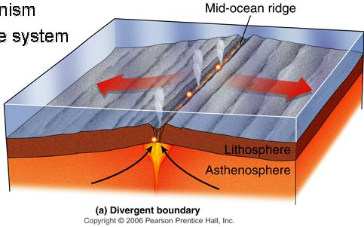
Divergent boundaries - place where two plates move apart

Slide 16
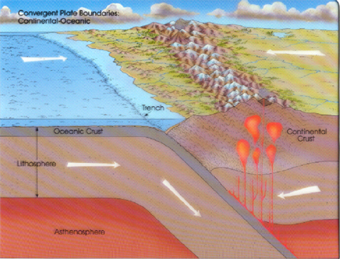
Convergent boundaries - two plates move together

Slide 17
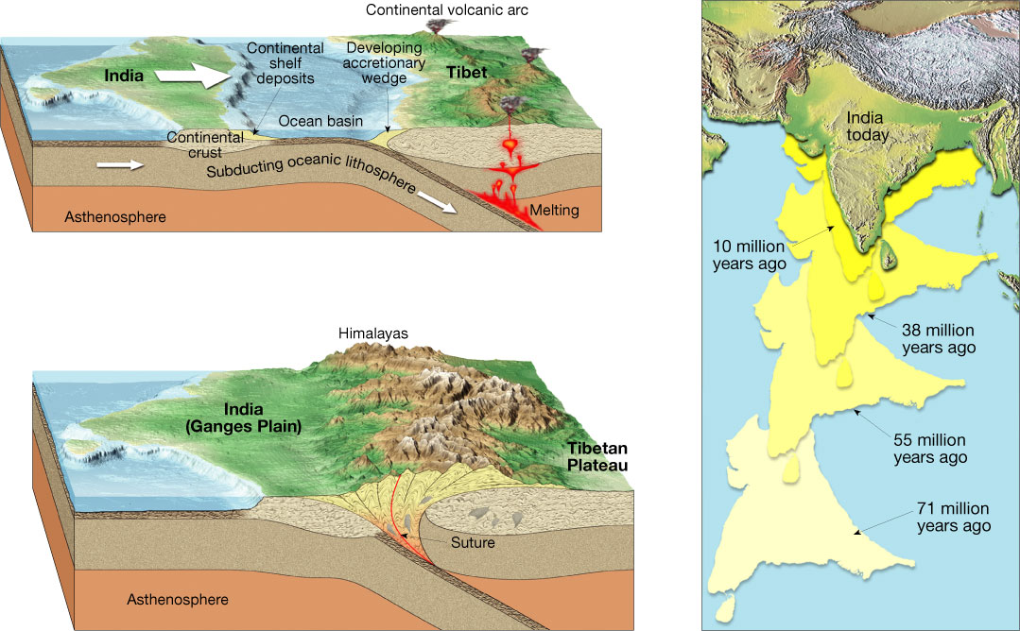

Slide 19
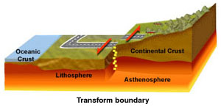
Transform fault boundaries - two plates grind past each other

Slide 20
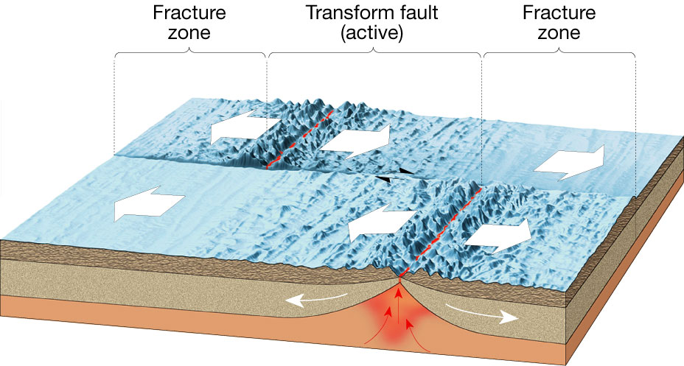

Slide 23
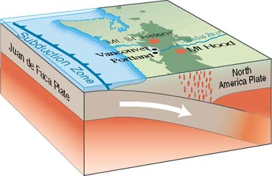
Subduction zone - oceanic plate forced into the mantle

Slide 24
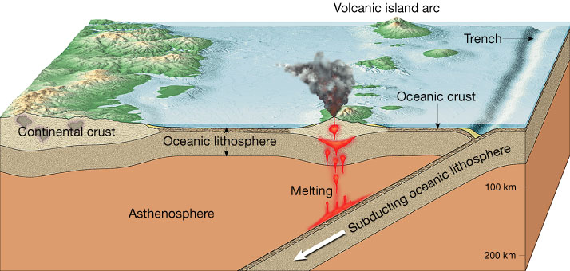

Slide 25
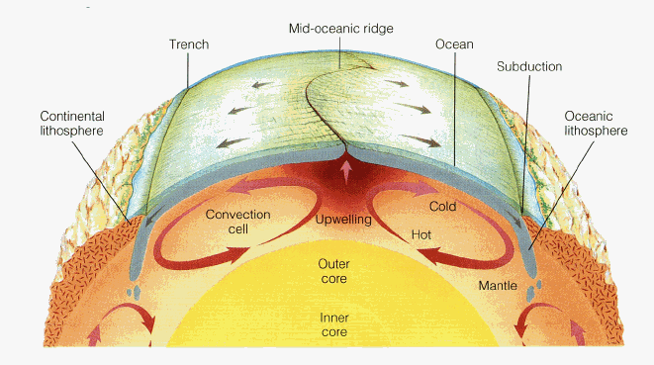
What causes the plate motion?
Convection cells in mantle
Hot material rises
Cool material sinks

Slide 26
Ridge Push
Ridge push – cooling rock sinks and gets pushed away from ridge

Slide 27
Slab pull
Slab pull – subducting plate pulls the rest of the plate with it

Slide 28
Continents Adrift Video

