Slide 1
14-3
Land Management and conservation

Slide 2
More Rural Land is Needed
Population is rising!
Types of rural land:
Farm
Range
Forrest
National and State Park
Wilderness

Slide 3
Farmlands
Areas for growing crops and fruit
Threatened areas:
North Carolina’s Piedmont region
Twin Cities in Minnesota
National Farmland Protection Program

Slide 6
Rangelands
Shrub-like desert not suitable for farming or timber
Livestock grazing
Wet or dry

Slide 8
Problems on the Range
Overgrazing – allowing more animals to graze in an area than it can support
Land degraded
Less desirable plants invade
Soil erodes

Slide 10
Maintaining the Range
Most in US is public land managed by the federal government
Leased to ranchers
Public Rangelands Improvement Act of 1978

Slide 11
Limits herd sizes
Areas left unused for time periods
Killing invasive species
Fences
Planting native vegetation

Slide 12
Forest Lands
Lumber
Maple syrup
Turpentine
Removing CO2
Adding O2

Slide 14
Harvesting Trees
We use this much in the US:
Each person cutting down a 30 m tall tree each year
1.5 billion people use it at as a main fuel source

Slide 15
Virgin forest – never been cut
Native forest – planted and managed
Tree farms – planted and harvested

Slide 17
Clear cutting – removing all of the trees in an area
Selective cutting – cutting middle aged or mature trees
More expensive

Slide 19
Deforestation
Clearing trees from an area without replacing them
Cleared and converted into farmland
Make space for building
Soil erosion

Slide 21
Tropical Rainforest – thin soil

Slide 22
Reforestation
Trees are planted to replace cut down areas
Steep hill sides

Slide 24
Parks and Preserves
1st National Park 1870’s
Yellowstone
Today – more than 50
Biosphere preserves – places where humans and wildlife live side by side

Slide 26
Wilderness
US Wilderness Act – 1964
Designated certain areas as wilderness
Area in which land and the ecosystem it supports are protected from all exploitation

Slide 27
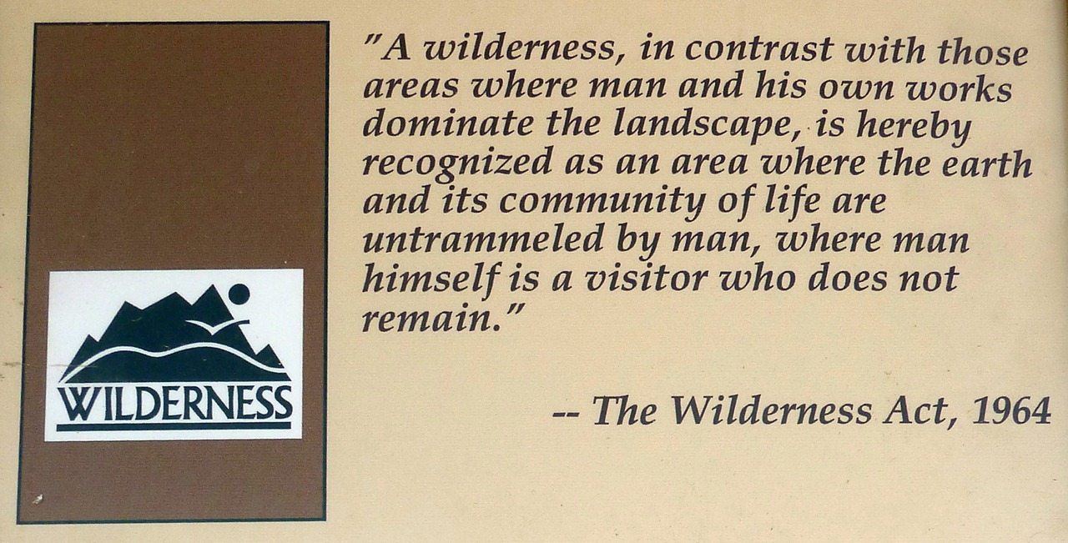
32 million acres
Open to camping, hiking, fishing
No roads or structures
No motorized equipment

Slide 28
Benefits of Protected Areas
Extinction of species prevented
Recreational areas
Only places with unspoiled resources

Slide 29
Threats to Protected Areas
Visitors leaving their marks on the area
Litter and pollution
Some areas have limited visitors or none at all

