Slide 1
13-2
France and the benelux countries

Slide 2
History of France
Lascaux Cave – prehistoric paintings of bulls jumping
Southern France
15,000 years old

Slide 3
Early History
France was called Gaul
Celtic people settled
Roman rule
Latin based language
Developed into French

Slide 4
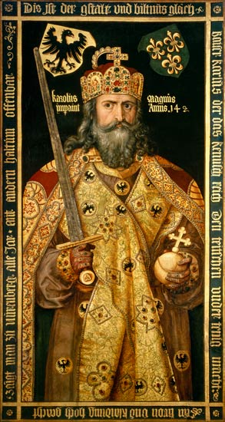
The Franks
Franks conquered Gaul
German people
Franks = France
Charlemagne – built Christian empire
Conquered old Roman Empire

Slide 6
Pope crowned Charlemagne Empire of Romans
Normans attacked after his death
Normans = Normandy
NW France

Slide 8
Normans conquered England
William the Conqueror became King of England and part of France

Slide 10
Revolution and Empire
Established a colonial empire
Like US
People had little rights
French Revolution
Over through King

Slide 11
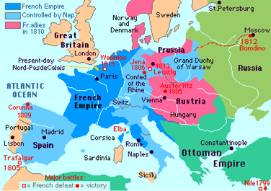
Napoleon took control
Conquered much of Europe
European powers joined to defeat him

Slide 12
Modern History
WWI and WWII
Germany invaded
Rebuilt after each war
Republic
Parliament with president

Slide 14
Language and Religion
French
Catholic

Slide 15
Customs
Some of the best cooking
Culinary schools
French words:
Café
Cuisine
Menu

Slide 16
Arts
Gothic style cathedrals
Notre Dame Cathedral in Paris

Slide 18
Enlightenment – ideas about government
Inspired American Revolution and democracy
Impressionism – rippling light creates impression of scene
The Three Musketeers

Slide 20
France Today
Regions largest country
Most live in cities
Paris – capital, largest
Eiffel Tower
Strong Economy

Slide 21
Benelux Countries
Belgium
Netherlands
Luxembourg
Low Countries

Slide 22
History
WWII – Germany’s control
Joined NATO – North Atlantic Treaty Organization
Protection
Parliament and ceremonial monarchy

Slide 23
Netherlands
Holland
People called Dutch
Amsterdam – capital
The Hague – seat of government

Slide 24
Belgium
Very urban
Brussels – capital
EU – European Union
NATO
Cosmopolitan – characterized by foreign influences

Slide 25
Language
North and Coast – Flanders (Flemish)
South and Interior – Wallonia (French)

Slide 26
Luxembourg
Hilly, forests
Very high standard of living
Banking
French or German

