Slide 1
12-1
Southern Europe – physical geography

Slide 2
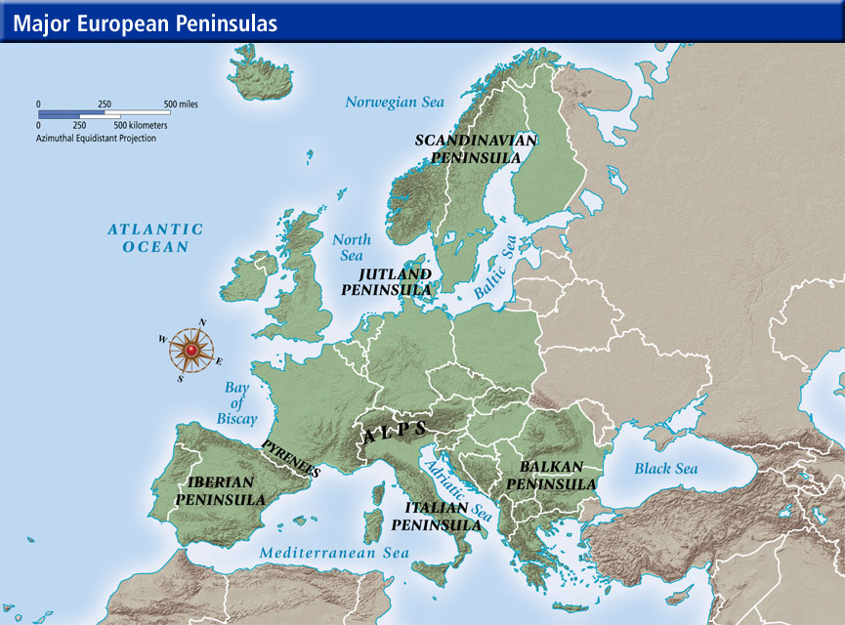
Physical Features
A peninsula of peninsulas
Iberian Peninsula
Italian Peninsula
Balkan Peninsula

Slide 3
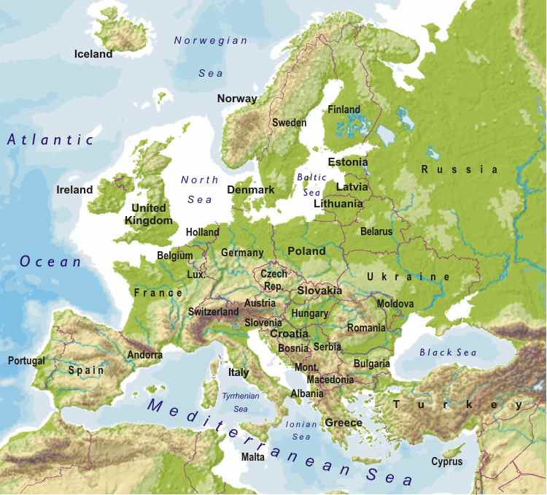

Slide 4
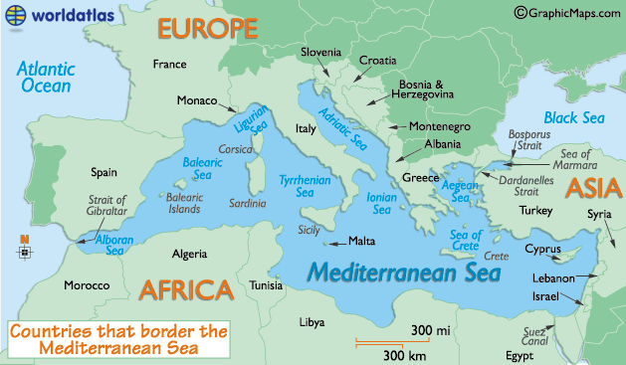
Mediterranean Europe
Coastlines on the Mediterranean Sea

Slide 5
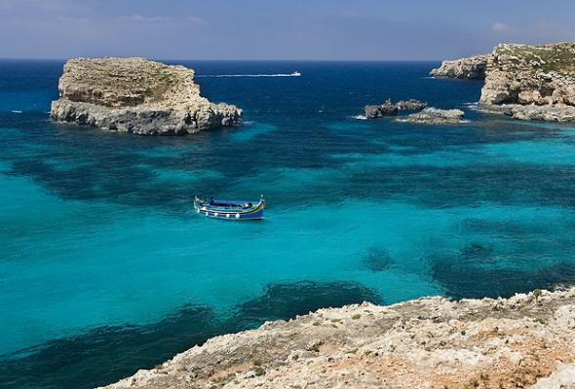
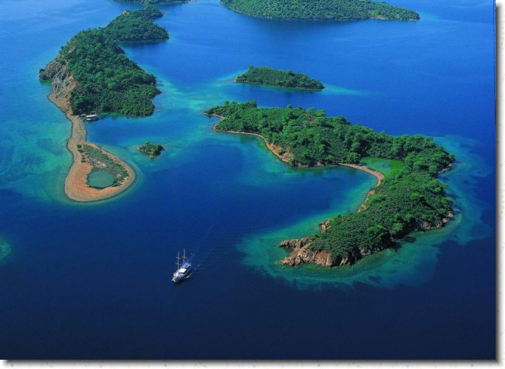

Slide 6
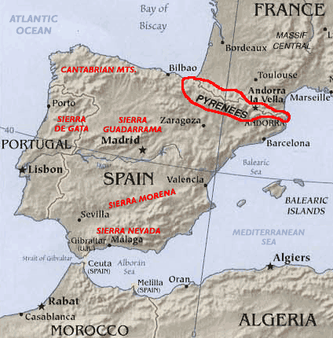
Landforms
3 peninsulas all have mountains
Pyrenees Mts.
  Iberian Penn.
  Boundary between Spain and France

Slide 7
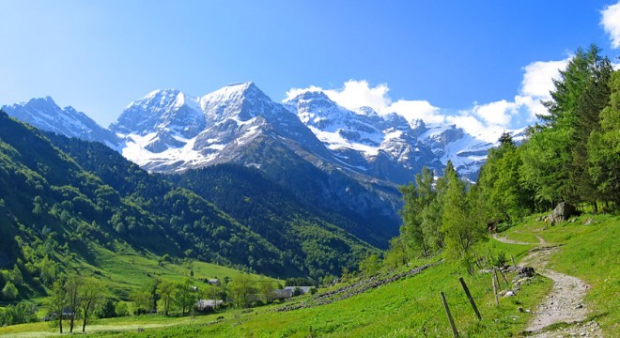

Slide 8
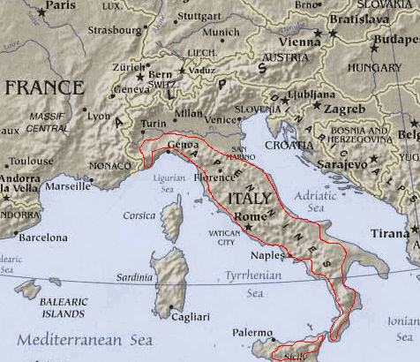
Mountains
Italy
Apennines –along whole penn.
Alps – Europe’s highest
  North

Slide 9
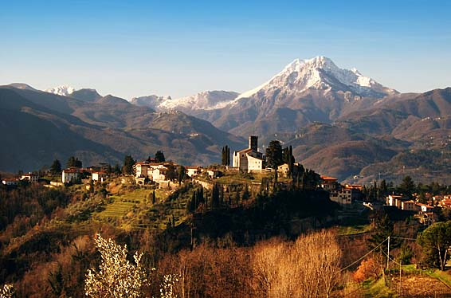

Slide 10
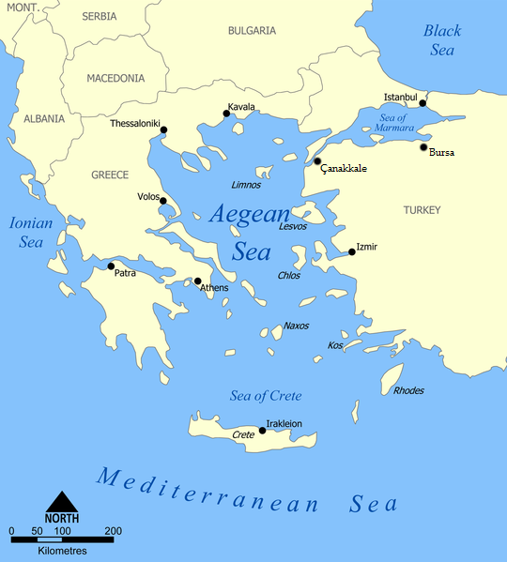
Aegean Sea – more that 2,000 islands
East of Greece
Crete and Sicily – undersea mountains

Slide 11
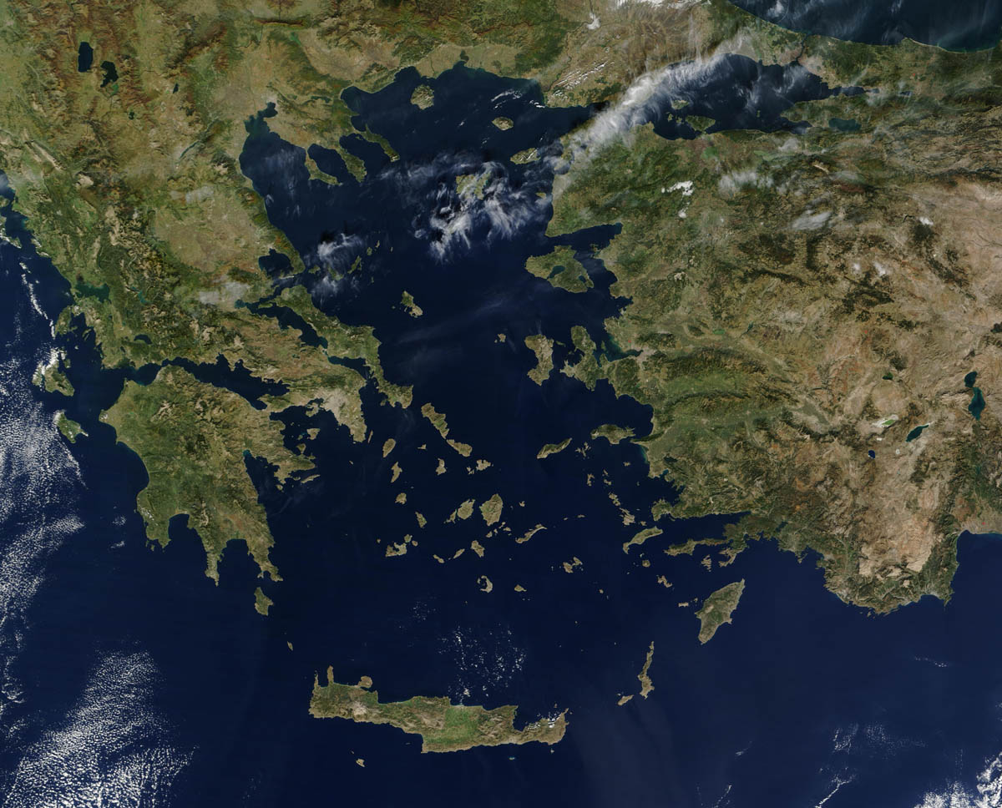

Slide 12
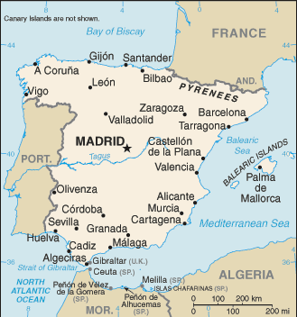
Water
Food and travel
Tagus River – regions longest
  Iberian Penn.
Po River – runs through most populated and fertile areas

Slide 13
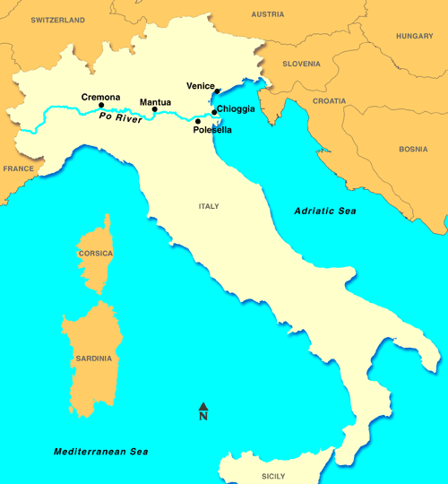

Slide 14
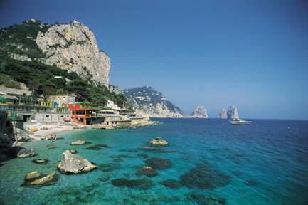
Climate
Mediterranean Climate
Warm days and mild nights
Little rain in summer
Rains during winter

Slide 15
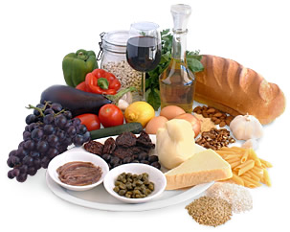
Citrus fruits
Grapes
Olives
Wheat
Fish
Shellfish
Vacationers love the climate

