Slide 1
12 - 3
Earthquakes and Society

Slide 2
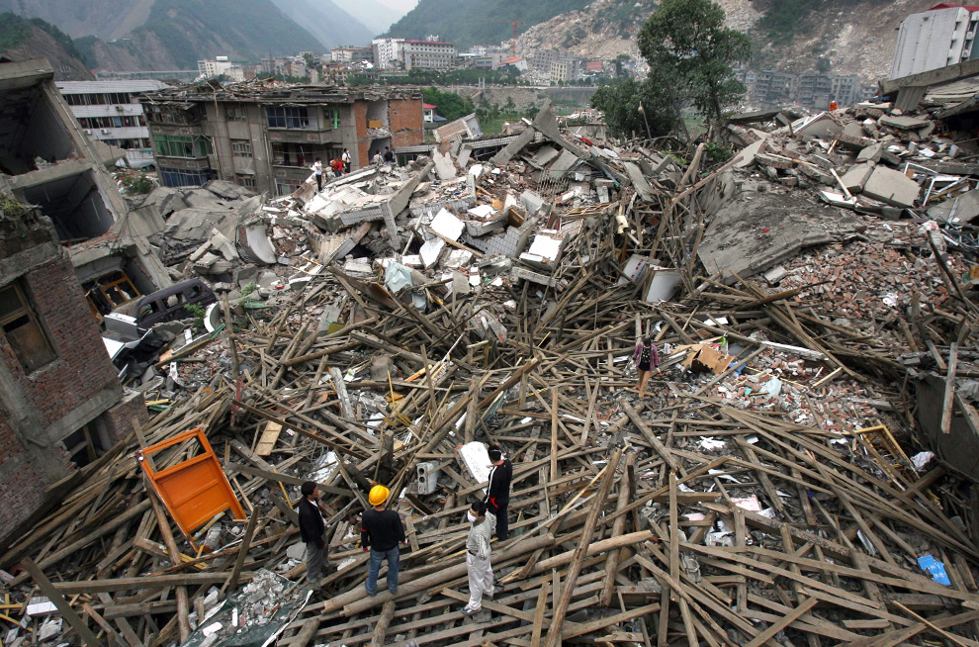
Look out!
Most people get hut in earthquakes due to collapsing structures.
Landslides
Fires
Explosions
Floods

Slide 3
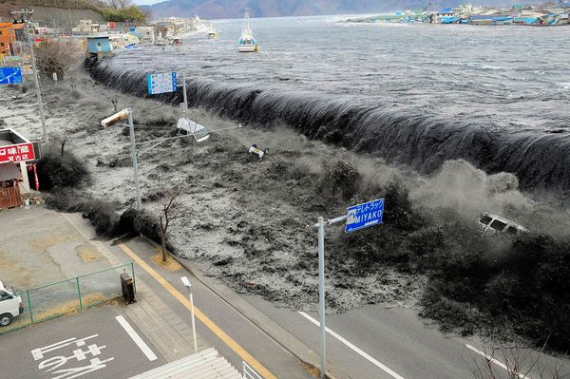
Tsunamis
Giant wave that forms after:
Underwater earthquake
Underwater eruption
Landslide

Slide 4
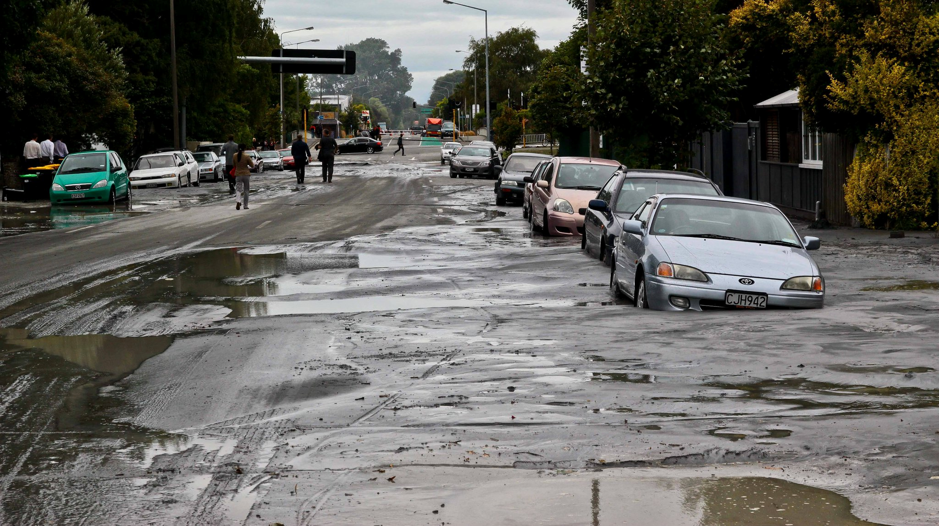
Destruction
Buildings on loose rock and soil will be more likely to fall.
Buildings need to sway to absorb energy
If it sways too much it may collapse

Slide 5
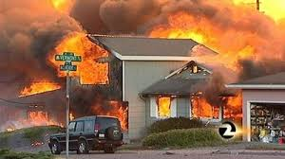
Earthquake Safety
Learn how and where to turn off gas, water, and electricity
Prepare ahead of time

Slide 6
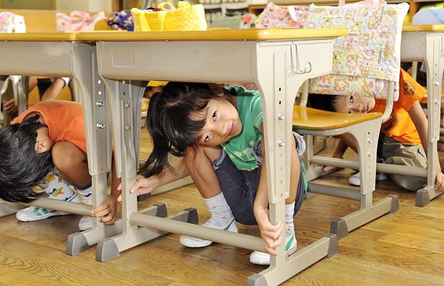
Earthquake safety
Stand in doorway or under a table
Try to get outside
Car – drive away from tall buildings and stay I car

Slide 7
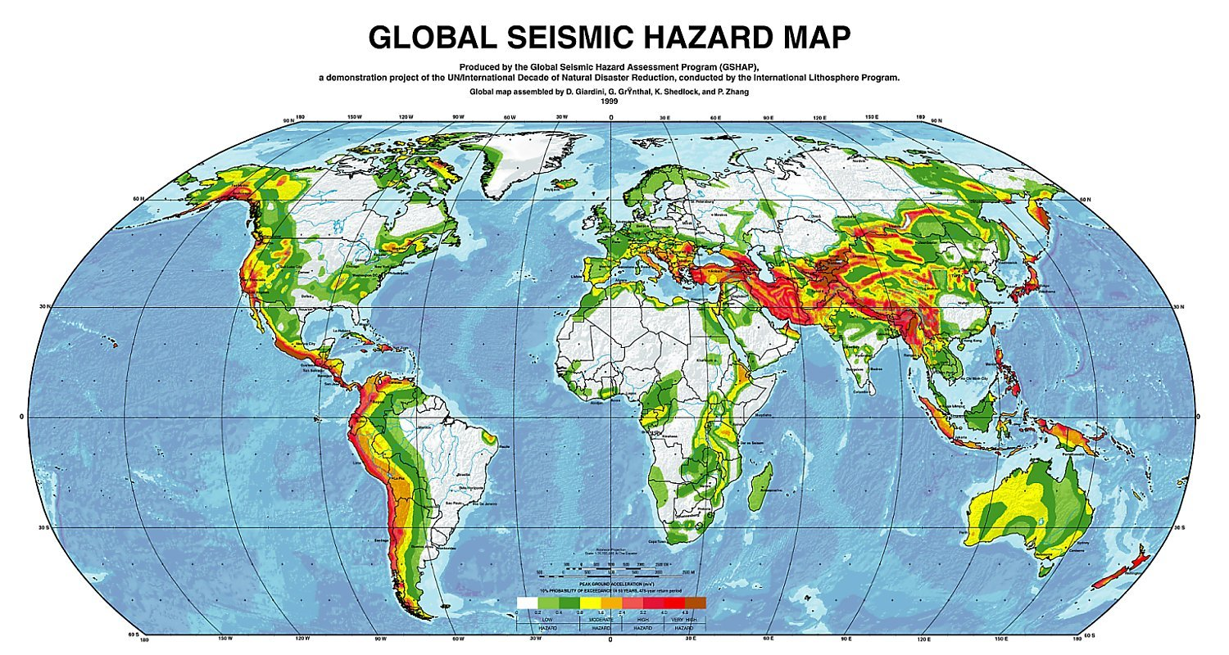
Earthquake Warnings
Scientist study past earthquakes in order to predict future quakes
Still no truly reliable method of prediction
Measure and monitor current faults

Slide 8
Seismic Gaps
Area of low earthquake activity along faults
Strong quakes in the past
Sites of future earthquakes

Slide 9
Foreshocks
Small earthquakes before a large quake
Seconds or weeks before

Slide 10
Changes in Rock
Tilting in rocks
Magnetic properties
  Due to water build up
Natural gas seepage

