Slide 1
12-3
Italy

Slide 2
History
Home of the continent’s greatest empire
Ancient Rome
Controlled almost all of the land around the Mediterranean Sea

Slide 4
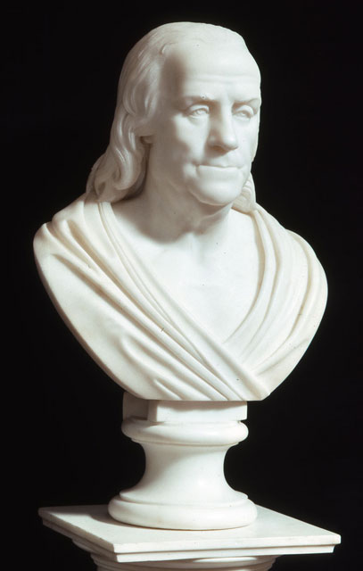
Rome
Influences:
Art
Architecture
Literature
Politics
Christianity

Slide 5
The Renaissance
Roman Empire collapsed
Weak leadership and invasions
Italy’s cities formed states
Wars
Governments

Slide 7
Cities became major trade centers
Money supported artists and architects
Renaissance - period of great creativity
Greatest works of art created

Slide 8
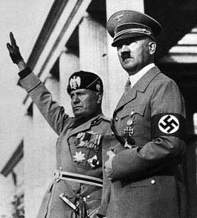
Unified Italy
Italy became a unified kingdom in 1861
Nationalism – patriotic feelings
Dictatorship – Benito Mussolini
Mussolini joined Hitler to fight in WWII
1945 – Italy was defeated

Slide 9
After the War
Democracy
Parliament and Prime Minister
Strong economy

Slide 10
Religion
Roman Catholic Church
Pope – head of the church
Lives in Vatican City
Independent state located in the city of Rome

Slide 12
Traditions
Olives, tomatoes, rice, pasta
South – pasta sauce
North – cream sauce
Fashion leader
Contemporary arts - modern

Slide 13
Southern Italy
Poorer half
Depends on agriculture
Sicily – island at the tip of peninsula
Naples – industrial center
Government incentives to build here

Slide 14
Northern Italy
Fertile farm land
Po River
Tourism
Strong economy
Milan – industrial city
Fashion

Slide 15
Florence - near the Leaning Tower of Pisa
Venice – water canals
Rome - capital

