Slide 1
Chapter 1 – Introduction to Earth Science
1-1 What is Earth Science?

Slide 2
Earth Science Is:
The scientific study of the Earth and the Universe around it.
  Causes of natural events can be explained through observation and experimentation

Slide 3
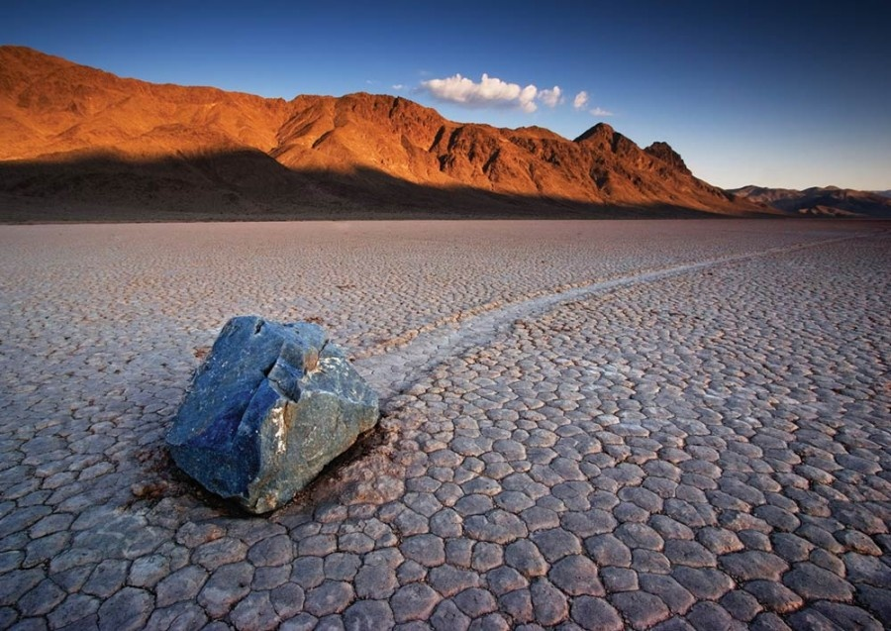
Racetrack Playa

Slide 4
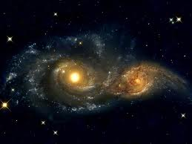
Branches of Earth Science:
Astronomy – Study of the Universe

Slide 5
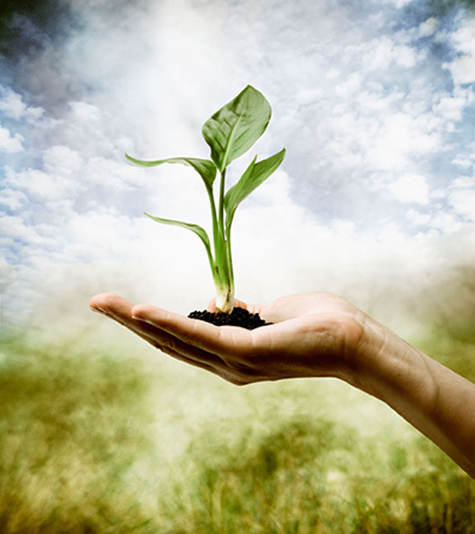
Environmental Science – Study of the ways humans interact with their environment.

Slide 6
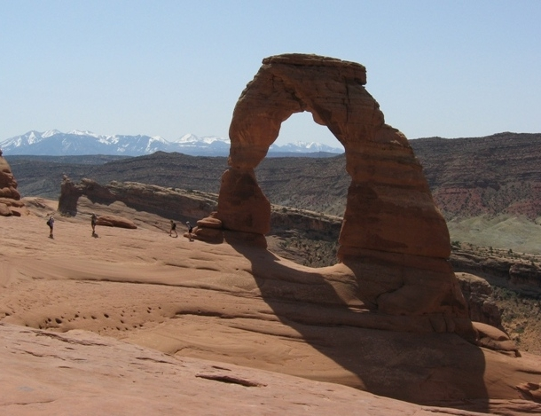
Branches of Earth Science:
Geology – Study of Earth’s origins, the structure of the Earth, and the process that shape the Earth.

Slide 7
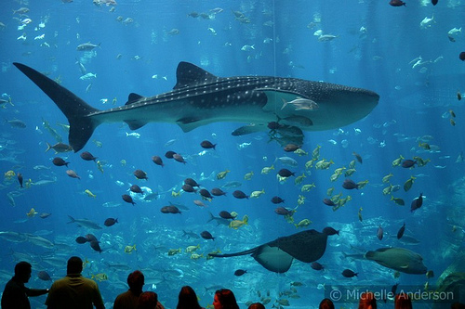
Oceanography – Study of the Ocean

Slide 8
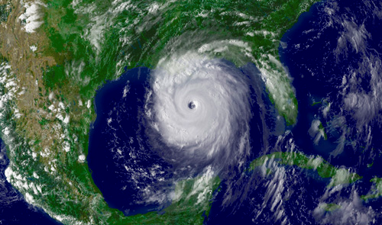
Meteorology – Study of the Earth’s atmosphere
  Weather and Climate

Slide 9
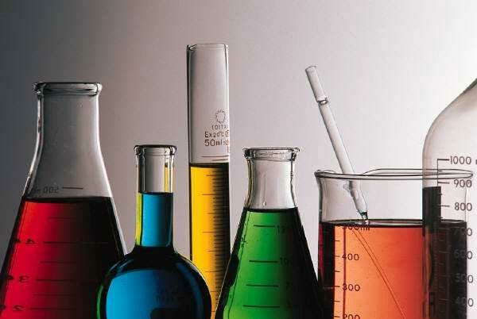
Technology and Science
Technology -the use of knowledge learned through science.
Technology and science depend on one another

Slide 10
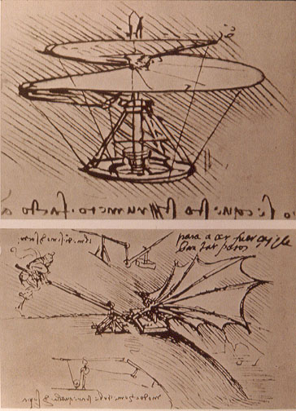
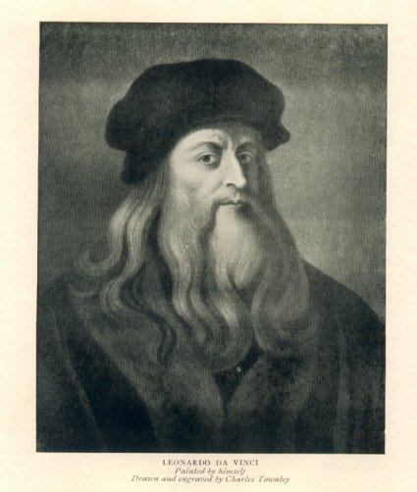
Leonardo da Vinci

Slide 11
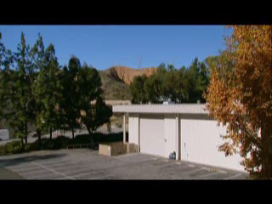
Leonardo da Vinci

Slide 12
Science and Technology
Goal of science - to gain knowledge about the natural world.
Goal of technology - to apply scientific understanding to solve problems.

Slide 13

Bionic Body Parts

Slide 14
Scientific Law and Theories
Scientific Law – summary of many experimental results and observations; tells how things work
Scientific Theory – an explanation for some phenomenon that is based of observation and experimentation

Slide 15
Law or Theory?
The Big Bang
Gravity
Conservation of Energy
Evolution
Plate Tectonics

Slide 16
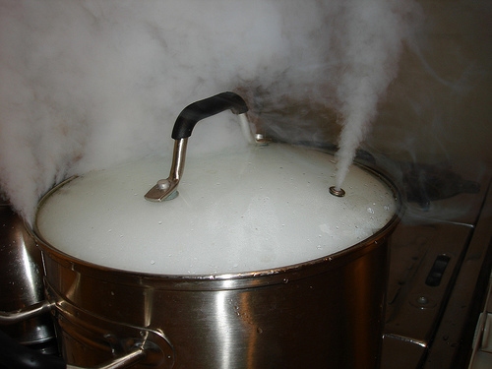
Science
Inference – explanation of what happened
Observation – what you see

Slide 17
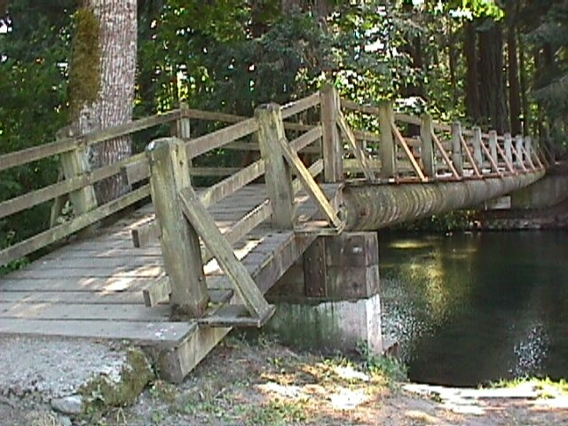
Hypothesis
An idea that can be tested by an experiment.
Can be tested.
All experiments should have one.

Slide 18
Variable and Control
Variable - Factors in an experiment that change.
Bridge strength variable – type of material
Control – Factors in an experiment that stay the same.
Bridge strength variable – size, shape

Slide 19
Scientific Method
Imagine that you want to find out what breed of dog is the smartest. After doing some reading you think that Labrador Retrievers are but you want to conduct your own experiment to find out. You put a lab, a boxer, and a great dane into a maze. At the end of the maze you put a steak and time to see how long it takes for each breed of dog to get out of the maze. After your experiment you find that lab made it out in 5 minutes, the boxer made it out in 2 minutes, and the great dane took 7 minutes.
What is the:
1. Hypothesis
2. Variable
3. Controls
4. Was your hypothesis correct?

Slide 20
Scientific Method
Scientific Method – a series of steps followed to solve problems including:
  1. Observations
  2. Formulating a question
  3. Research and data collection
  4. Form a hypothesis
  5. Test hypothesis
  6. Observations
  7. Draw conclusion

Slide 21
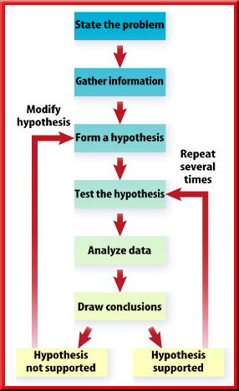

Slide 22
Scientific Method
You wake up late for school. You get ready and head out the door. You get into your car, put the keys in the ignition and nothing happens. What do you do?
You use the Scientific Method!

Slide 23
Scientific Method
1. Observations – Observe your surroundings.

Slide 24
Scientific Method
2. Formulate a question – What do you want to know?

Slide 25
Scientific Method
3. Research and collect data – What do you already know about your question?

Slide 26
Scientific Method
4. Form a hypothesis – Propose an answer to your question based on observations, research, and data.

Slide 27
Scientific Method
5. Test hypothesis – run a series of experiments

Slide 28
Scientific Method
6. Observations – What do you see?

Slide 29
Scientific Method
7. Draw a conclusion – Did the results support your hypothesis? If not, modify the hypothesis based on observations.

Slide 30
The Scientific Method
The Strange Case of BeriBeri
In 1887 a strange nerve disease attacked the people in the Dutch East Indies. The disease was beriberi. Symptoms of the disease included weakness and loss of appetite, victims often died of heart failure. Scientists thought the disease might be caused by bacteria. They injected chickens with bacteria from the blood of patients with beriberi. The injected chickens became sick. However, so did a group of chickens that were not injected with bacteria.
One of the scientists, Dr. Eijkman, noticed something. Before the experiment, all the chickens had eaten whole-grain rice, but during the experiment, the chickens were fed polished rice. Dr. Eijkman researched this interesting case. he found that polished rice lacked thiamine, a vitamin necessary for good health.
1. State the Problem
2. What was the hypothesis?
3. How was the hypothesis tested?
4. Should the hypothesis be supported or rejected based on the experiment?
5. What should be the new hypothesis?

