Slide 1
The Mauryan Empire
9-3

Slide 2
India’s First Empire
500s B.C. – India was divided into small kingdoms
Weak
Persians conquered the Indus River Valley
Alexander the Great – Greeks
Defeated the Persians
Entered India but turned back when troops were homesick

Slide 3
Chandra Gupta Maurya – military leader
Wanted to conquer northern India to unify the region
1st ruler – well run government
Pataliputra – capital
Set up postal system

Slide 4
Used spies to see who was disloyal
Servants tasted food to make sure it wasn’t poisoned
Never slept two nights in the same bed

Slide 5
Ashoka
Gupta’s grandson
Helped to reach height of empire
Grew tired of killing and war – promoted Buddhism

Slide 6
Stupas – Buddhist shrines
Build roads – improved trade
Hospitals

Slide 7
End of the Mauryan Empire
After Ashoka died the empire declined
New rulers:
Not kind
Taxed too much
Took lands
Indian people rebelled
Kind was murdered by his own general

Slide 8
Gupta Empire
500 years later after small warring kingdoms
Chandra Gupta I - ruler
Same name at the Mauryan ruler
Samudra Gupta – son
Golden Age of India
Pilgrims – person who travels to holy sites along trade routes

Slide 9
Literature
Religious Epic – Mahabharata
Longest in written language
90,000 verses
Struggle for India kingdom
Stories:
Bhagavad Gita
Prince has to choose duty over family
Ramayana
King saves kidnapped wife

Slide 10
Math
Algebra
Infinity
Invented the symbol “0” and also “1-9”

Slide 11
Science
Mapped the movement of stars and planets
Idea that Earth was round and revolved around the Sun
Pillar of Iron of Delhi
Rust free

Slide 12
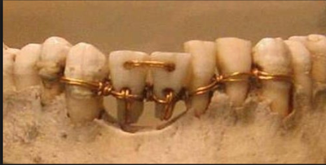
Medicine
Bow drill for dental surgeries
Set broken bones
Sew wounds
Medical instruments
Plastic surgery – nose job

