Slide 1
Ancient India
9-1

Slide 2
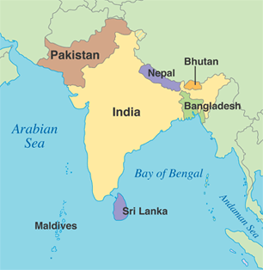
Subcontinent
A large landmass that is smaller than a continent
South Asia

Slide 3
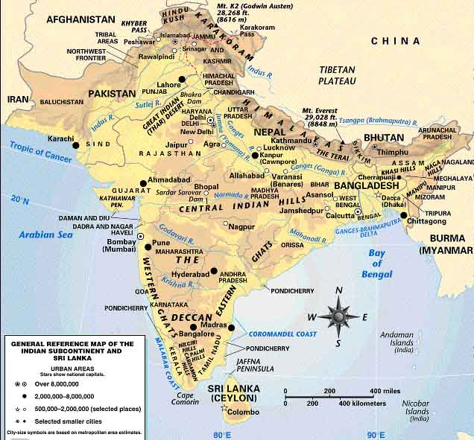
Mountains

Slide 4
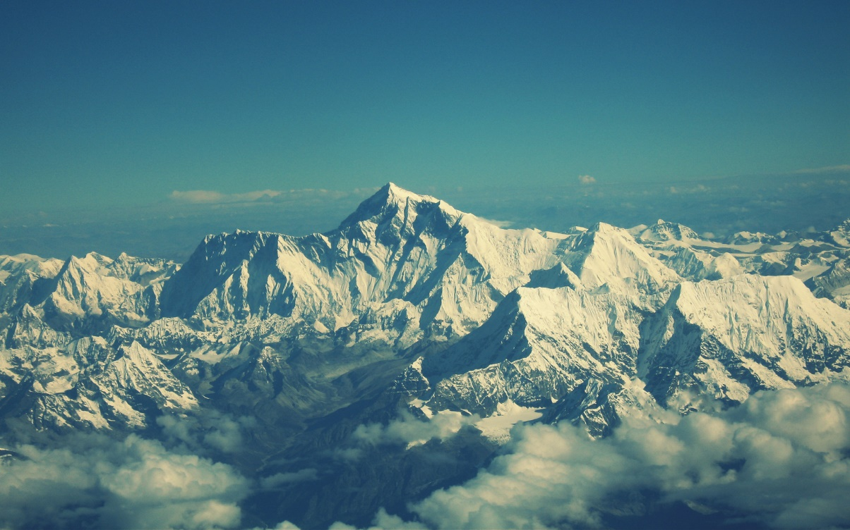
Himalayas
1,500 miles
Tectonic collision
World’s highest mountain chain

Slide 5
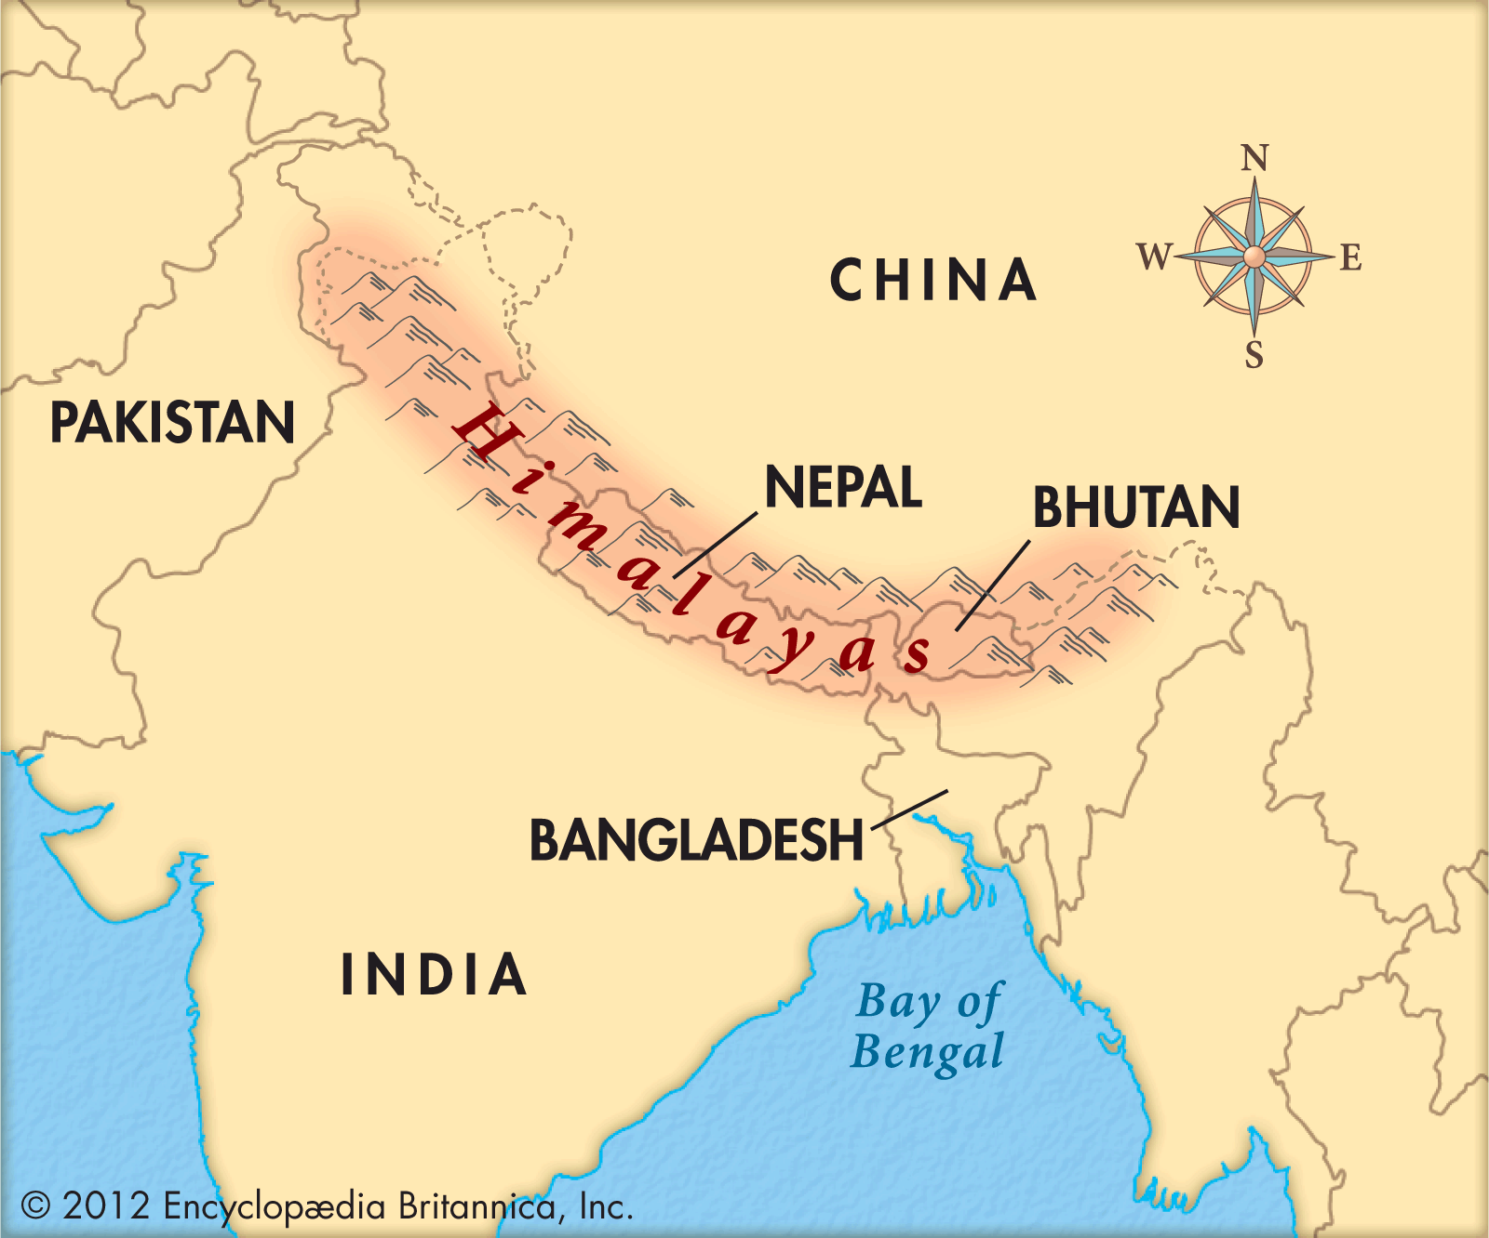

Slide 6
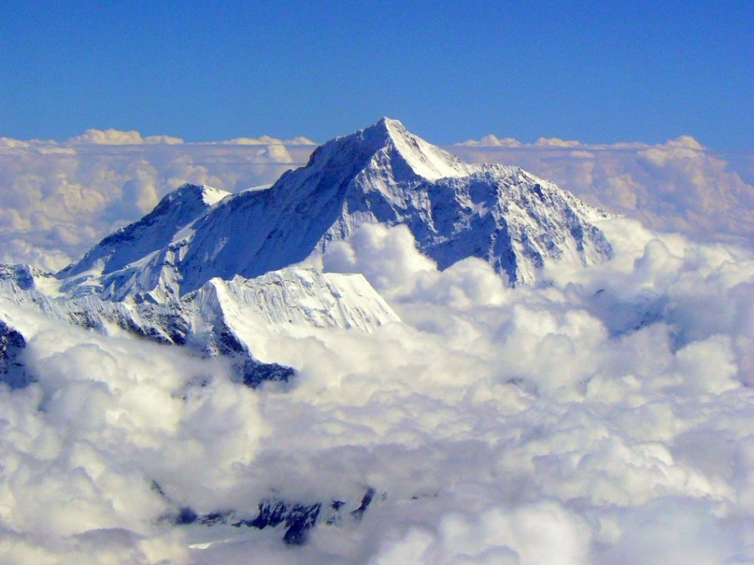
Mount Everest – highest mountain
  29,035 ft
  5.5 miles
K2 – 2nd highest
  Pakistan

Slide 7
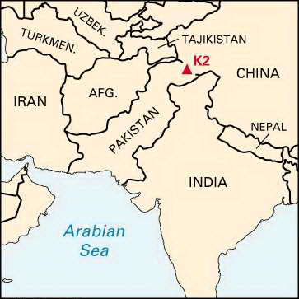
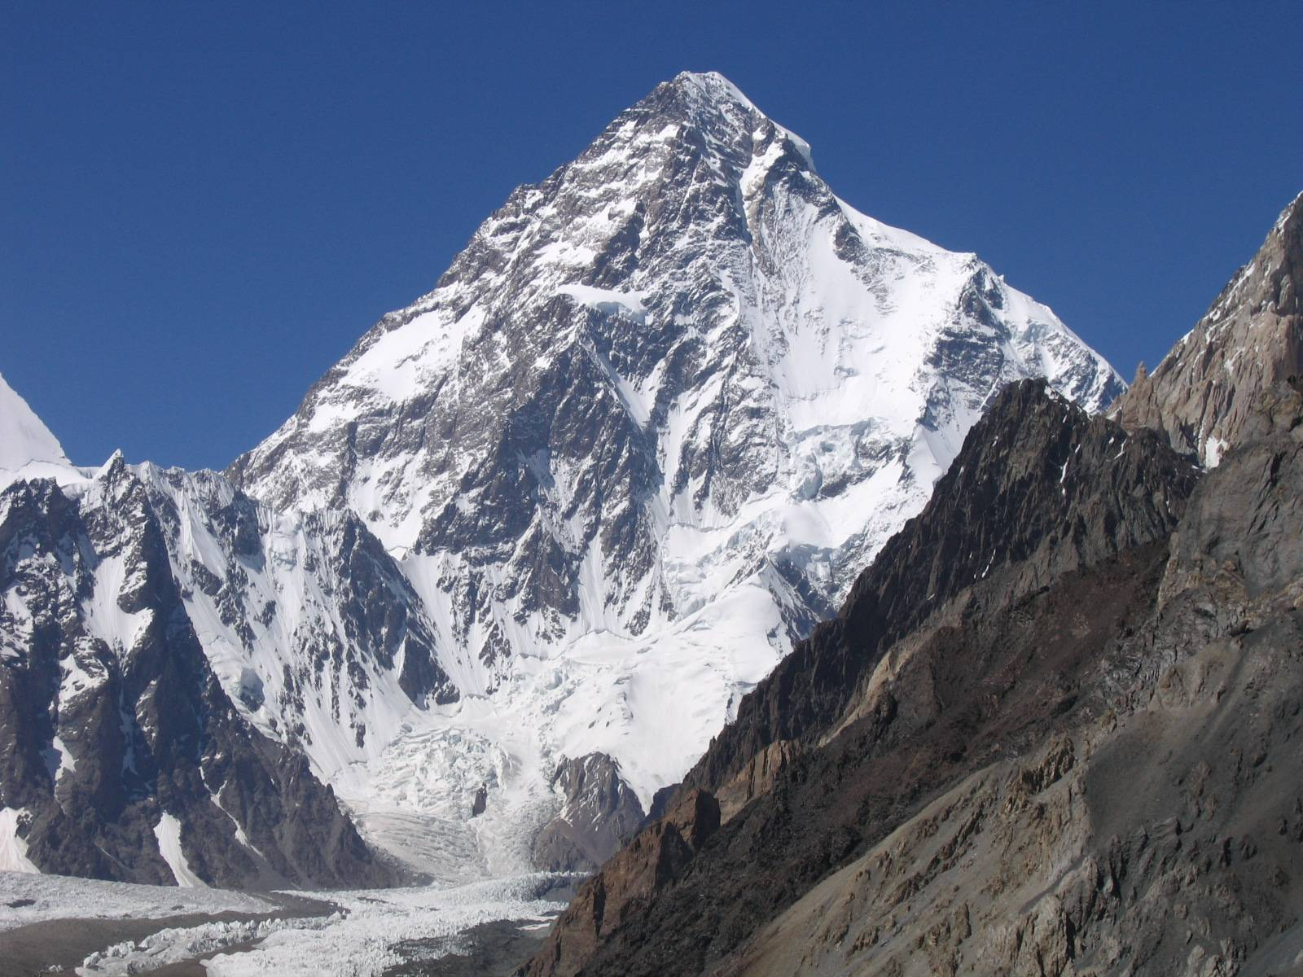

Slide 8
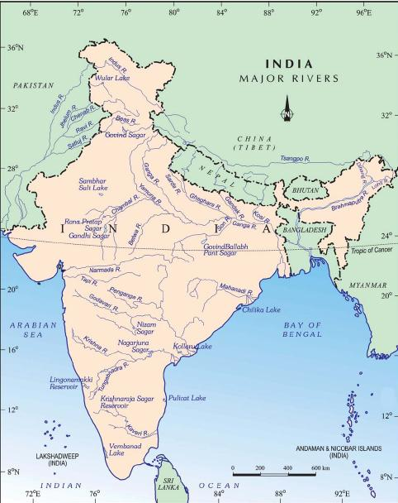
Rivers
Wide fertile plain at the base of the mountains
Indus
Ganges
Brahmaputra
Farming, transportation and trade

Slide 9
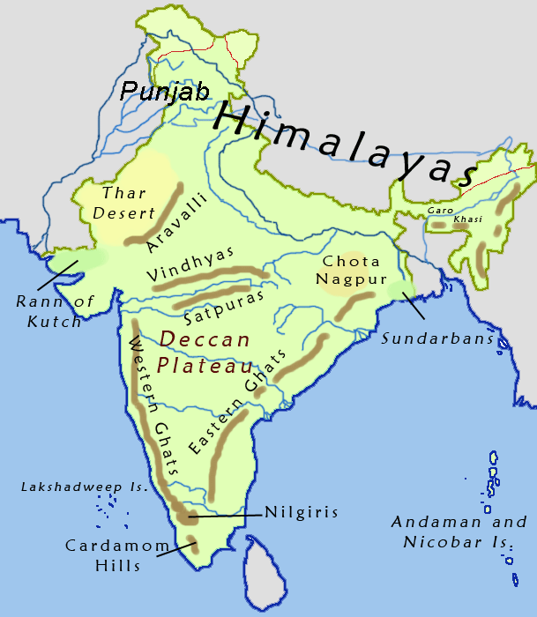
Deccan Plateau
Southern 2/3 of India
Located between Eastern and Western Ghats mountains

Slide 10
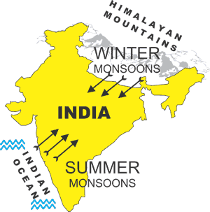
Monsoons
Seasonal winds that bring either moist or dry air
Summer – wet, warm
Winter – dry, cold

Slide 11
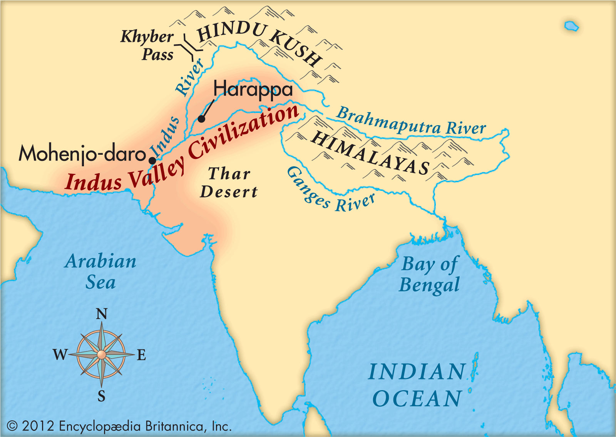
Indus Valley Civilization
5,000 years ago
The cradle of ancient India
Abundant crops = other jobs other than agriculture
Modern day Pakistan

Slide 12
Mohenjo-Daro and Harappa
2 major cities
35,000 residents
Dozens of streets
Fortress at west end of city
Oven baked bricks
Wooden roofs

Slide 13
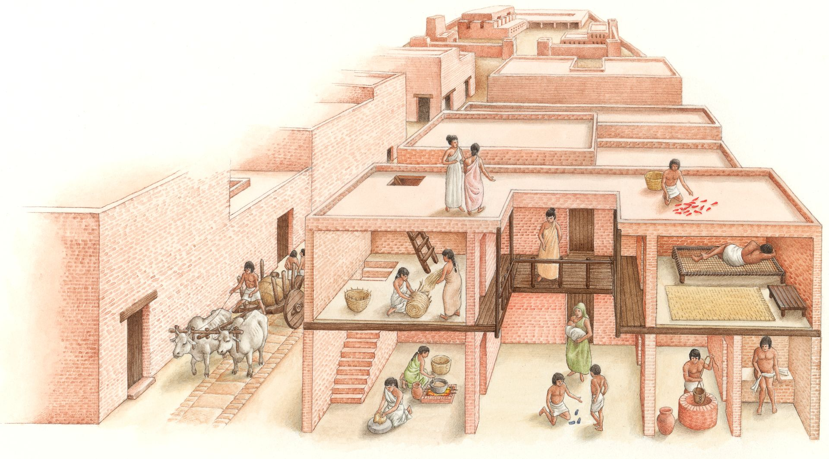
Grain storage buildings
Wells for water
Indoor bathroom
  Waste water chutes lead outside city walls
Garbage chutes

Slide 14
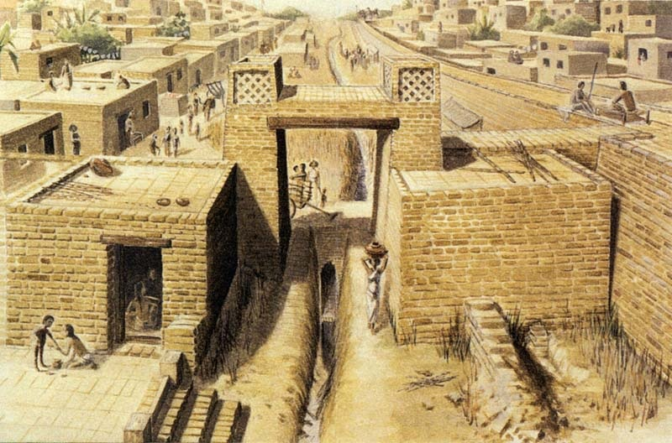
Life in the Valley
Religion
Government
Farming villages surrounded city walls
Copper, bronze, pottery
Traded with Mesopotamia

Slide 15
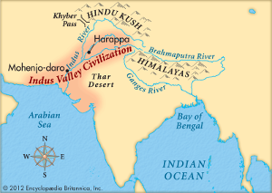
1900 B.C. – people began to abandon their cities
Drought
  Lasted 100’s of years
Earthquakes
Floods
  In some areas

Slide 16
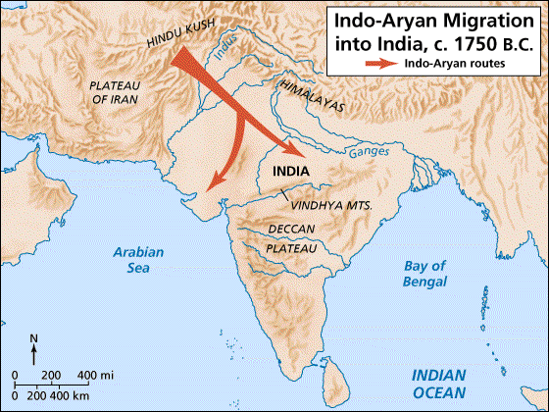
Aryan Migration
New group of people that moved into India

Slide 17
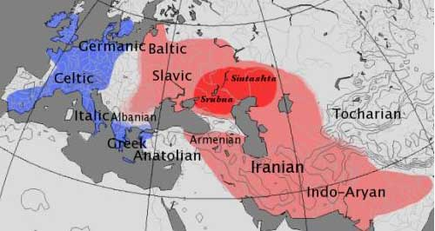
Indo-European
Aryans were not a race or ethnic group
Speakers of Indo-European languages
Language family – group of similar languages
From Central Asia

Slide 18
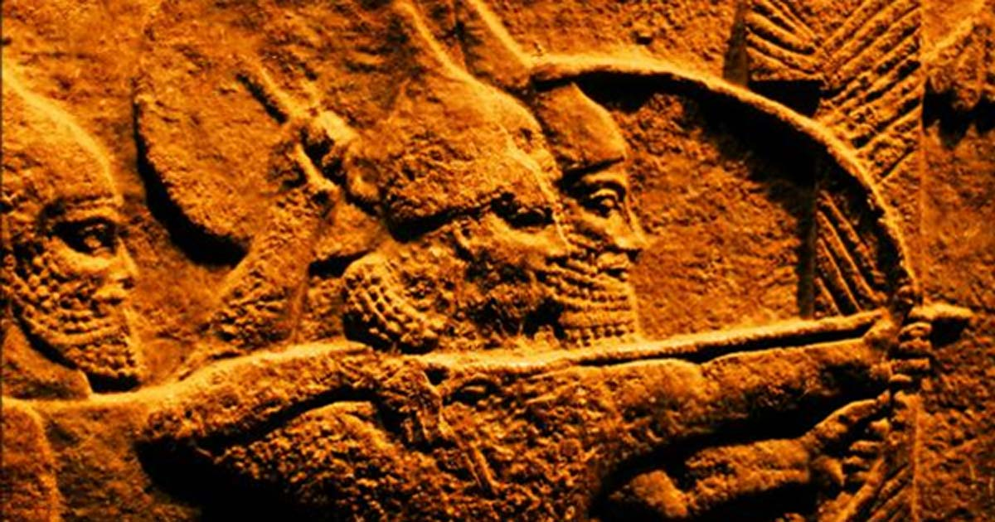
Moved from place to place to find pastures for cattle
Expert horse riders
Hunters
Warriors

Slide 19
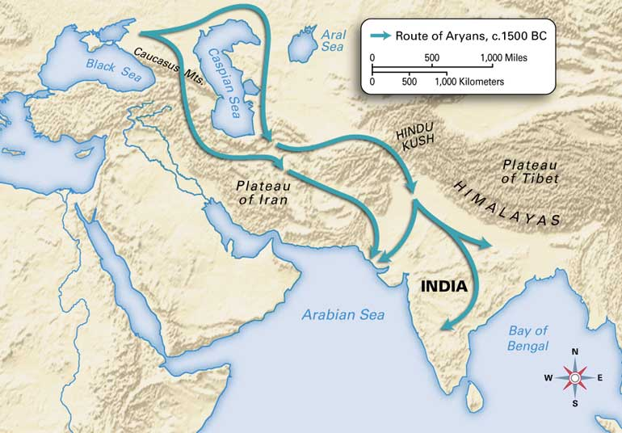
Aryans mixed with Indus River people
  New culture
Eventually saw their cattle as sacred and banned from eating them
Turned Ganges River valley into farm land

Slide 20
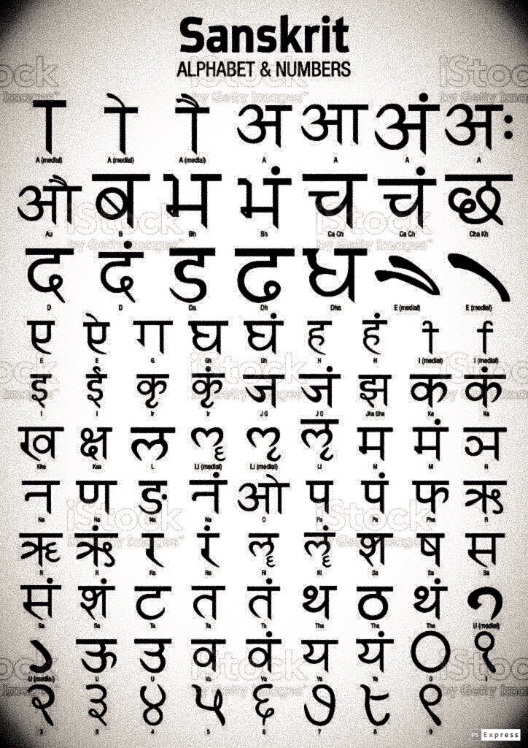
Aryan Tribes
Raja – prince
Sanskrit – written language
Vedas – sacred texts

Slide 21
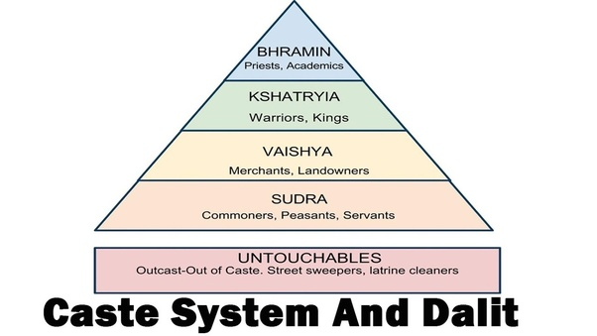
Varnas (Caste System)
4 social classes
  Born into
Brahmins – priests
Kshatriyas – warriors, rulers
Vaisyas – commoners
Sudras – unskilled, servants

Slide 22
Jati – smaller groups of varna
  1,ooo’s
  Rules for: diet, marriage, and social customs

Slide 23
Untouchables – lowest level
  Not part of varna system
Did work the varna Indians would not do
  Trash, skinning animal, carrying dead bodies

Slide 24
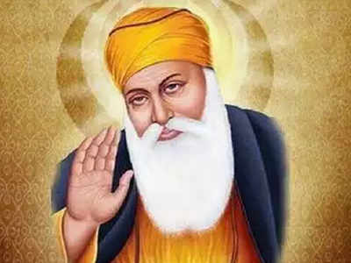
Family
Family was the center of life
Extended family lived together
  Guru – family teacher
  After school was attended in the city
  Could marry after 12 years of school
Arranged marriages

