Slide 1
Electrons and Energy Levels
8-1

Slide 2
Periods and Groups
Periods – rows
Groups – Columns
Similar chemical properties

Slide 3
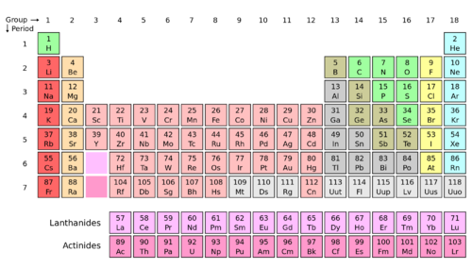

Slide 4
Three Regions of Elements
Metals – Shiny and conducts heat and electricity

Slide 5
Three Regions of Elements
Nonmetals – Don’t conduct heat or electricity

Slide 6
Three Regions of Elements
Semiconductors –conducts heat and electricity but not as well as a metal

Slide 7
Chemical Bond
Force that holds two or more atoms together
Compounds make up most of the matter around us

Slide 8
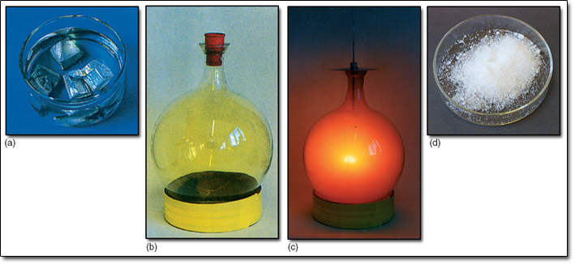
What is a Compound?
Compound – when 2 or more elements combine
New properties
NaCl (Table Salt)

Slide 9
Electrons and Energy
Energy levels – areas where electrons are found around the nucleus
Close to nucleus – least energy
Far from nucleus – most energy

Slide 10
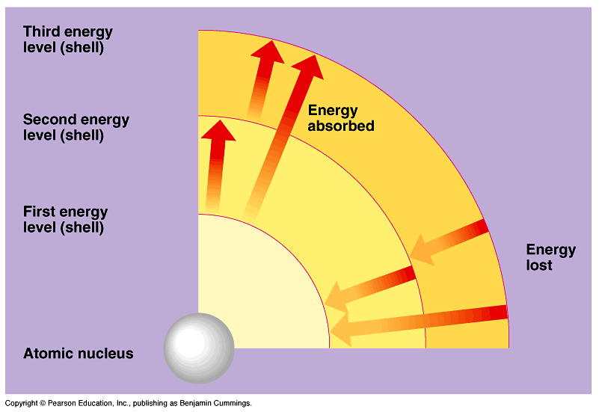

Slide 12
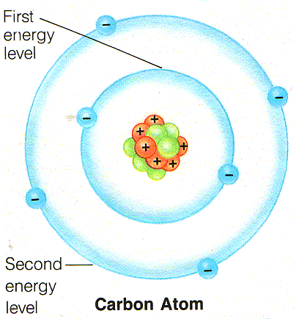
Electron Energy Level
1st level – 2 electrons
2nd level – 8 electrons
3rd level – 18 electrons
4th level – 32 electrons

Slide 13
Electrons and Bonding
Outer electrons can be easily attracted to the nucleus of other atoms.

Slide 15
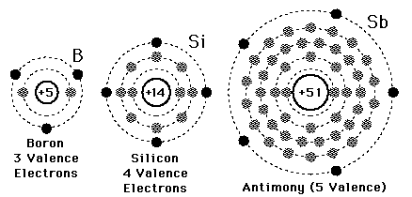
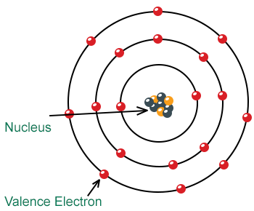
Valence Electrons
Valence Electrons – outermost electrons of an atom
Participates in bonding

Slide 16
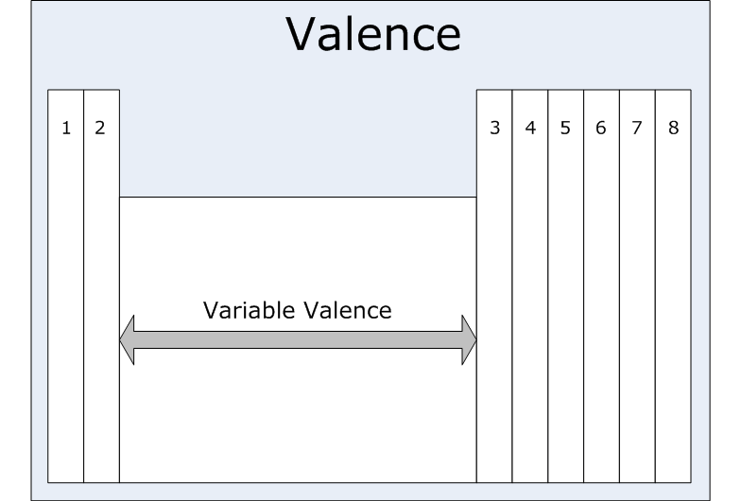

Slide 18
Electron Dot Diagram
Model that show valence electrons on an atoms

Slide 20
Noble Gases
Group 18
Chemically stable
Don’t react or form bonds
8 valence electrons

Slide 21
Stable vs Unstable
Unstable = unpaired electrons
Atoms become more stable after forming bonds
Atoms with less than 8 valence electrons will bond to become more stable

