Slide 1
Persia
7-3

Slide 2
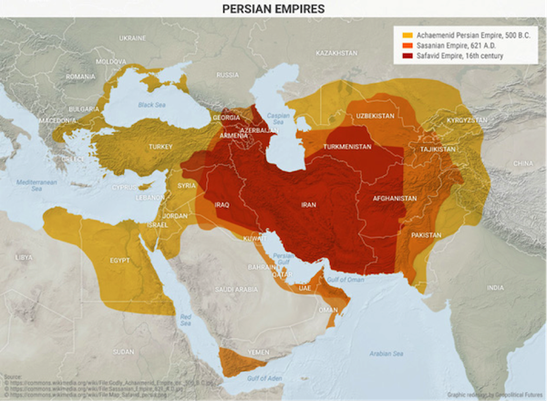
Empire
Present SW Iran
Cyrus the Great – king
Created an empire that was the largest in the ancient world

Slide 3
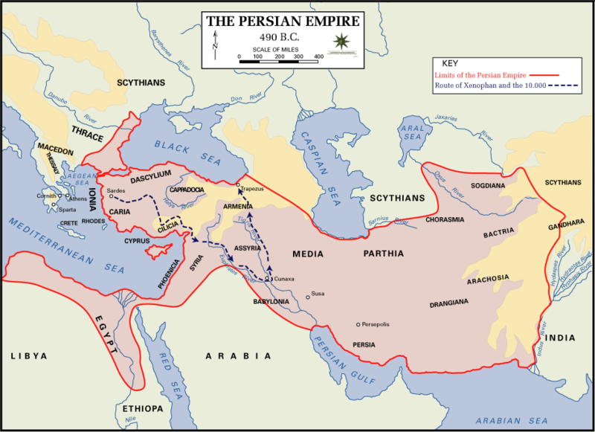
540s B.C. - Conquered a large area
Allowed conquered people to keep:
Languages
Religions
Laws

Slide 4
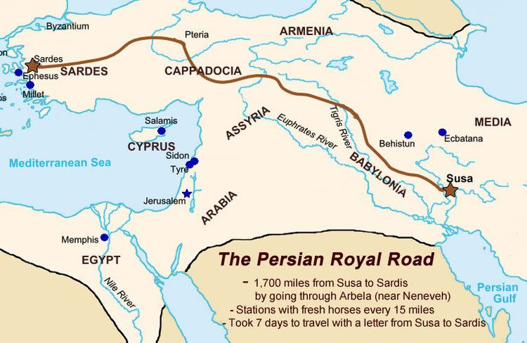
After King Cyrus Persia continued to grow
Improved a network of roads left by Assyrians
Royal Road – Persia to Anatolia
Shortened travel time from 3 months to 7 days

Slide 5
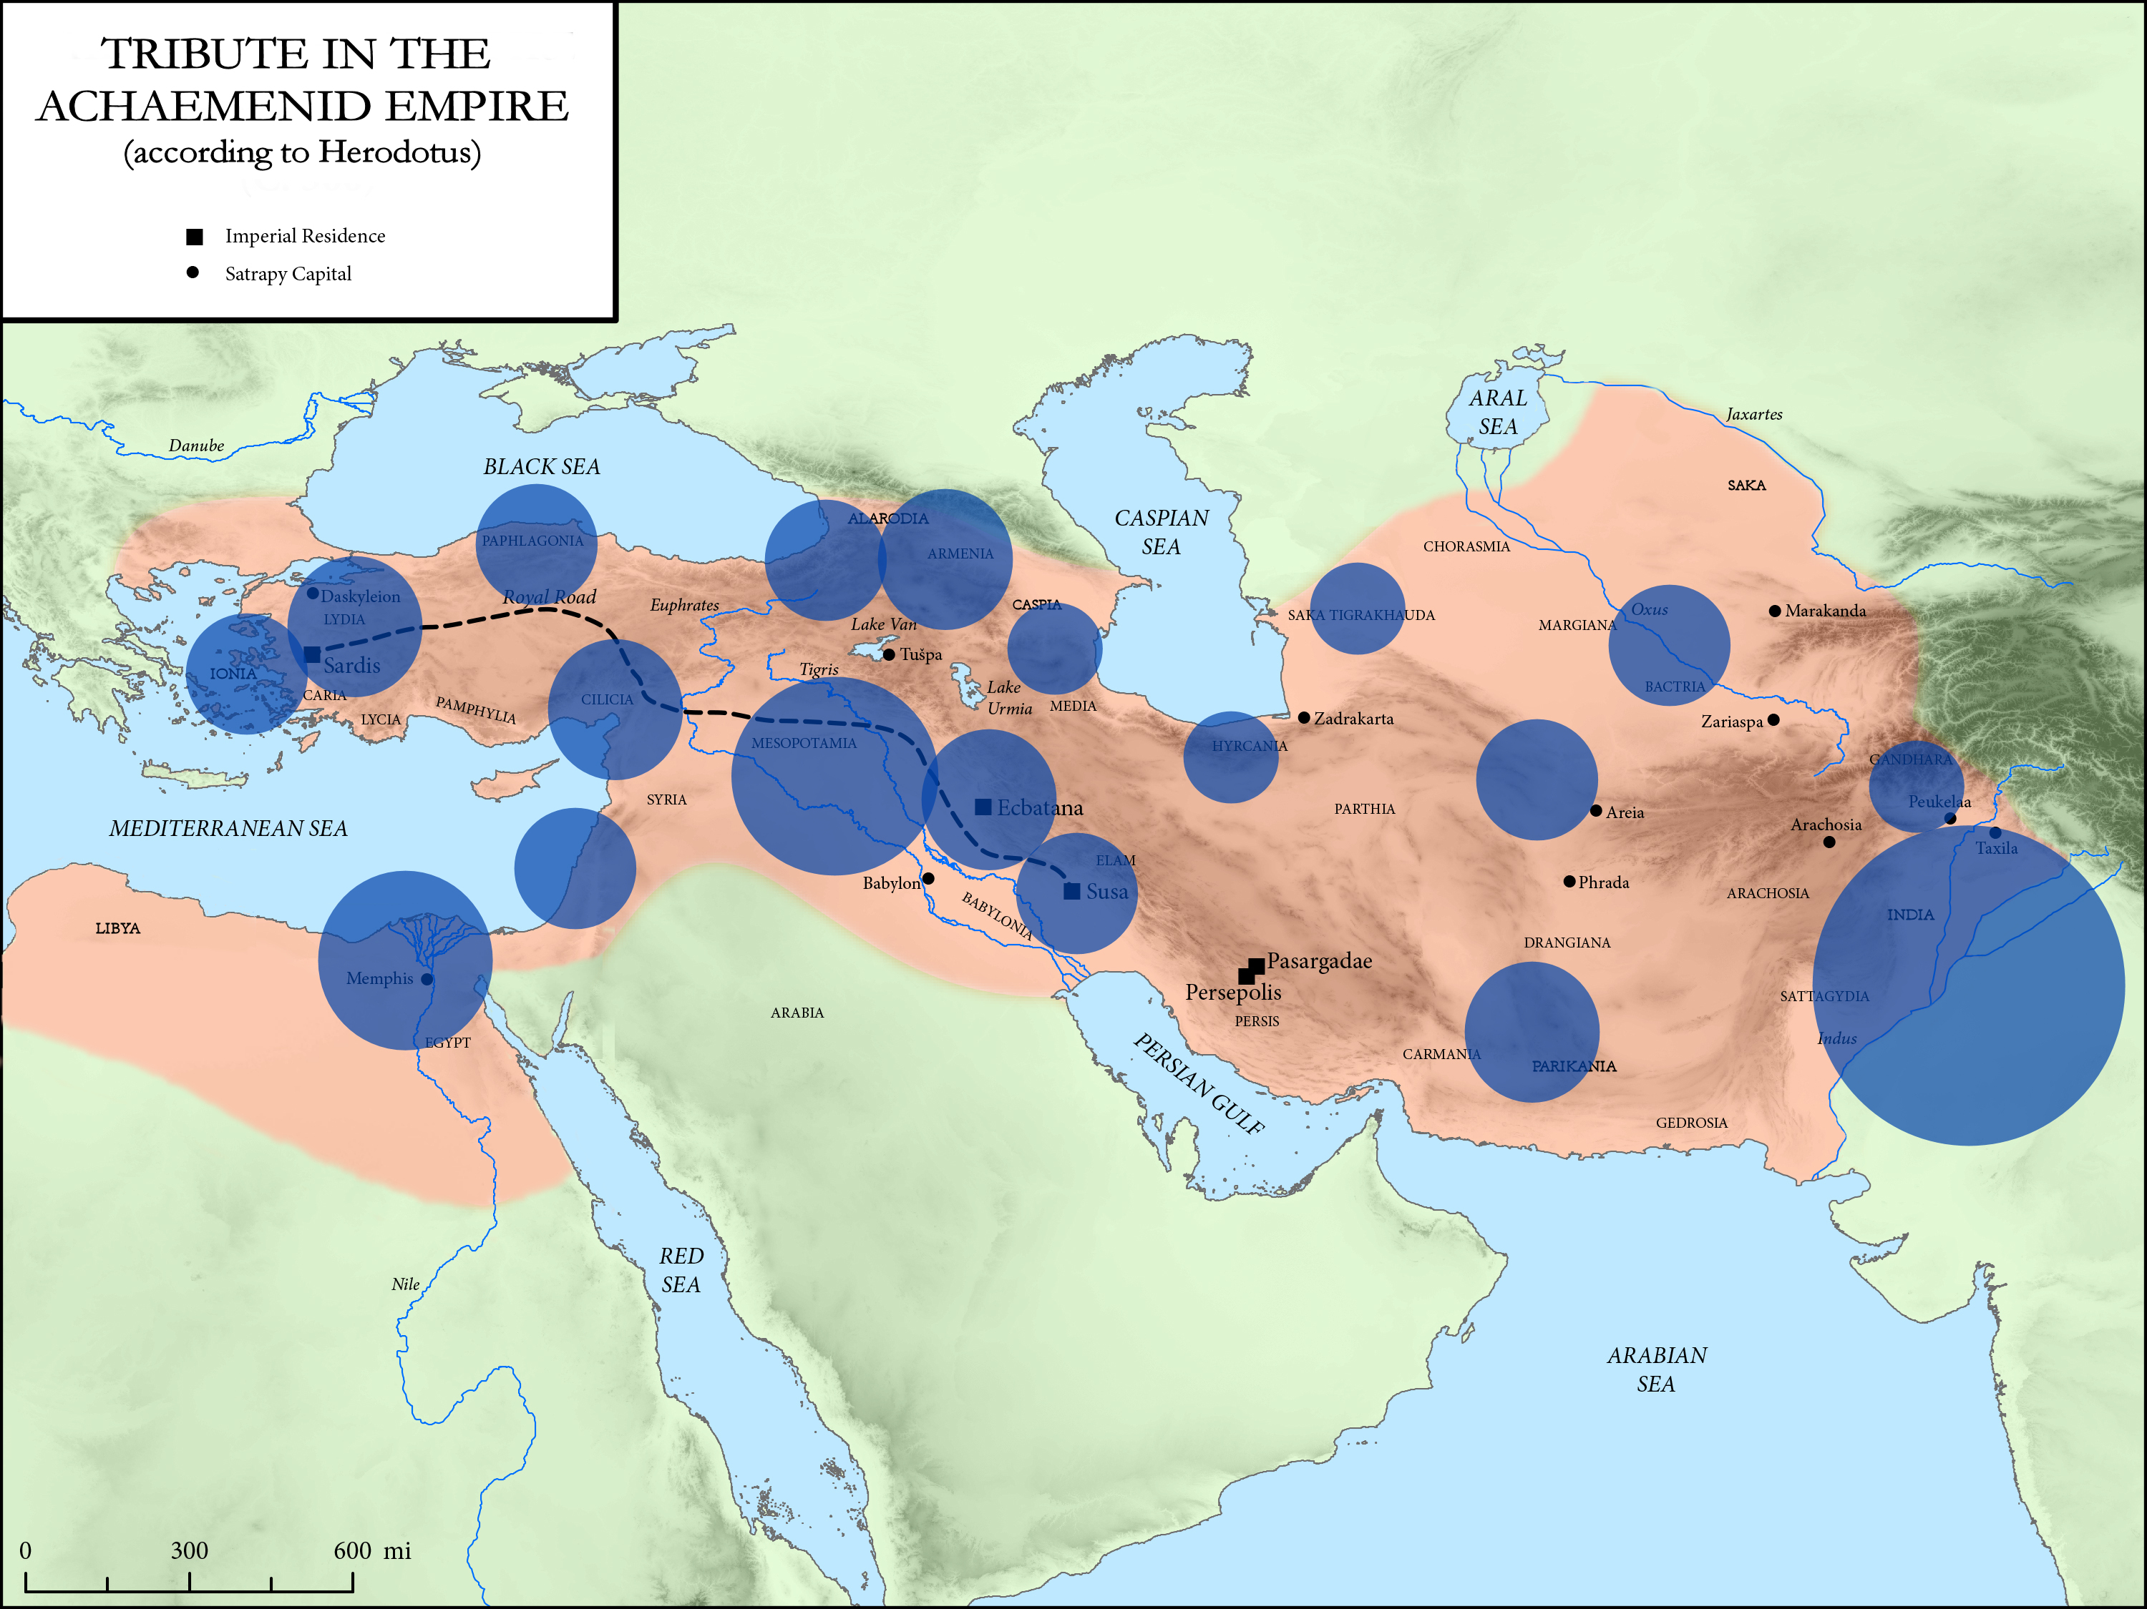
Government
Darius I – reorganized government to become more efficient
Satrapies – Providences
Satrap – Governor
  “Defender of the Kingdom”
  Taxes
  Judge
  Police
  Soldiers

Slide 6
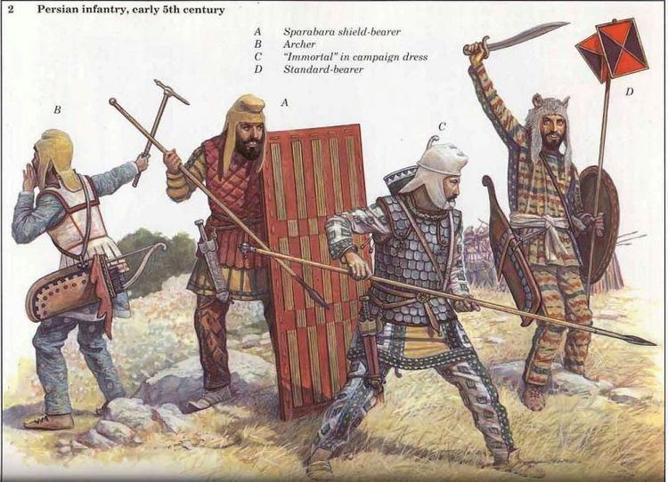
Immortals - Paid professional army
  10,000 soldiers
  Full time
  Protected the king
  If one died, another took their place

Slide 7
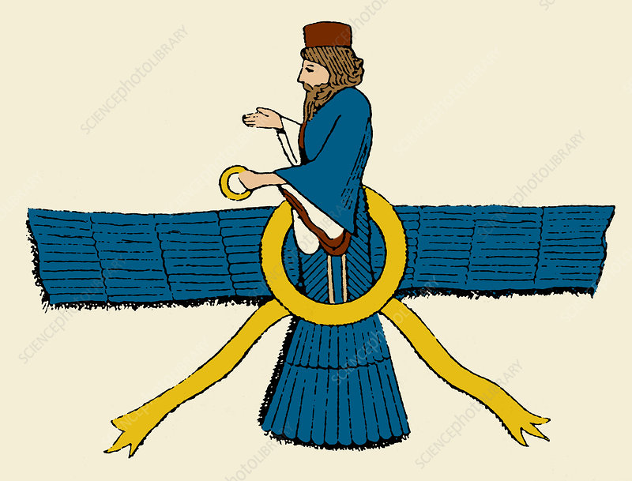
Religion
Persians worshiped many gods at first
Zoroastrianism – one supreme god
  Ahura Mazda – creator of things (wise lord)
  Good vs Evil
  Kings believed they rule by the power of him

Slide 8
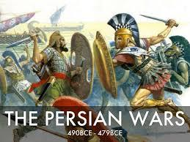
Persian Wars
400s B.C. – Persia was ready to expand into Europe
Clashed with the Greeks
Some Greeks already under their rule rebelled
Athenians sent warships to help rebels
Persian King Darius – wanted to punish Greeks for interfering

Slide 9
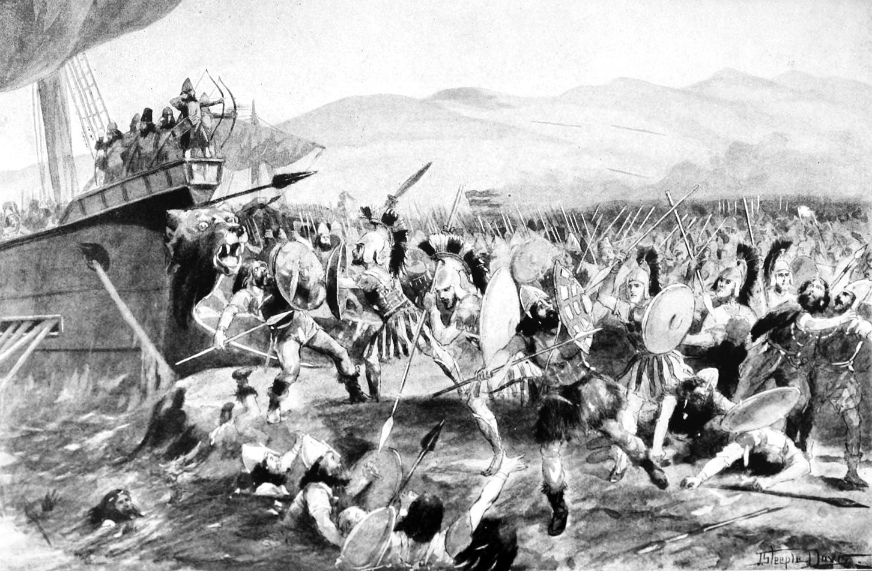
Marathon
Persians invaded Marathon
Persians waited for the Greeks to come and fight
  Never showed up
  10,000 vs 20,000
Persians began to load cavalry onto ships
  Athenians charged and won
26 mile run to Athens – Victory!

Slide 10
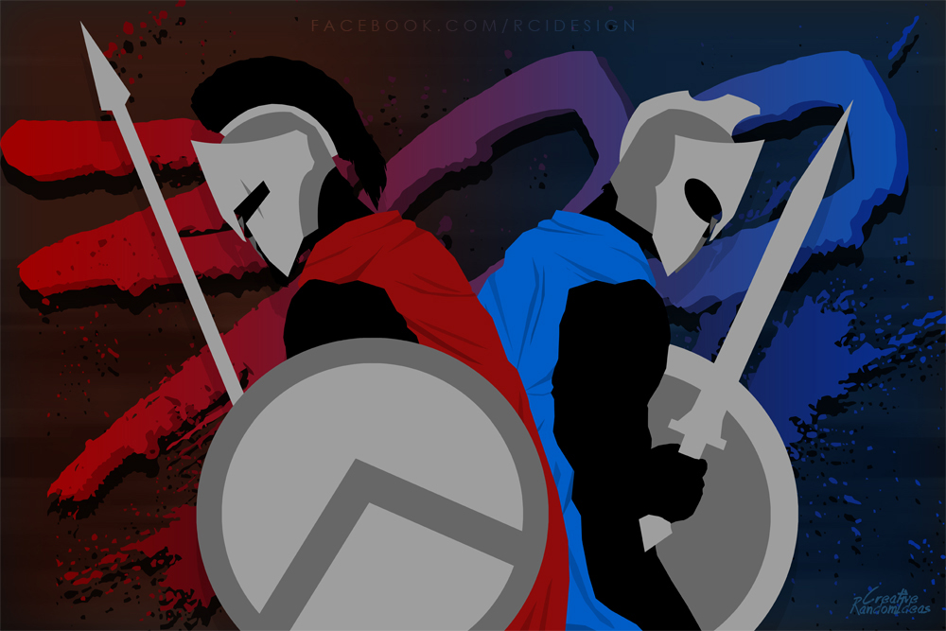
Land and Sea Battles
Xerxes – invaded Greece
  200,000 soldiers
  Thousands of ships
Greek city-states banded together
Sparta – King Leonidas
  Most of the soldiers
Athens – Themistocles
  Naval force

Slide 11
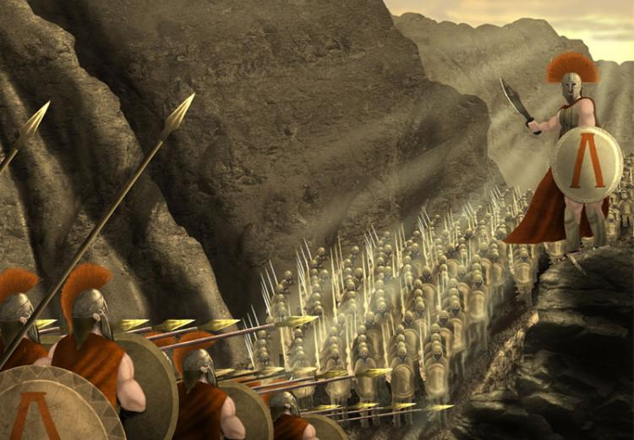
Persia ships were supplying food
  Athenians wanted to attack ships
Spartans had to protect Athens
  Spartans fought at 3 days at Thermopylae
Traitor showed Persian a trail to attack from behind

Slide 12
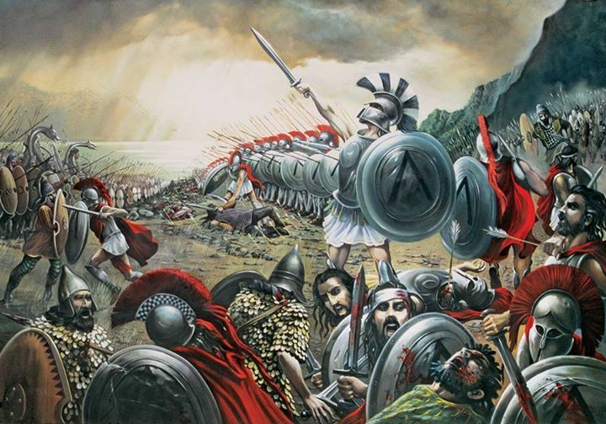
Leonidas dismissed most of his troops
300 stayed to fight

Slide 13
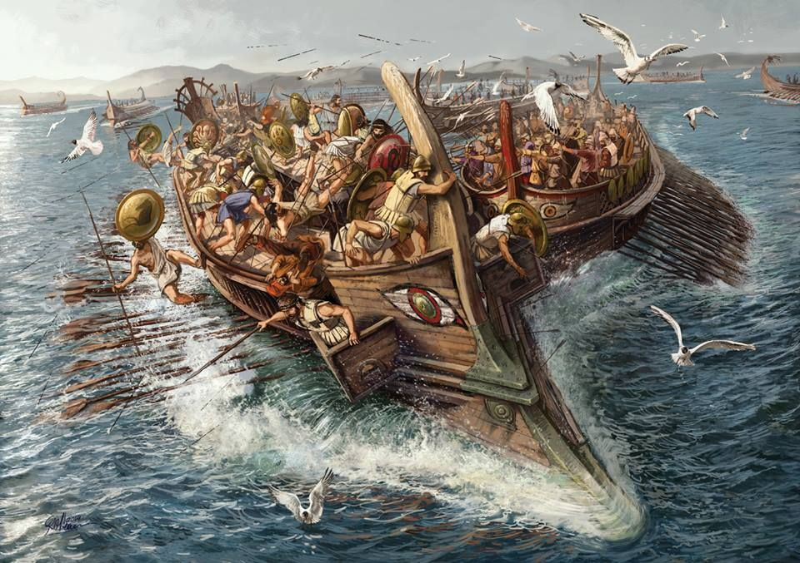
Athenians had enough time to attack Persia’s ships
Lured the ships into a narrow channel
Persian fleet was almost totally destroyed

Slide 14
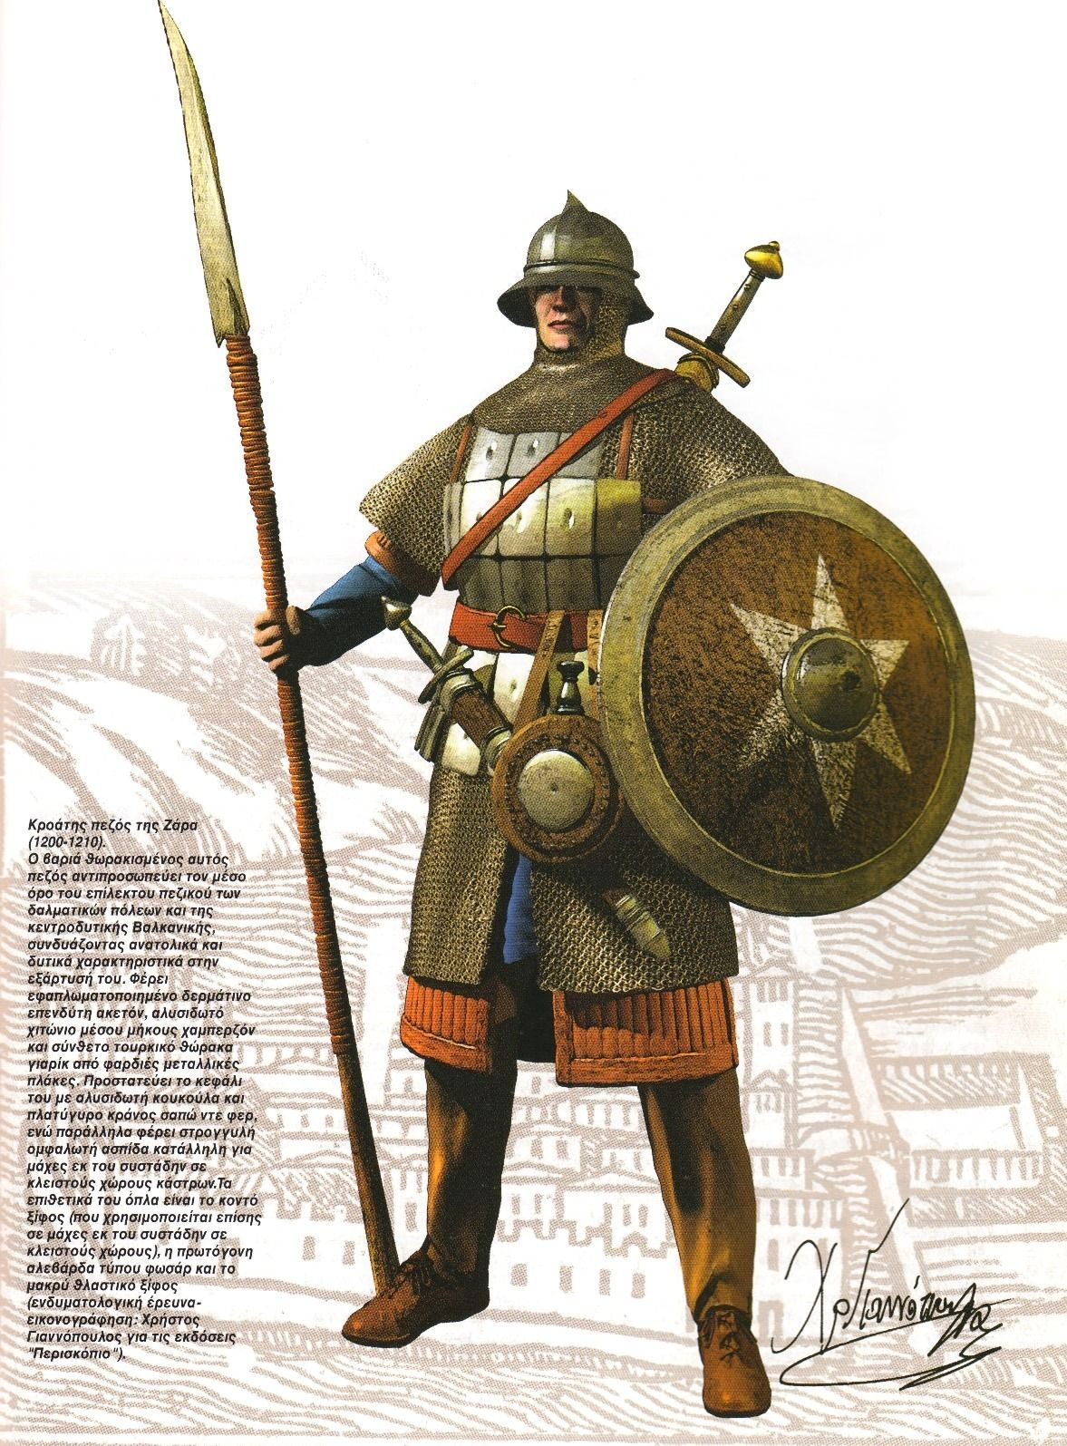
Persian foot soldiers marched to Athens and set it on fire
  Almost total deserted

Slide 15
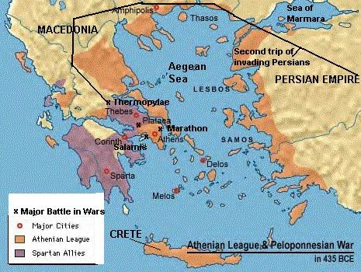
479 B.C. – Greeks and Persian fought at Plataea
  Greeks won
449 B.C. – Finally peace

Slide 16
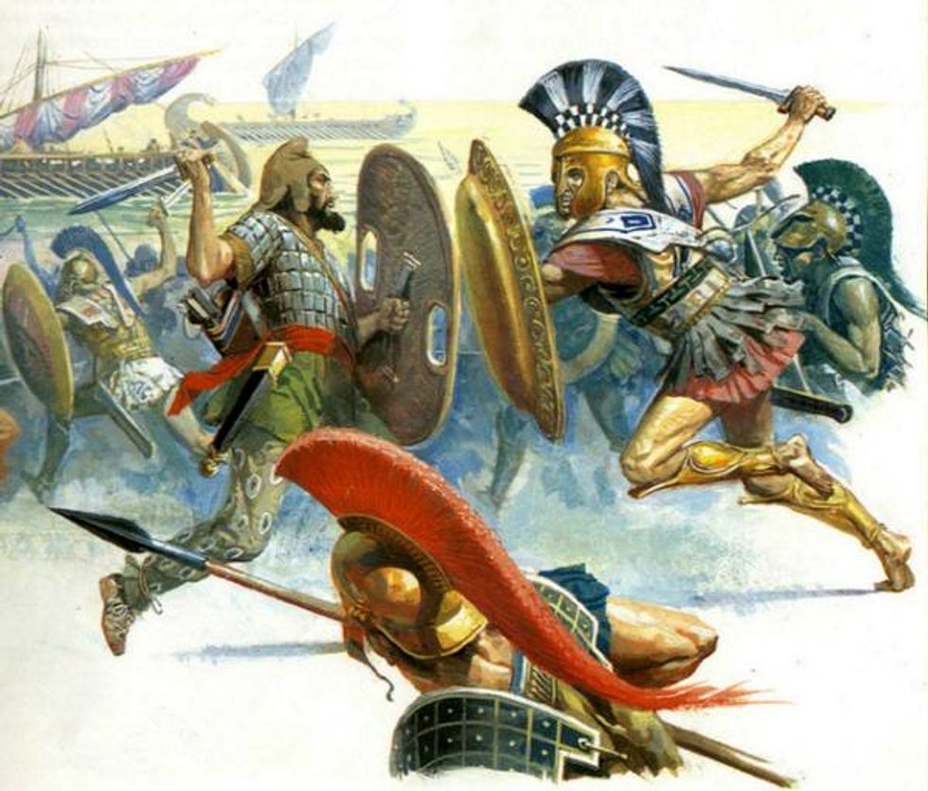
Decline of Persia
Army was no longer strong enough to defend the entire empire
  Too many taxes
  Disagreements on rulers
New Greek Empire rose
  Alexander the Great

