Slide 1
Sparta and Athens
7-2

Slide 2
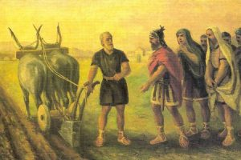
Political Changes
Farmers grew to resent nobles
Farmers borrowed money from nobles to buy land
If unable to pay loans – land was taken

Slide 3
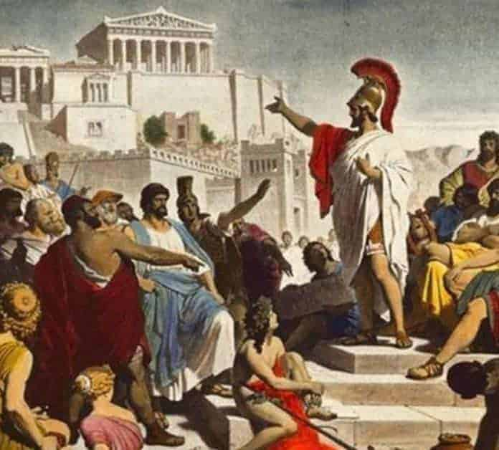
Merchants and artisans wanted reform
  They did not own land so no citizenship
Tyrant – someone who seizes power and rules with total authority
  Most ruled fairly
Tyranny – ruled by a cruel person
  Few

Slide 4
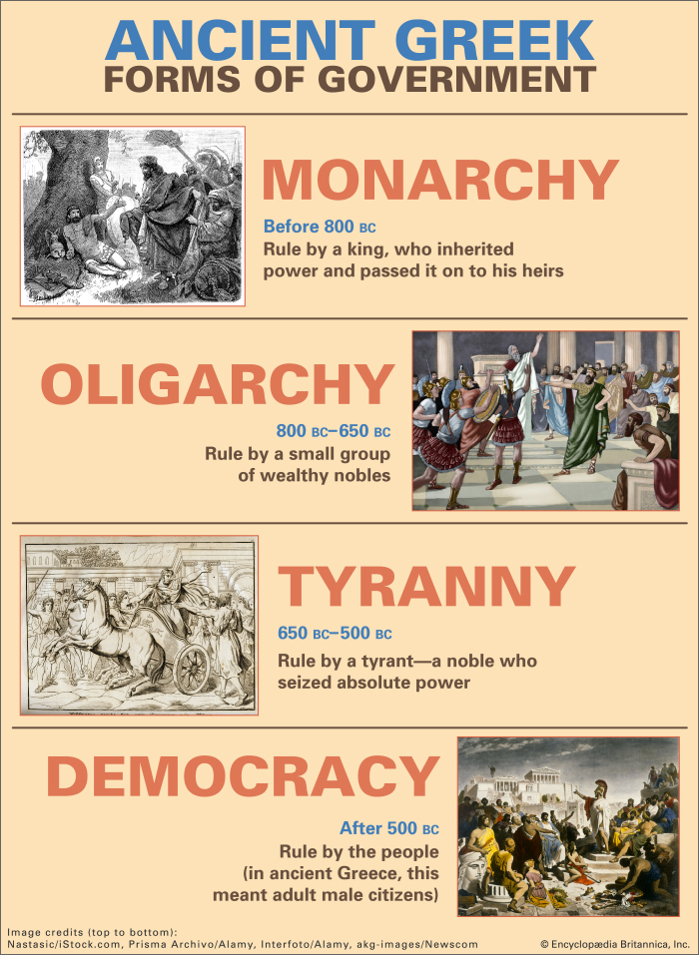
Common people as well as hoplites supported tyrants
Most wanted a government that was not ruled by one person but by the citizens
Oligarchy – a wealthy few held power over the citizens
Democracy – all citizens share in running the governments

Slide 5
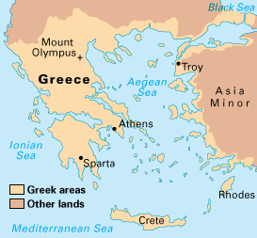
Sparta
Descendants of the Dorians
  Invaded Greece during Dark Ages
No oversea colonies
Enslaved neighboring city-states
Helots – enslaved laborers
  Agriculture
  “capture”

Slide 6
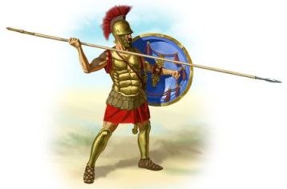
Sparta’s Military
Helot’s revolted but lost
Created a military society
  More obedient and loyal society
Boys left at 7 to train
  Read, write, weapon use
Treated harshly
  Help in battle

Slide 7
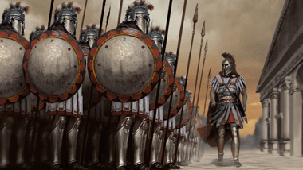
Men joined army at 20
Could marry but had to live in barracks
Could live at home after age 30
Retired at 60
Youtube – Spartans Hardcore Soldiers

Slide 8
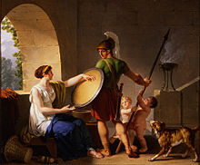
Spartan Women
More freedoms
  Own property
  Travel
  Trained in sports - wrestling and javelin
Main Goal: To raise warriors
  No surrender!
  “Come home carrying your shield or be carried on it”

Slide 9
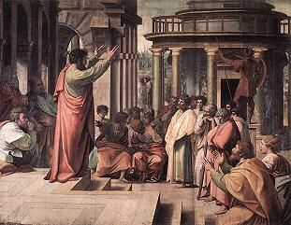
Sparta’s Government
Oligarchy
2 kings – lead army and carry out religious ceremonies
  Not much power

Slide 10
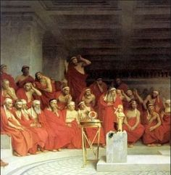
Assembly
  Decisions on war
  All male citizens over 30
Council of Elders
  More power
  Judges – executions and exile
  Elected 5 ephors – laws and taxes

Slide 11
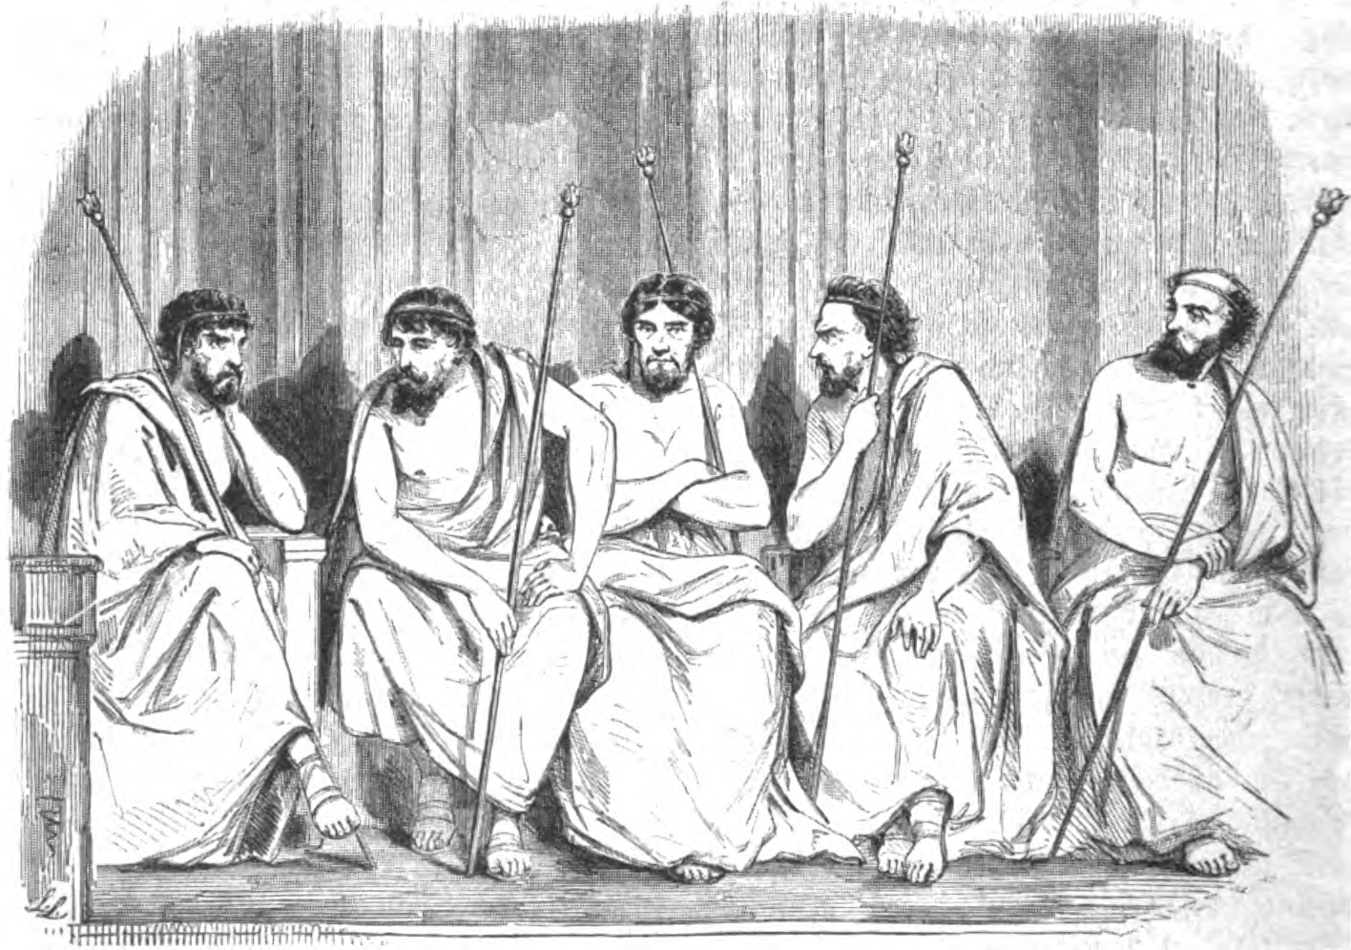
Strict government created stability
Discouraged free thinking and new ideas
Prevented travel except for military reasons
Discouraged literature and the arts

Slide 12
Athens
Descendants of Mycenaeans
More well-rounded education
School was done at 18
  Expected to take a role in public affairs
Girls we educated at home
  Household duties

Slide 13
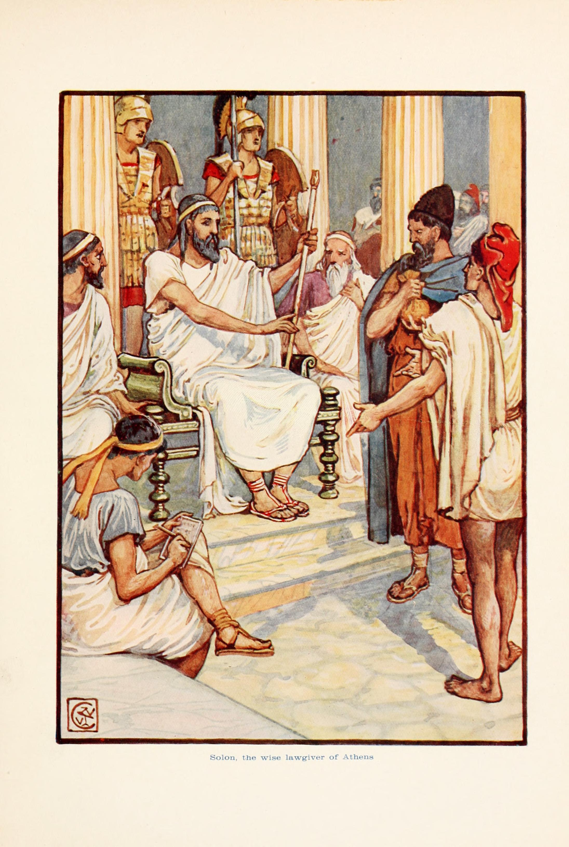
Early Reforms
Tensions between nobles and farmers
Solon – respected by nobles and commoners
  Helped to ease tensions
  Ended farmers’ debt
  Opened assembly to all male citizens
  Wealthy citizens didn’t care for him

Slide 14
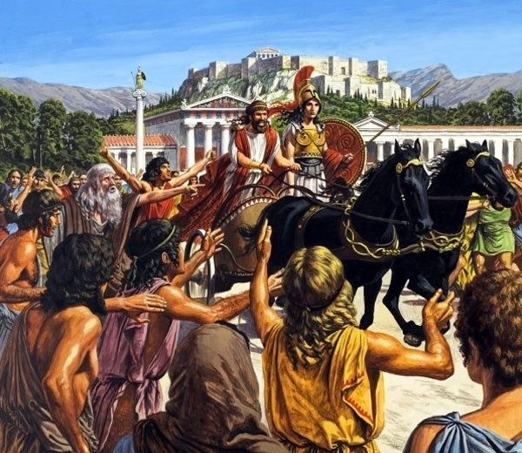
Peisistratus – tyrant with more reforms (changes)
Divided large estate among farmers with no land
Loans for farmers
Citizenship for those with no land
Hired poor to build temples

Slide 15
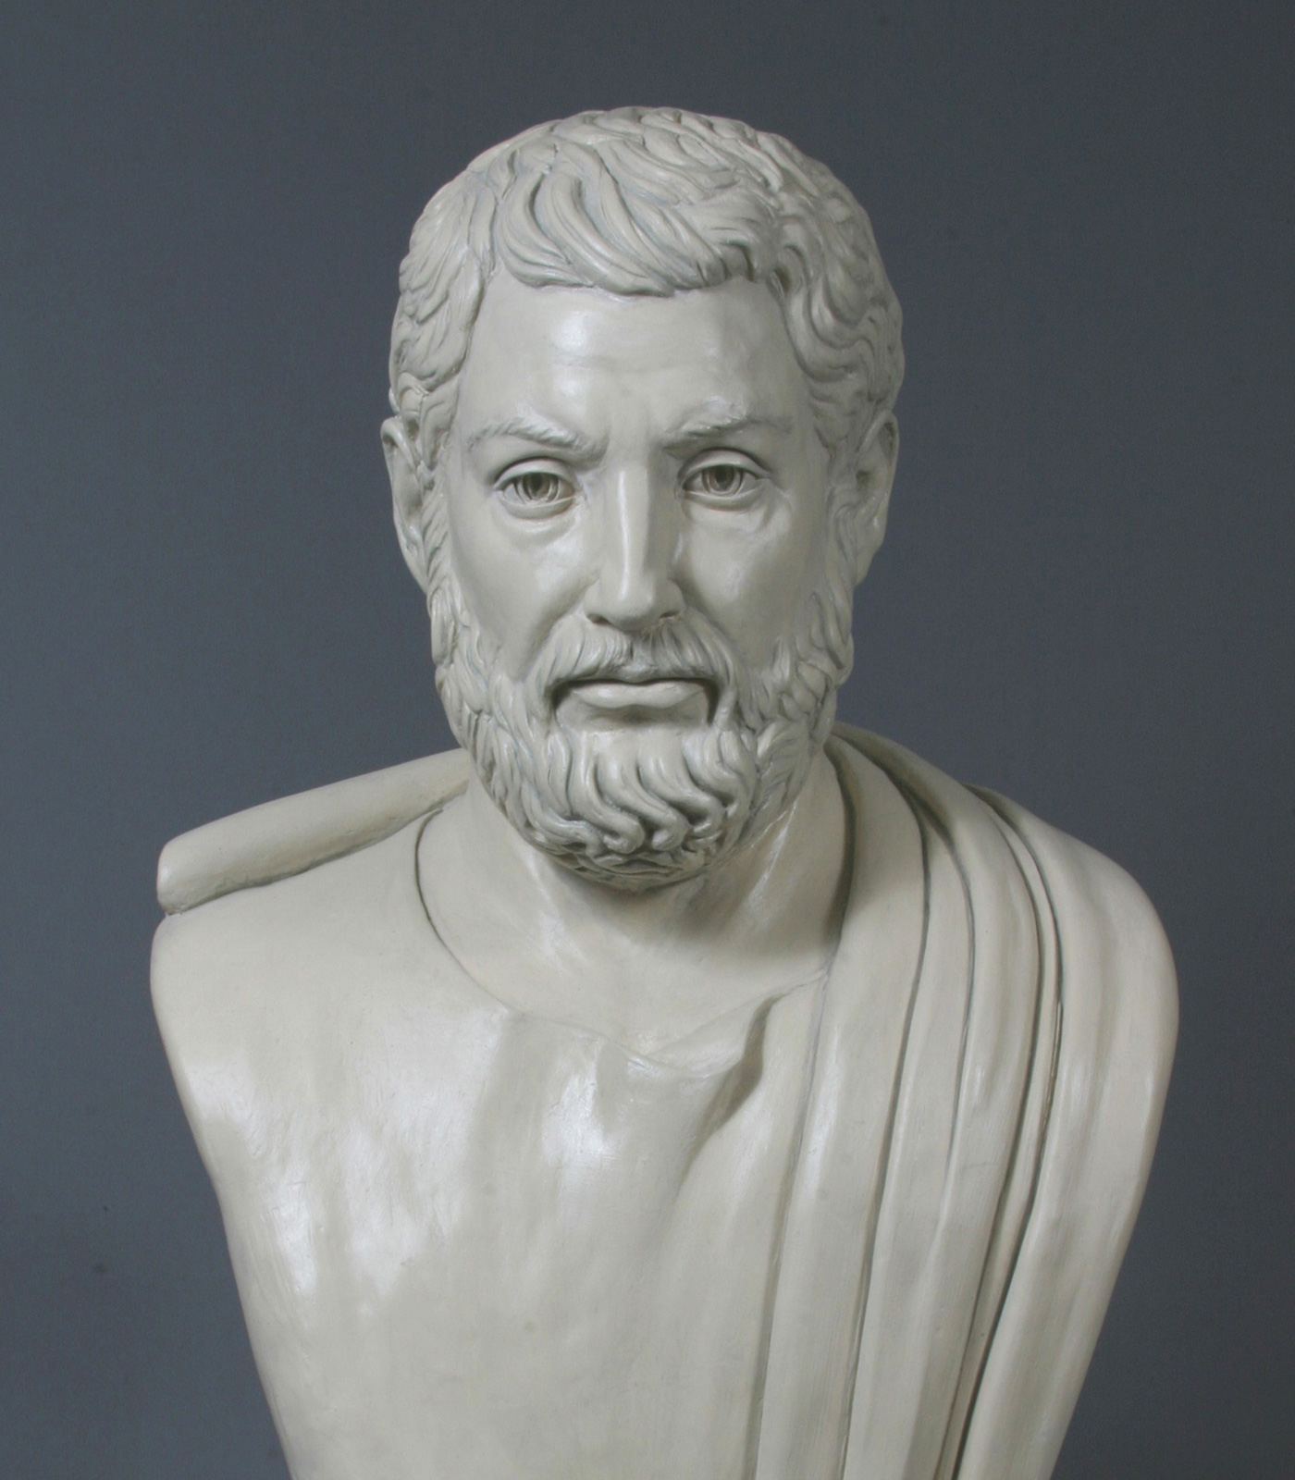
Democracy
Cleisthenes – made the assembly the main governing body
New council of 500 citizens
Lottery each year to pick citizens

