Slide 1
Rise of Greek Civilization
7-1

Slide 3
Mountains and Seas
1st civilization to develop in Europe
Other civilizations formed in river valleys
Balkan Peninsula
Anatolian Peninsula

Slide 4
Aegean Sea
Hundreds of islands
Mediterranean Sea
Mild Climate
Fishing / farming

Slide 5
Communities were separated from each other
Fiercely independent
Came to think of themselves as separate countries

Slide 6
Island Civilization
Minoans – 1st civilization in Aegean Sea
Crete – island
Knossos – kingdom
Minos - king

Slide 7
Sailed to Egypt and Syria for trade
1450 B.C. – Civilization collapsed
Underwater earthquakes?
Tidal waves?
Invasions from the mainland?

Slide 8
Mycenaean Kingdom
2000 B.C. - Moved from homeland of central Asia to Greece
King lived in a palace on a hill
Stone walls for protection
Nobles lived outside the walls
Estates

Slide 10
Traders and Warriors
Mycenaean adopted parts of the Minoan culture
Ships
Bronze
Stars for navigation
Earth Mother – chief god
Mycenaeans conquered Minoans
Controlled the Aegean Sea

Slide 11
Dark Age
Mycenaean civilization decline
Earthquakes
Fighting between kingdoms

Slide 12
Article Break

Slide 13
Dorians – took control of Greek mainland
Less food production
Slow trade
No record keeping
Iron was introduced

Slide 14
Hellenes (Greeks)
Descendants of people who ran away from Greek mainland
Grew food surpluses
Increased trade

Slide 15
Greek alphabet
24 letters
Record keeping
Bards – storytellers (written)

Slide 16
Colonies and Trade
Colonies – groups of people living in a new territory who have ties to their homeland
Needed for land for food production
Colonies traded goods between each other

Slide 17
Greek City-State (Polis)
Independent comminutes within Greece
Acropolis – hilltop with a fort
Honored local gods
Citizen could take refuge during battles
Agora – marketplace

Slide 18
Citizenship
Male citizens could:
Vote
Hold public office
Own property
Defend themselves in court
Required to fight for their polis as a citizen soldier

Slide 19
Citizens were:
Free
Land owners
Men
Born in polis
Women and children might qualify as citizens but none had the rights that went along with it.

Slide 20
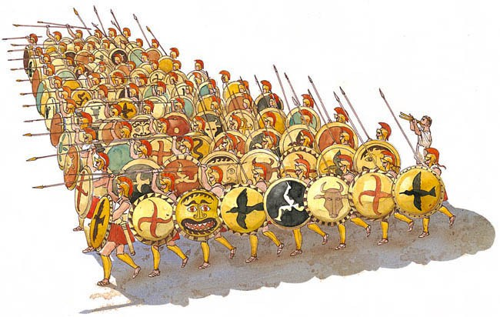
Citizen Soldiers
Wealthy nobles – horses and chariots
Hoplites – solders who fought on foot
Phalanx – unified formation

