Slide 1
The Kingdom of Kush
5-4

Slide 2
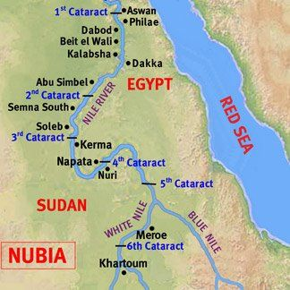
Nubians
Located in present day Sudan
Herded long-horned cattle
Savannas – grassy plains
Did not have to rely on the Nile for everything

Slide 3
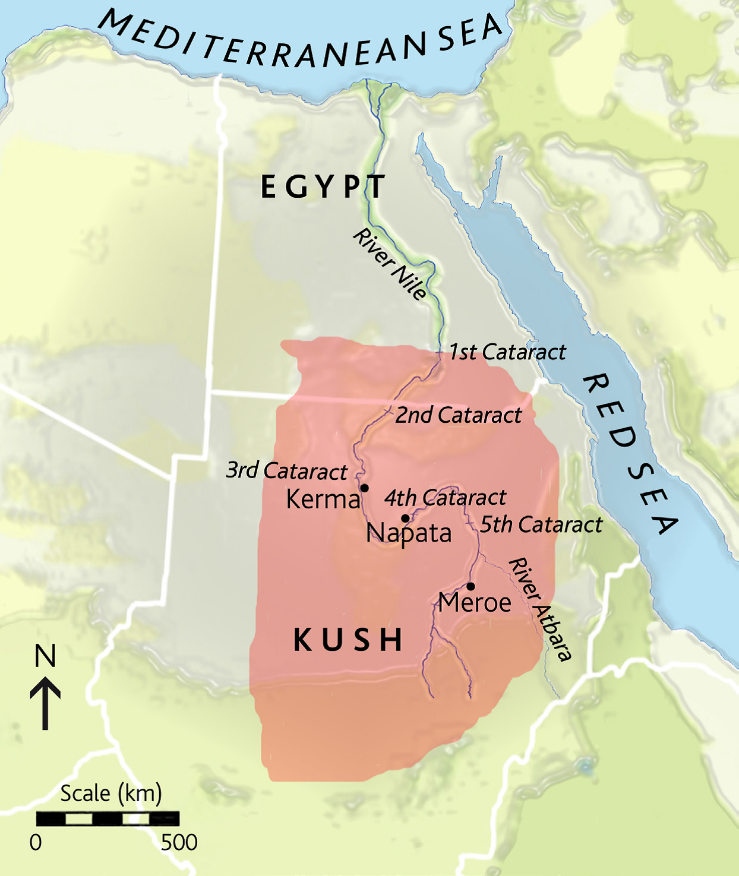
Kerma
Formed after stronger Nubian villages merged with weaker ones
Trade partner with Egypt
Hired to serve on Egyptian armies

Slide 4
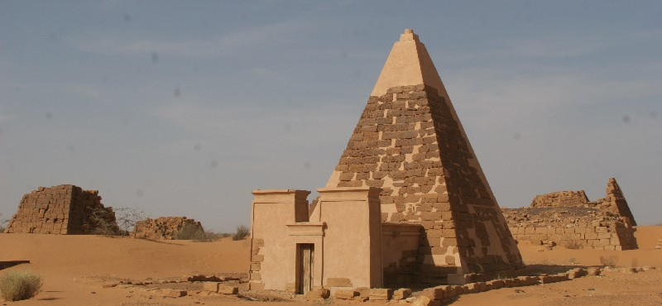
Built smaller scale tombs than Egyptians
Buried with riches

Slide 5
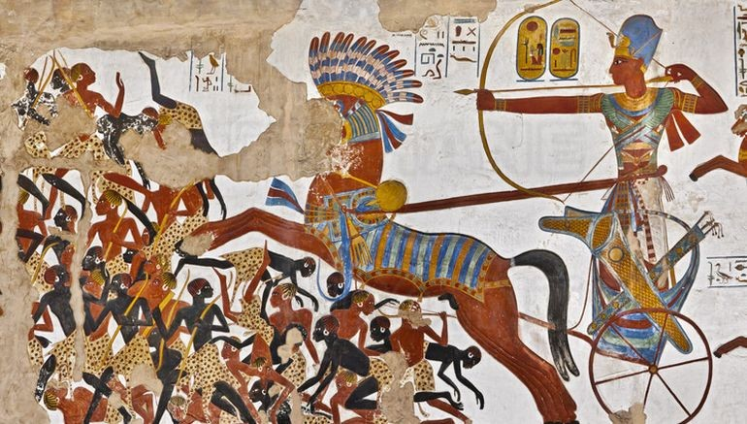
Egyptian Invasion
1400s B.C.
50 year long war
Conquered Kerma
  Ruled for 700 years
Adopted many of the Egyptian beliefs and customs

Slide 6
Kush
By the end of the Middle Kingdom Egypt had become weak
Nubians formed an independent kingdom – Kush
Napata - capital

Slide 7
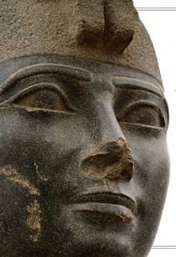
Kashta – Kushite king
Invaded Egypt
  Thebes
Piye – son of Kasta
Continued to invade the rest of Egypt

Slide 8
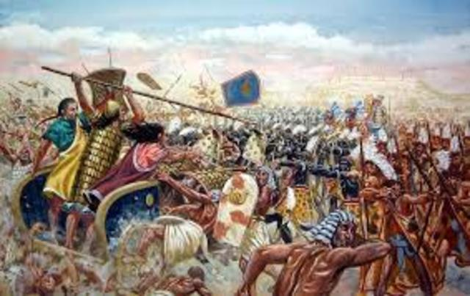
Iron
Kush ruled for about 60 years
671 B.C. – Assyrians invaded
  Better made weapons
Kushites fled south to homeland

Slide 9
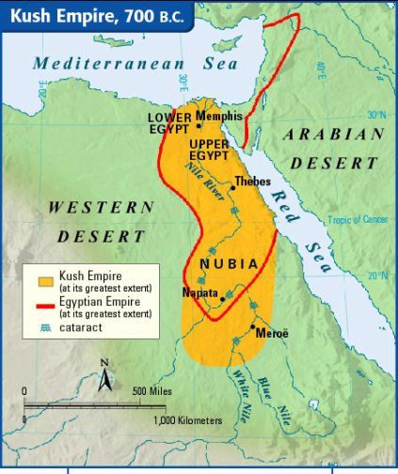
Meroe
Kush’s new capital
Located near a Nile cataracts
  Safer from invasions
Iron ore deposits
  Weapons and tools

Slide 10
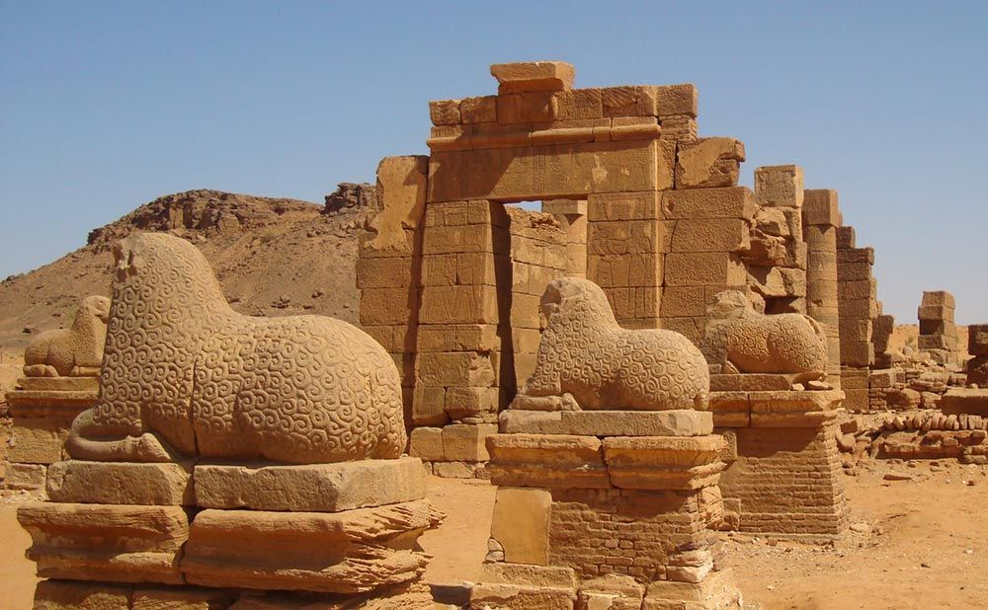
Trade center
Textiles – clothes
  Traded for iron
Axum eventually invaded Kush 600 years later

