Slide 1
Egypt’s Empire
5-3

Slide 2
A Golden Age – Middle Kingdom
2200 B.C. – Pharaohs in Memphis began to weaken
200 years of disorder and violence
A new dynasty of pharaohs came to power
Moved capital to Thebes
Period of peaceful / wealthy times

Slide 3
Conquests
Egyptian armies gained new territories
South - Nubia
North east – Syria (present day)
Built a canal between the Nile and Red Sea
More tributes, more trade, more WEALTH!

Slide 4
Art
Thrived during the Middle Kingdom
Painters decorated tombs and temples
Statues of pharaohs

Slide 5
Developed a new kind of architecture
They no longer build pyramids
Valley of the Kings – pharaoh’s tombs cut into limestone cliffs
West of the Nile

Slide 7
The Hyksos
1600s B.C.
Egyptian nobles challenged the power of the pharaohs
Civil War – weakened the Kingdom
Hyksos – invaded Egypt
Horse drawn chariots

Slide 8
1550 B.C.
Egyptian prince – Ahmose
Formed an army and drove the Hyksos out

Slide 9
Building an Empire – New Kingdom
Ahmose founded a new prosperous dynasty
Egypt reached the height of its power

Slide 10
A Woman Pharaoh
Hatshepsut
Governed with husband
After his death – she made herself pharaoh and ruled on behalf of her young nephew

Slide 11
Had to prove she was a good leader
Dressed in clothes of male pharaoh
Wore false beard – as kings did
Built temples and restored old monuments

Slide 12
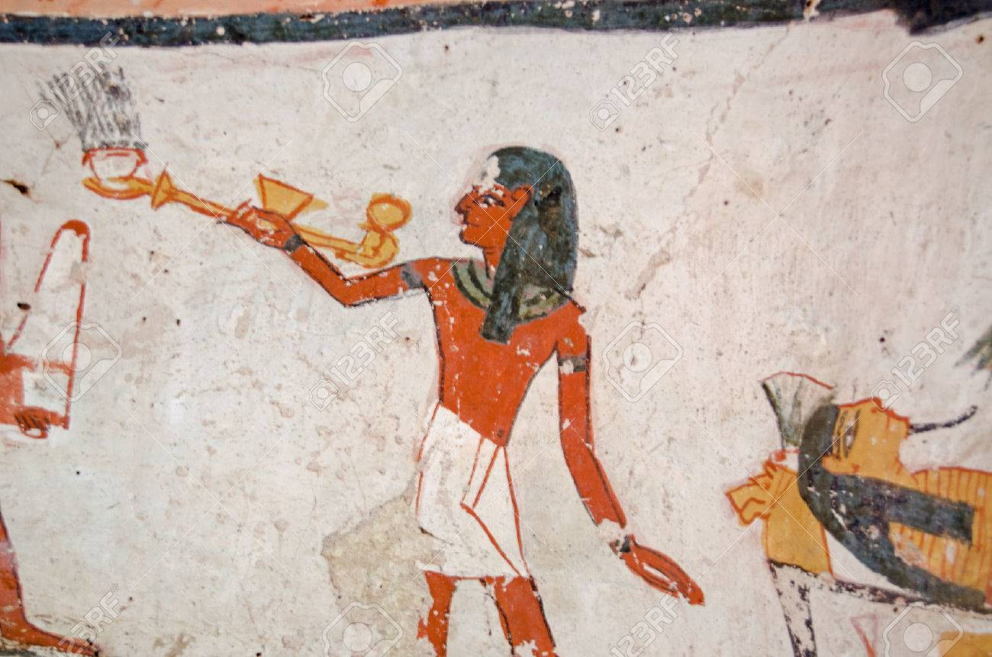
Trade Growth
Queen promoted trade
Sailed to ports in Arabia and East Africa
Incense – smelled nice when burnt
Traded with Phoenicians for wood products
Modern day Lebanon

Slide 13
Trade and Politics
Pharaohs and other rulers exchanged envoys
Envoy - A government representative for another country

Slide 14
Expanding Empire
After Hatshepsut’s death
Thutmose III – New pharaoh
Nephew
Expanded rule
Captured over 350 cities
Captured for riches and also more slaves

Slide 15
Amenhotep
Felt priest had grown too powerful
Started a new religion
Aton – sun god (Only god)
Changed name to Akhenaton
“Spirit of Aton”
Moved capital
Weakened Egypt

Slide 16
King Tutankhamen
Tutankhamen
Akhenaten's son in law
Restored the worship of many deities
Only ruled for 9 years until early death
Ruler of Egypt at age 10
Power with people who surround him
Famous for tomb - treasures

Slide 18
Died at 19
Murdered for power?
Infection from broken leg?

Slide 19
Ramses II
Conquered many regions
Built lots of temples
Signed peace treaty with Hittites

Slide 20
Age of Temples
Built many temples during Ramses 66 year reign
Karnak at Thebes
Served many purposes:
Granaries
Banks
Workshops

Slide 21
Decline of Egypt
Death of Ramses II
670 B.C. - Egypt was taken over by the Assyrians from Mesopotamia

