Slide 1
Life in Ancient Egypt
5-2

Slide 2
Early Rulers
2600 B.C. – 2200 B.C. – Old Kingdom
Built cities
Increased trade
Prized unity – principals and beliefs
Theocracy – government in which the political and religious leader is the same

Slide 3
Political Leader
Pharaoh – king or ruler
Originally meant “Great House”
Strong rulers would unify the kingdom
Bureaucrats – government officials
Carried out Pharaoh's orders
Oversaw granaries

Slide 4
Pharaoh owed all the lands
Taxed people in the form of grain
Distributed land to officials, priests, and the wealthy

Slide 5
Religious Leader
Pharaohs were thought to be the son of Ra (Sun God)
A god on earth
Participated in religious ceremonies
Rode a bull around Memphis
Cut the first ripened grain

Slide 6
Religion
Worshiped many gods and goddesses
Most crucial:
Ra – Sun
Happi – river
World of the Dead:
Osiris – laws and farming
Isis – wife and mother
Toth - learning

Slide 7
Amon
Amon was one of the most powerful gods in ancient Egypt.
He was the god of the city-state of Thebes.
When combined with Ra, he was then called Amon-Ra.

Slide 8
Anubis
God of embalming and the dead
Since jackals were often seen in cemeteries, the ancient Egyptians believed that Anubis watched over the dead.
Anubis was the god who watched over the process of mummifying people when they died.

Slide 9
Ra
Ra was the sun god.
He was the most important god of the ancient Egyptians.
The ancient Egyptians believed that Ra was swallowed every night by the sky goddess Nut, and was reborn every morning.

Slide 10
Sobek
Sobek was a Nile god.
Sobek was connected with the Nile, and protected the king.
Live crocodiles were kept in pools at temples built to honor Sobek.

Slide 11
Afterlife
Believed it would be better that life
The Book of the Dead – studied it’s prayers and magic to prepare for death
Tells what to expect when dead

Slide 12
Early On…
Only Pharaoh’s had an afterlife
They protected the people
If the body decayed – no place to live and won’t survive the afterlife
Later…
All people had hope for eternal life
Simply History – How to Make A Mummy

Slide 13
Embalming – process of treating a body to keep it from decaying
Organs put in special jars
Salt (natron) spread on body
Shrunken, dried body filled with spices
Wrapped in linen
Mummy put in a coffin and put in a tomb

Slide 15
Rich – buried in tombs
Poor – sand or caves
Animals were not just pets but sacred creatures
Mummies of cats and birds

Slide 16
Medical Skills
Wrote the first medical books
Embalming helped them learn about the body

Slide 17
Pyramids
Pyramids – stone tomb built for Pharaohs
Protection from robbers, floods, and animals
Clothing, weapons, furniture, and jewelry buried with them

Slide 18
Thousand of works
Years
Farmers built in summer months
Nile flooded and couldn’t farm

Slide 19
Copper tools used to cut stone blocks
Floated down the river on barges
Large logs helped to roll blocks up ramps

Slide 21
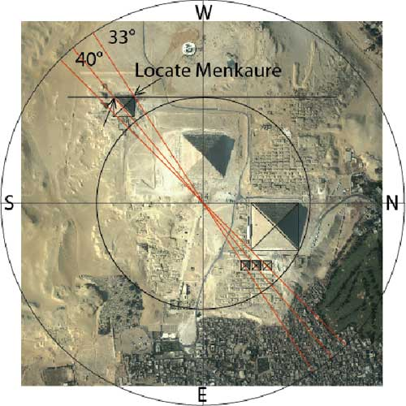
Square foundation faced North
Astronomy
Help to invent modern calendar
Amount of bricks
Math
System of number based of 10
Fractions

Slide 26
The Great Pyramid
King Khufu
Giza’s west bank
48 stories tall
9 football fields
2 million blocks (2.5 tons/brick)
20 years
Was the tallest structure for over 4,000 years

Slide 27
Social Groups

Slide 28
Life
Upper class –
Homes of wood and brick
Garden and ponds
White linen
Have Servants
Middle class –
Business and skilled jobs
Lived simpler

Slide 29
Lower Class -
Largest group – farmers, unskilled workers, enslaved people
Manual laborers
Fishermen
Mud brick homes

Slide 30
Families
Important part of life
Women had many rights
Children learned from their parents

