Slide 1
The Nile River
5-1

Slide 2
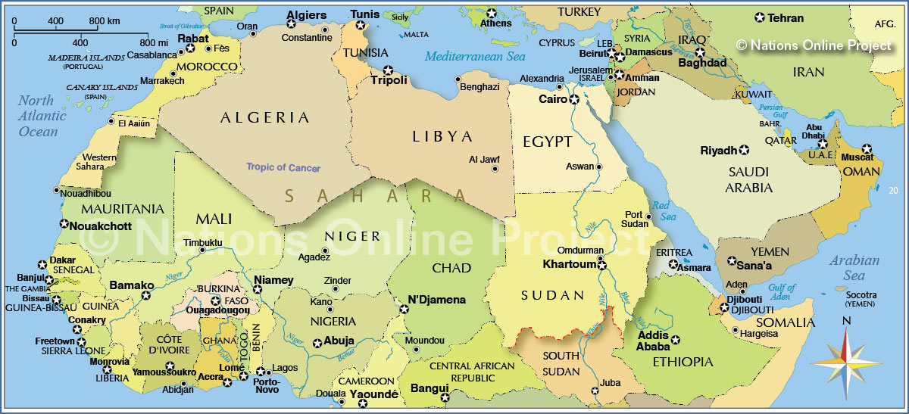

Slide 3
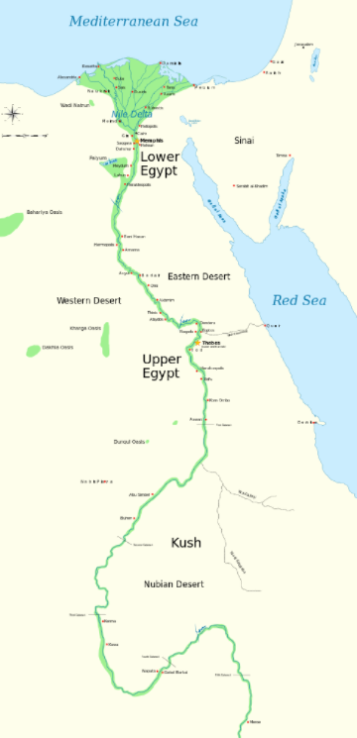
Nile River Valley Civilizations
Egypt – North
  Kemet – “black land”, fertile soils
Kush - South

Slide 4
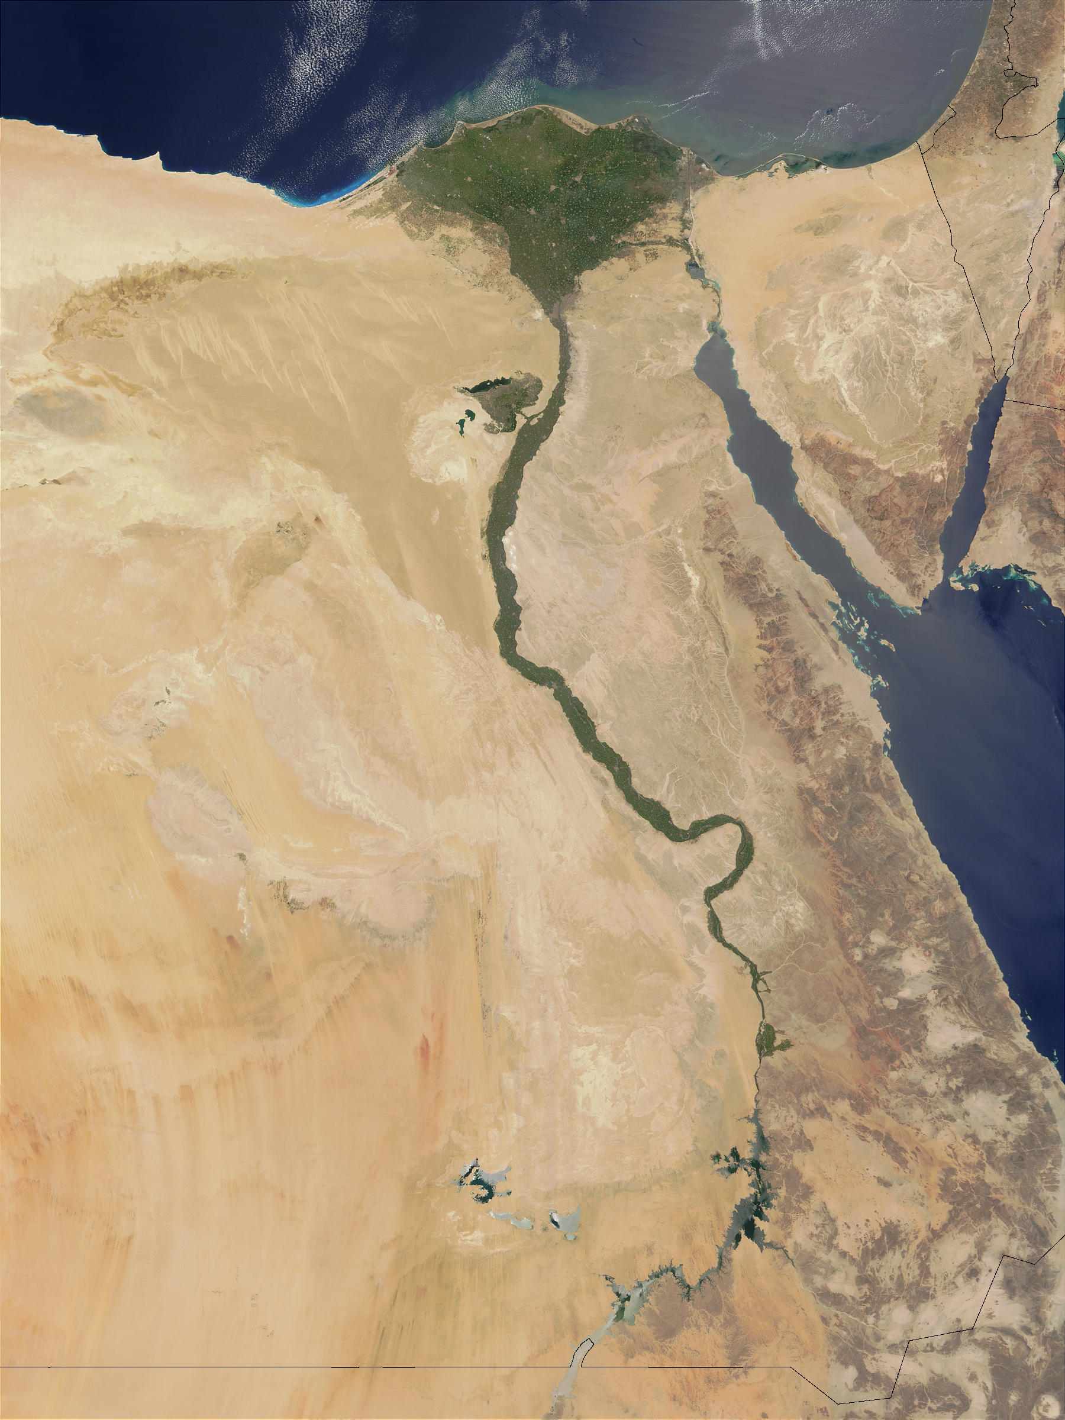

Slide 5
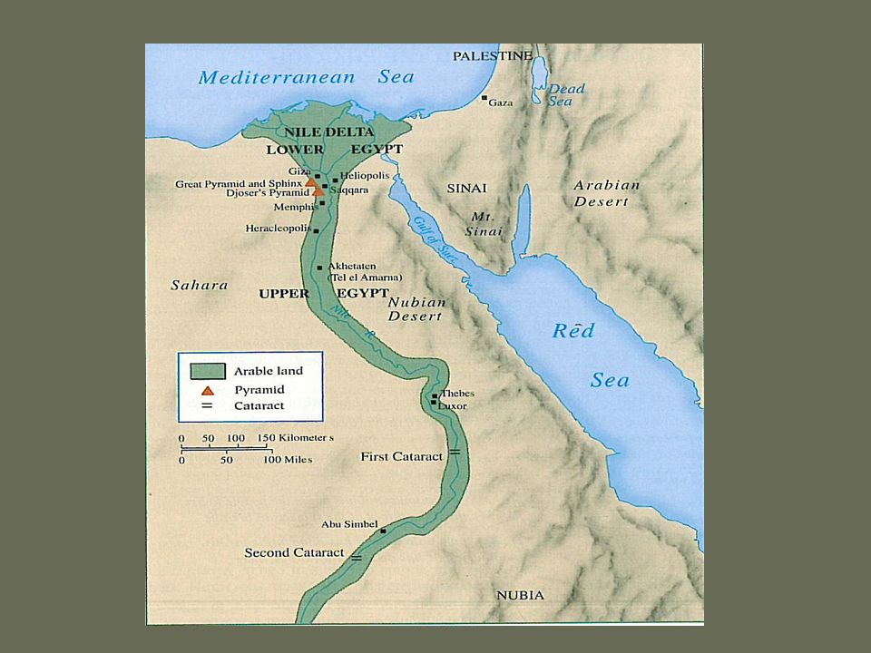

Slide 6
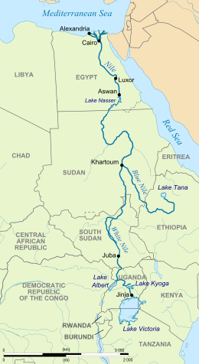
The River
Dry climate – allowed for many structures to survive
Nile – drinking, bathing, crops
“Creator of all good”

Slide 7
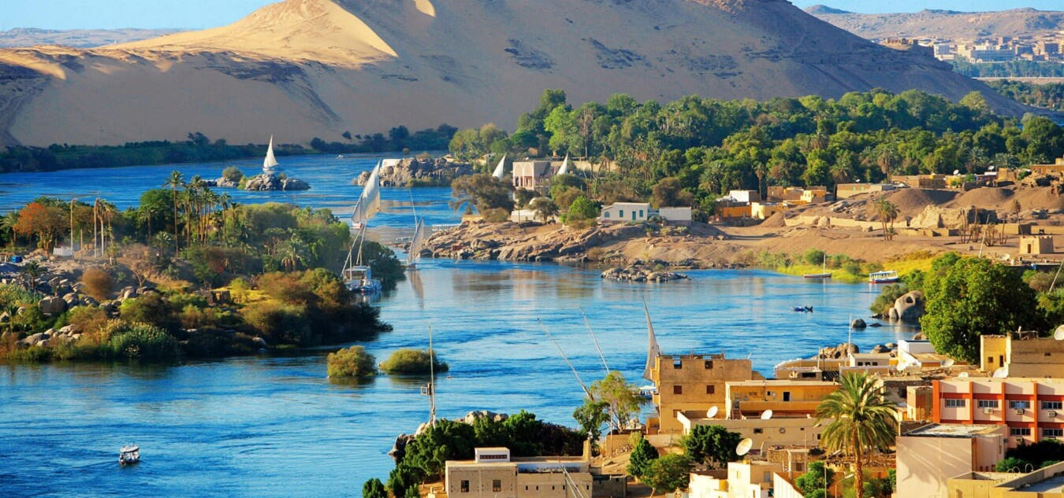
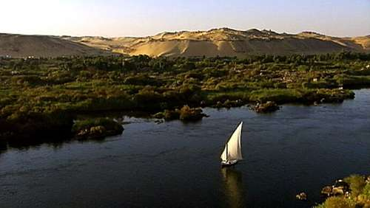

Slide 8
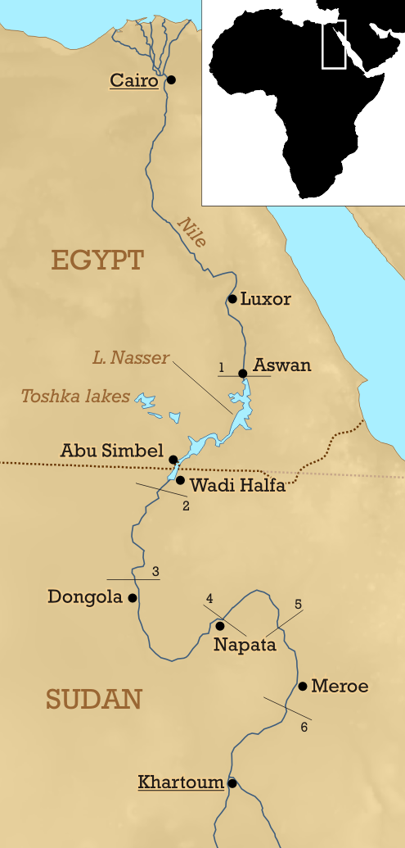
World longest river
  4,000 miles
Blue Nile and White Nile feed into it
Cataracts – waterfall or rapids in river
  Difficult for travel

Slide 9
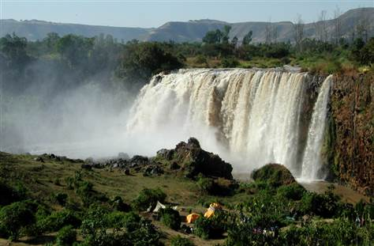
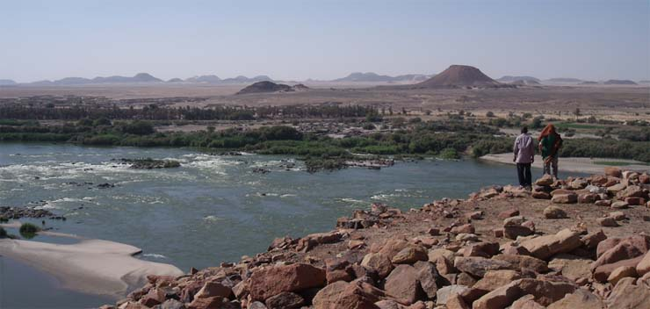

Slide 10
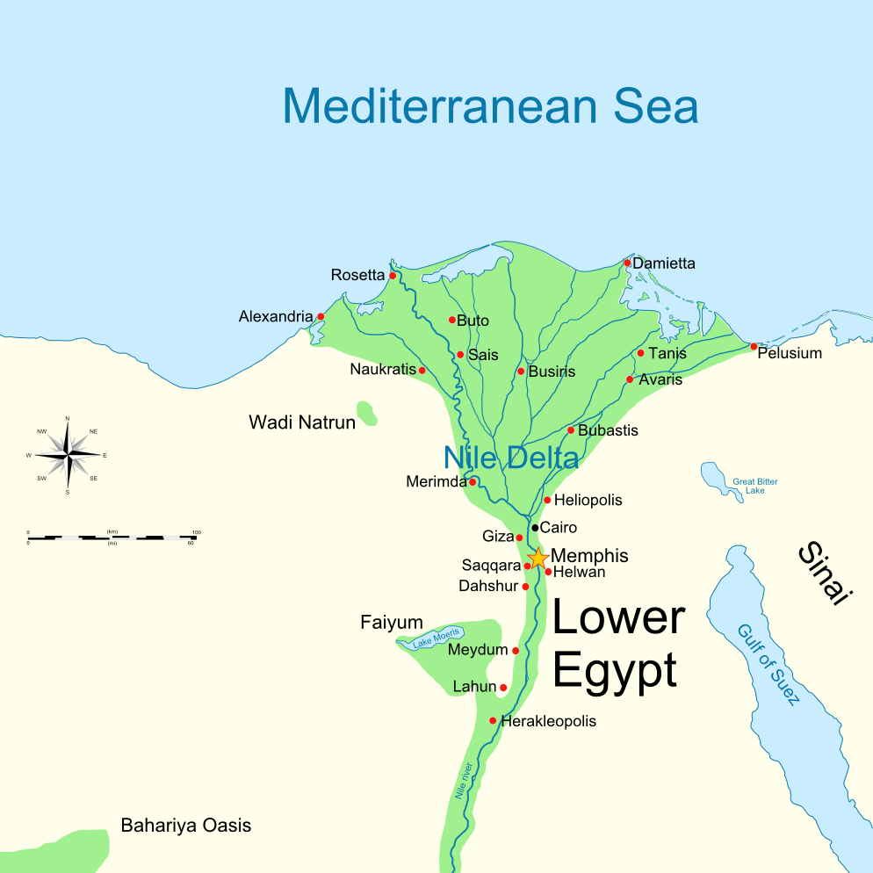
Land by the Nile
Delta – fan-shaped area of silt at river mouth
Sahara Desert
Libyan Desert
Eastern Desert
“Red Land” – intense heat
Kept Egypt isolated from invaders

Slide 11
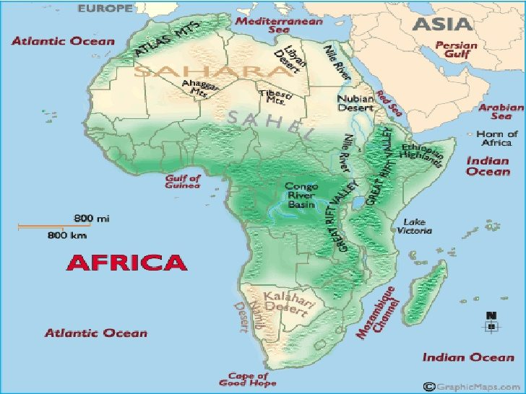

Slide 12
Civilization developed peacefully do to protection from the land
Mesopotamia lacked this advantage

Slide 13
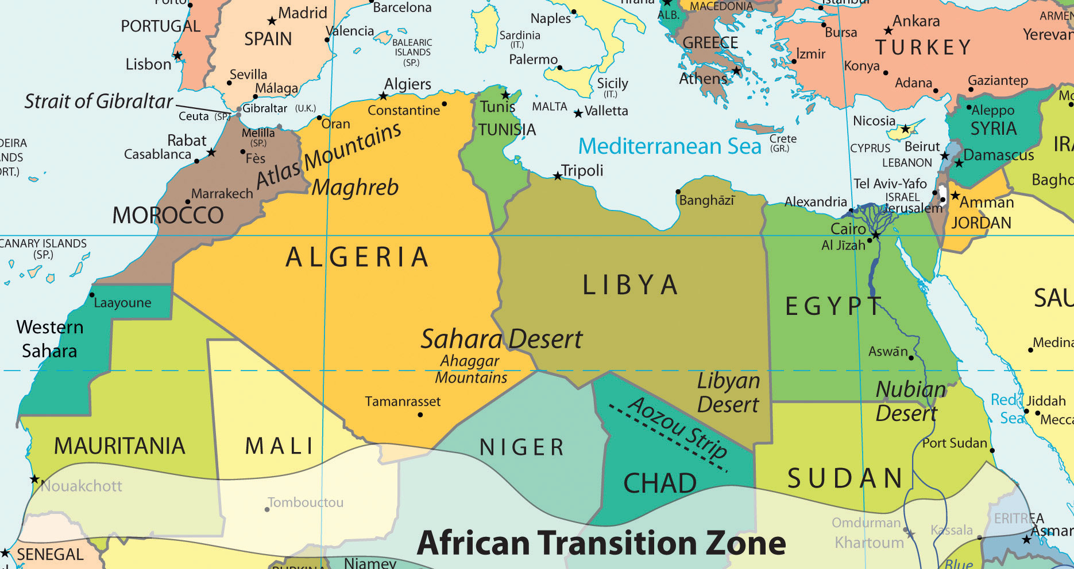
Mediterranean Sea and Red Sea – allowed for trade

Slide 14
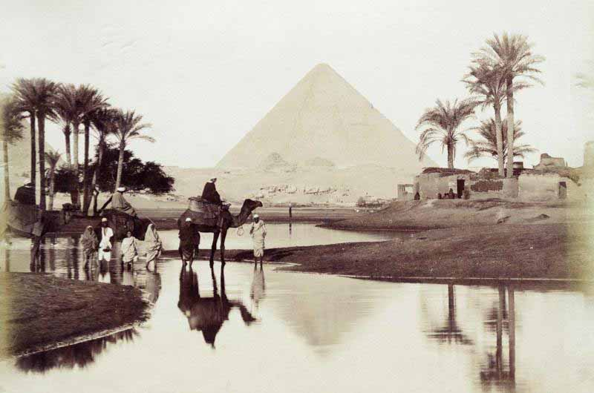
Floods
Predictable
Seasonal
Silt – fertile soil

Slide 15
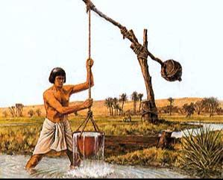
Farming
Shadoof – bucket attached to a pole used to transfer water to storage basins
During the dry season

Slide 16
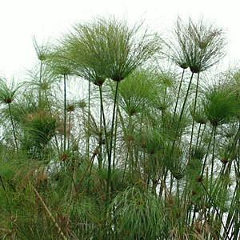
Papyrus – a reed plant that grew wild
Rope, baskets, rafts, paper

Slide 17
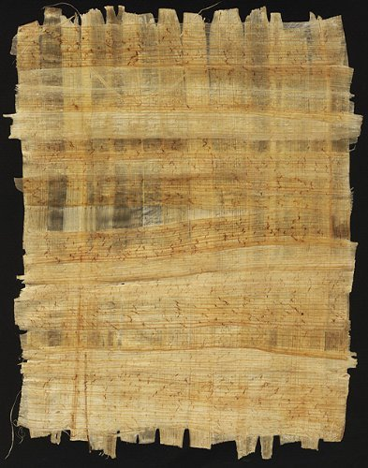
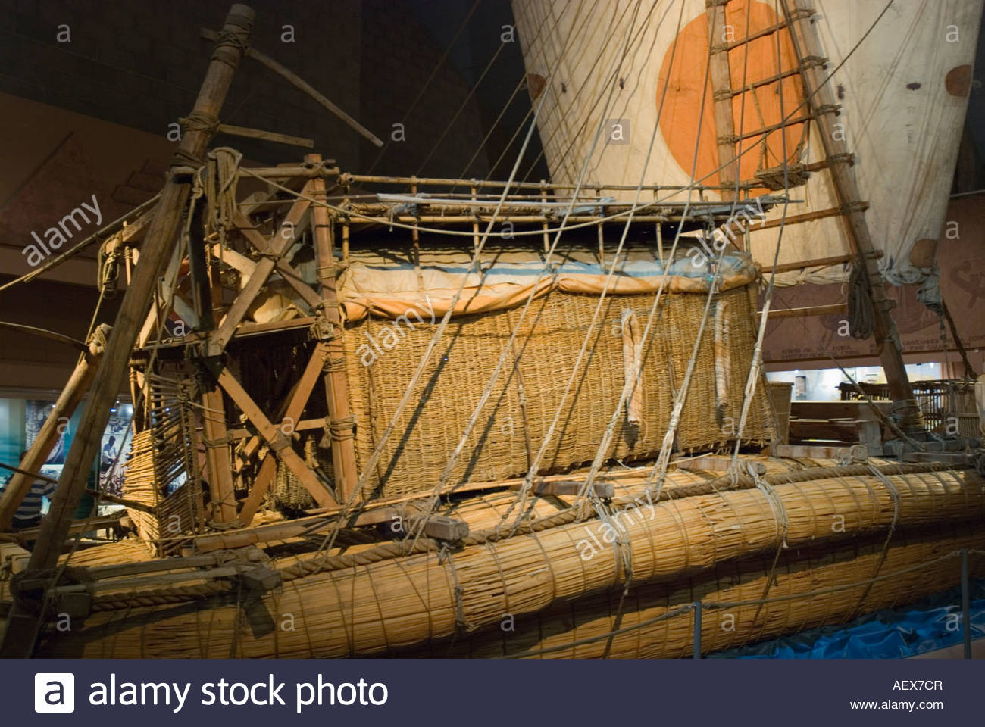

Slide 18
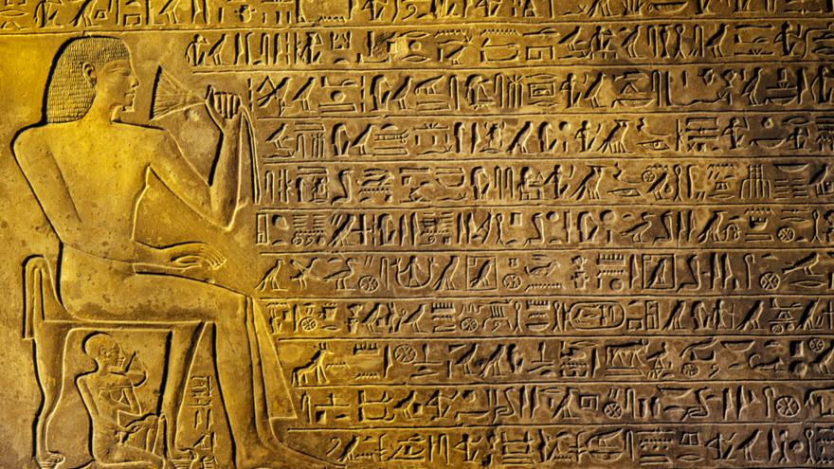
Writing
Hieroglyphics – combination of pictures and sound symbols
Scribes were able to read
Wrote on papyrus
Carved onto walls

Slide 19
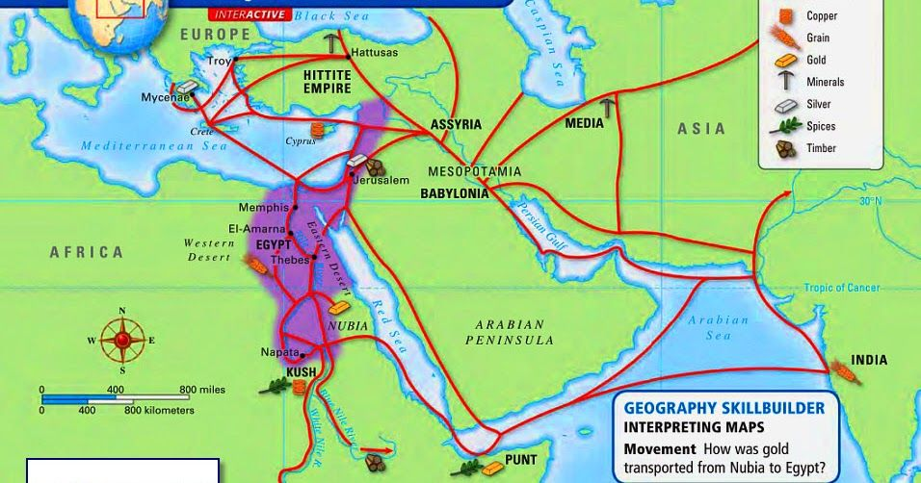
Trade
Nubia – south
Mesopotamia – northeast
Caravan traders learned of other ways of life

Slide 20
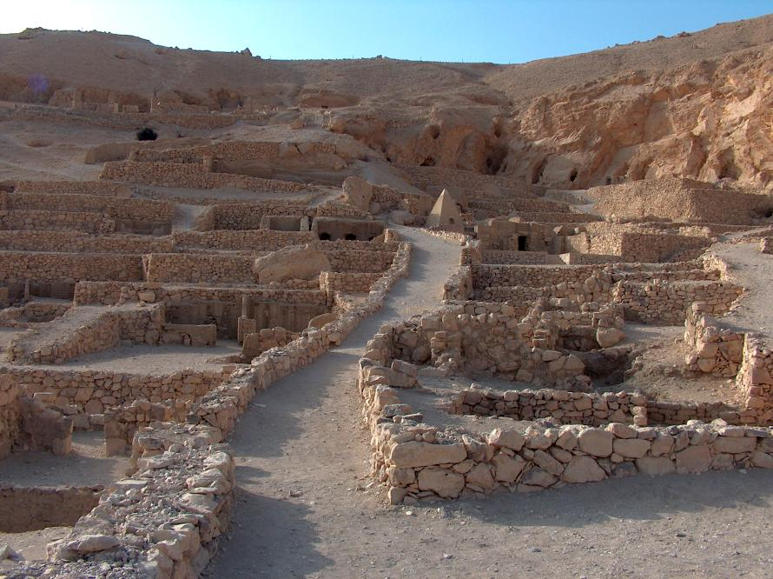
Kingdoms
A need for government:
Oversee construction of dams for irrigation
Storing and distributing grains
Conflict over land
Groups of villages formed kingdoms

Slide 21
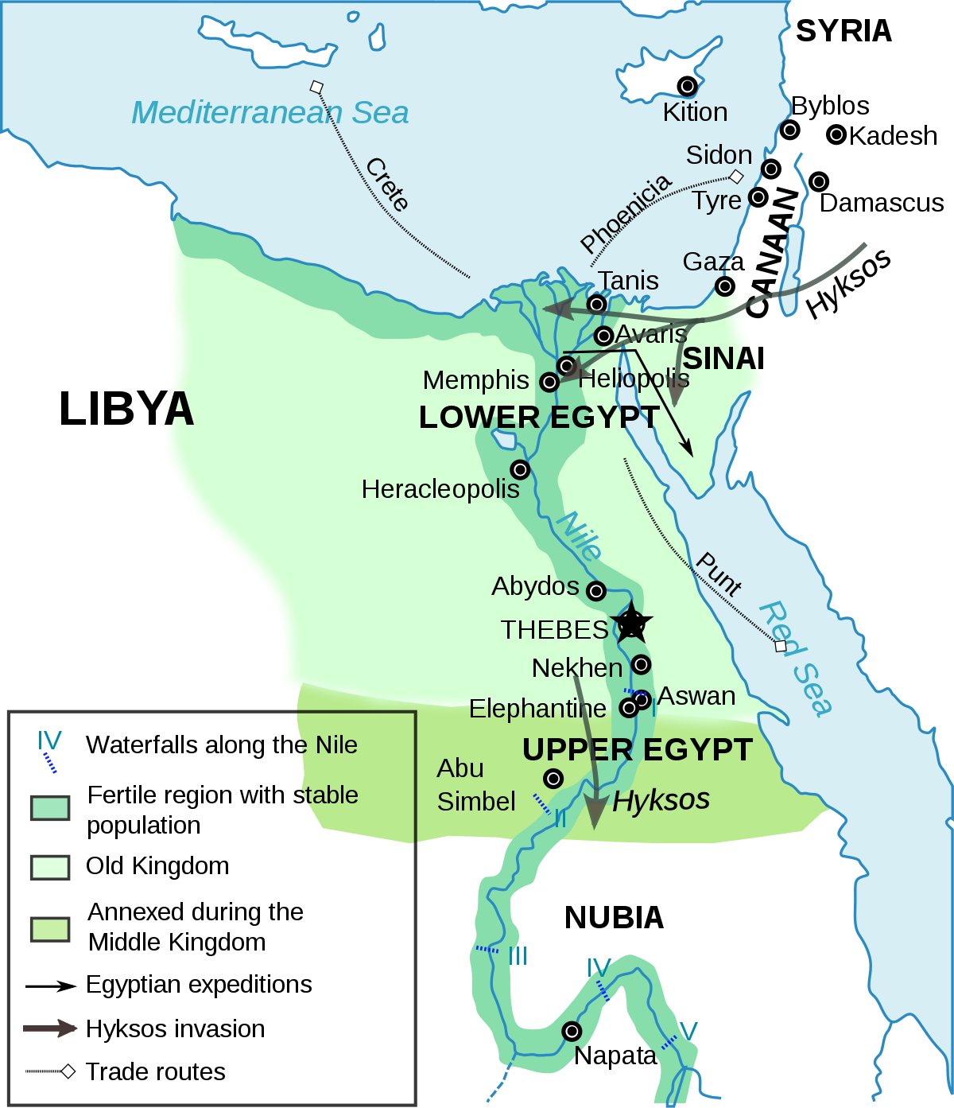
4000 B.C.
2 Kingdoms
Upper Egypt – South-central part of Valley
Lower Egypt - Delta

Slide 22
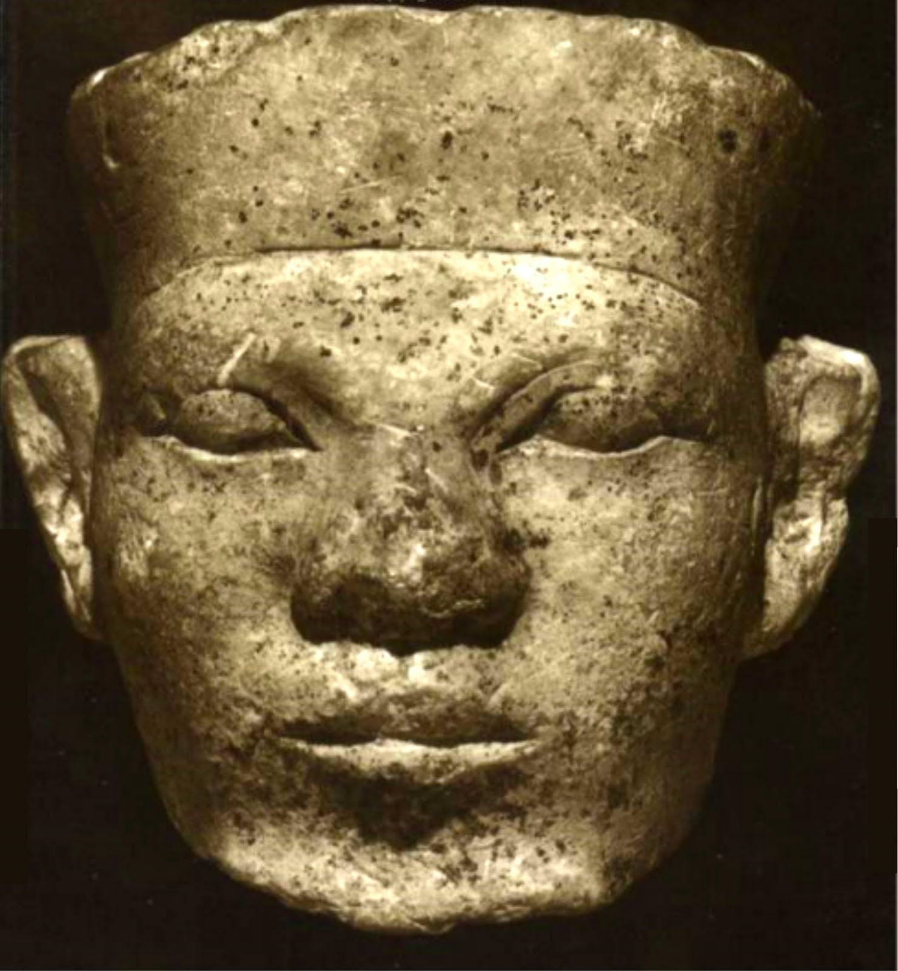
Narmer
King of Upper Egypt
Conquered Lower Egypt
Married a princess – unified kingdoms

Slide 23
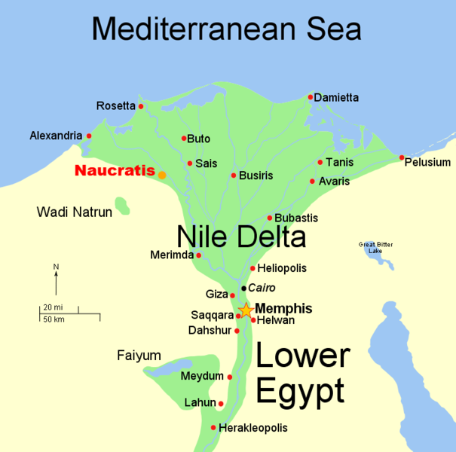
Memphis – capital
Dynasty – line of rulers from one family

Slide 24
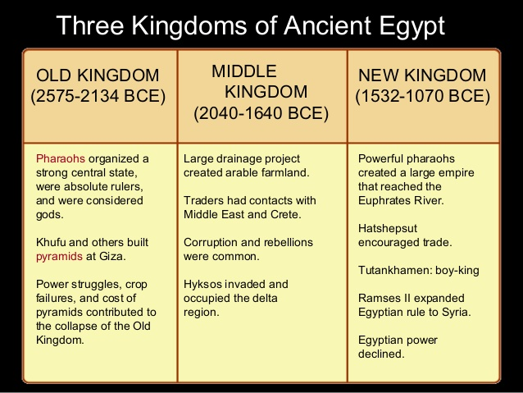
Between 3100 B.C. – 332 B.C.
  30 dynasties ruled Egypt
3 Time Periods
  Old Kingdom
  Middle Kingdom
  New Kingdom

