Slide 1
Mesopotamian Empires
4-2

Slide 2
The First Empires
Sumer’s city-states were weakened by conflict
2400 B.C.
Kingdoms rose in N. Mesopotamia
These rulers built empires
Empire – large territory governed by one ruler

Slide 3
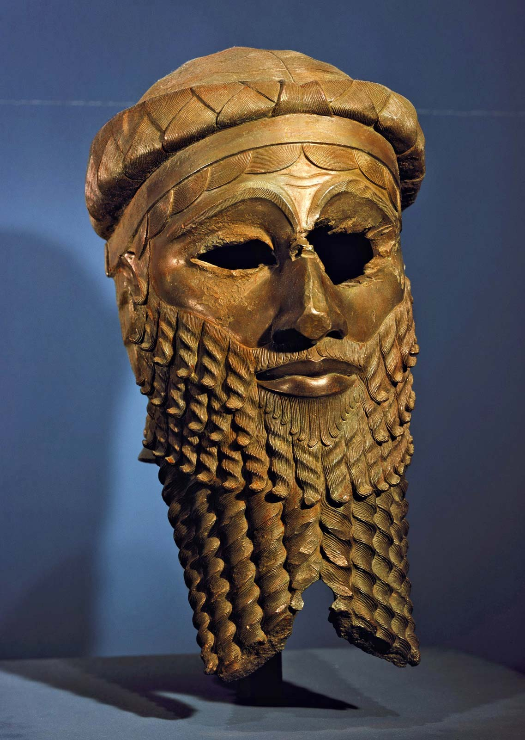
Sargon
Akkad – kingdom in the North
Sargon – ruler of the Akkadians

Slide 4
Conquered all of the city-states in Sumer
First empire
2340 B.C.
Eventually his empire included all of Mesopotamia
Empire lasted for over 200 years

Slide 5
Hammurabi
Amorites – lived in a region west of Mesopotamia
Conquered Mesopotamia
Babylon was the greatest city

Slide 6
Hammurabi – Babylonian King
He began conquering cities controlled by the Amorites
1800 B.C.
Babylonian Empire

Slide 7
Hammurabi’s Code
Laws that were posted for all to see
Listed crime and punishment for each
“An eye for an eye”
The punishment should match the crime

Slide 10
Hammurabi’s Code Sheet

Slide 11
PART 2

Slide 12
Assyrian Empire
900 B.C.
Army began to take over Mesopotamia with their powerful military

Slide 13
50,000 soldiers
Infantry, cavalry, horse soldier, charioteers
Slingshots, bows, spears

Slide 14
Tribute – forced payment from conquered people
Stories of brutality spread
Army would sometime surrender without a fight

Slide 15
Hittites - People from the north that had mastered iron production
Assyrian learned from their technology
Weapons

Slide 16
Nineveh – capital located along Tigris River
Provinces – political districts within the empire
The King chose people to govern each district

Slide 17
Chaldean Empire
A new empire
650 B.C. – fighting over who would be the next Assyrian leader allowed the next group to take power
At one time these people were under the control the Assyrians

Slide 18
Nabopolassar – Chaldean king
Led a revolution against the Assyrians
Nebuchadnezzar – king’s son
Started a new empire

Slide 19
Babylon
Babylon became the new capital

Slide 20
Became the largest and richest city
Trade route between Mediterranean Sea and Persian Gulf

Slide 21
Hanging Gardens – staircase located on ziggurat
One of the Seven Wonders of the Ancient World

Slide 22
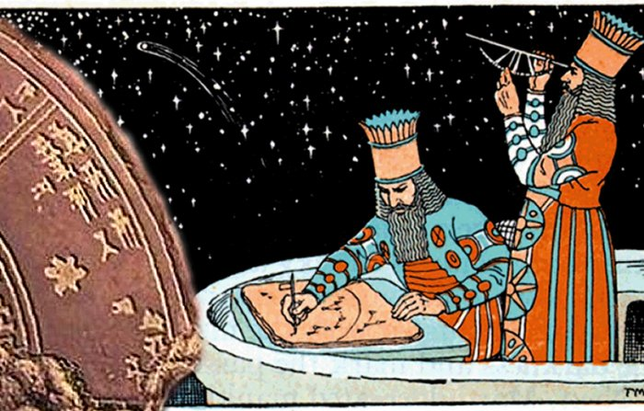
Caravans – groups of merchants traveling together
Astronomers – studies space

Slide 23
Fall of the Empire
Nebuchadnezzar died
539 B.C. – Persians took control
Kept much of the same culture

