Slide 1
The Sumerians
4-1

Slide 2
Mesopotamia
Region containing the earliest known civilizations
“The land between the rivers” – Greek
Tigris and Euphrates Rivers

Slide 3
Southern Iraq
Eastern part of Fertile Crescent

Slide 4
People settled the area about 7000 B.C.
Groups moved to the plain of Tigris-Euphrates valley

Slide 5
The Rivers
Farmers used water from the rivers for crops
Spring brought floods
Silt – fine particles of fertile soil
Great for farming

Slide 6
Build dams
Dug canals
Irrigation – system that supplies dry land with water

Slide 7
Irrigation led to surpluses
Surpluses – an amount that is left over after a need has been met
Allowed for more specialization

Slide 8
Sumer
Empire in Mesopotamia
Cities in Sumer:
Ur (uhr)
Uruk (OO*rook)
Eridu (ER*i*doo)
Became centers of civilization that controlled lower parts of Tigris and Euphrates valleys.

Slide 9
City States
Cities in Sumer were difficult to travel between
City-state – city that governs itself and surrounding area

Slide 10
Protected by walls
Mud / crushed reeds for building materials
Ruler’s palace – centrally located

Slide 12
City-states would occasionally go to war
Resources
Boundaries
During peace – trade
Formed alliances

Slide 13
Gods
Polytheism – a belief in many gods
Gods played different roles
Rain and wind
Guided actions

Slide 14
Ziggurats – pyramid shaped structure with temple at top
“To Rise High”
The god’s home
Only one priest was allowed there
Priests originally rules city-states

Slide 15
Kings
Sumerian cities became monarchies
Claimed their power to rule came from the gods
First Kings were war hero's

Slide 16
Social Groups
Upper Class – kings, priests, warriors, government officials
Middle Class – merchants, farmers, fishers, artisans
Lower Class – enslaved people

Slide 17
Men – head of family
Boys – trained at school for specific jobs
Woman – ran the home
Girls – learned from mom
Law –
Parents care for kids
Kids care for parents

Slide 18
Farmers
Majority of population
Located around the city-state
Dams and waterways for irrigation

Slide 19
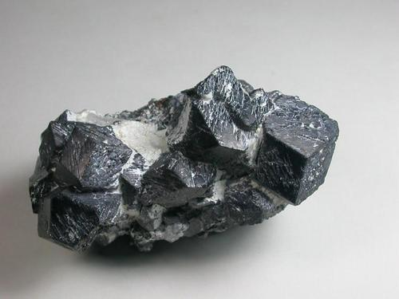
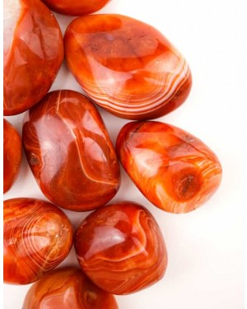
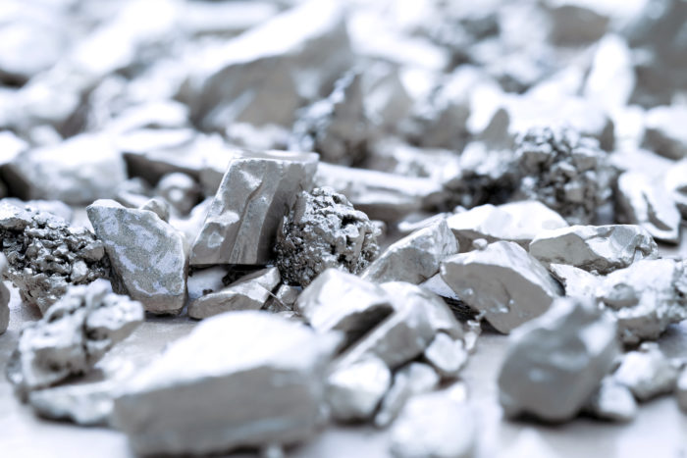
Traders
Routes linked Sumer to Egypt and India
Trade agricultural goods for:
Lapis Lazuli – Afghanistan
Carnelian - India
Iron and silver - Turkey

Slide 20
Writing
Earliest known writing system in the world
Cuneiform – used wedge shaped marks made in soft clay

Slide 22
Scribes – person who copies or writes documents
Boys from wealthy families were the only people taught
Years of training

Slide 23
The Epic of Gilgamesh
A long poem that records the deeds of a legendary or real hero

Slide 24
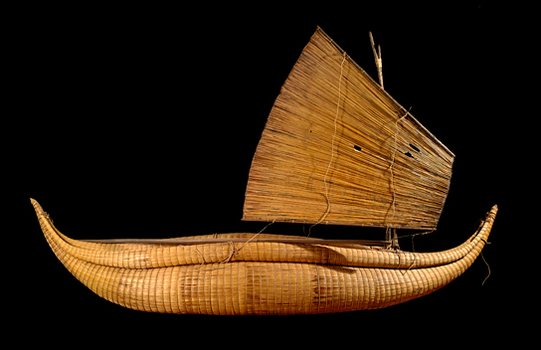
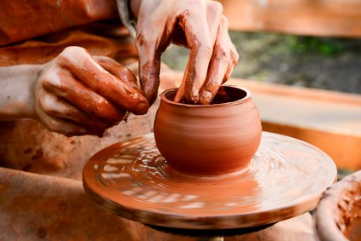
Technology
First to use:
Wheel
Carts
Chariot
Sailboat
Wooden plow
Potter’s wheel
Bronze

Slide 25
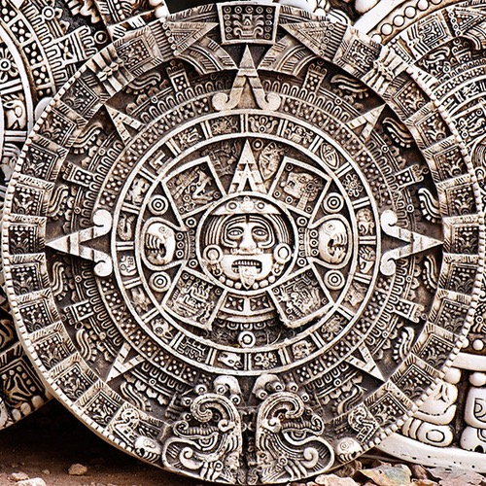
Math and Astronomy
Geometry
Place value system based on 60
Time
Circle measurements
Watched stars:
Plant crops
Religious ceremonies
Moon – 12 month calendar

