Slide 1
The Agricultural Revolution
3-2

Slide 2
Neolithic Times
Ice Age ends
Climate warms
Nomads move to areas with fertile soil

Slide 3
Farming replaced hunting and gathering
Domestication – adaption of animals to live with humans
Transportation
Meat
Milk
Wool

Slide 4
Neolithic Age
8000 B.C. – 4000 B.C.
Neolithic – “New Stone”
Systematic agriculture – organized growing of food on a regular schedule
Slow process to change over

Slide 5
Agricultural Revolution
Humans can now produce a constant supply of food
Populations grew
Nomadic living changed to communal living

Slide 6
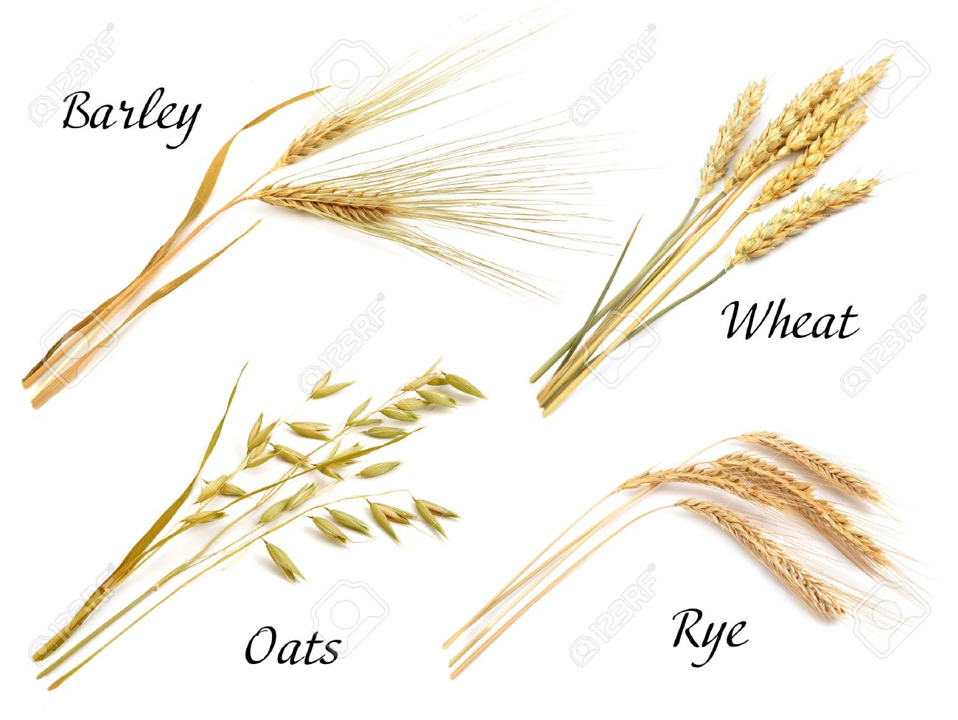
8000 B.C. - SW Asia – wheat, barley, pigs, cows, goats, and sheep
Farming was now an economic activity in Europe

Slide 7
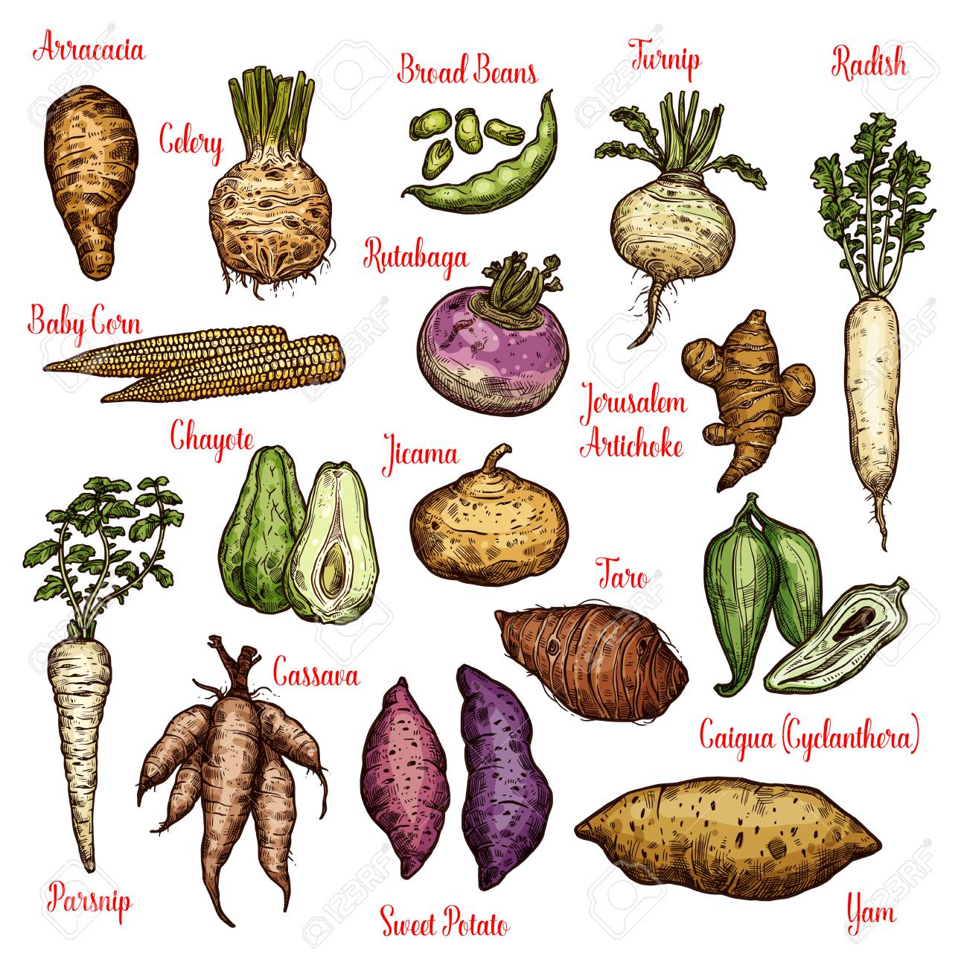
6000 B.C. – Nile Valley in Egypt – wheat and barley
Spread to other part of Africa
Tubers, yams, bananas
Wheat and Barley then moved into India

Slide 8
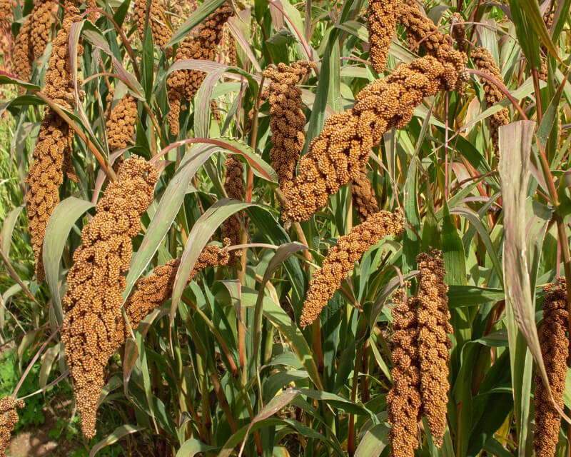
6000 B.C. – China – millet and pigs
5000 B.C. – SE Asia – rice
Spread to China

Slide 9
7000 – 5000 B.C. – Mexico and C. America
Corn, squash, potatoes, chicken

Slide 10
Neolithic Life
Settled in villages
Permanent homes
Near fields and water

Slide 11
Jericho
One of the oldest communities
Present day Israel and Jordan
West Bank
8000 B.C.

Slide 14
Catalhuyuk
Present day Turkey
6700 – 5700 B.C. – 32 acres and home to 6,000 people
Entered homes through a hole in the roof

Slide 16
Shrines – place to worship
Pictures of Gods and Goddesses
Pictures drawn in homes showed how villages lived

Slide 18
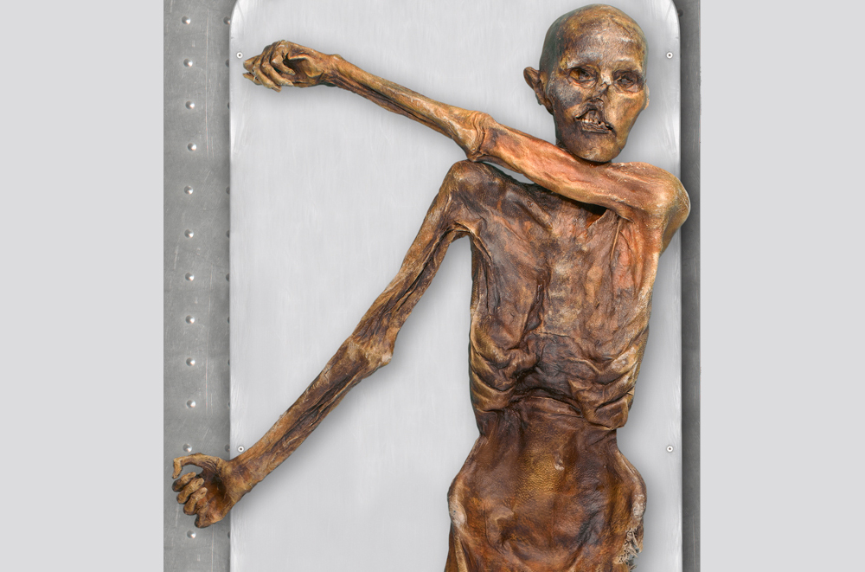
Otzi the Ice Man
Youtube clip.
In Focus: Ötzi "The Ice Man" (2016: 25th Anniversary)

Slide 19
Settled Life
Security
Steady food
Larger populations
Specialization – the act of training for a particular job
People now:
Made weapons
Clay pots
Artisans

Slide 20
Men – worked fields and herded animals
Protected village
Women – bore the kids, made clothes, managed food supplies

Slide 21
Settlements that grew too quickly:
Used up resources
Deforestation

Slide 22
Bronze Age
Period when people began to use tools and weapons made of bronze
Mixed copper and tin – stronger
Better farming tools
Heated rock and copper came out

Slide 24
Civilizations Emerge
4 Great River Valley Civilizations (300 B.C.)
Mesopotamia
Egypt
India
China

Slide 25
Cities and Governments
Protection for people and food supplies
Monarchy – ruler is a king or queen and inherits position from parent

Slide 26
Religions
Developed to help explain the unknown
Gods ensured survival
Ruler claimed the Gods gave them power

Slide 27
Social Structure
Groups divided by wealth and jobs
Rulers, Priests, Government Officials, Warriors
Farmers, Artisans, Craftspeople
Enslaved people – mostly captured in wars

Slide 28
Writing and Art
A way to pass on information
Symbols used for letters and words

