Slide 1
Hunter - Gatherers
3-1

Slide 2
Paleolithic Age
“Old Stone” - Greek
Stone Age – stones were used to make tools and weapons
2.5 millions years ago – 8000 B.C.
4,500 earlier than recorded time

Slide 3
Survival
Moved in search of food
Nomads – moved from place to place to survive
Groups (bands) of 20-30

Slide 4
Survived by hunting and gathering
Bison, wild goats, reindeer, fish
Nuts, berries, fruit, green plants, wild grains

Slide 5
Food
Men – hunted
Used clubs to drive animals off cliffs
Later developed traps and spears
Women – took care of children
Gathered food

Slide 6
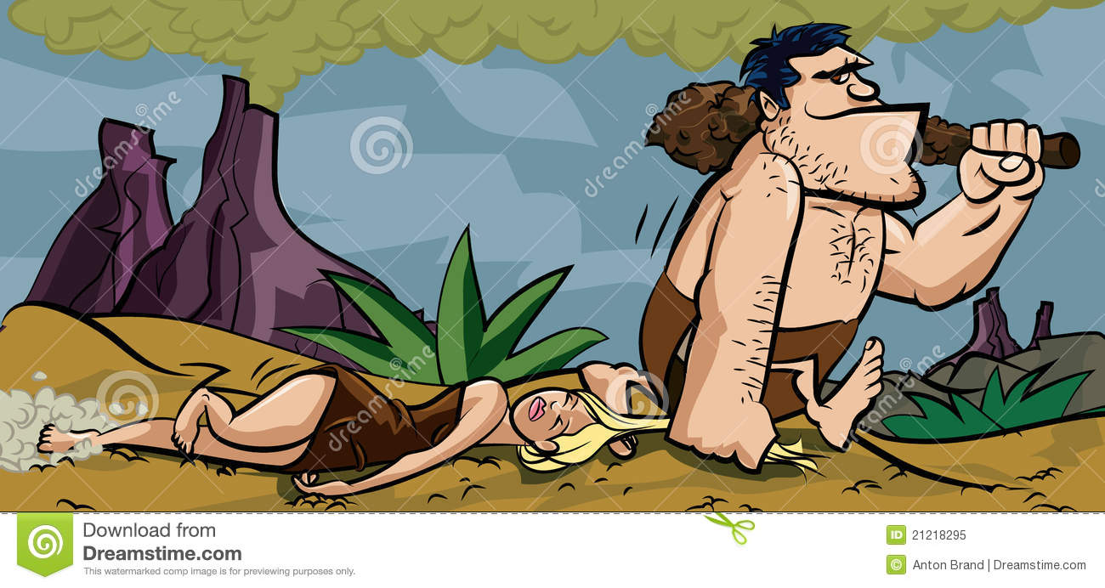
Equal relationship between man and woman
Both made decisions
Hunted in monogamous pairs
First families

Slide 7
Tools
Technology – ability gained by the use of knowledge
Used flint for cutting
Later:
Axes
Spears and bows
Harpoons
Needles from bones

Slide 10
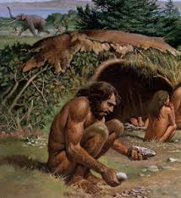
Shelter
Clothes from animal skins
Natural shelters
Tents – skins, brush, wood
Wooly mammoth bones for frames

Slide 11
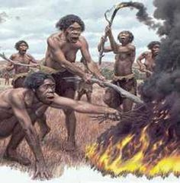
Fire
Warmth
Light
Scare animals
Cook – easier to digest and tastes better
Smoked meats – preserved

Slide 12
Fire
Rubbing sticks together
Iron pyrite – sparks
YOUTUBE - Primitive Technology: Cord drill and Pump drill

Slide 13
Language
Communicated first with sounds and gestures
Spoken language was constantly growing and changing
New experiences = new words

Slide 14
Art
Lascaux caves in France
Rock crushed with animal fat
Record of history
Enjoyment
Good luck

Slide 16
Ice Age
Long periods of extreme cold that affected all of Earth
Most recent – 100,000 years ago

Slide 17
Large glaciers grew
Ocean levels dropped

Slide 18
Land Bridge
Connected N. America to Asia
Allowed migration of people

Slide 19
Humans had to adapt to cold
Ate more fat
Better shelters
Fire
Warm clothes

