Slide 1
27-2
History and Culture

Slide 2
Early History
Influenced by China
Parts of culture seeped into Japan and the Koreas
Buddhism – main religion
Scholars and missionaries

Slide 3
Emperors
Emperors ruled Japan
Capital – Kyoto (Heian)
Today - Tokyo
Center of art, literature, and learning
Some emperors were more concerned with art than running the country
Power slipped away

Slide 4
Shoguns
Military leaders
Powerful generals
Ruled Japan in the emperor’s name
Only one shogun could hold power at a time

Slide 5
Samurai
Serving under that shoguns
Highly trained warriors
Very respected

Slide 6
Later Japan
1868 – Group of samurai overthrew the shogun
Gave power back to emperor

Slide 7
World War II
Allied with Germany and Italy
Drew the US into the war in 1941
Bombed Pearl Harbor in Hawaii

Slide 9
US dropped atomic bombs on Hiroshima and Nagasaki
Japan surrendered

Slide 11
Korea
Influenced by China
Part of China’s empire – still independent
Japan later invaded Korean Peninsula
Harsh rulers

Slide 12
After WWII
Korea was taken away from Japan
Formed 2 countries
North – Communist
Aided by Soviet Union

Slide 13
South – Democratic government
Aided by United States

Slide 14
1950 – North Korea invaded South Korea
Korean War
North wanted to unify both countries under communism

Slide 15
South Korea drove invaders back
US help

Slide 16
Japanese Culture
Japanese language
Writing
Kanji – represents whole words
Kana – parts of words

Slide 17
Religion
Shinto
Kami – nature spirits
Everything in nature have kami
Kami help people live and harm free
Shrine to the kami

Slide 18
Buddhism – search for enlightenment

Slide 19
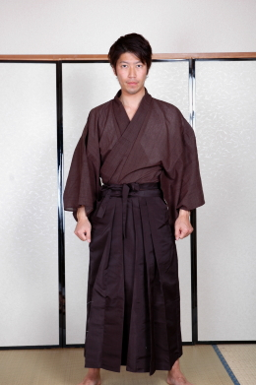
Customs
Kimonos – traditional robes
Special occasions
Same as samurai

Slide 20
Noh – plays that use music and dance
Actors have masks
Kabuki – more active
Teach lessons / tell stories

Slide 21
Korean Culture
Korean language
Alphabet
Past – Buddhist / Confucianists
Now – Christianity ¼
Communism discourages religion

Slide 22
Kimchi – pickled cabbage with spices
Government encourages people to retain old cultures

