Slide 1
27-1
Japan and the Koreas

Slide 2
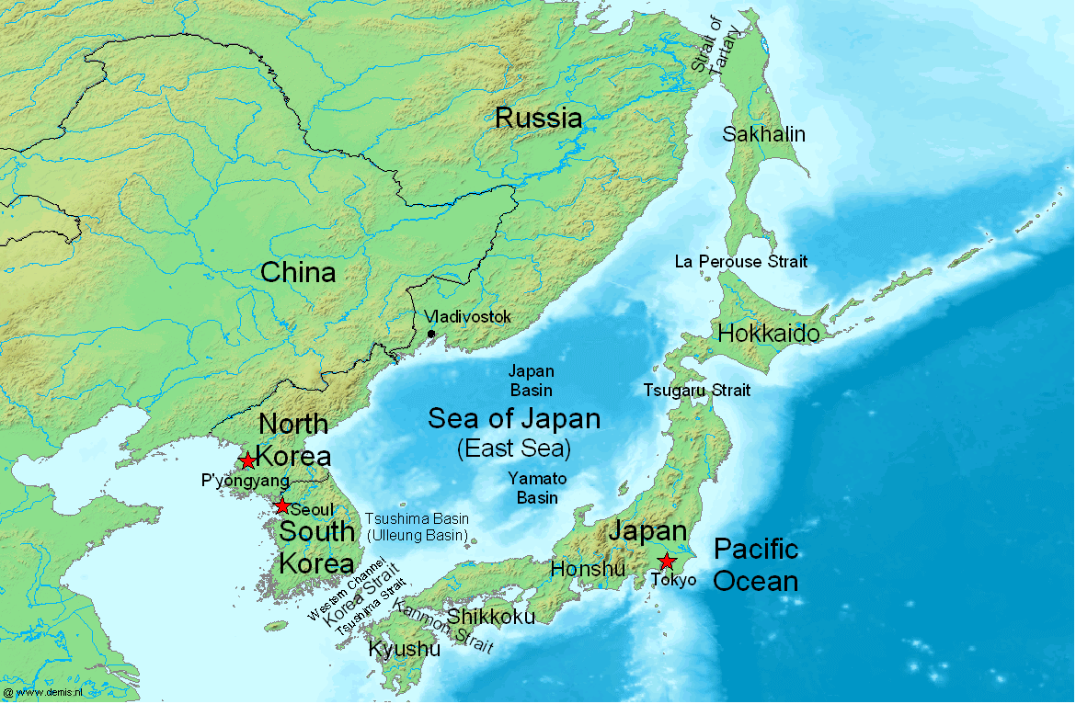

Slide 3
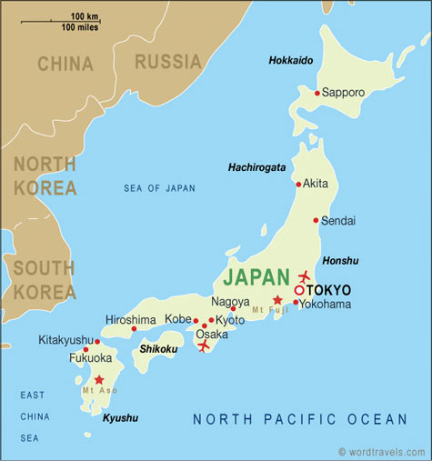
Physical Features of Japan
Island country
4 large islands
  95% on area
3,000 smaller islands
1,500 miles long

Slide 4
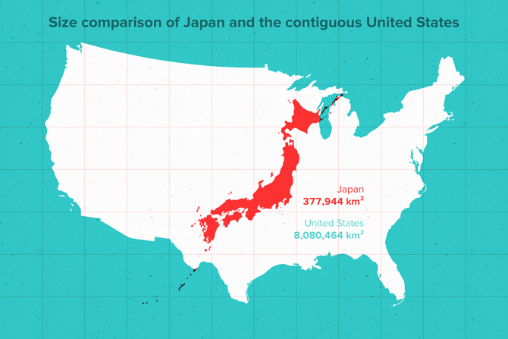
Same length as the US east coast
Same areas as California
  Little smaller

Slide 5
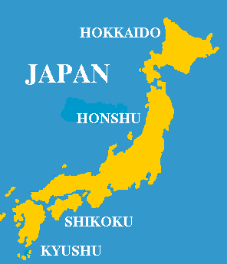
Major Islands
Home Islands:
Hokkaido
Honshu
Shikoku
Kyushu

Slide 6
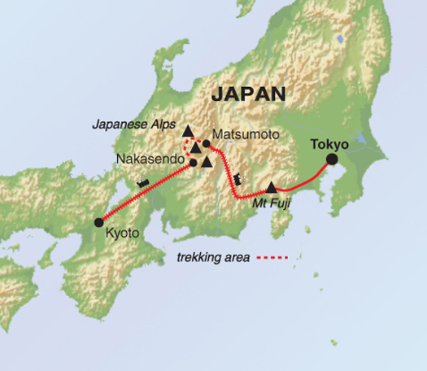
Mountains
75% of land
Japanese Alps
Mount Fuji – volcano
  Highest mountain
  Sacred place
Not part of a mountain range

Slide 7
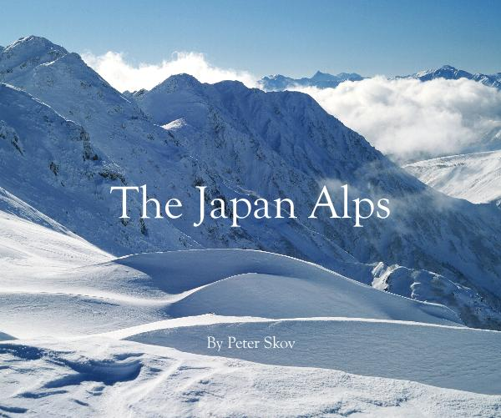
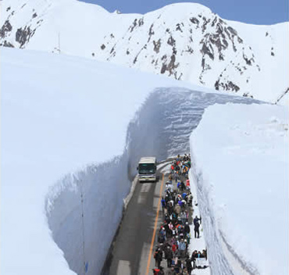

Slide 8
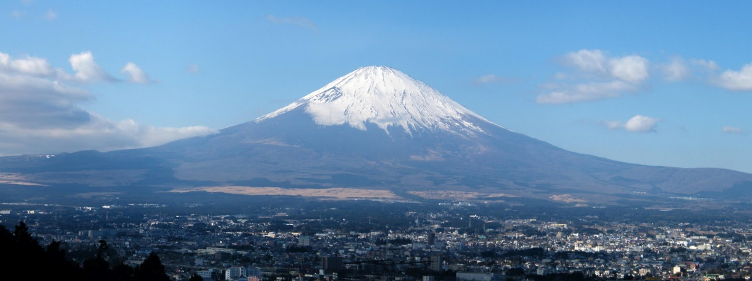

Slide 9
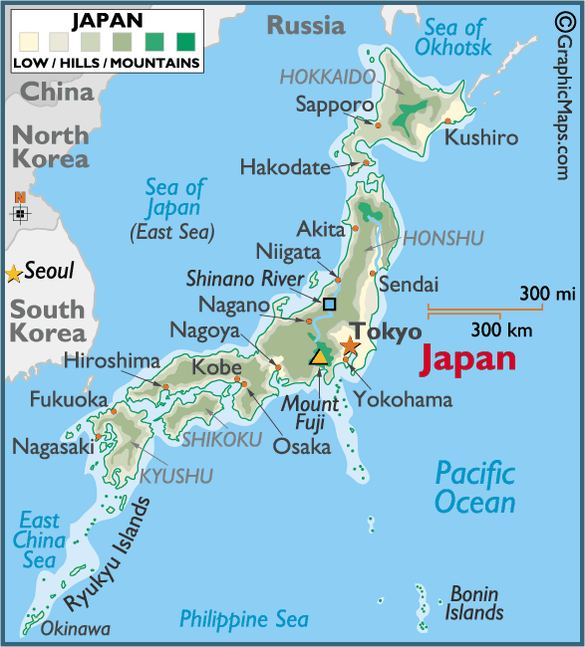
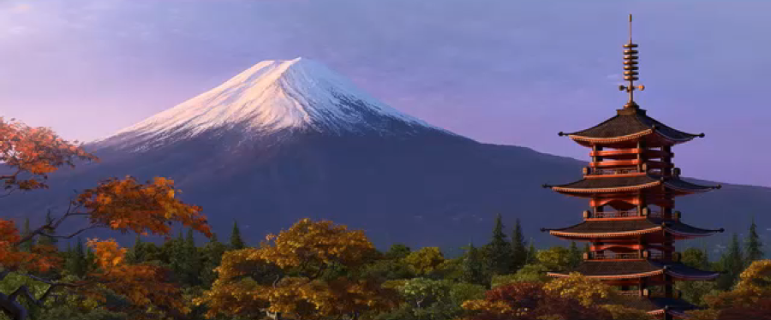

Slide 10
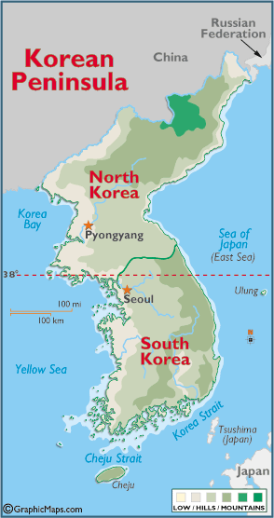
Physical Features of Korea
Korean Peninsula
  North and South Korea
Mountains along east coast
Highest in north

Slide 11
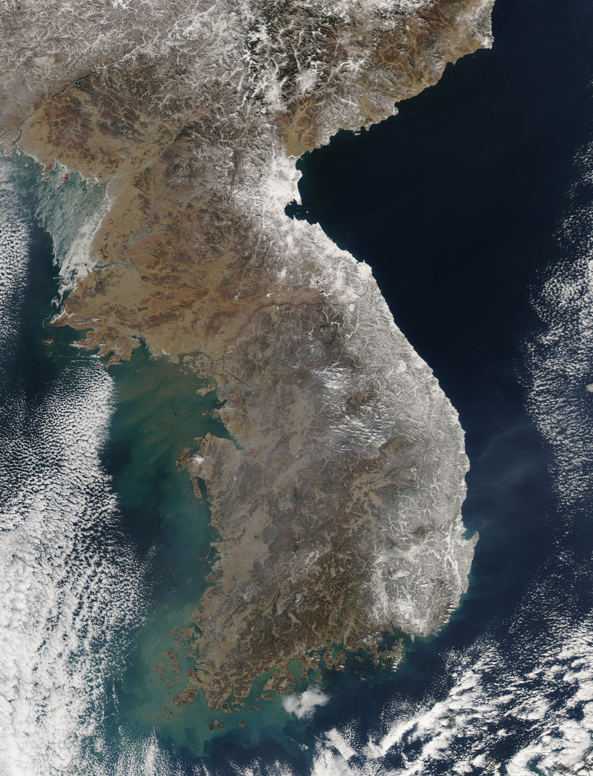

Slide 12
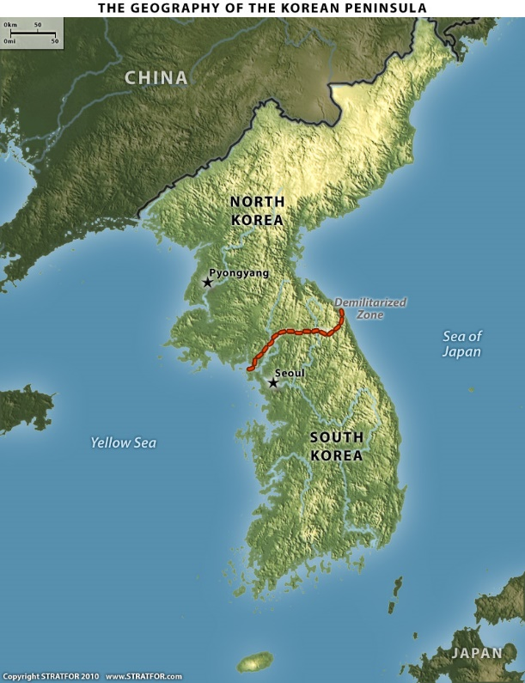
Large plains
  West coast and river valleys
More rivers than Japan
Most flow into Yellow Sea

Slide 13
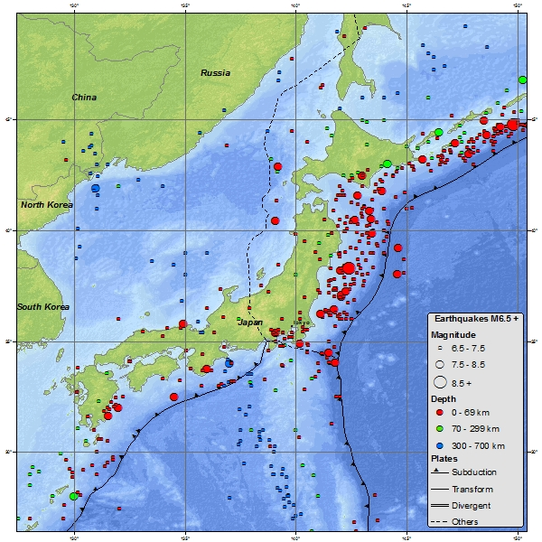
Natural Disasters - Japan
Earthquakes
Volcanic eruptions
Tsunamis – destructive waves

Slide 14
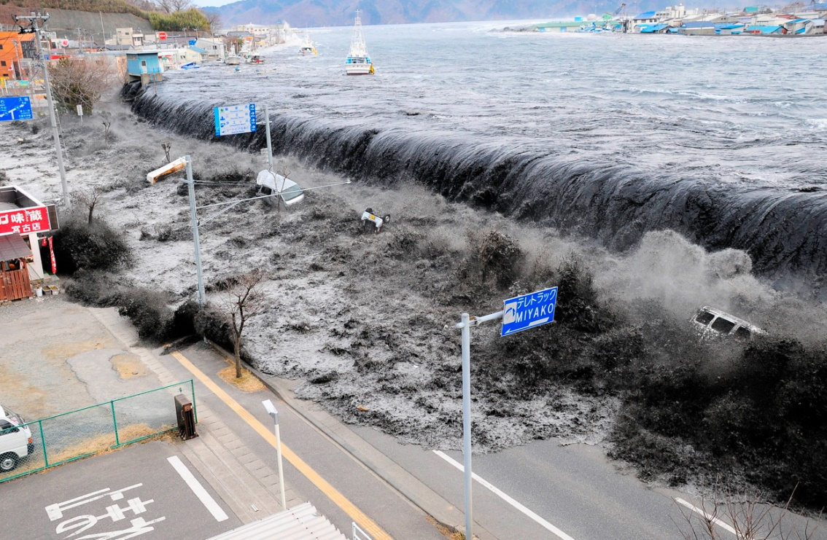
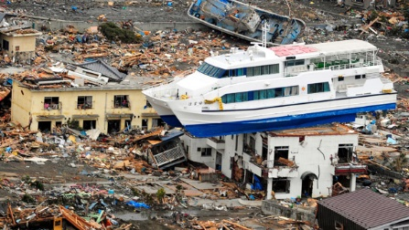
2011

Slide 15
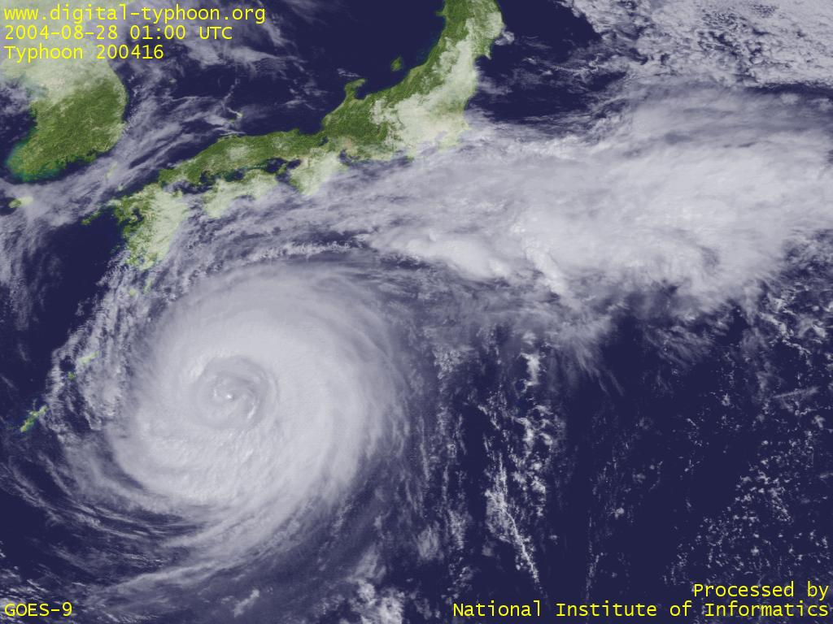
Typhoons
Cause damage to Japans and the Koreas
80 inches of rain in the southern region

Slide 16
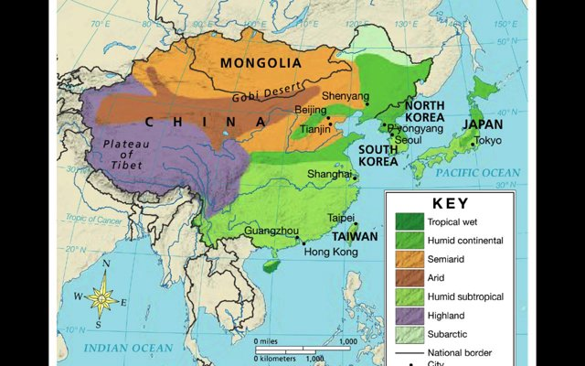
Climate
North – humid continental
  Similar to Michigan
Summers are cool
Winters are long and cold

Slide 17
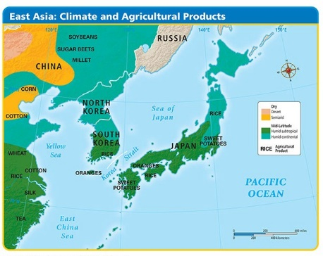
South – humid subtropical
  Mild winters
  Hot humid summers

Slide 18
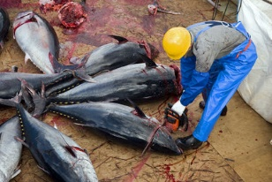
Resources
North Korea – coal and iron
Hydroelectric power
  Mountains
Japan – fisheries
Place where lots of seafood is caught
  Ocean currents move fish into area

