Slide 1
26-1
China, Mongolia, and Taiwan

Slide 3
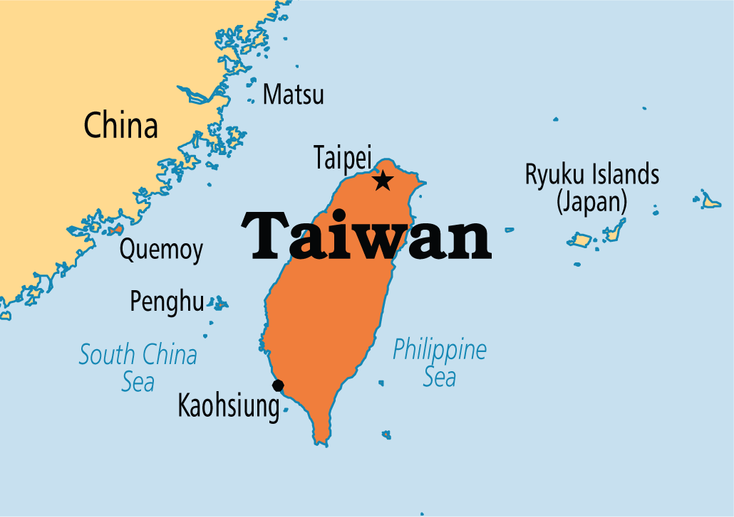

Slide 5
Physical Features
Himalayas – China is to the east
China is about the size of the US
Long rivers
Dry desserts

Slide 6
North – Mongolia
Dry, rugged grasslands
Taiwan – island
Tropical

Slide 7
Mountains

Slide 8
Plateau of Tibet
Southwest China
North of the Himalayas
World’s highest – “Roof of the World”

Slide 9
Taklimakan Desert
“Enter and you will not come out” – Turkish
Sandstorms
Low dry area

Slide 10
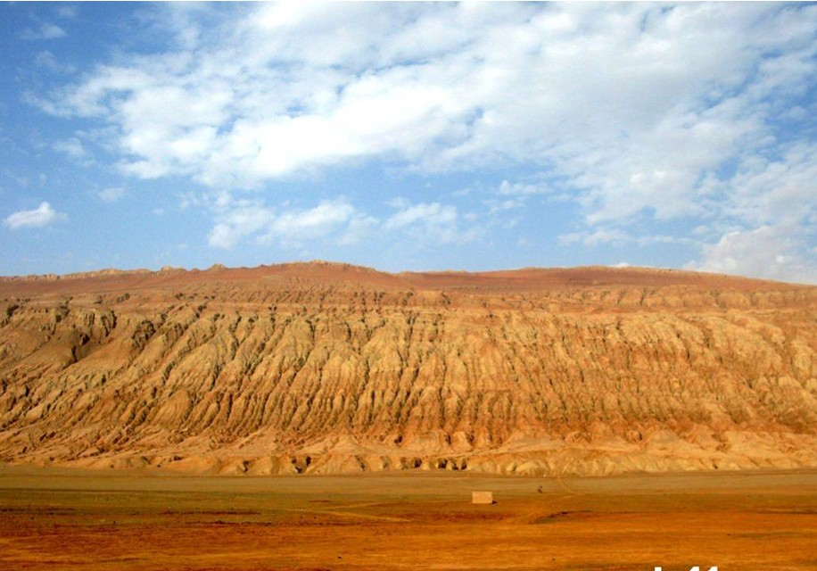
Turpan Depression
China’s lowest point
505 ft below sea level

Slide 11
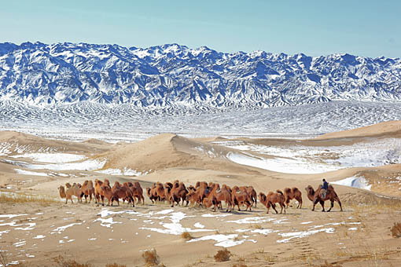
Gobi
Mongolia
World’s coldest dessert
-40 F

Slide 12
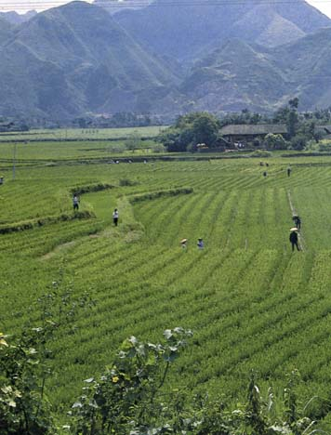
North China Plain
East China
Farmlands
Main population centers

Slide 13
Rivers
Northern China
Huang He – Yellow River
Loess – fertile soil
Yellow color
China’s Sorrow
Floods in summer

Slide 15
Chang Jiang
Yangzi River
Central China
Asia’s longest river

Slide 16
Climate
Southeast – warm, monsoons
Typhoons – coast
Northeast – dry and cold

Slide 17
Resources
China
Mineral and agriculture
Mongolia
Minerals and livestock
Taiwan
Sugarcane, tea, bananas

