Slide 1
24-3
Weather Instruments

Slide 2
Lower-Atmospheric Conditions
Can change a lot in a day
Magnitude and speed of changes to make predictions

Slide 4
Air Temperature
Thermometer – measures and indicates temperature
Liquid – mercury or alcohol
Heat causes expansion = rise in sealed tube

Slide 5
Galileo Thermometer
Weight of each tag is slightly different from the others.
Bubbles are calibrated by adding a certain amount of fluid to them so that they have the exact same density.
Each differs very slightly in density

Slide 6
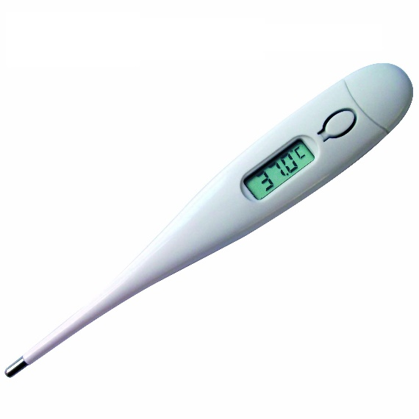
Electric thermometer
Temperature rises – current increases through devise
Thermistor – responds very quickly to temperature change

Slide 7
Air Pressure
Approach of a front usually indicates a drop in air pressure
Barometer

Slide 9
Wind Speed
Anemometer – measures wind speed

Slide 10
Wind Direction
Wind vane
16 compass directions
Degrees in a circle

Slide 12
Upper-Atmospheric Conditions

Slide 13
Radiosonde
Helium filled weather balloon
Measures:
Humidity
Air Pressure
Temperature
Radio waves transmit info
Eventually expands and bursts

Slide 14
Radar
RAdio
Detection
And
Ranging
Velocity of objects
Location
Reflected radio waves

Slide 16
Weather Satellites
Provides information of areas when ground observations cannot be made
Infrared energy at night
Temperature of ocean water – currents or waves

Slide 17
Computers
Process lots of information
Weather programs
Store past information

