Slide 1
23-3
Precipitation

Slide 2
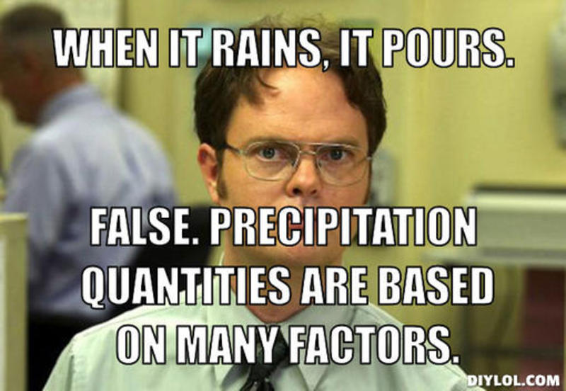
Precipitation
Moisture that falls to the Earth’s surface
Rain
Sleet
Snow
Hail

Slide 3
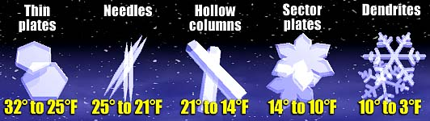
Precipitation
Snowflakes get smaller in colder temperatures
Sleet – rain falls through a layer of freezing air
  Clear ice pellets
Glaze ice – freezes when it hits the ground

Slide 4
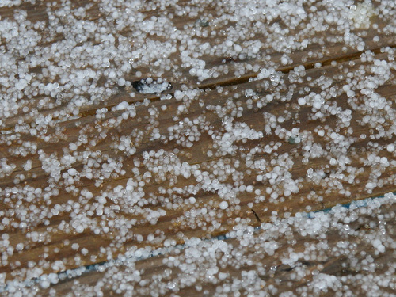
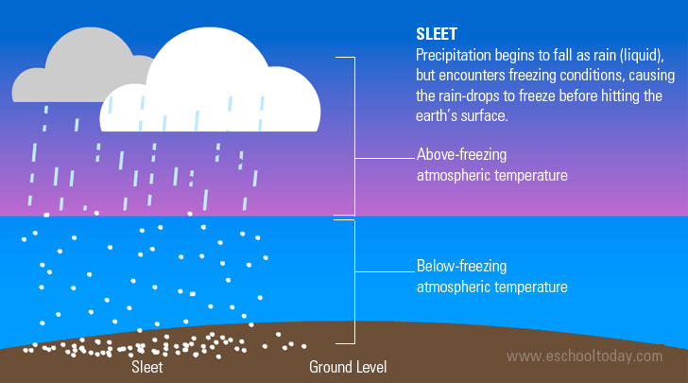

Slide 5
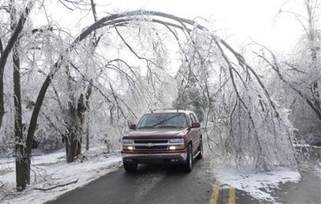
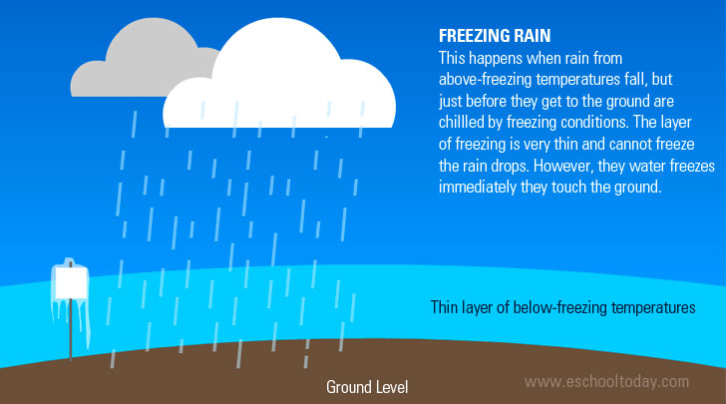

Slide 6
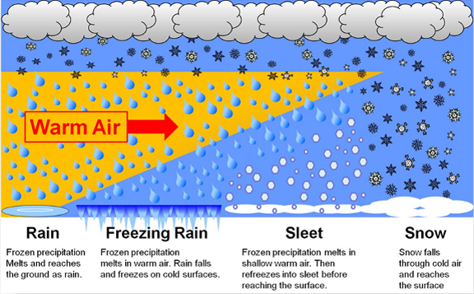

Slide 7
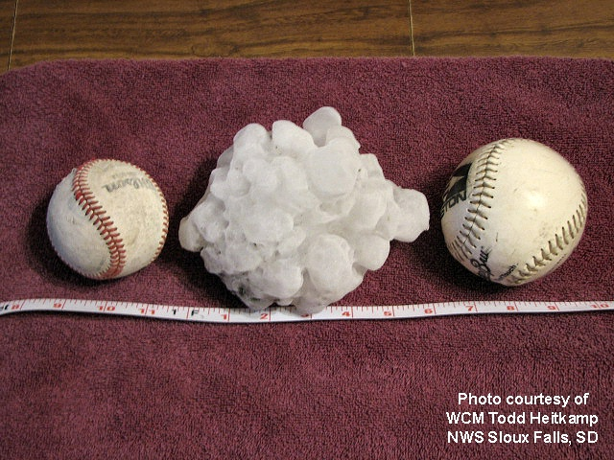
Precipitation
Hail – solid lumps of ice
Convection currents carry raindrops to high levels and freeze
Can be carried up multiple times

Slide 8
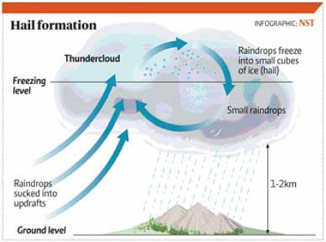
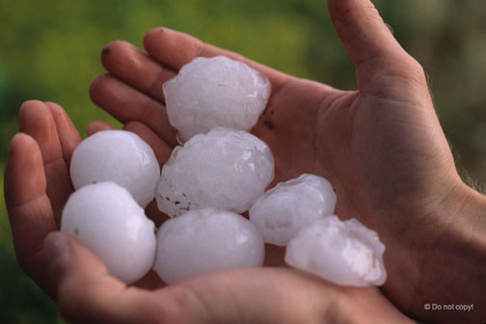

Slide 9
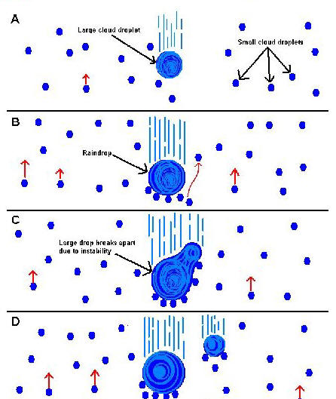
Coalescence
Formation of a large droplet
Combination of smaller drops

Slide 10
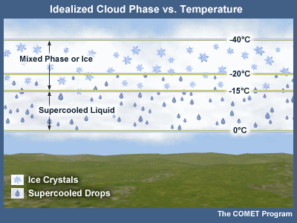
Supercooling
Substance is cooled below freezing, condensation, or sublimation point
Doesn’t go through a change of state
-50 C
Not enough freezing nuclei
  Most evaporate and vapor condenses to ice crystals and fall as snow (can melt in warm temps)

Slide 11
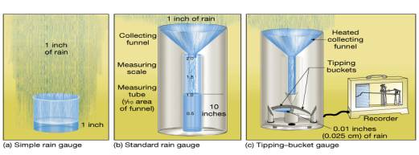
Measuring Precipitation
Rain gauge
10 cm of snow will melt to produce 1 cm of water

Slide 12
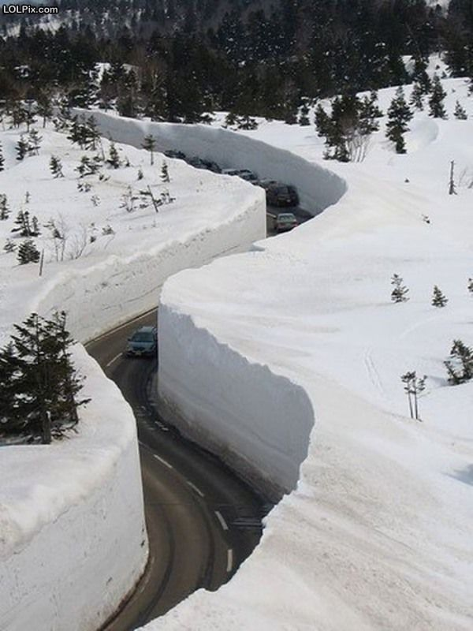
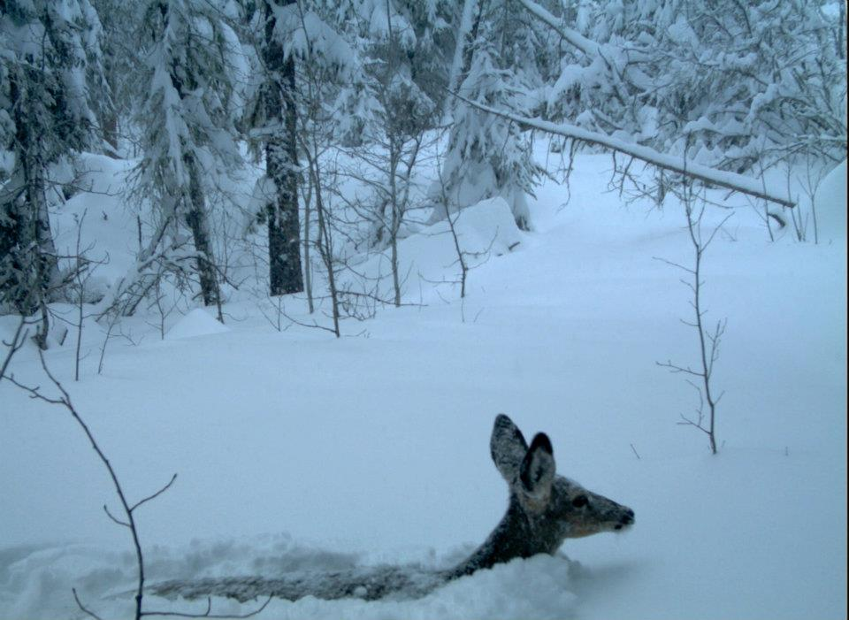

Slide 13
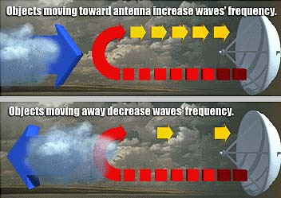
Doppler Radar
Bounces radio waves off of precipitation

Slide 14
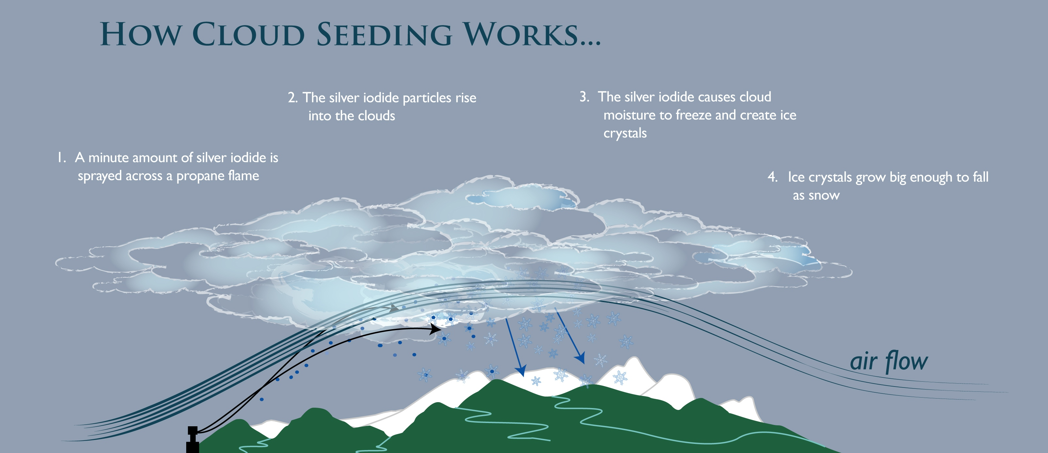
Cloud Seeding
Introducing freezing nuclei or condensation nuclei into a cloud
Silver iodide

Slide 15
