Slide 1
23-2
Clouds and fog

Slide 2
Clouds
Small water droplets or ice crystals that fall through air
Fog is a cloud that forms near the surface

Slide 3
Formation
Solid surface are needed for water vapor to condense on
Troposphere – lower layer of atmosphere
Ice, salt, dust – remain suspended in the air for a long time

Slide 5
Condensation nuclei – particles for water vapor to condense on
Water droplets form
Cooling air causes the condensation

Slide 6
Adiabatic Cooling
Temperature of an air mass decreases as the air mass rises and expands

Slide 7
Mixing
Moist air mixes with another body of moist air with different temperatures

Slide 8
Lifting
Sloping terrain forces air up
Rising air expands and cools

Slide 9
Advective Cooling
Temperature of an air mass decreases as it moves over a cold surface

Slide 10
Classifications of Clouds
Shape and altitude

Slide 11
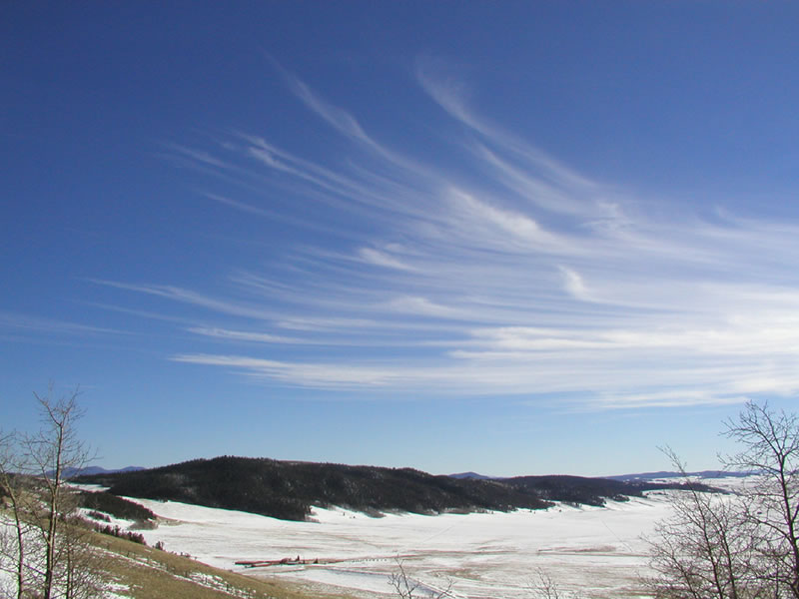
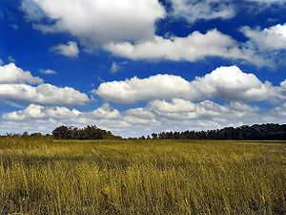
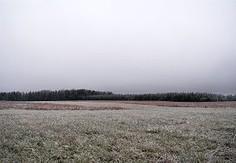
Cloud Types
3 Main Cloud Types (Based on Appearance)
Cirrus - Wispy, Feather-like clouds
Cumulus – Fluffy, Cotton ball-like clouds
Stratus – Layered, Sheet-like clouds

Slide 12
Stratus
Gray
Flat, uniform base
Low altitudes

Slide 13
Cumulus
Top – cotton ball
Bottom – dark
Low level
Billowy

Slide 14
Cirrus
Feathery
Ice crystals
High altitude

Slide 15
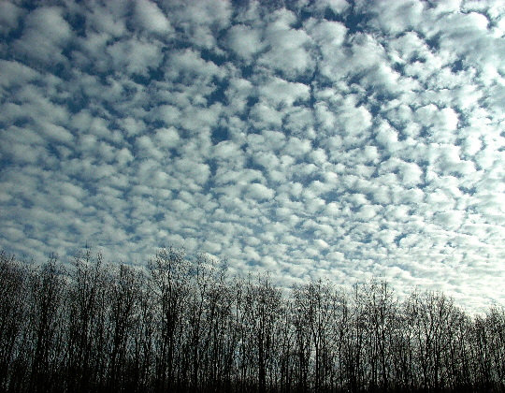
Cloud Types
Cloud Prefixes - Determines Cloud Subtypes
Cirro – High Elevation
Alto – Medium Elevation
Strato – Layered
Nimbo – Rain
Ex: An altocumulus cloud is a medium elevation cumulus cloud

Slide 16
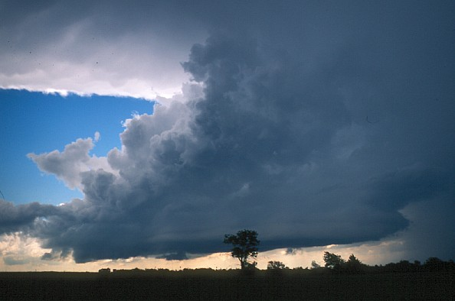
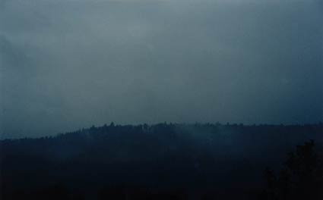
Rain Clouds
Cumulonimbus – Large, anvil-shaped storm clouds associated with storms and hail
Nimbostratus – Dark, layered rain clouds

Slide 17
Fog
Water vapor that has condensed by Earth’s surface

Slide 18
Radiation Fog
Nightly
Layer of air in contact with ground cools below dew point
Results from loss of heat due to radiation

