Slide 1
23-2
Central Africa
History and Culture

Slide 2
Early History
2,000 years ago
People migrated from West Africa
Kongo Kingdom – near the mouth of Congo River

Slide 3
Trade routes to east and west Africa
Rich – skins, shells, slaves, ivory

Slide 5
Europeans
Wanted forest products and ivory
Piano keys, jewelry, statues, furniture

Slide 7
Took millions of slaves to colonies in the Americas

Slide 8
Divided Africa into colonies
France, Belgium, Germany, Spain, UK, and Portugal
Conflict between cultural groups

Slide 9
Modern Africa
Gained independence after WWII
Fought bloody wars
1975 – Angola gained freedom from Portugal

Slide 10
U.S. and Soviet Union
Used the region as a battle ground during Cold War
Supported different allies in smalls wars throughout Africa

Slide 11
Culture
Hundreds of languages
Dialects – regional varieties of a language

Slide 12
Religion
Christianity – brought by Europeans
Muslims – North
Hindus - Zambia

Slide 13
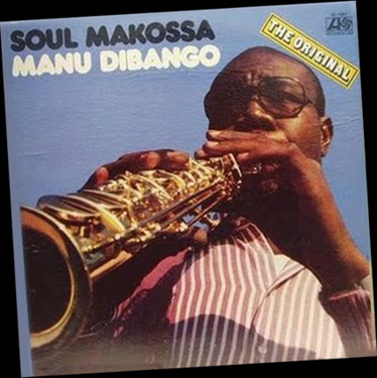
Art
Carved wooden masks
Cotton gowns
Likembe – thumb piano
Makossa – dance music

