Slide 1
23-1
Atmospheric moisture

Slide 2
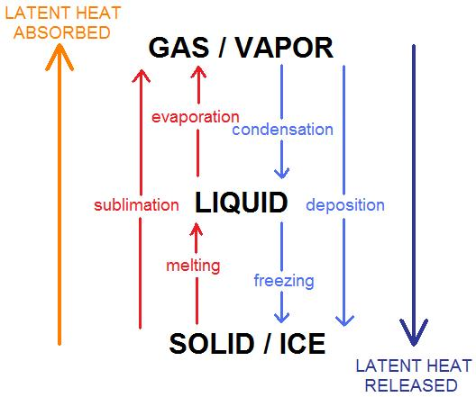
Water
Solid – ice
Liquid – water
Gas – water vapor

Slide 3
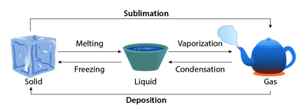

Slide 4
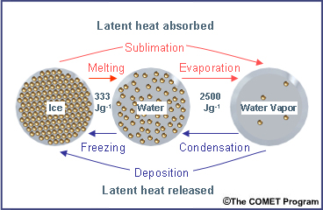
Changing Forms
As energy is absorbed by water:
Solid – Almost fixed
Liquid – Slide past
Gas – Rapid movement

Slide 5
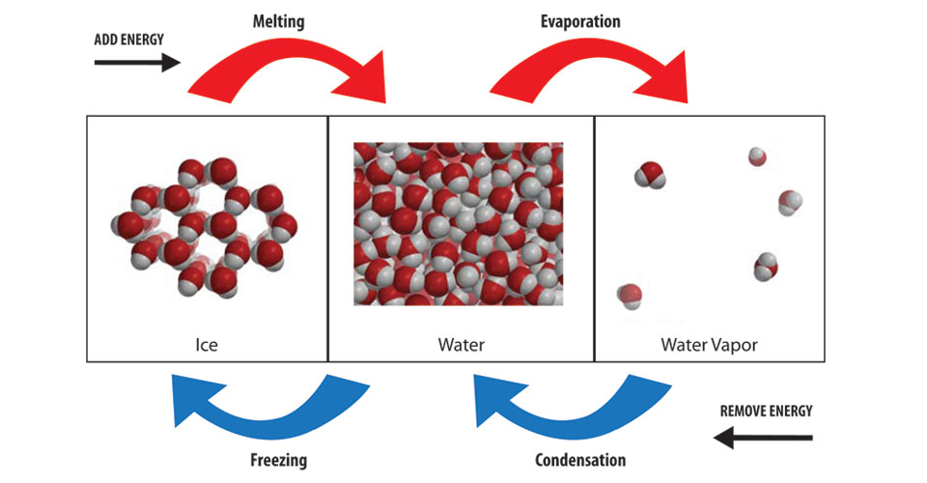
Latent Heat
Heat energy that is absorbed or released during change
Ice melting – absorbs energy from surrounding
Condensation – energy released

Slide 6
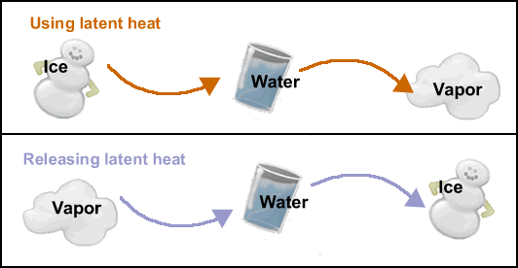

Slide 7
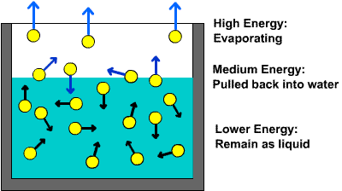
Evaporation
Water entering the atmosphere
Equator
Plants – transpiration
Volcanoes / fossil fuels – small amounts

Slide 8
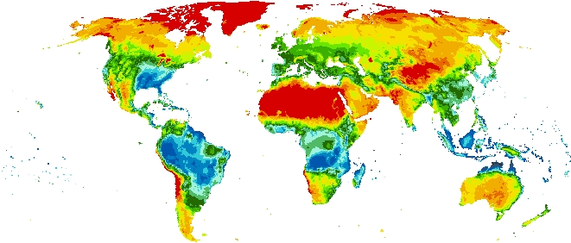

Slide 9
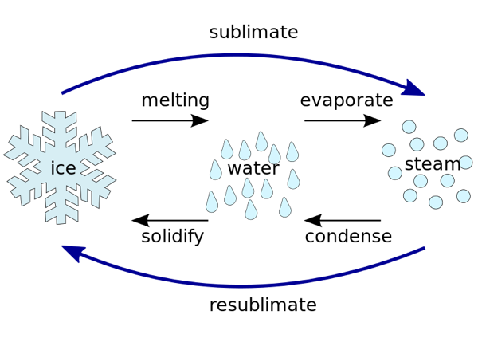
Sublimation
Solid changes to a gas
Skips liquid phase
Air is dry and temperature is below freezing

Slide 10
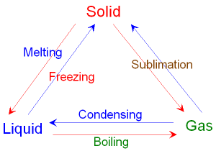
Water vapor can directly become ice

Slide 11
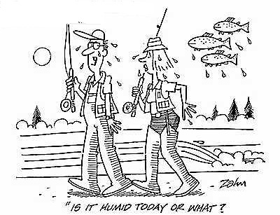
Humidity
Water vapor in atmosphere
Controlled by rates of evaporation and condensation

Slide 12
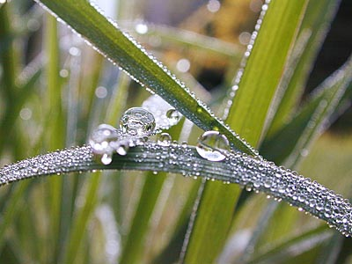
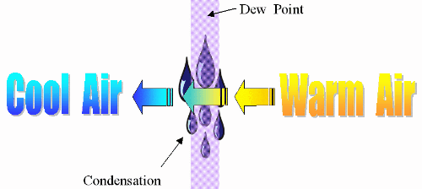
Dew Point
Temperature - Rate of evaporation and condensation are in equilibrium
“Saturated”
Temperature below dew point = water droplets

Slide 13
Absolute Humidity
Mass of water vapor contained in a volume of air
How much water vapor is in the air

Slide 14
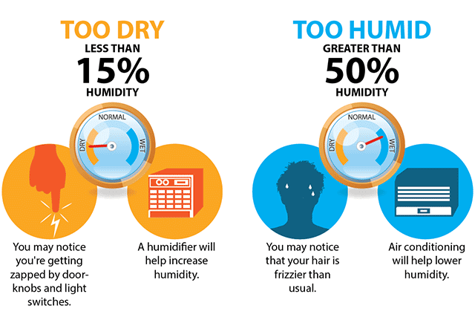
Absolute Humidity = mass of water vapor (grams) / Volume of air (Cubic meters)

Slide 15
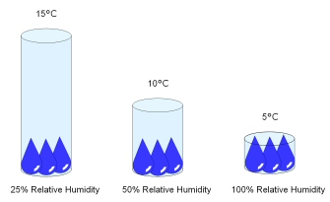
Relative Humidity
Ratio of amount of water vapor in air to amount needed for saturation
Given temperature
How close it is to reaching the dew point

Slide 16
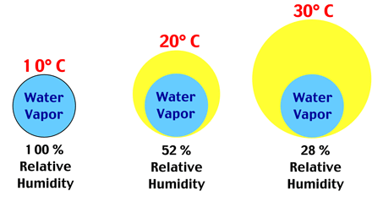

Slide 17
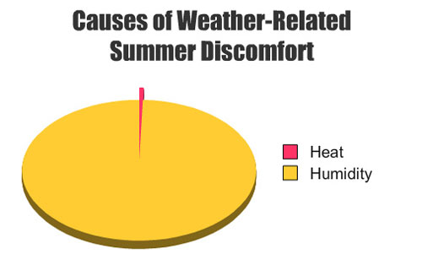
Absolute Humidity – The exact amount of water vapor in the air (ex: 30 lbs of water vapor)
Relative Humidity – The % of the total possible amount of water vapor in the air (ex: 30 lbs out of a possible 100 lbs = 30% Humidity)

Slide 18
