Slide 1
1
Models of the Earth
Finding Locations on Earth

Slide 2
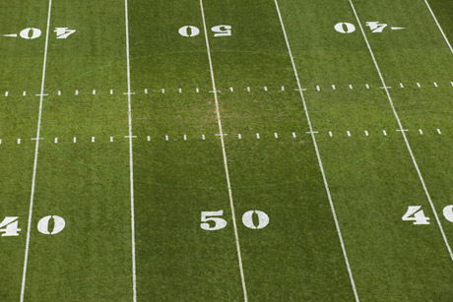
Reference Points
The points at which Earth’s axis of rotation intersect Earth’s surface
Equator
Prime Meridian

Slide 3
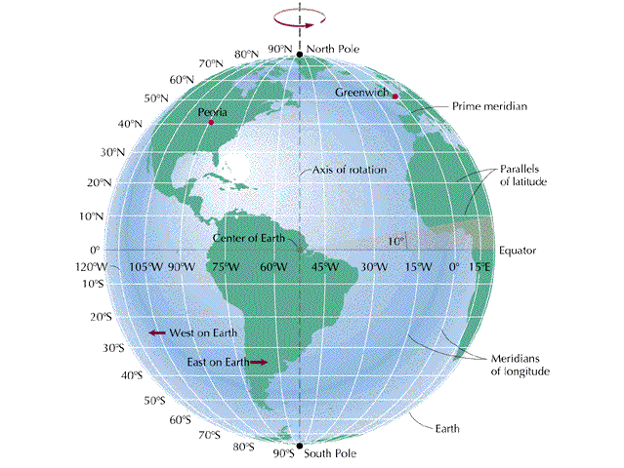
Parallels
Parallels – circle that runs east and west around the Earth
Parallel to equator

Slide 4
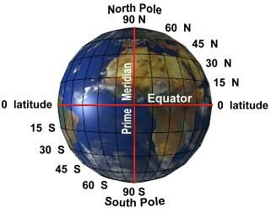
Latitude
Latitude – angular distance north or south from equator
Degrees

Slide 5
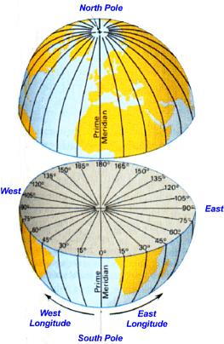
Longitude
Meridians – semi circles that runs from pole to pole
Greenwich, England – Prime Meridian
Longitude – angular distance measured east or west from P.M.

Slide 6
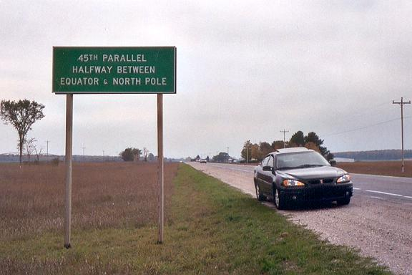

Slide 7
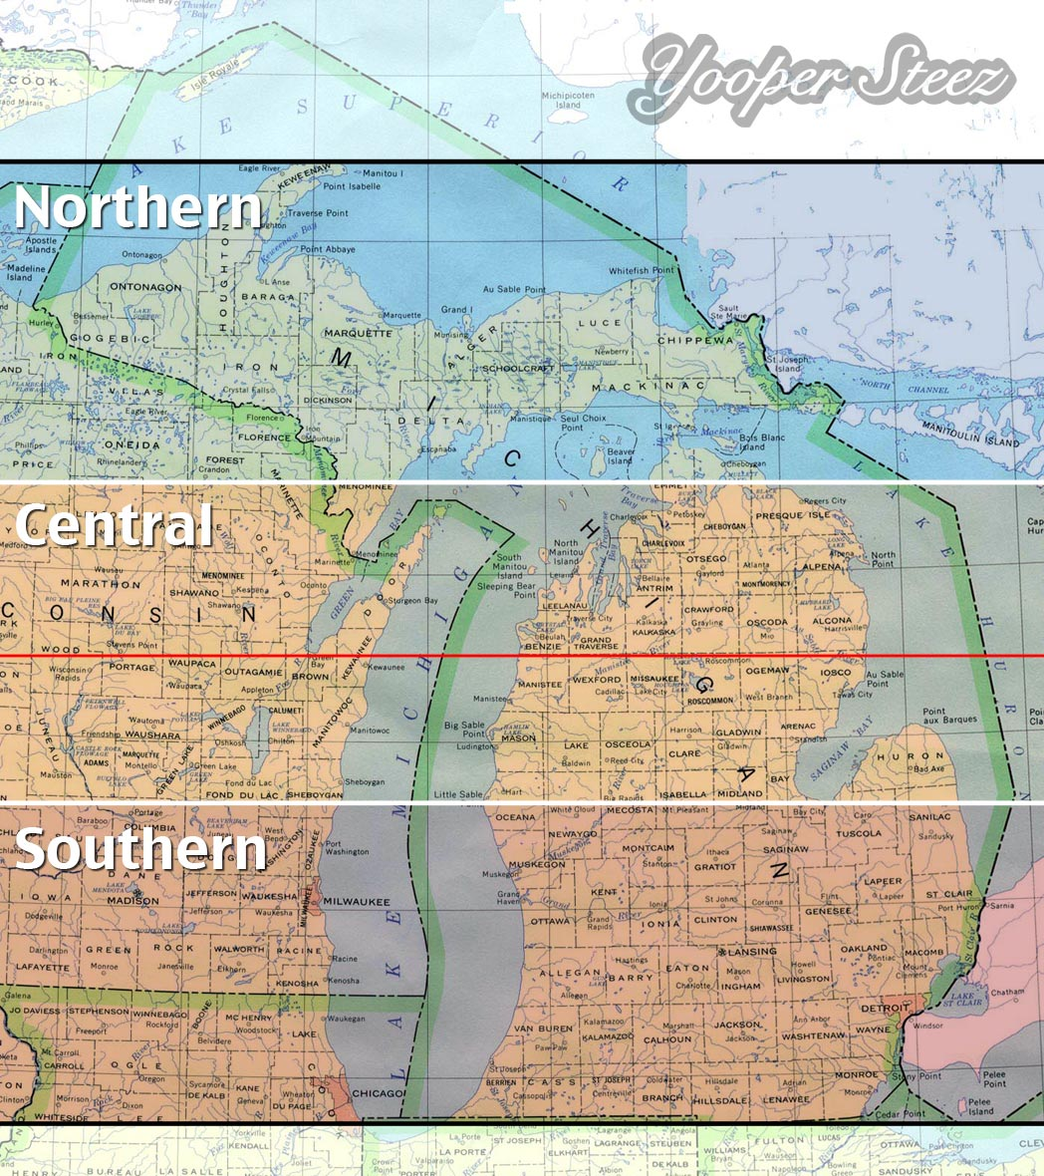

Slide 8
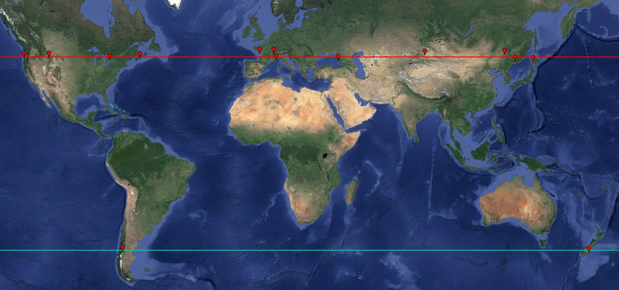

Slide 9
