Slide 1
The View from Earth
12-1

Slide 2
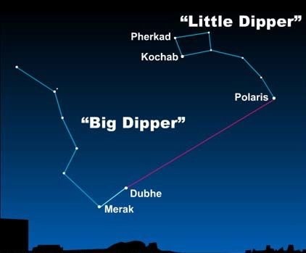
The North Star
Polaris
Directly above the North Pole

Slide 3
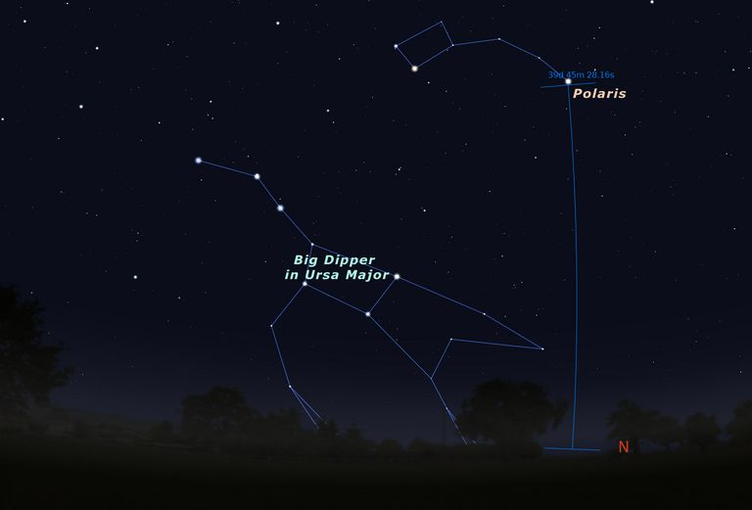

Slide 4
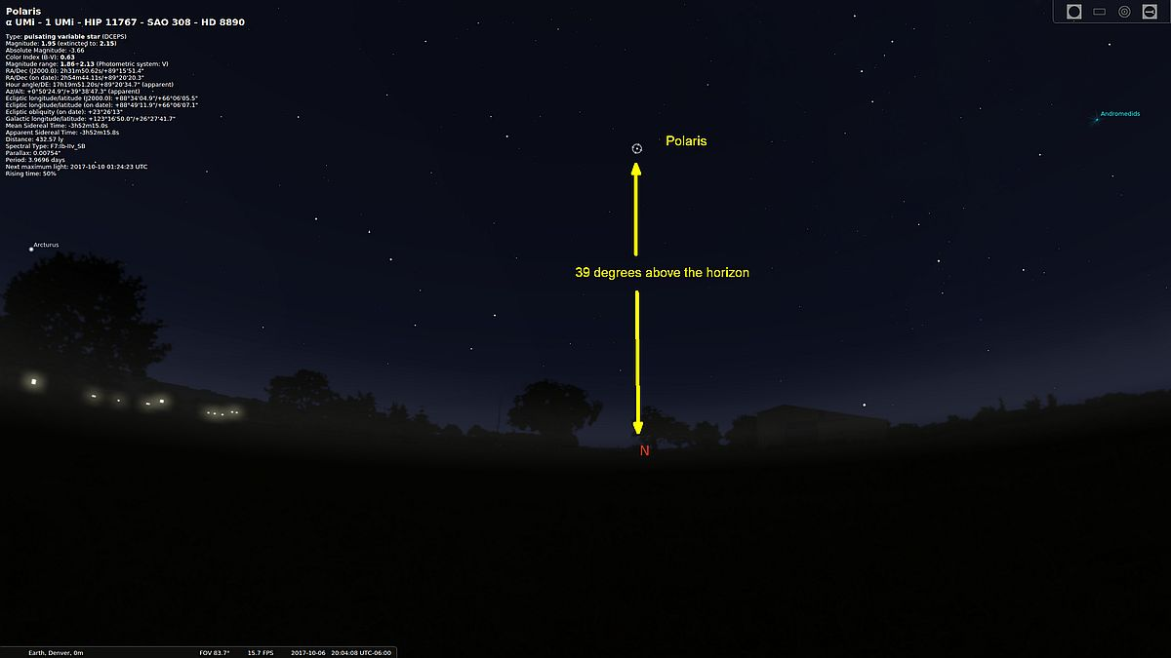

Slide 5
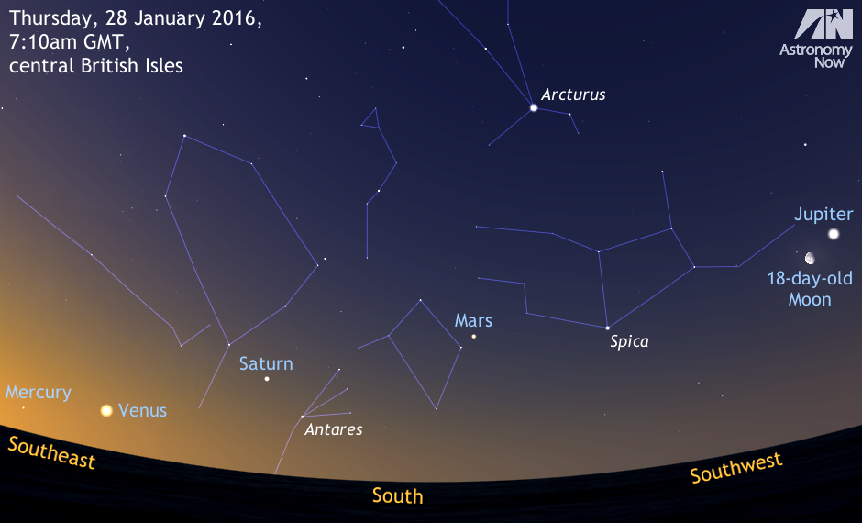
Naked Eye Astronomy
Just your eyes for viewing

Slide 6
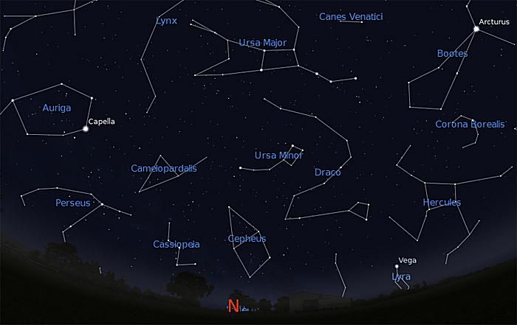
Constellations
Patterns in the sky
People, animals, or objects
Ptolemy – identified dozens of star patterns 2,000 years ago

Slide 7
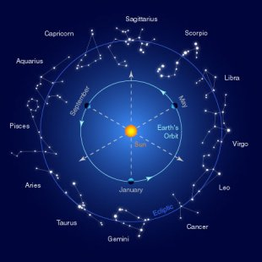

Slide 8
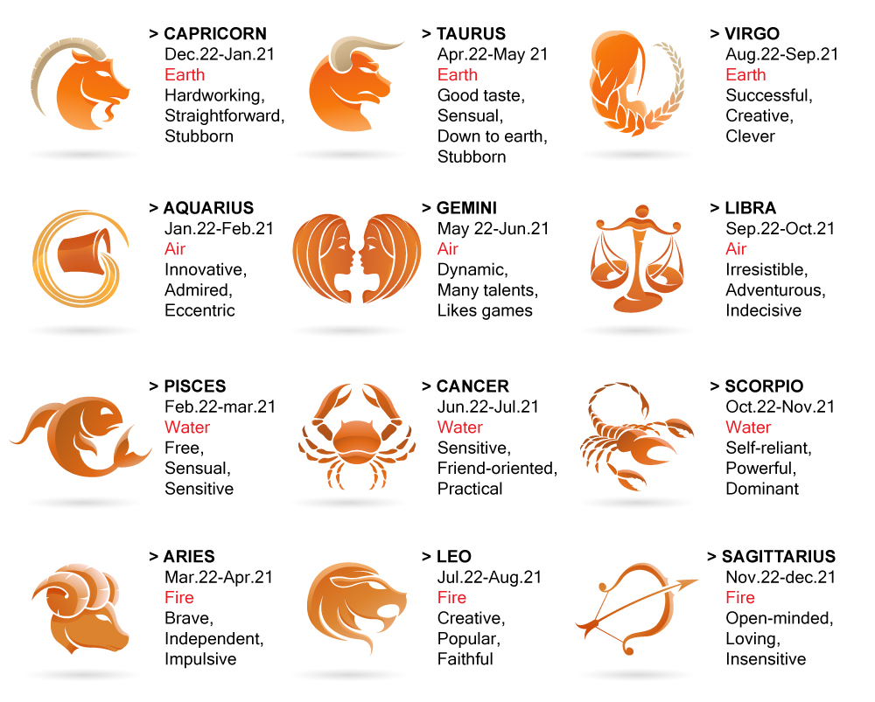

Slide 9
https://www.horoscope.com/us/index.aspx

Slide 10
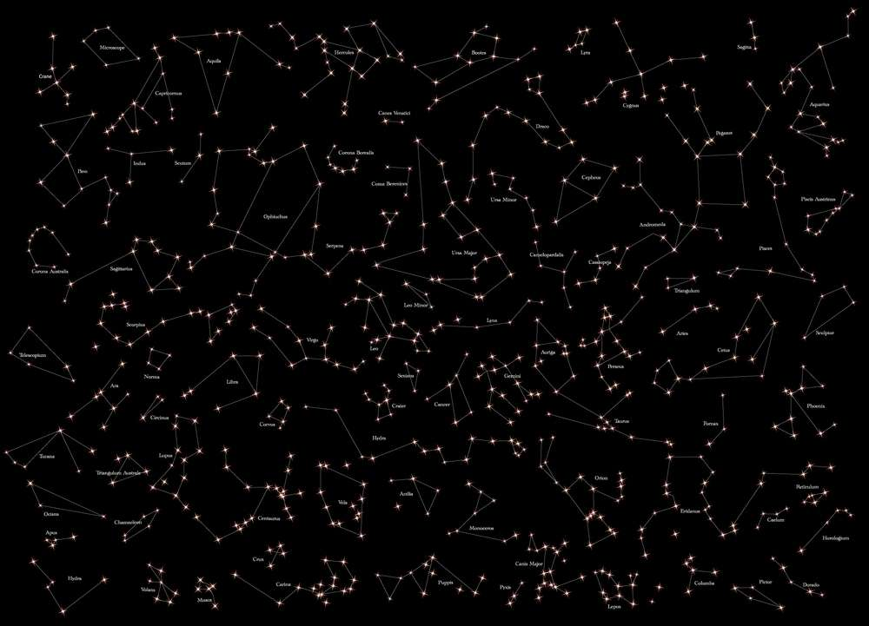

Slide 11
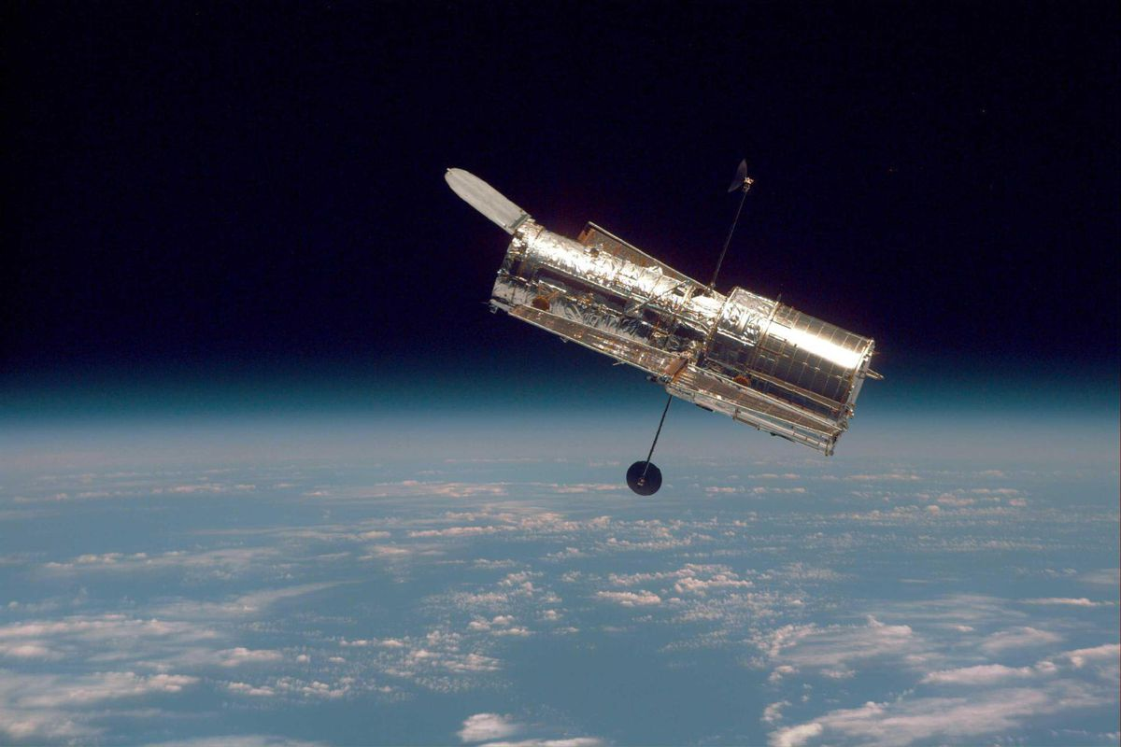
Telescopes
Collects lots of light
Hubble
Launched in 1990

Slide 12
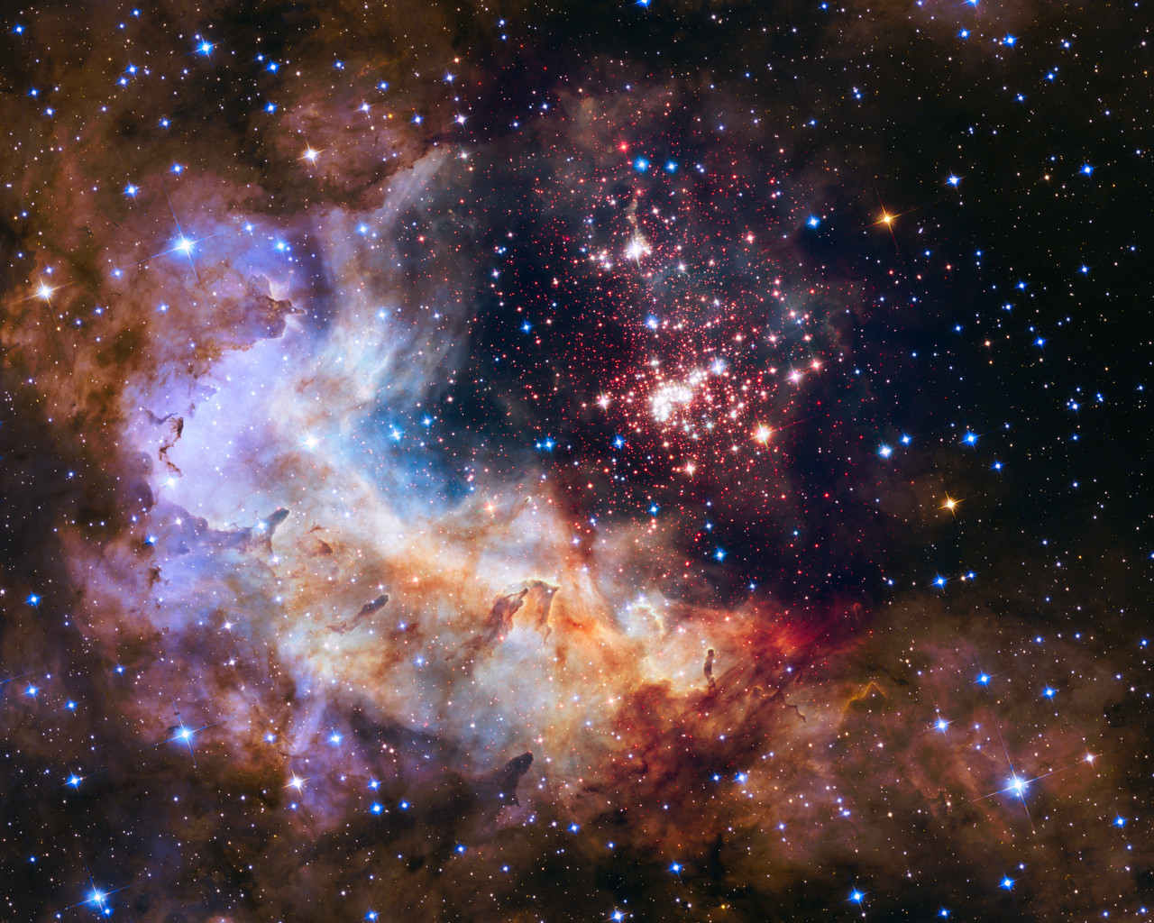
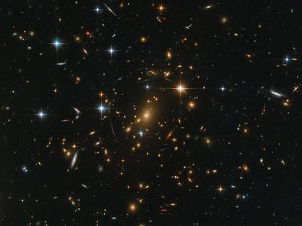

Slide 13
https://scaleofuniverse.com/the-largest-picture-taken-to-date-andromeda-from-hubble/

Slide 14
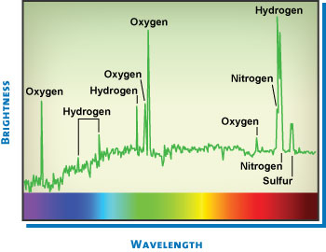
Star Spectra
Range of wavelengths that a star emits
Radio – cold dark regions
Infrared – star forming regions
UV – young stars
X-rays and Gamma – high energy gas jets

Slide 15
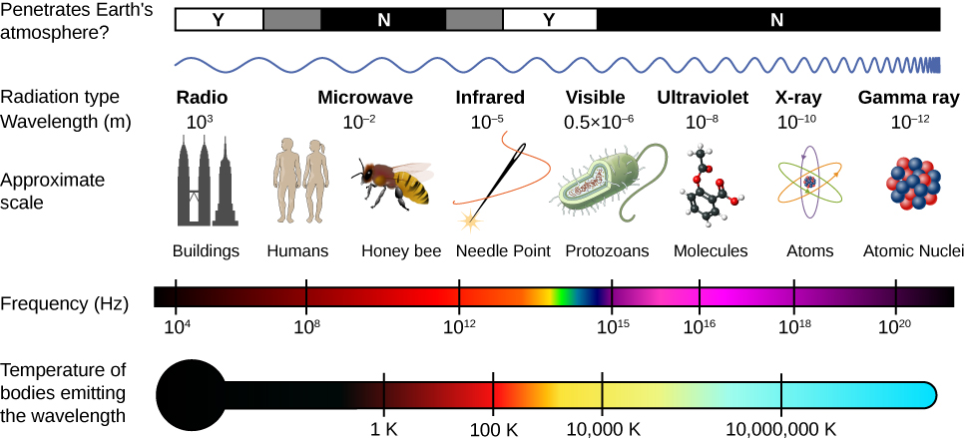

Slide 16
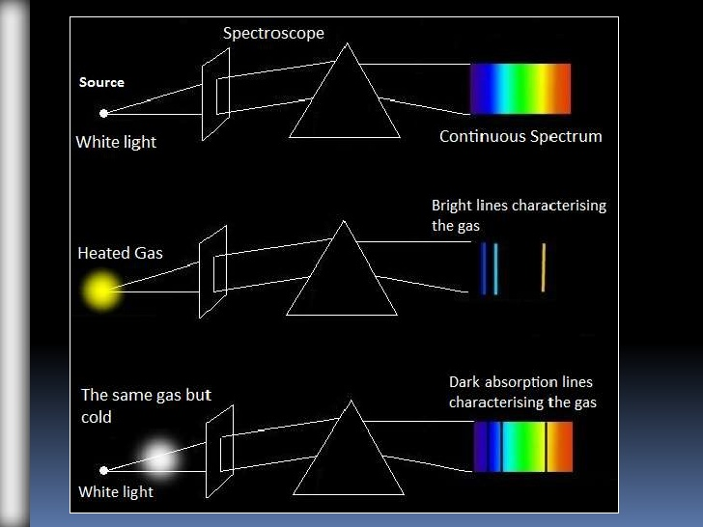
Spectroscopes
Spreads light into different wavelengths
Used to determine:
Temperature
Composition
Energy

Slide 17
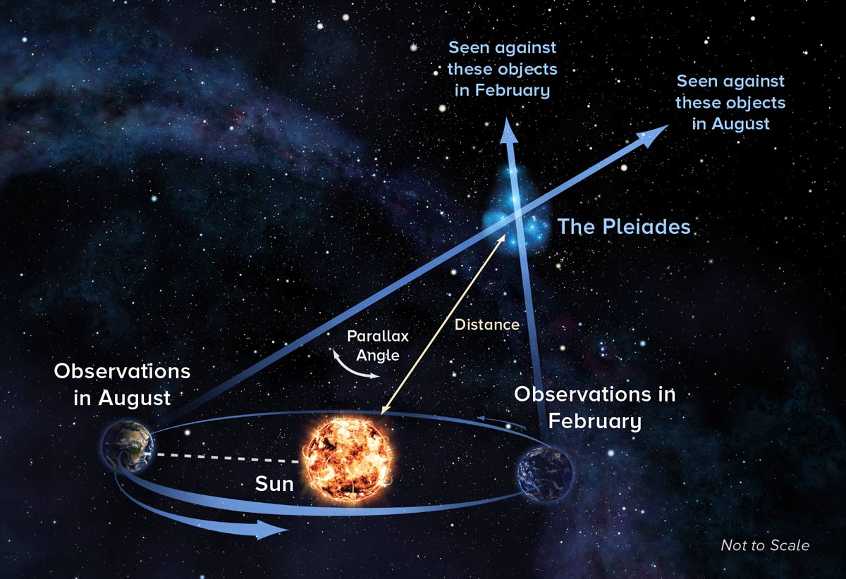
Parallax
Apparent change in an objects position
Caused by looking at an object from two points

Slide 18
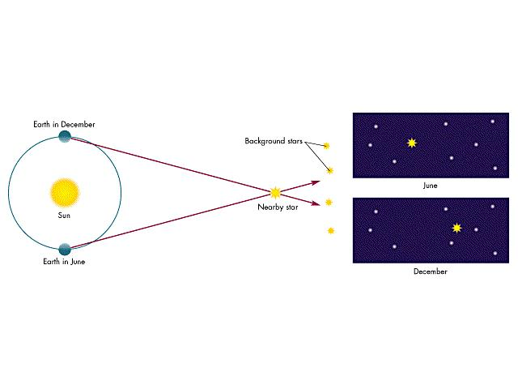

Slide 19
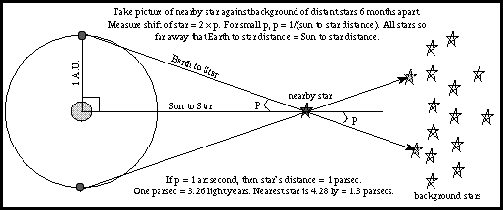
Distance
Parallax used to measure distances in space
2 different points on Earth’s orbit

Slide 20
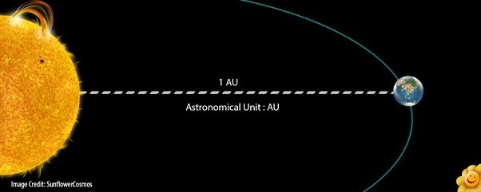
Distances in Solar System
Astronomical Unit – AU
Sun to the Earth
150,000,000 km

Slide 21
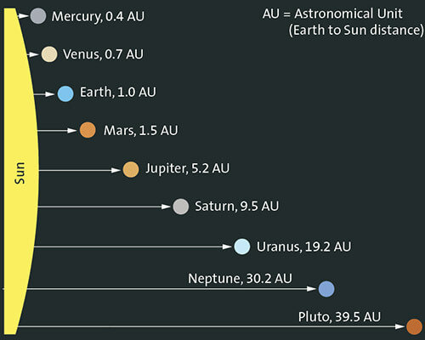

Slide 22
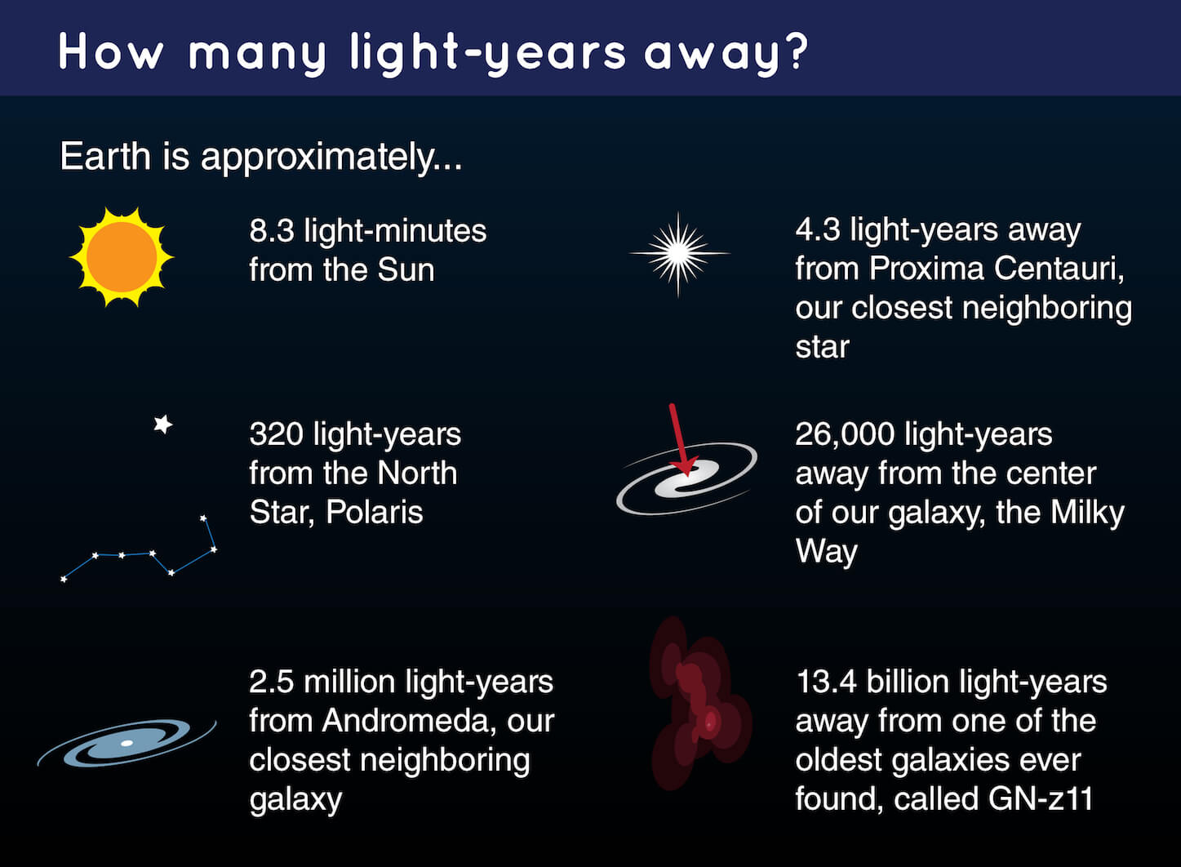
Distances Beyond Solar System
Light year – distance light travels in a year
Light – 300,000 km/s
10 trillion km
Proxima Centauri – 4.2 light years

Slide 23
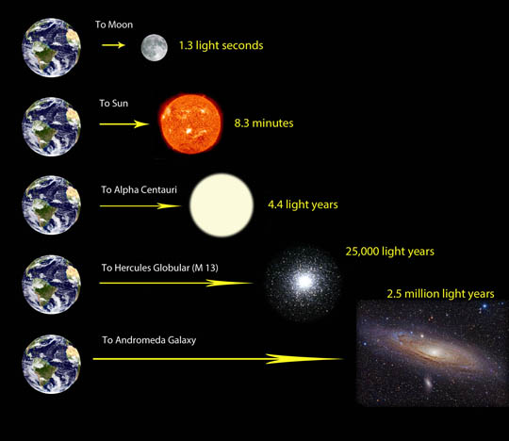

Slide 24
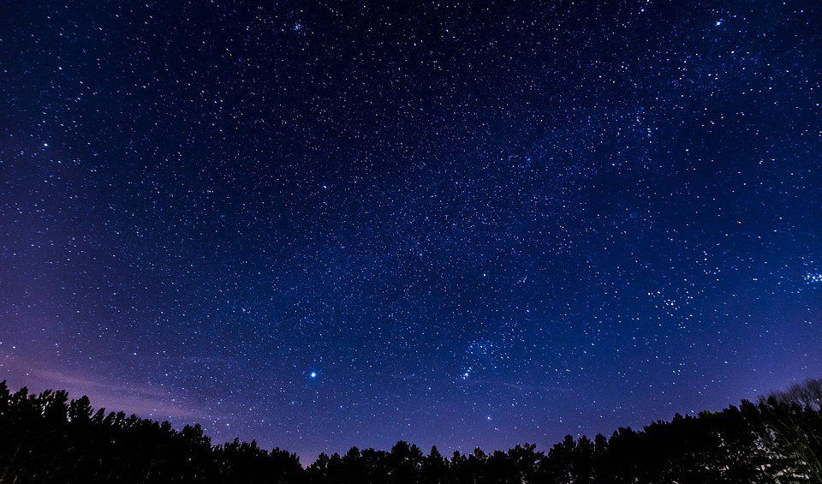
Looking Back in Time!

Slide 25
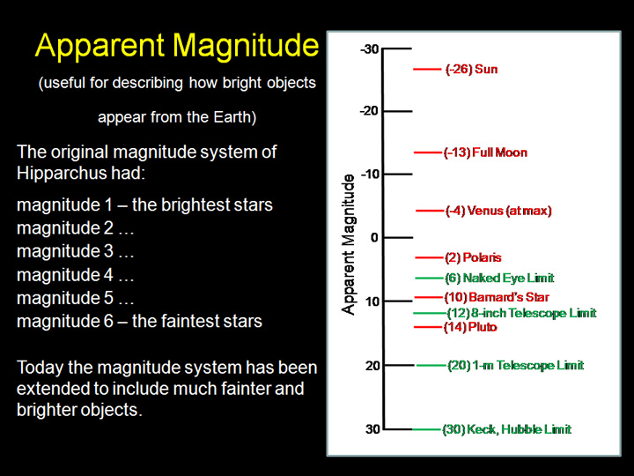
Apparent Magnitude
How bright an object appears from Earth
1 – Brightest stars
Negative – Moon, Sun, Venus, some bright stars

Slide 26
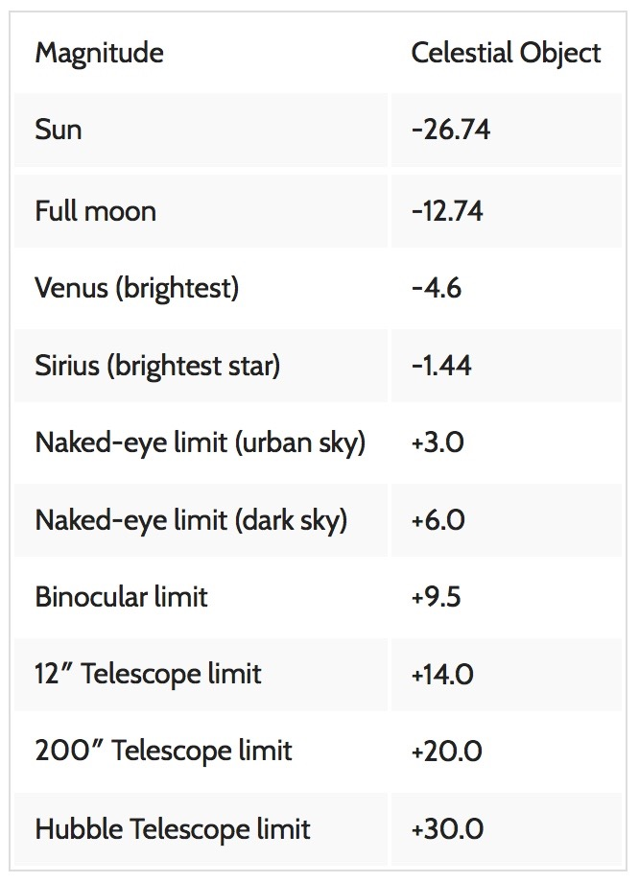

Slide 27
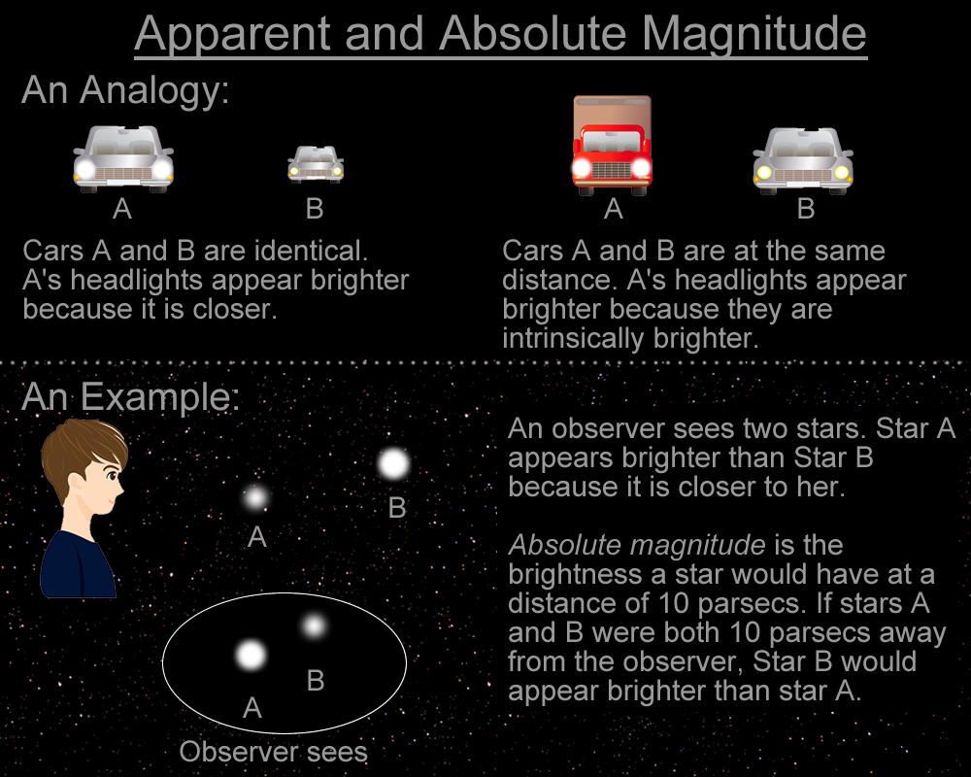
Absolute Magnitude
Luminosity – True brightness of an object
Depends on temperature and size, not distance

