Slide 1
Rome as a Republic
11-2

Slide 2
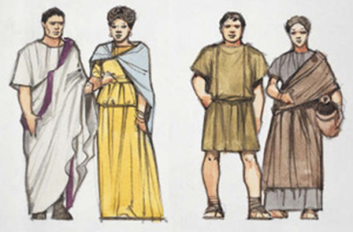
Governing Rome
Early Romans were divided into two divisions:
Patricians – Ruling class
  Wealthy land owners
  Prominent families
Plebeians – Majority
  Not wealthy
  Farmers, artisans, shopkeepers
  Couldn’t hold public office lead ceremonies for gods

Slide 3
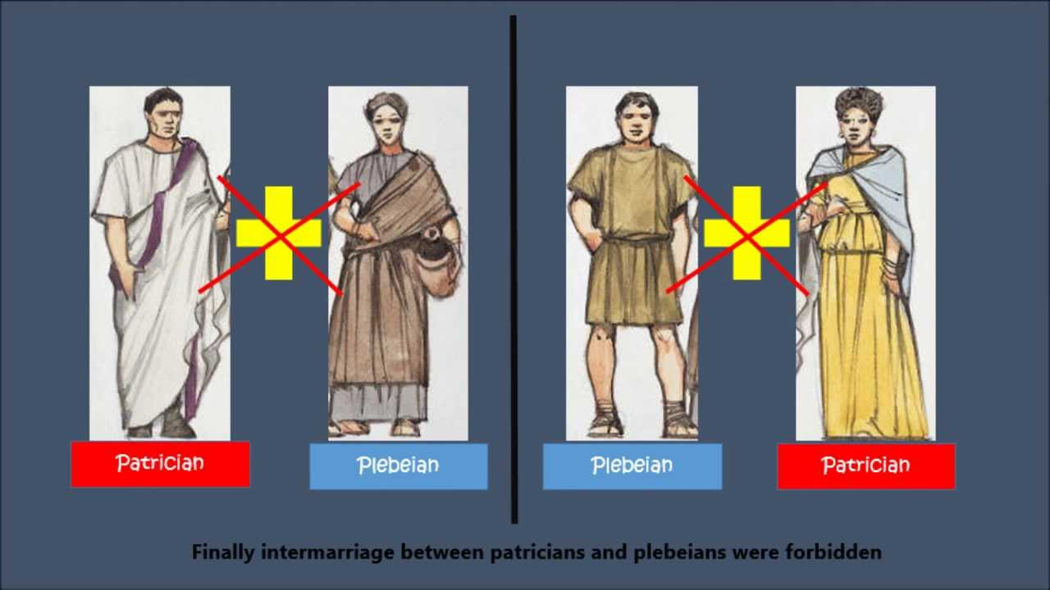
Both:
Roman citizens
Taxed
Served in military
Couldn’t marry between classes

Slide 4
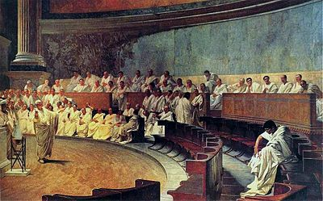
Government
3 Branches
1. Made laws
2. Ran daily affairs of government
3. Judges
Check and balances – prevented one branch from getting too large
Branches were not separated

Slide 5
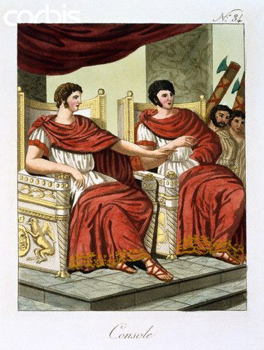
2 consuls headed the government
  Administrative and army leaders
  Served 1 year in office – prevented too much power
  Each could veto (reject) the other’s decision
Praetors – interpreted the laws and served as judges

Slide 6
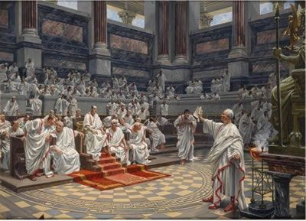
Senate
  Rome’s legislature
  300 patrician men
  Served for life
Assembly of Centuries
  Elected consuls and praetors
  Passed laws
  Like the Senate but controlled by patricians

Slide 7
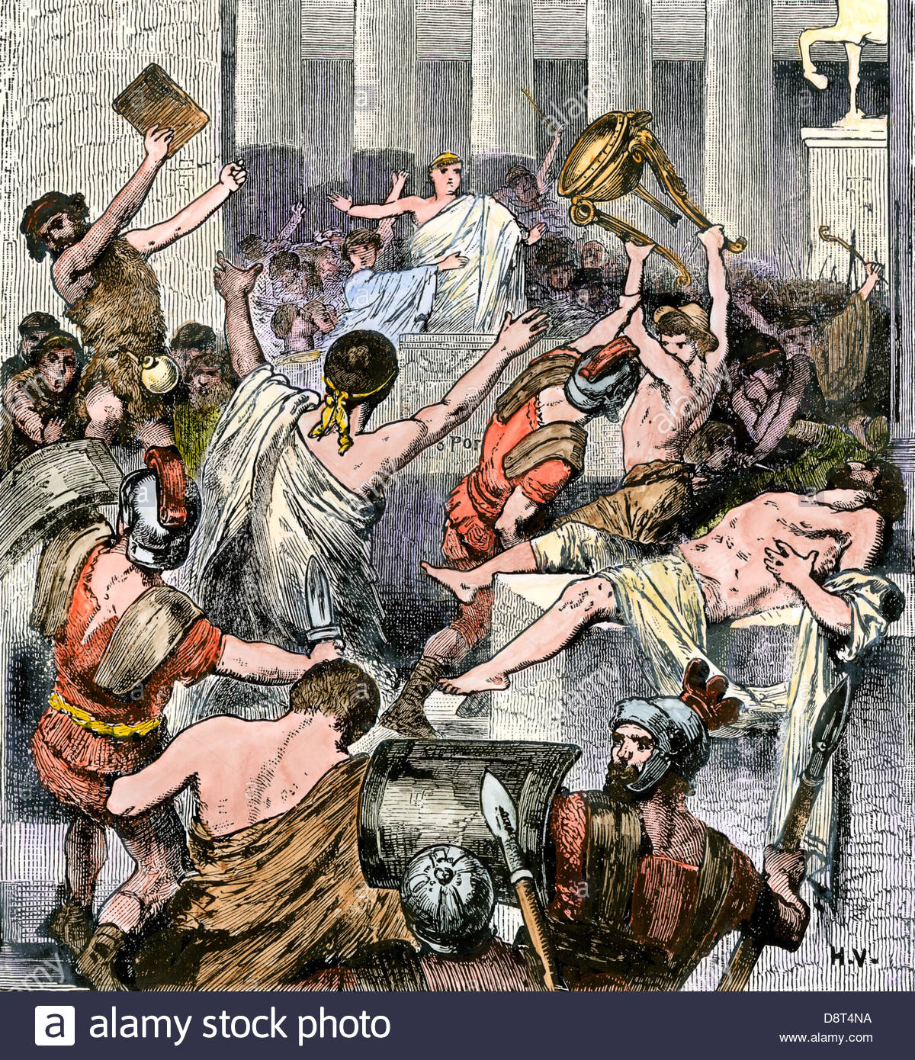
Conflict Between Classes
Plebeians grew frustrated
Went on strike and started their own government
Patricians agreed to allow plebeian representatives

Slide 8
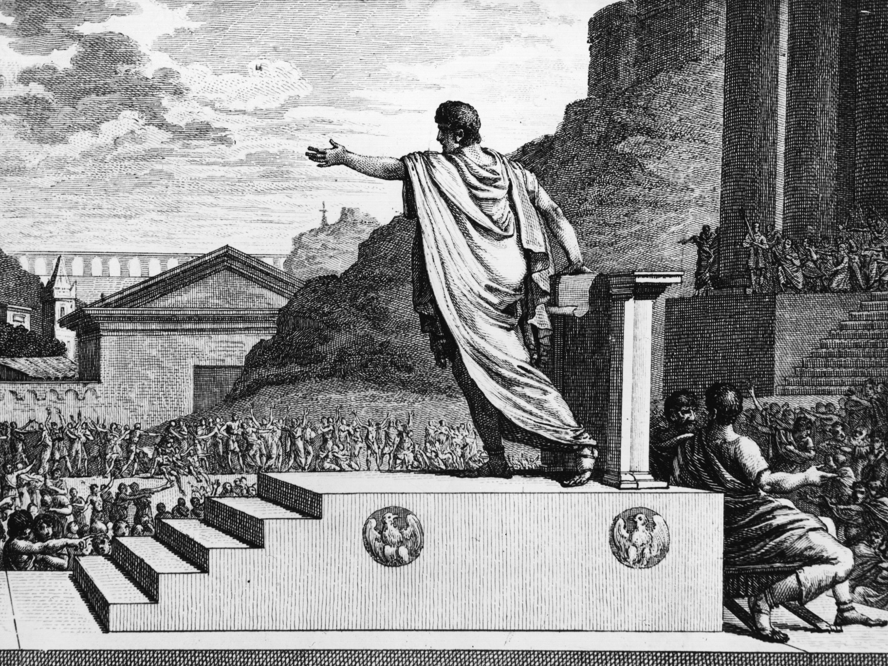
Council of the Plebs
Elected officials called Tribunes
  Voiced concerns
  Veto governmental decisions
  Could become council
  Marriages were eventually allowed
Eventually allowed to pass laws

Slide 9
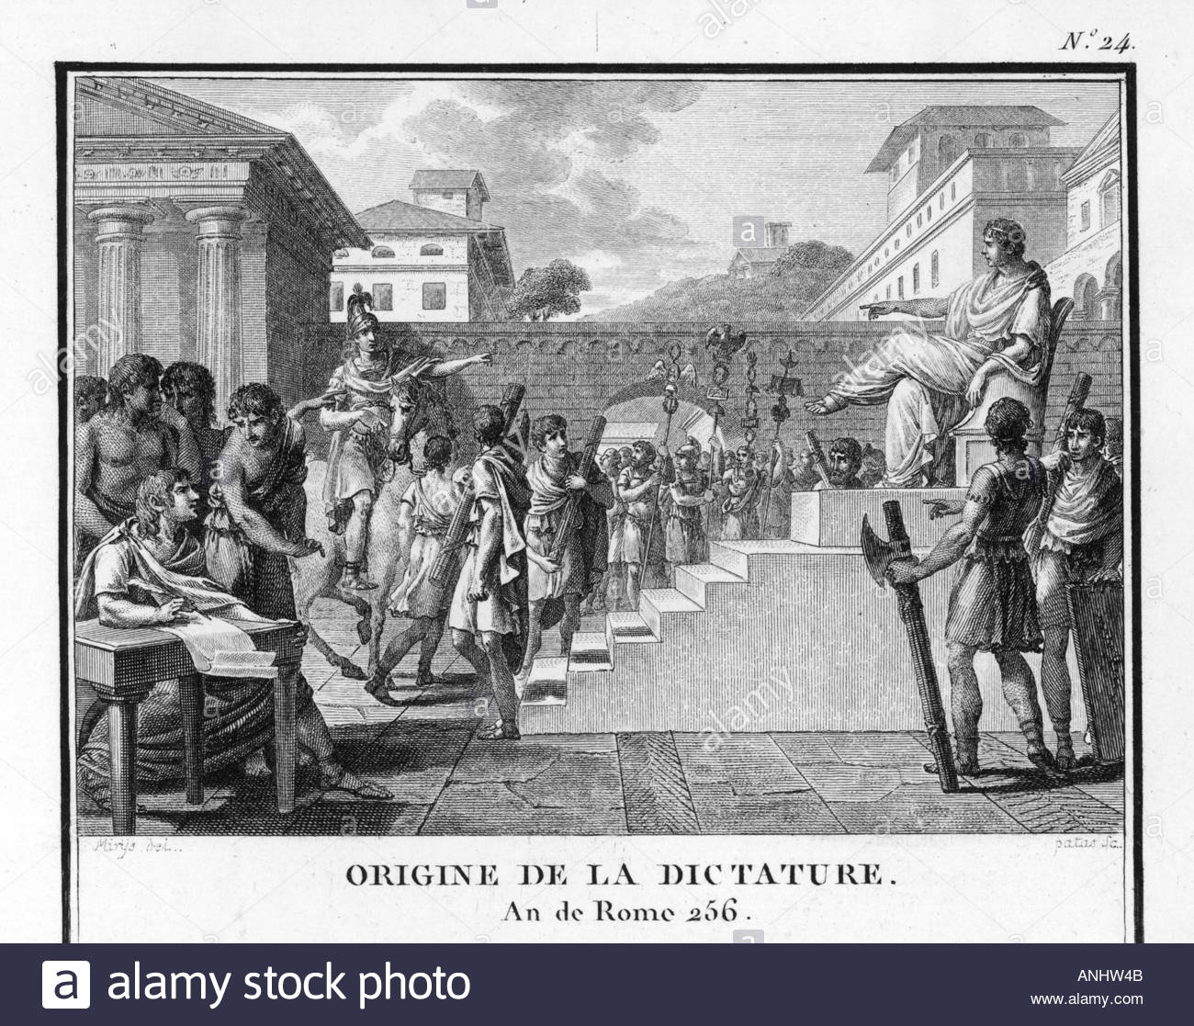
Dictators and Civil Duty
Time of crisis – consuls would resign and a dictator would be appointed
Dictator – senate appointed person to lead with absolute power
After the crisis – dictator would give up power and government restored

Slide 10
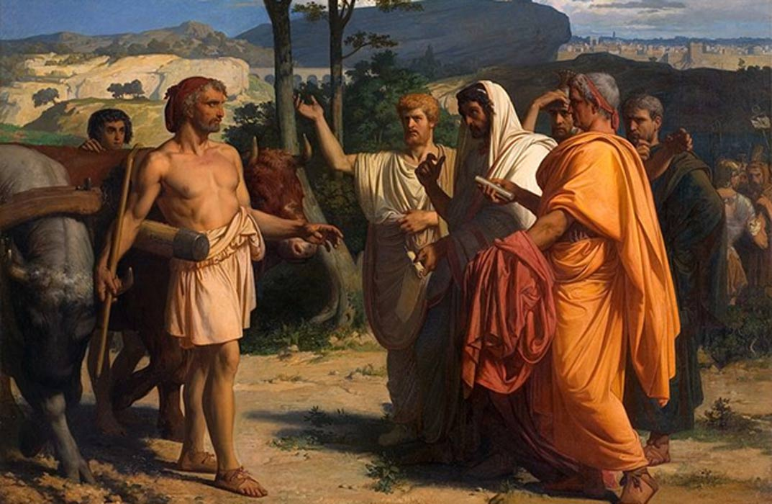
Cincinnatus – famous dictator know for loyalty to Rome
Enemy threatened Rome
Found him plowing his fields
Created an army
Defeated the enemy
Marched back to Rome
Resigned as dictator
16 days

Slide 11
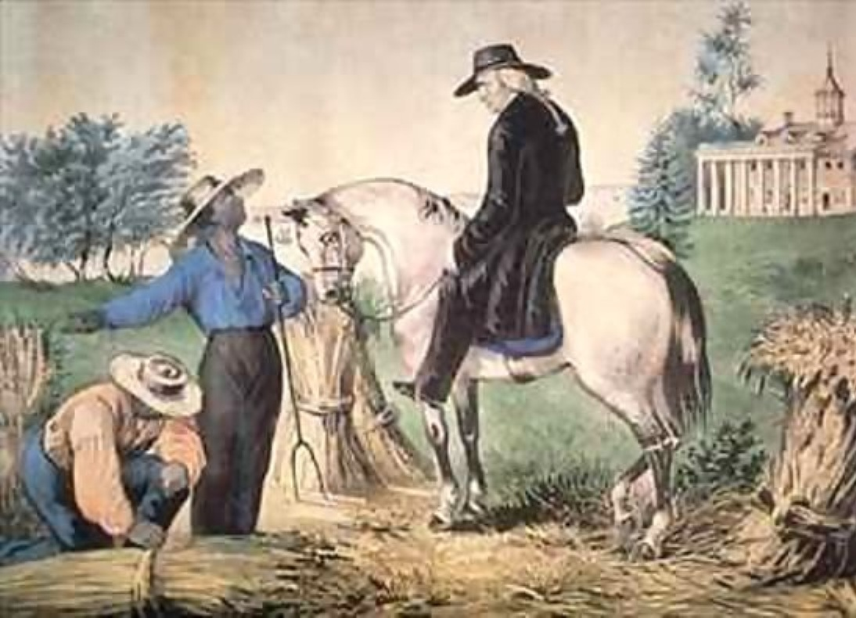
Civic Duty – idea that citizen have a responsibly to help their country
George Washington was inspired by Cincinnatus – he too was a farmer that was asked to help his country
  Led Continental Army for independence
  Returned back home to farm
  Reluctantly agreed to become the 1st president

Slide 12
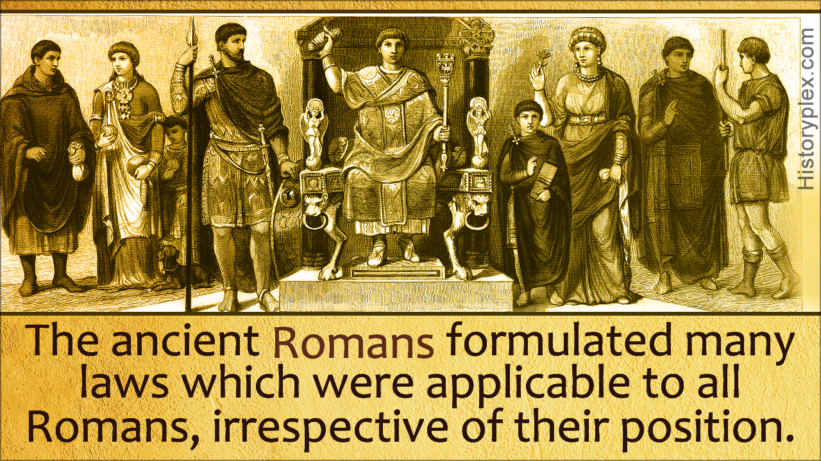
System of Law
Influenced the US legal system
Plebeians demanded that laws were to written down
Fear that patrician judges would rule unfairly
Judges could then refer to written laws

Slide 13
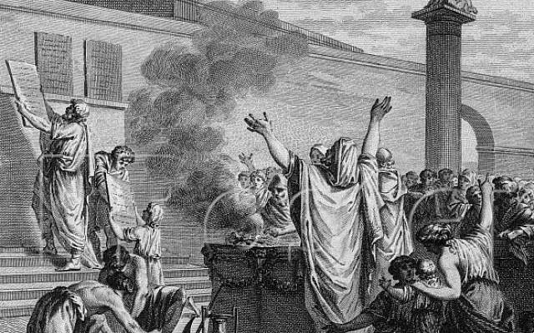
451 BC
Twelve Tables – first written code of laws
Bronze tables
Placed in the Forum – marketplace
All citizens have the right to be treated equally

Slide 14
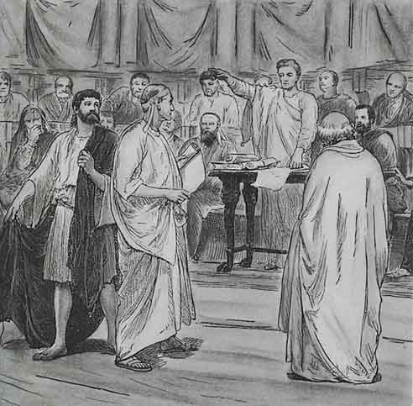
Law of Nations – laws that applied to all people everywhere in the empire
  Non citizens

Slide 15
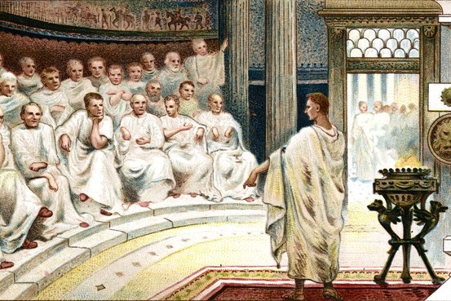
Roman Justice
Innocent until proven guilty
Rule of Law – all people should be have laws applied to them equally
Upper class and lower class had different laws

