Slide 1
The Founding of Rome
11-1

Slide 2
Rome’s Beginnings
Romans adopted Greek culture
Empire expanded through much of Europe, Africa, and Asia

Slide 3
Settling of Italy
Located on Mediterranean Sea
Mountain passes linked settlements together
Mild climate – fertile farm land

Slide 4
Rome’s Location
Italian Peninsula
Alps to the north
Apennines – central Italy (North to South)
Tiber River
Shipping to Mediterranean
Defense – far up river, steep hills

Slide 5
Rome’s Origins
1st Legend
Aeneid – Poem by Virgil
Greeks captured the city of Troy
Trojan named Aeneas (father of the Romans) escaped
Settled in Italy and waged war
Married a local king’s daughter

Slide 6
2nd legend
Romulus and Remus – twins
Left beside the Tiber River
Female wolf cared for them
Shepard and his wife raised the twins

Slide 7
The twins grew and wanted to build a great city
Remus made fun of the walls Romulus built
Remus was killed by Romulus
Romulus became the ruler

Slide 8
Rome’s Origins
Archaeological artifacts in Italy
Neolithic people – 500 BC
Latins – 2000 BC
Latin-speaking people settled Rome
Known as Latins
Became knowns as Romans

Slide 9
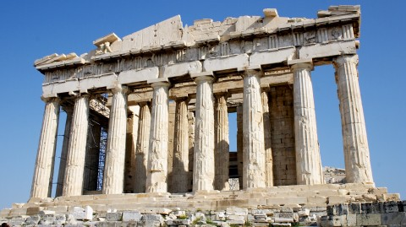
Greeks and Etruscans
After 800 BCE other groups moved into the region
2 groups that had a great influence on the Roman civilization
Greeks –
Grape and olive farming
Greek alphabet
Literature
Sculptures
Architecture

Slide 10
Etruscans –
Ruled by nobles
Metals – weapons and tools
Paintings on tombs
Brick buildings
Tile roofs
City streets
Religious rituals
Clothing - togas

Slide 11
Republic
Romans over through Etruscan king
Tarquin the Proud
Started a republic
Citizens elect leaders

Slide 12
267 BC – Romans had control of most of Italy
Male land owners had to serve in army
Well trained
Deserters were put to death

Slide 13
Fought in legions – large groups of soldiers
Easier to get around battle field
6,000 men
Further divided into groups of 60 – 120
Gladius – short double edged sword
Pilum – iron spear
Standard – tall pole topped with a symbol

Slide 14
Ruling Rome
Built permanent outposts
Protected new conquered regions
Built roads between settlements
Supplies
Roman Confederation – gave some conquered people full citizenship
WHY?

Slide 15
Conquered people would become allies
Paid Rome taxes
Provided soldiers
Maintained peace in conquered lands
Became stronger and more unified

