Slide 1
The Qin and Han Dynasties
10-3

Slide 2
Qin Dynasty
Period of the Warring States
Qin – one of the warring
Defeated the Zhou dynasty
Qin Shihuangdi – “The First Qin Emperor”

Slide 3
Qin took control of all of China’s provinces
Opposition was punished or killed
Some writings were burned
Censor – official who watches over workers

Slide 4
Created currency – money
Hired scholars – simplify writing system
Constructed his own tomb
Terracotta army – clay soldiers
Build a canal
Connected Chang Jiang to city of Guangzhou

Slide 5
The Great Wall
Built from protection to the north
Xiongnu – nomadic warriors on horseback
Originally separate walls that would later be connected

Slide 6
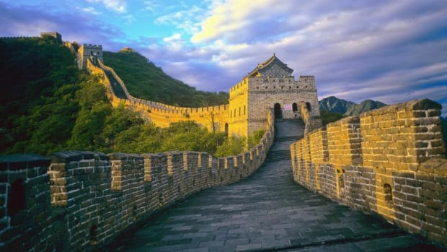

Slide 9
Qin dynasty ended soon after his death
Farmers and aristocrats revolted against the harsh rule

Slide 10
Han Dynasty
Liu Bang – leader
Farmer turned soldier
400 year rule

Slide 11
Han Wudi
1st strong emperor of the dynasty
Recruited talented people for civil service
Government workers
People who scored the highest on test received the jobs
No longer handed down in family
Rich tended to get jobs

Slide 12
Population grew by 60 million = more food
Farmers land was divided each generation for sons
Lands became too small to farm
Forced to sell land
Tenant farmers – work the land owned by someone else

Slide 13
Empire grew from Korean to India
Pushed back nomads to the north
Peace for almost 150 years

Slide 14
Han Culture
Peaceful – more time for the arts and inventions
Confucius gain popularity
Stably government

Slide 15
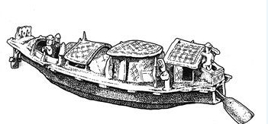
Inventions
Caste-iron plow
Iron tools used to drain swamps – more farm land
Waterwheels – grain grinding
Wheelbarrow
Silk manufacturing
Paper
Boat rudder

Slide 16
Medicine
Foods and herbs that prevented disease
Acupuncture – needles inserted into skin to prevent pain

Slide 17
Silk Road
General Zhang Qian – explored areas west of China
Looked for allies
13 years later returned
Found a kingdom with strong horses they could trade silk with

Slide 18
A network of trade routes
4,000 miles long
Western China to the Mediterranean
Many goods were traded along the route
Buddhism was also spread along the road

Slide 19
End of Han Dynasty
Corrupt emperors caused a rebellion
China was divided into smaller kingdoms and civil war
Buddhism becomes more popular as people look for stability

