Slide 1
Society and Culture
10-2

Slide 2
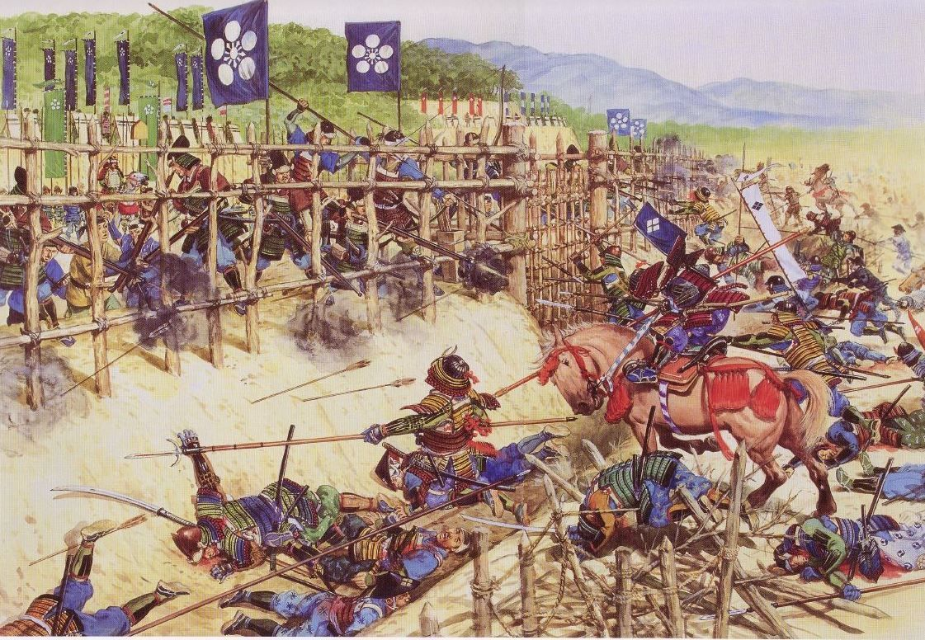
Philosophies
Period of the Waring States – people looked to find ways to end the violence
3 major philosophies were developed
Goal:
  Create a well run peaceful society
New ideas were welcomed after so much war

Slide 3
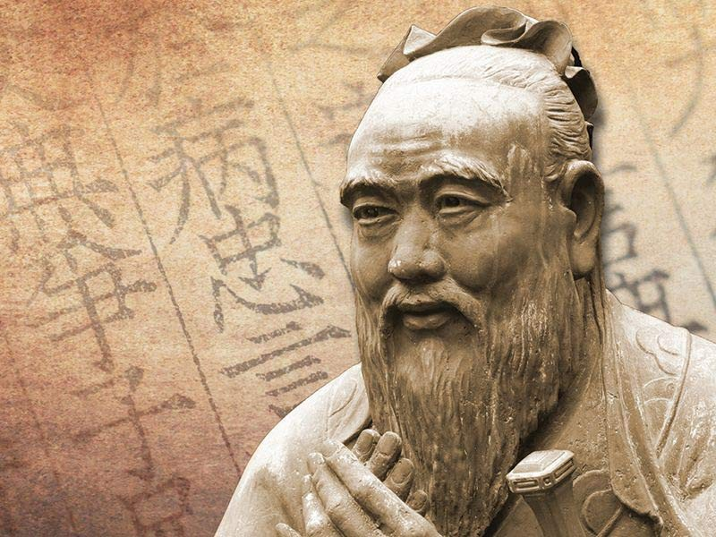
Confucianism
Confucius – leader
Duty – place the needs of family and community over your own
  Parents – love kids
  Kids – respect parents
  Husbands - support wife
  Wife - obey husband
  Rulers – rule justly
  Subjects – be loyal

Slide 4
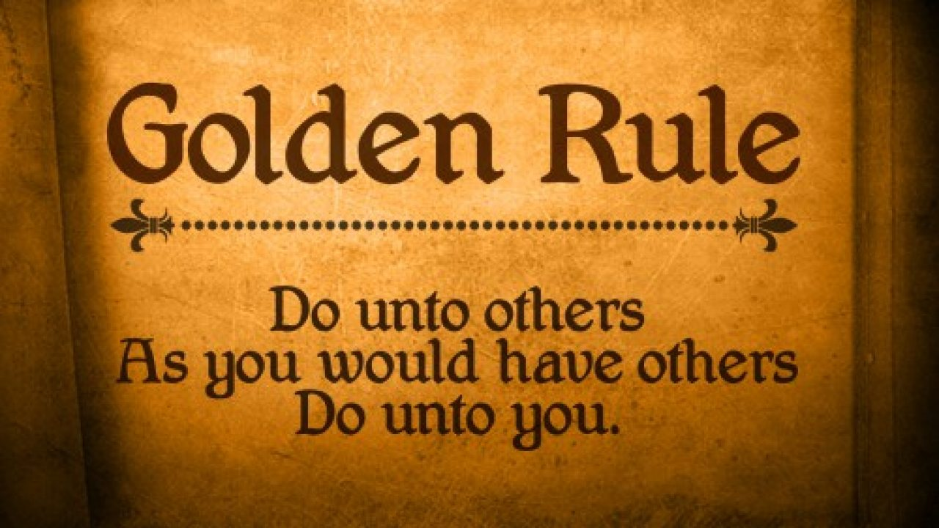
Golden Rule – “Do unto others as you would have others do unto you.”

Slide 5
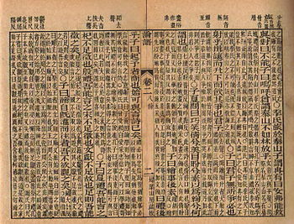
Government service should be open to all men
Analects – collection of his teachings

Slide 6
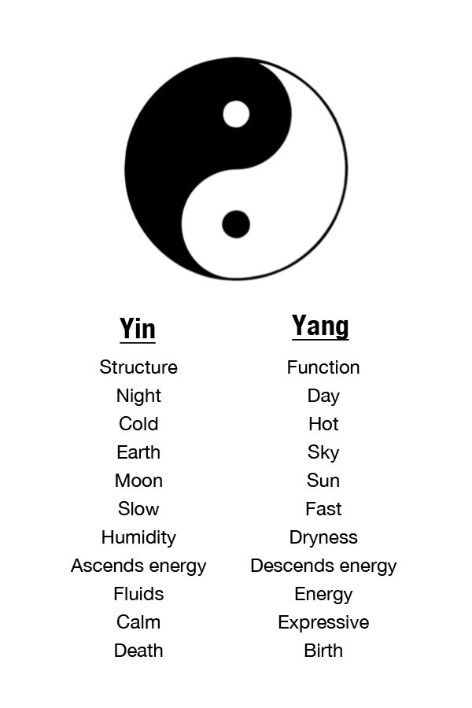
Daoism
Laozi – leader
“The Way”
Free of worldly desires
Live in harmony with nature
Many followed both ideas

Slide 7
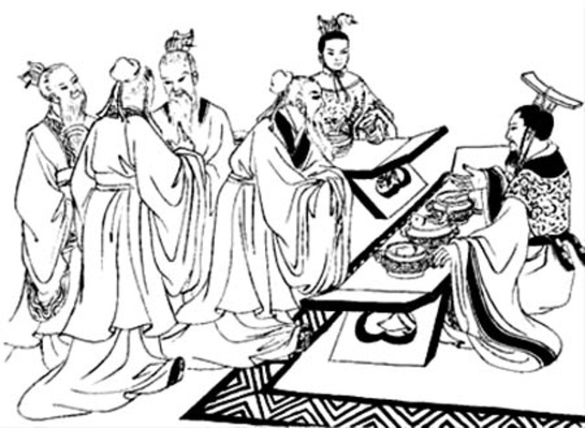
Legalism
“School of Law”
Hanfeizi – leader
Humans are naturally evil
Strict laws are necessary
Supported by many aristocrats

Slide 8
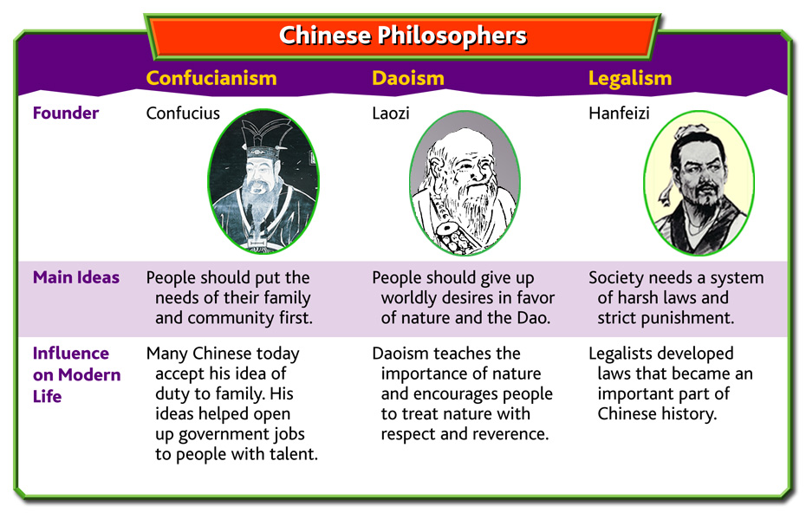

Slide 9
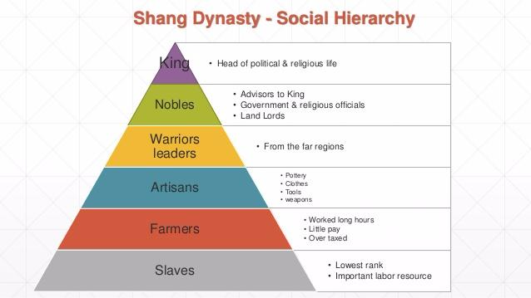
4 Social Classes
Aristocrats – land and wealth
  Protected homes
  Land was divided among male heirs
Farmers – majority
  Taxed
  Soldiers during war

Slide 10
Artisans – skilled workers
  Iron, silk, bronze, jade artists
  Learned from parents
Merchants – shops, traders, bankers
  Some wealthy but not respected – believed they worked for their own gain
  Barred from government jobs

Slide 11
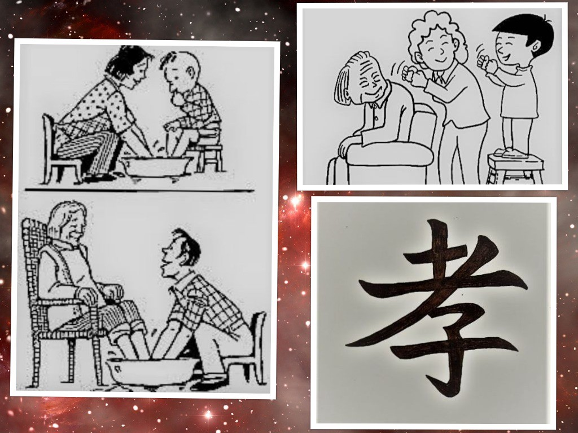
Family
Large – to help with work
Filial piety – responsibility to respect parents
Take care of older parents
Needs of the head of the family is placed above their won

Slide 12
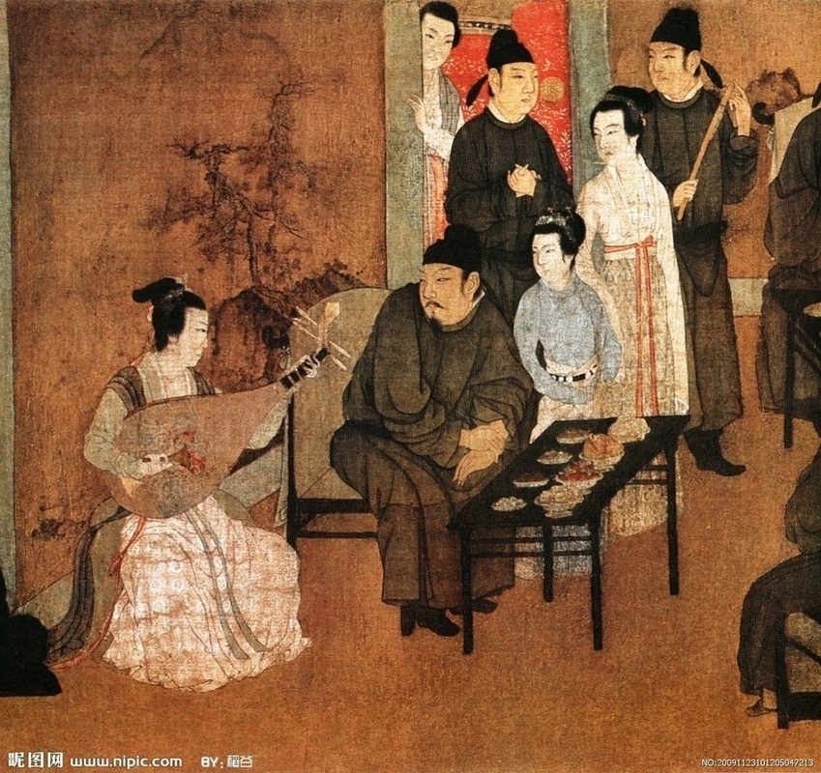
Men vs Women
Men were respected more due to jobs
Men – school, farm, government, soldiers
Women – household, kids, finances

