Slide 1
Chinese Civilization
10-1

Slide 5
Huang He River
Yellow River
First civilizations
Thick yellow soil – loess
One of the greatest wheat producers
China’s Sorrow – floods that have killed many

Slide 7
Chang Jiang River
Also called Yangtze River
People moved south to settle this area later
Farming, trade, transportation

Slide 8
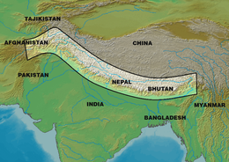
Mountains
1/10 of the land can be farmed
Himalaya Mountains - South
Separates China from S. Asia

Slide 9
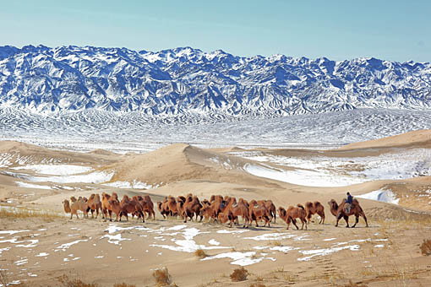
Deserts
Gobi Desert – North
Cold and rocky
World’s coldest
-40 F

Slide 10
Natural barriers limited contact with others
Unique culture and sense of independence
Middle Kingdom – center of the world

Slide 11
Myths
Yu dug – hero that controlled flood waters
Chased away dragons that caused floods
He dug channels with the help of a dragon
Helped water go to the sea

Slide 12
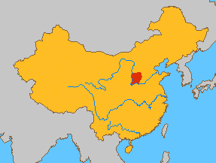
Xia – 1st dynasty founded by Yu
(SHYAH)
No archeological evidence

Slide 13
Shang Dynasty
1st recorded dynasty
Built the first cites in China
Anyang – royal capital
Kings – political, religious, and military leader
Warlords – military leaders who led their won armies

Slide 14
Aristocrats – noble birth, wealthy land owners
Most people were farmers
Worshipped many gods

Slide 15
Honored ancestors with offerings
Bring good luck
Kings – power from gods, wisdom of ancestors
Oracle – helped with communication
Bones cracking in fire

Slide 16
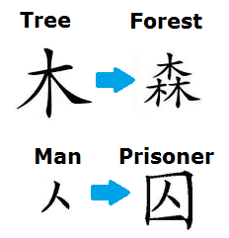
Writing
Pictographs – symbol for an object
Ideographs - symbol that represents an idea
Links pictographs together

Slide 17
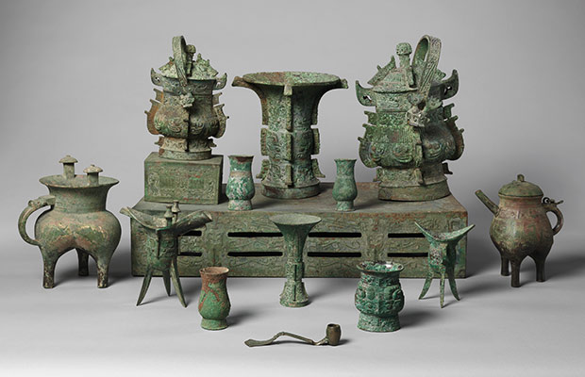
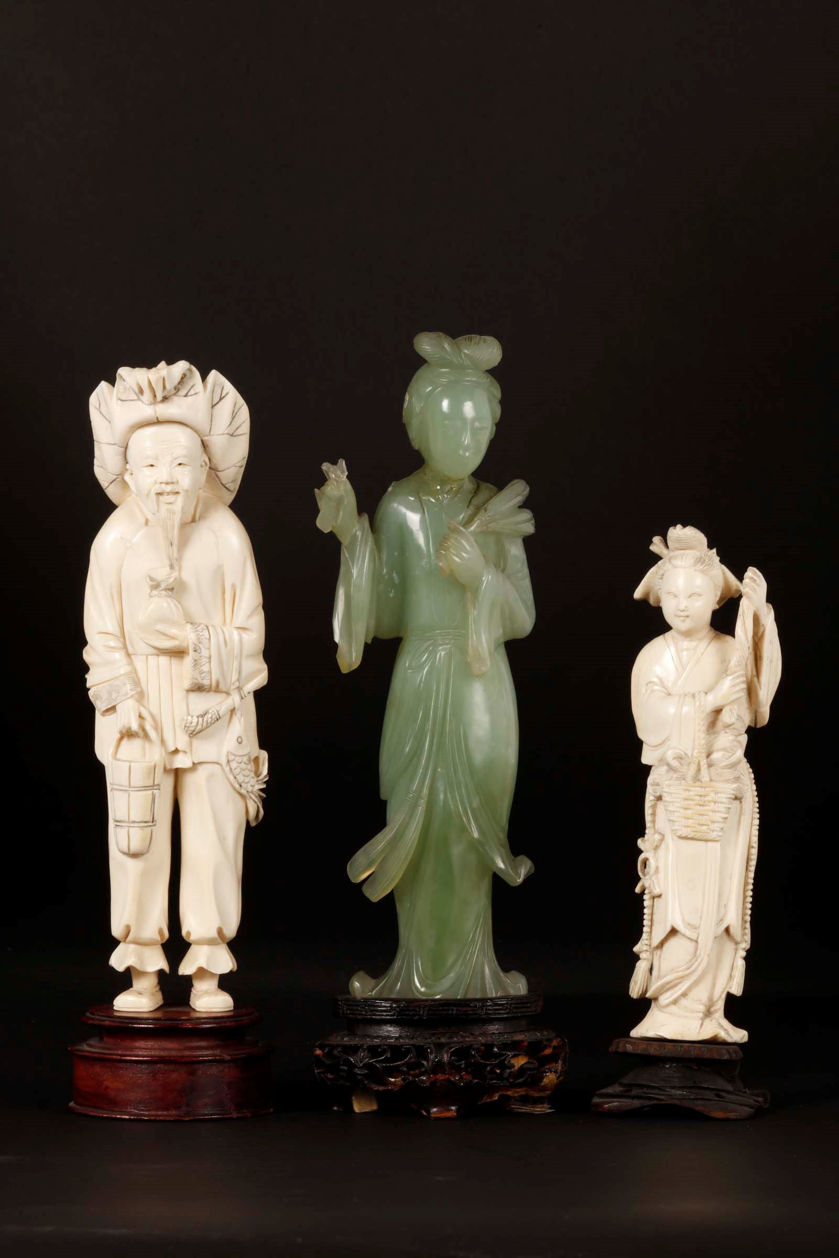
Arts
Bronze artwork
Clay molds
Silk
Silk worms
Ivory and jade carving

Slide 18
Zhou Dynasty
Tyrant at the end of the Shang Dynasty
People rebelled and overthrew the government
Wu Wang - leader
Longest dynasty
800 years

Slide 19
Bureaucracy – non-elected officials
Became larger than Shang
Territories – lead by aristocrats
Hereditary – power passed on to son

Slide 20
Mandate of Heaven – right to rule came from the gods
Dao – the proper way to rule

Slide 21
Developed irrigation systems
Silk trade increased wealth

Slide 22
Period of Warring States
Aristocrats ignored king and fought each other for power
Forced farmers to fight as soldiers
Fighting on horses
Developed saddle and stirrup

